Slide 1


Lesson 5:
Direct proportion
Level 2
Objectives
Identify when two quantities differ in direct proportion to each other
Understand the multiplicative relationship between two quantities
Solve simple proportional problems using efficient methods with ratio tables and double number lines
Notes:
Tutor guidance for lesson introduction:
Ask a confident/fluent learner to read the lesson objectives to the group.
Reiterate and clarify learning objectives.

Slide 2
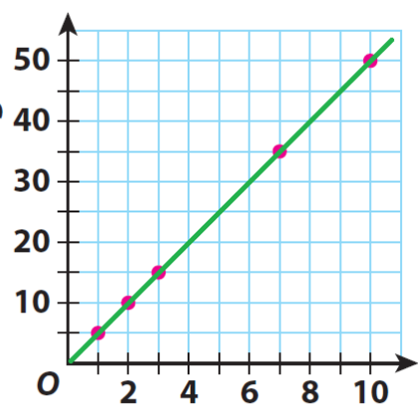
INTRODUCTION
Graph to show …?
1. Consider a label for the y-axis
?
2. Think of a title for this graph
3. Explain how the plotted points are related?
Number of people
Notes:
Tutor guidance: 15-minute exercise
Present information for individual and/or small group work.
Encourage learners to discuss and share ideas in their groups, agree on a y-axis label and include units.
Allow a minute for individuals/groups to decide.
Learners share their idea choices with the class (5–10 minutes)

Slide 3
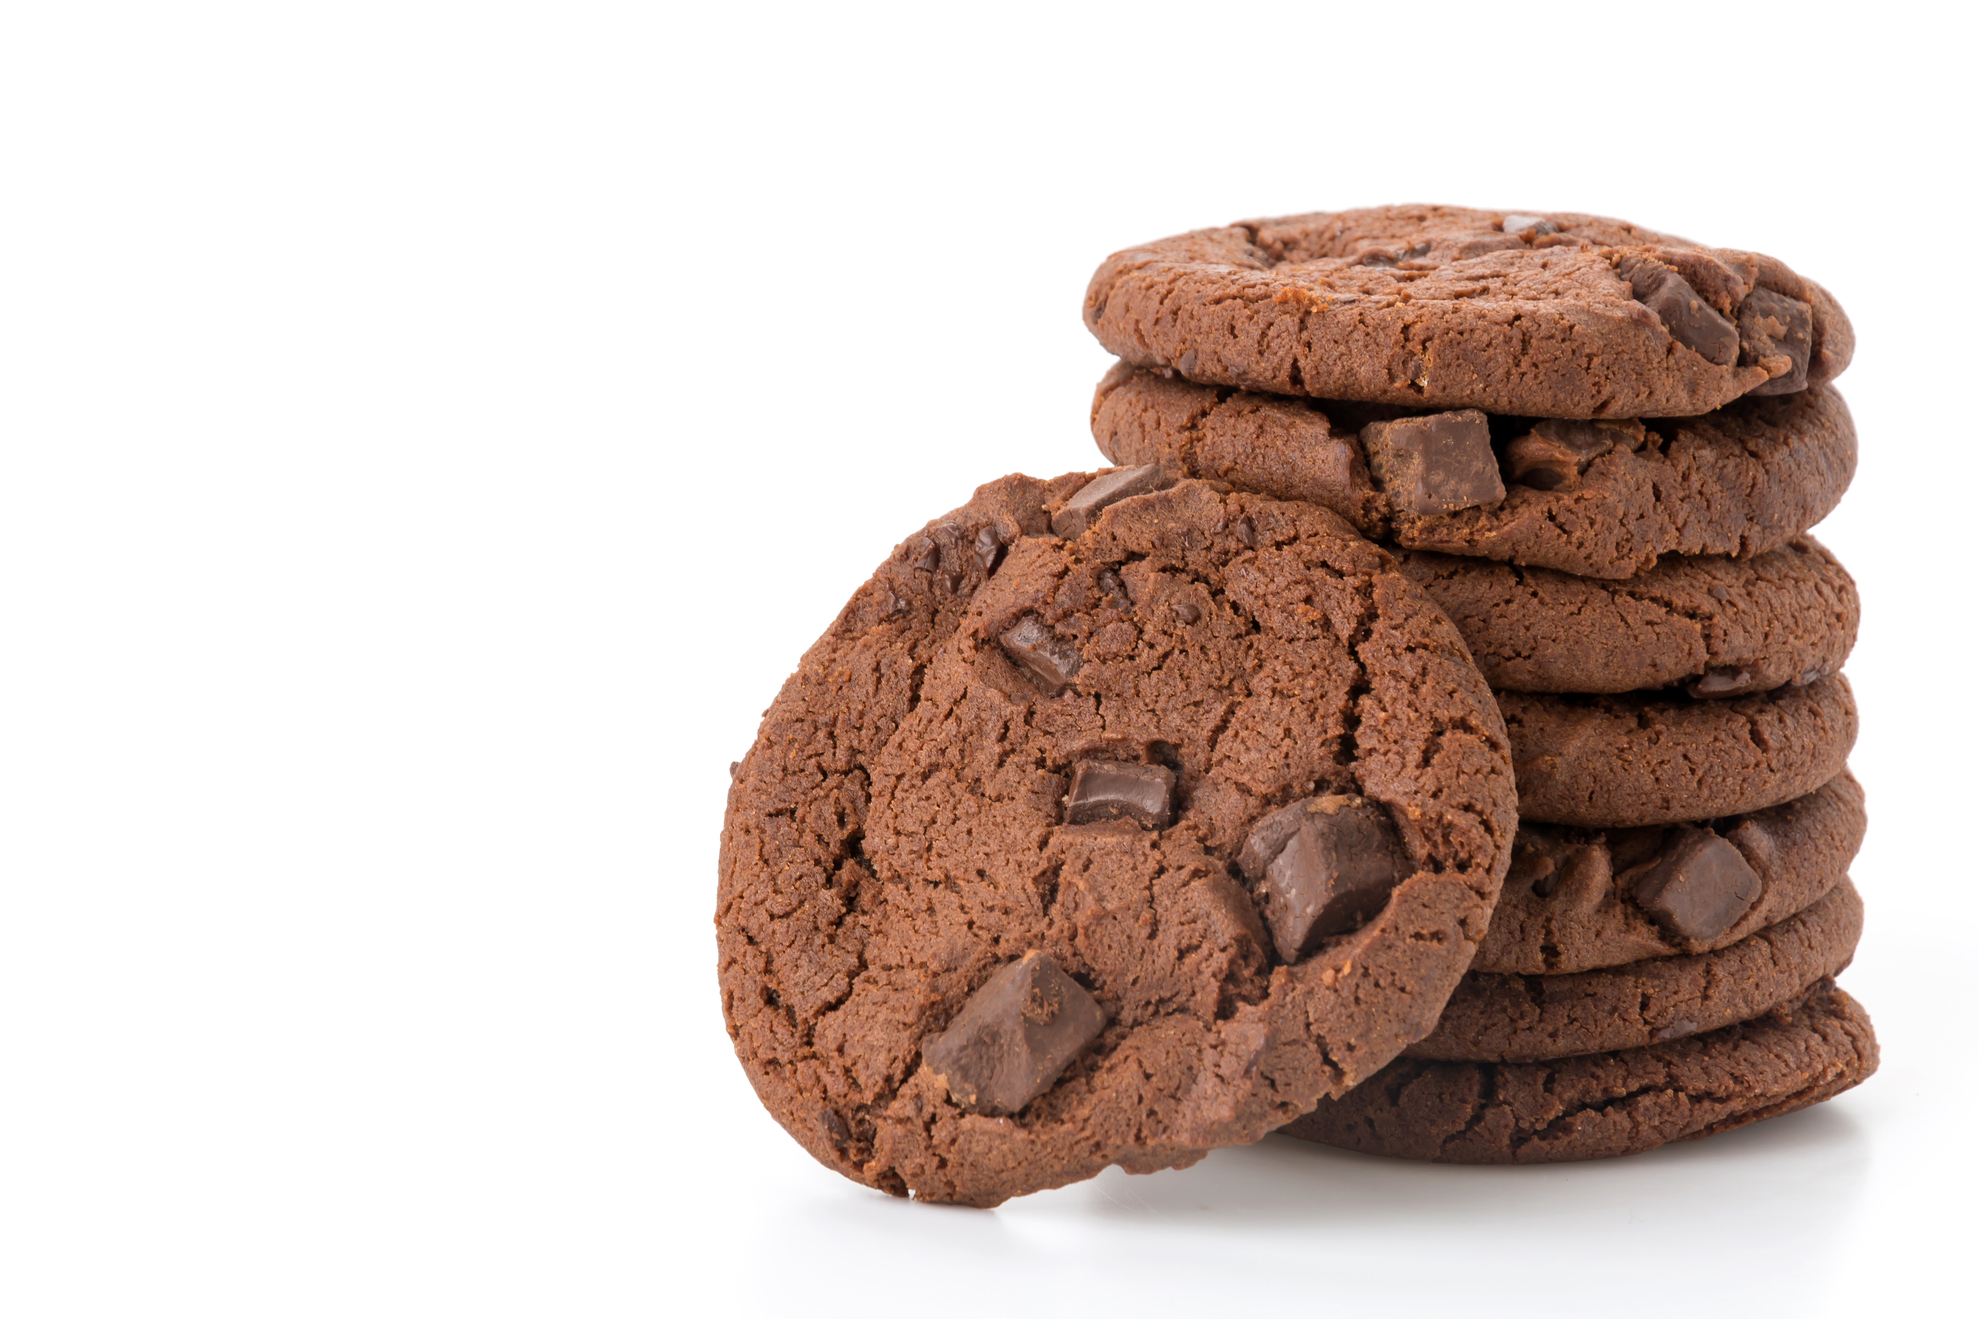
INTRODUCTION
Amount of cocoa powder (in grams) needed for each chocolate cookie per person
Number of people | 1
Cocoa powder (g) | 5
2
10
3
15
7
35
10
50
?
?
Cocoa powder
(grams)
Number of people
Notes:
Tutor guidance: 15-minute exercise
Present graph title and y-axis label to learners.
Allow exploration, through discussion, of what direct proportion means.
Reveal table of plotted values using learner responses (e.g. ‘Learner A, can you determine the grams of cocoa powder needed for 3 people, from the graph and/or ratio table?’)
Emphasise the proportional relationship between the number of people and the grams of cocoa.
Highlight the constant of proportionality in both horizontal and vertical approaches – noting that in either approach a multiplicative calculation is required.
Use '?’ column to explore an extrapolated number of people for learners to use horizontal or vertical multiplication.
Allow 5 minutes for individuals/groups to decide on definition/meaning of direct proportion.
Learners share their definitions with the group and key words/phrases are placed on the board. (5–15 minutes)

Slide 4

Direct proportion
KEY IDEA
If two quantities are in direct proportion:
As one value gets bigger, so does the other (by the same multiplier).
A​s one value gets smaller, so does the other (by the same divisor).
If one value is 0, then the other value is 0.
Notes:
Share a formal definition of direct proportion with learners.
Explore values from 0 and link these to people vs cocoa (grams).
Contextualise as required.

Slide 5
Investigating recipes
INVESTIGATE
No. of Cookies | 12
Flour | 300 g
Sugar | 150 g
Butter | 200 g
Cocoa powder | 60 g
Here are the ingredient proportions in grams required to make 12 cookies.
Notes:
Tutor guidance (slides 5 and 6): 15-minute exercise
Present this information outlining full recipe for 12 cookies.

Slide 6

Investigating recipes
EXPLORE 1
Handout
available
No. of Cookies | 12
Flour | 300 g
Sugar | 150 g
Butter | 200 g
Cocoa powder | 60 g
Using this recipe, how much of each ingredient would you need to make a different number of chocolate cookies?
Fill in as many columns as you can – without using a calculator
Notes:
Tutor guidance:
Offer learners blank copies the of table presented in this slide, Handout 1: Recipes.
Ask learners to complete as many columns as possible for the full recipe of a different number of cookies using the recipe given to them for 12.
If weaker learners need more scaffolding, offer this help while circulating in class, by filling in the top row of recipe for making 6, 3 and 24 cookies (pre-selected values).
Encourage completion without a calculator in the first instance.

Slide 7
Investigating Recipes
INVESTIGATE
Handout
available
6
No. of Cookies | 12 |  |  |  |  | 18
Flour | 300 g
Sugar | 150 g
Butter | 200 g
Cocoa powder | 60 g
÷2
150 g
75 g
100 g
30 g
How much of each ingredient would be required to make 18 cookies?
Notes:
Tutor guidance:
Use chocolate cookie recipe (unless not explored already with learner examples) to ask learners to find recipe for 18 chocolate cookies.
Explore 12 + 6 method (slide 7 – slide 23).
Use learner feedback to explore any other methods learners can think of (unitary method, multiplicative method e.g., 18/12 = 1.5, vertical multiplier(s)). Ask learners whether they have used a different approach to that used above when solving proportion problems. How has their thinking changed? What have they learned about multiplicative structure?

Slide 8
Investigating recipes
INVESTIGATE
12 + 6 = 18
No. of Cookies | 12 | 6 |  |  |  | 18
Flour | 300 g | 150 g
Sugar | 150 g | 75 g
Butter | 200 g | 100 g
Cocoa powder | 60 g | 30 g
+
450 g
+
225 g
+
300 g
+
90 g
How much of each ingredient would be required to make 18 cookies?
Notes:
Tutor guidance:
Use chocolate cookie recipe (unless not explored already with learner examples) to ask learners to find recipe for 18 chocolate cookies.
Explore 12 + 6 method (slide 7 – slide 23).
Use learner feedback to explore any other methods learner can think of (unitary method, multiplicative method e.g., 18/12 = 1.5, vertical multiplier(s)). Ask learners whether they have used a different approach to that used above when solving proportion problems. How has their thinking changed? What have they learned about multiplicative structure?

Slide 9
Investigating recipes
INVESTIGATE
No. of Cookies | 12 | 6 |  |  | 15 | 18
Flour | 300 g | 150 g |  |  |  | 450 g
Sugar | 150 g | 75 g |  |  |  | 225 g
Butter | 200 g | 100 g |  |  |  | 300 g
Cocoa powder | 60 g | 30 g |  |  |  | 90 g
How much of each ingredient would be required to make 15 cookies?
Notes:
Tutor guidance:
Use chocolate cookie recipe (unless not explored already with learner examples) to ask learners to find recipe for 15 chocolate cookies.
Explore 12 + 6 method (slide 7 – slide 23).
Use learner feedback to explore any other methods learners can think of (unitary method, multiplicative method e.g., 18/12 = 1.5, vertical multiplier(s)). Ask learners whether they have used a different approach to that used above when solving proportion problems. How has their thinking changed? What have they learned about multiplicative structure?

Slide 10
Investigating recipes
INVESTIGATE
12 + 3 = 15
No. of Cookies | 12 | 6 | 3 |  | 15 | 18
Flour | 300 g | 150 g |  |  |  | 450 g
Sugar | 150 g | 75 g |  |  |  | 225 g
Butter | 200 g | 100 g |  |  |  | 300 g
Cocoa powder | 60 g | 30 g |  |  |  | 90 g
÷2
75 g
375 g
37.5 g
187.5 g
50 g
250 g
15 g
75 g
How much of each ingredient would be required to make 15 cookies?
Notes:
Tutor guidance:
Use chocolate cookie recipe (unless not explored already with learner examples) to ask learners to find recipe for 15 chocolate cookies.
Explore 12 + 6 method (slide 7 – slide 23).
Use learner feedback to explore any other methods learners can think of (unitary method, multiplicative method e.g., 18/12 = 1.5, vertical multiplier(s)). Ask learners whether they have used a different approach to that used above when solving proportion problems. How has their thinking changed? What have they learned about multiplicative structure?

Slide 11
EXPLORE 2
Handout
available
PRACTICE
Use the ratio tables on the handout to answer the questions.
Ensure you show your working out.
Notes:
Tutor guidance:
Ask learners to work in pairs and give each pair a copy of ‘Explore 2’ handout. It is important that learners answer the questions in order, because they have been carefully designed to guide them to complete the table in a way that explores different relationships in a sequential way. Ask them not to be tempted just to fill in the table.
Make sure that learners explain their approach to their partner, working together to agree on a solution and to develop their own understanding. If you notice that one learner is answering all the questions, or that they are not working collaboratively, ask a learner to explain a question that has been answered by their partner.
Observe learners as they complete this task but do not intervene unless necessary. As learners work on the task, notice how they illustrate their strategy. As you observe them, identify those with different approaches. You can call on them to explain their thinking in the next part of the lesson.

Slide 12

Answers
DISCUSS
Handout
available
3 metres of copper pipe costs £22. How much will 60 metres cost?
Length of pipe (m) | 3 |  |  |  | 60
Cost (£) | 22
30
220
440
A photocopier can produce 25 copies in 30 seconds. How long will it take to make 150 copies?
Copies | 25 |  |  |  | 150
Time (sec) | 30
50
100
60
120
180
Notes:
Tutor guidance:
Ask groups to feedback on how they solved questions 1 and 2, and how they used ratio tables.
Use the animated slides, as required, to model use of ratio tables.

Slide 13
Answers
DISCUSS
Handout
available
Sarah likes to keep fit by running. She can cover 4 km in 25 min. She thinks she can do a 10 km run in less than an hour. Is she right?
Distance (km) | 4 |  |  |  | 10
Time (min) | 25
8
2
50
12.5
62.5
Naz buys a fridge from a shop for £189. The cost of delivery is proportional to the distance from the shop. For 15 miles, the cost is £9. Naz lives 24 miles from the shop. Is the total cost for the fridge and delivery more than £200?
Distance (miles) | 15 |  |  |  | 24
Cost (£) | 9
5
10
1
3
6
0.6
14.4
Notes:
Tutor guidance:
Ask groups to feedback on how they solved questions 3 and 4, and how they used ratio tables.
Use the animated slides, as required, to model use of ratio tables.

Slide 14
True or false?
REVIEW
Handout
available
No. of Cookies | 10 | 25
Cocoa Powder | 40 g | 55 g
+ 30
+ 30
False
No. of Cookies | 10 | 20 | 25
Cocoa Powder | 40 g | 80 g | 85 g
False
×2
+ 5
×2
+ 5
Ratio tables work both vertically and horizontally – multiplicatively!
Notes:
Tutor guidance:
Learners explore the multiplicative relationship between columns and rows to decide whether the graphic shown for calculating direct proportion is true or false in each instance.
Open discussion to highlight this common misconception - that learners calculate differences between adjacent columns and/or rows by using addition and/or multiplication.

Slide 15
True or false?
REVIEW
Handout
available
No. of Cookies | 12 | 6
Cocoa powder | 60 g | 30 g
×5
×5
True
No. of Cookies | 12 | 6
Cocoa powder | 60 g | 30 g
÷2
True
÷2
Ratio tables work both vertically and horizontally – multiplicatively!
Notes:
Tutor guidance:
Allow learners to explore the multiplicative relationship between these columns and rows to decide whether the graphic shown is a true or a false representation for calculating direct proportion.

Slide 16
Clarifying misconceptions
REVIEW
No. of Cookies | 12 | 6 | 1
Cocoa powder | 60 g | 30 g | 5 g
Finding the multiplier:
×5
×5
×5
60 ÷ 12 = 5
60 grams for 12 cookies, so 5 grams for a single cookie.
Divide the gram quantity by the number of cookies to determine the multiplier value.
No. of Cookies | 12 | 6
Cocoa powder | 60 g | 30 g
÷2
How would you describe the
relationship in the table?
÷2
Ratio tables work both vertically and horizontally – multiplicatively!
Notes:
Tutor guidance:
Allow learners time to explore the multiplicative relationship between columns and rows to decide whether this statement is true or false in all instances.

Slide 17
Using a calculator
DISCUSS
A bakery starts to manufacture the cookies to sell to local shops.
Last week the bakery made 416 packets of cookies and used 26 kg of cocoa.
Next week the bakery has orders for 1020 packets of cookies.
How much cocoa does the bakery need?
Notes:
Tutor guidance:
Up to this point, the focus has been on solving relatively straightforward proportion problems, which don’t require the use of a calculator. These questions are usually suitable for using a ratio table.
The next section looks at calculator questions, where the use of ratio tables can be limited and inefficient. The double number line (DNL) is introduced as a more appropriate model for solving such problems.
Talk through this question, then allow learners to discuss in pairs how they would solve it. Take feedback on methods used and address any misconceptions that arise. Did anyone try using a ratio table? Was it effective? Why not?

Slide 18




Using a calculator: double number lines
DISCUSS
$$× 2.45$$
Packets of cookies | 416 |  |  | 1020
Cocoa powder (kg) | 26
$$÷16$$
$$÷16$$
63.75
$$× 2.45$$
Notes:
Tutor guidance:
Use this animated slide to model the use of a DNL to answer the question.
Start by highlighting the relationship between the number of packets and the amount of cocoa – would they expect this to be proportional? If you doubled the number of packets, would you double the amount of cocoa needed?
Ask how 416 relates to 26, and highlight that if you divide 416 by 26 you get 16. Or if you divide 416 by 16 you get 26. In other words 416 is 16 times 26.
Because it is proportional, the same relationship applies between the 1020 cookies produced and the amount of cocoa used – so 1020 divided by 16 = 63.75. So 63.75 kg of cocoa will be needed.
The answer can be checked by multiplying along the number line: 1020 divided by 416 = 2.45. In other words 2.45 times more cookies are to be made next week compared to last.
So, 2.45 times as much cocoa will be required. 26 × 2.45 = 63.7 kg (note there may be some error here due to rounding).

Slide 19
Using a calculator
PRACTICE
Handout
available
PRACTICE
Use double number lines on the worksheet to answer the questions.
Ensure you show your working out.
Notes:
Tutor guidance:
Ask learners to work in pairs and give each pair a copy of the ‘Explore 4’ handout. It is important that learners answer the questions in order because they have been carefully designed to guide them to complete questions in a way that explores different relationships in a sequential way.
Make sure that learners explain their approach to their partner, working together to agree a solution and develop their own understanding. If you notice that one learner is answering all the questions, or they are not working collaboratively, ask a learner to explain a question that has been answered by their partner.
Observe learners as they complete this task but do not intervene unless necessary. As learners work on the task, notice how they illustrate their strategy. As you observe them, identify those with different approaches whom you can call on to explain in the next part of the lesson.

Slide 20




Using a calculator: double number lines
DISCUSS
Handout
available
1. A hair salon uses 43 litres of shampoo over a 4-week period. The manager wants to place an order for a full 52-week year. How much shampoo should he order?
$$× 13$$
0
4
52
weeks
$$× 10.75$$
$$× 10.75$$
litres
0
43
559
$$× 13$$
Notes:
Tutor guidance:
Ask groups to feedback on how they solved question 1, and how a double number line was used.
Use the animated slides, as required, to model use of ratio tables.

Slide 21






Using a calculator: double number lines
DISCUSS
Handout
available
2. A baker produces 38 loaves of bread every 20 minutes. How many loaves could he expect to make during a 7-hour shift?
$$× 3$$
$$× 7$$
0
1/3
1
7
hours
$$× 114$$
$$× 114$$
no. of loaves
0
38
114
798
$$× 3$$
$$× 7$$
Notes:
Tutor guidance:
Ask groups to feedback on how they solved question 2, and how a double number line was used.
Use the animated slides, as required, to model use of ratio tables.

Slide 22




Using a calculator: double number lines
DISCUSS
Handout
available
3. Aisha’s car can do 312 miles on a full tank of 45 litres. Next week she is driving from London to Glasgow and back. The distance from London to Glasgow is 415 miles. How many litres of petrol will she use?
$$× 2.66$$
0
312
830
miles
$$÷6.93$$
$$÷6.93$$
litres
0
45
119.7
$$× 2.66$$
Notes:
Tutor guidance:
Ask groups to feedback on how they solved question 3, and how a double number line was used.
Use the animated slides, as required, to model use of ratio tables.

Slide 23
Practice question (1)
REVIEW
Handout
available
Kate is making some pastry.
She will use 20 ounces of flour.
Kate has a recipe that uses 8 ounces of flour with 3 ounces of butter.
Work out how many ounces of butter Kate needs to use.
7.5 ounces
Notes:
Tutor guidance:
Refer to handout worksheets.
Encourage learners to work at a level suitable for them or direct specific learners to a particular level (Bronze, Silver & Gold).
Despite learners on GCSE course, use FS questions as the starting point to build confidence in these questions.

Slide 24
Practice question (2)
REVIEW
Handout
available
Bill is a builder.
On Monday he made mortar mix.
He used 24 kg of sand and 5 kg of cement.
On Tuesday Bill will make the same type of mortar mix. He will use 36 kg of sand.
How much cement does he need to make the same type of mortar mix?
7.5 kg
Notes:
Tutor guidance:
Refer to handout worksheets.
Encourage learners to work at a level suitable for them or direct specific learners to a particular level (Bronze, Silver & Gold).
Despite learners on GCSE course, use FS questions as the starting point to build confidence in these questions.

Slide 25
Practice question (3)
DISCUSS
Sasha is the manager at a factory.
Last weekend 15 employees assembled 390 identical wardrobes.
Sasha wants 1200 of these wardrobes to be assembled next weekend.
How many employees does Sasha need next weekend?
You must show your working.
47 employees
Notes:
Tutor guidance:
Refer to handout worksheets.
Encourage learners to work at a level suitable for them or direct specific learners to a particular level.
Questions 3 and 4 are calculator questions, so are likely to require the use of DNLs.

Slide 26
Practice question (4)
DISCUSS
Luke plays a computer game where he manages a city.
He buys two buildings.
Luke receives
135 coins every 8 hours from building A
36 coins every 15 minutes from building B.
Luke thinks he receives a total of 4000 coins in 24 hours from these buildings.
Is Luke correct?
Show why you think this.
3861
So Luke is not correct!
Notes:
Tutor guidance:
Refer to handout worksheets.
Encourage learners to work at a level suitable for them or direct specific learners to a particular level.
Questions 3 and 4 are calculator questions, so are likely to require the use of DNLs.

Slide 27




Practice question (3) – answers
DISCUSS
$$× 3.077$$
0
390
1200
wardrobes
$÷$26
$÷$26
employees
0
15
46.15
$$× 3.077$$
So 47 employees will be needed
Notes:
Tutor guidance:
Use this animated slide to model the use of a DNL for Q3, as required.

Slide 28
Practice question (4) – answers
DISCUSS
Building A
Time (hours) | 8 | 16 | 24
No. of coins | 135 | 270 | 405
Notes:
Tutor guidance:
Q4 is in two parts. This slide models how a ratio table can be used to calculate the number of coins from Building A.

Slide 29



Practice question (4) – answers
DISCUSS
Building B
$$× 24$$
Time (hours) | 1/4 | 1/2 | 1 | 2 | 4 | 8 | 16 | 24
No. of coins | 36 | 72 | 144 | 288 | 576 | 1152 | 2304 | 3456
$$× 144$$
$$× 144$$
$$× 24$$
Building A + Building B = 405 + 3456
= 3861
So Luke was not correct, as he has less than 4000 coins.
Notes:
Tutor guidance:
The calculation for Building B is more challenging. Although a ratio table could still be used, it becomes inefficient.
This slide models how a DNL can be used to calculate the number of coins from Building B. You may want to compare it with using a ratio table for the same calculation.

Slide 30
Lesson review:
Direct proportion
Level 2
Objectives
Identify when two quantities differ in direct proportion to each other
Understand the multiplicative relationship between two quantities (non-calculator)
Solve simple proportional problems using efficient methods with ratio tables and double number lines
Suggested further steps/areas to work on
Interpret and use fractions in another context

Slide 31
Lesson 5:
Credits
Photo acknowledgements:
123RF.com: Natthapon Ngamnithiporn
Text acknowledgements:
Pearson Edexcel Functional Skills, Past Paper 4 – Mathematics Level 1 (Non Calculator) PMAT1/N04 Question 3, Pearson Edexcel Functional Skills, Past Paper 2 – Mathematics Level 1 (Calculator) PMAT1/C02 Question 9, Pearson Edexcel Functional Skills, Practice paper (Sept 2019) – Mathematics Level 2 (Non-Calculator) PRACL2/01 Question 1, Pearson Edexcel Functional Skills, Practice Set 2 – Mathematics Level 2 (Calculator) PRACL2/C02 Question 4, Pearson Edexcel Functional Skills, Practice Set 2 – Mathematics Level 2 (Calculator) PRACL2/C02 Question 1

