Slide 1


Lesson Study and research questions

Slide 2
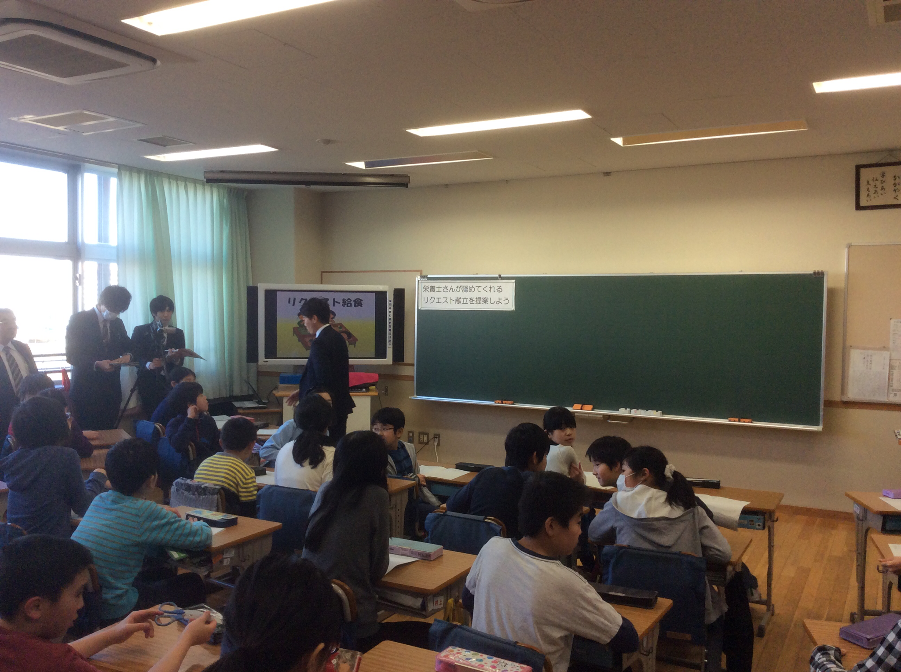

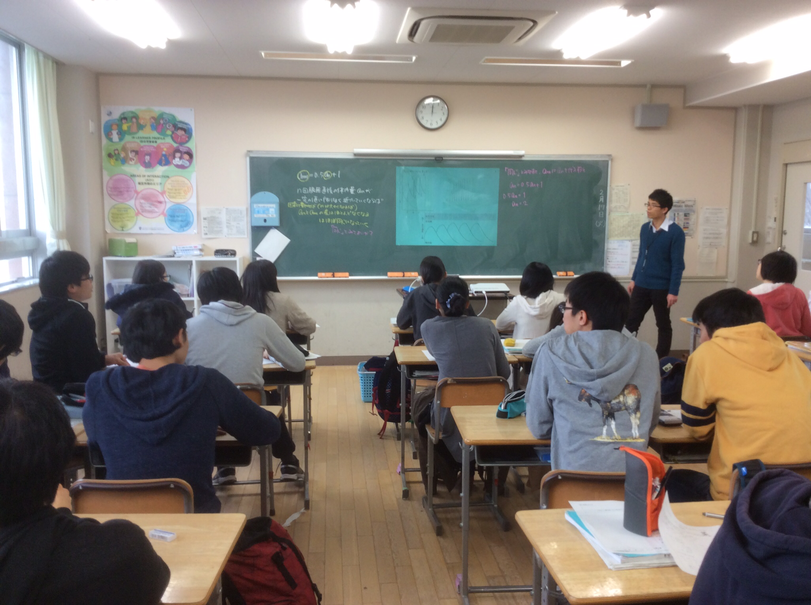
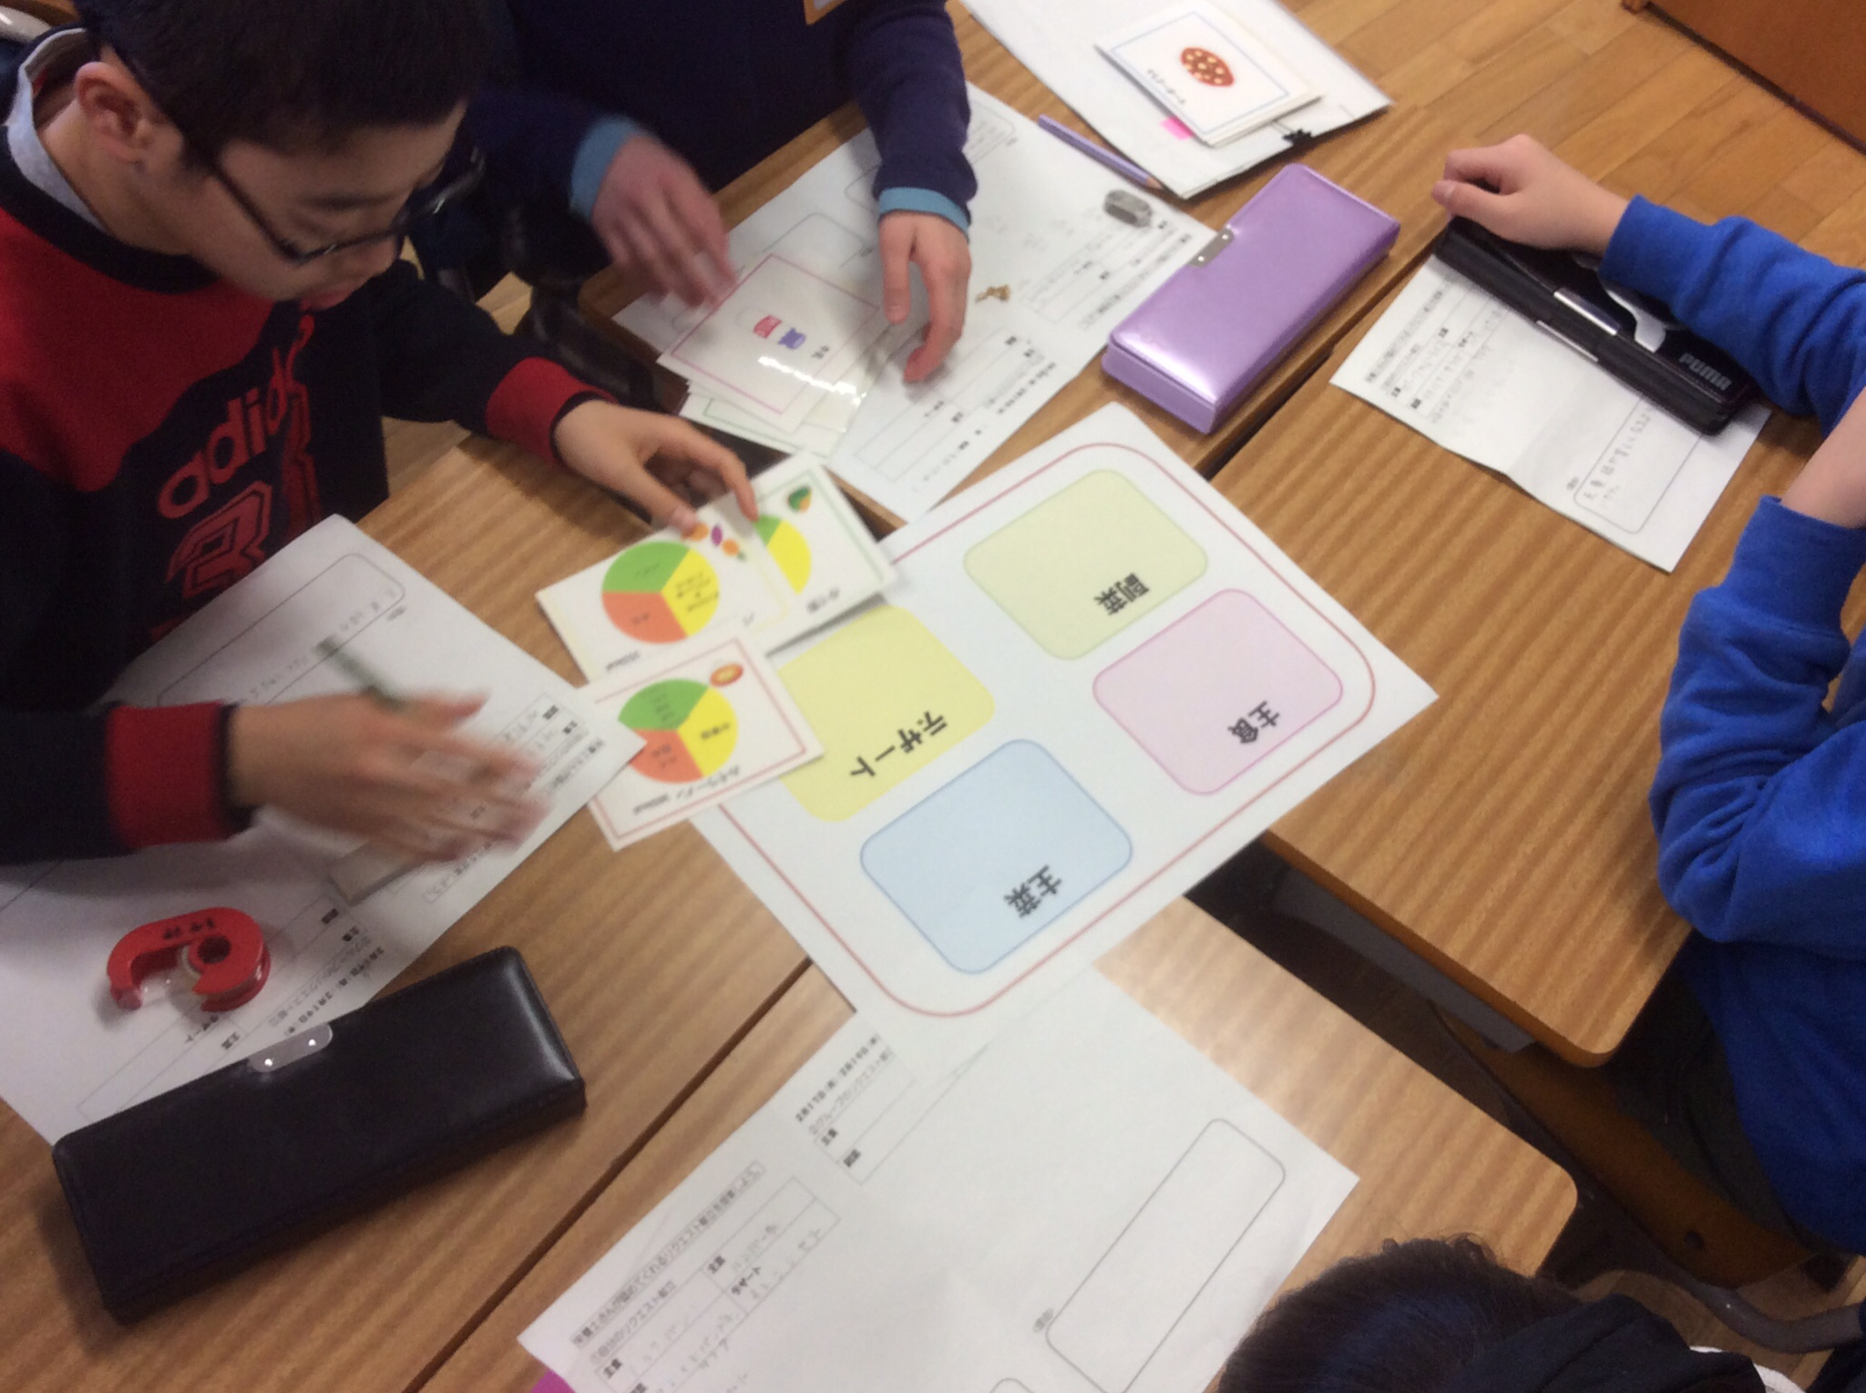
Lesson Study
© Crown copyright 2023. This information is licensed under the Open Government Licence (nationalarchives.gov.uk) v 3.0
Notes:
‘Lesson Study ‘originated in East Asia. Although the claim to its actual origin is often disputed, Japan is often considered to be its country of origin.
There, especially in Primary schools, it is an important part of teachers’ professional lives.
The aim is for teachers to work collaboratively to research and improve their classroom practice in ways that lead to better learning.
‘Lesson Study’ is an important part of teachers’ professional development.

Slide 3
Effective Professional Development is
Experiential: stimulating & drawing on teachers’ experiences.
Sustained: cycles of planning, predicting, enactment & reflection.
Grounded: practical, well-resourced; related to context & culture.
Safe: teachers able to speak their minds, permission to take risks.
Collaborative: involving networks of teachers & administrators.
Informed: by outside expertise and research.
Provocative: involving both pressure and support.
Focused: attentive to the development of the mathematics itself.
(Guskey, 2002; Joubert and Sutherland, 2009; Villegas-Reimers, 2003; and many others.)
© Crown copyright 2023. This information is licensed under the Open Government Licence (nationalarchives.gov.uk) v 3.0
Notes:
This slide outlines the features that have been found to be effective in the design of teachers’ professional development.
‘Lesson Study' encompasses all of these features.

Slide 4
Lesson Study lessons are research lessons
Lessons where, as teachers, we inquire/research into what effective teaching for mastery is.
This is a collective and collaborative endeavour.
They are experiential, sustained, grounded, safe, collaborative, informed, provocative and focused.
© Crown copyright 2023. This information is licensed under the Open Government Licence (nationalarchives.gov.uk) v 3.0
Notes:
‘Lesson Study’ is collaborative lesson research. That is, collaboration between teachers, and others involved in supporting teaching and learning, in which researching what works in teaching is the aim.
A lesson is the focal point of a cycle of ‘Lesson Study’ – this is a research lesson.

Slide 5
Lesson Study lessons are research lessons
Decide on a research theme
Research question
Summarise
research findings
Plan the research lesson
Post-lesson discussion
Teach the research lesson
© Crown copyright 2023. This information is licensed under the Open Government Licence (nationalarchives.gov.uk) v 3.0
Notes:
It is important that ‘Lesson Study’ efforts are directed carefully within an overarching theme – such as ‘Teaching for Mastery’, which was the focus of the research trials within the CfEM programme.
This theme will set the direction of all ‘Lesson Study’ activity over a substantial period. For this reason, it is important that the group defines and agrees on the theme and has a shared understanding of their research objectives.
During the CfEM research trials the Centres collaboratively came to an agreement of key principles that applied to their thinking. These were carefully documented and exemplified. See the Teaching for Mastery Handbook that sets out the Key Principles.
In this way all teacher participants in the research were able to make sure that they had a shared understanding of the issues that they would explore in the research lessons. These principles were important in developing the exemplar lessons and their accompanying research questions.

Slide 6
Lesson Study lessons are research lessons
Decide on a research theme
Research question
Summarise
research findings
Plan the research lesson
Post-lesson discussion
Teach the research lesson
© Crown copyright 2023. This information is licensed under the Open Government Licence (nationalarchives.gov.uk) v 3.0
Notes:
Research Questions
The research lesson in ‘Lesson Study’ explores a professional or research question that the group seeks to answer in the carefully explored research lesson. Consequently, the research question(s) relate very directly to important incidents that are planned for in the lesson.
For example, if the group is exploring students' use of different representations in their solution to a problem, the lesson needs to be planned in ways that encourage such representation development.
The lesson plan for the research lesson should be considerably more extensive than would be the case for a day-to-day lesson. It needs, for example, to signal to the class teacher (and observers) where this is planned for, and to indicate what the planning team expect to happen and how to deal with what they expect students to do in response to the task(s).

Slide 7
Research questions
In the CfEM research trials the sample Teaching for Mastery research lessons had two research questions.
For example, in Lesson A:
Pedagogic focus
How does the teacher use the student tasks to help develop understanding of mathematical structure?
Maths focus
In what ways do students use representations to consider mathematical structure and develop their mathematical understanding of highest common factor and lowest common multiple?
© Crown copyright 2023. This information is licensed under the Open Government Licence (nationalarchives.gov.uk) v 3.0

Slide 8
Lesson Study lessons are carefully and collaboratively planned
Decide on a research theme
Research question
Summarise
research findings
Plan the research lesson
Teach the research lesson
Post-lesson discussion
© Crown copyright 2023. This information is licensed under the Open Government Licence (nationalarchives.gov.uk) v 3.0
Notes:
In ‘Lesson Study’, the research lesson is a lesson that is carefully designed to allow the group to explore a question that they have identified that is important to their teaching within the overall focus of the research theme that informs all of their work.
In the CFEM research trials the research theme was ‘Teaching for Mastery’ and each of the research lessons had two research questions: one with a mathematical focus, the other with a pedagogical focus.
The lesson is planned to ensure that the teacher and observers of the research lesson were able to answer the research question(s). That means that the format of the lesson needs to be such that there will be opportunities for students to engage in ways that will stimulate learning in alignment with the research question(s).
For example, if, in a particular lesson, the Lesson Study group is exploring students' use of different representations in their solution to a problem, the lesson needs to be planned in ways that encourage such representation development. The lesson plan for the research lesson should be considerably more extensive than would be the case for a day-to-day lesson. It needs, for example, to signal to the class teacher (and observers) where this is planned for, and to indicate what the planning team expect to happen and how to deal with what they expect students to do in response to the task(s).
In their planning the group should inform their planning by thinking carefully about:
The needs of the particular students who will be taught the research lesson
The place of the lesson in the sequence of learning
Phases within the lesson and their purpose
The key questions that will be posed
Their anticipated student responses
What responses the teacher might make to these
How learning and progress may be recognised.

Slide 9
Lesson Study lessons are observed carefully by the Lesson Study group
Decide on a research theme
Research question
Summarise
research findings
Plan the research lesson
Post-lesson discussion
Teach the research lesson
© Crown copyright 2023. This information is licensed under the Open Government Licence (nationalarchives.gov.uk) v 3.0
Notes:
One of the teachers of the ‘Lesson Study’ group teaches the research lesson in line with the agreed plan. The rest of the group attend the lesson as observers.
The observers of the research lesson have the job of collecting evidence that will inform the group in answering the research question in the post-lesson discussion.
Observers should not interact with students as that will interfere with planned intentions.
Observers might find it useful to use an observation form that allows them to record their observations and reflect on these in light of the research questions for the lesson.
Questions observers might like to think about:
How did students respond to the task(s) used in the lesson?
How did students respond to the teachers' questioning?
What anticipated and unanticipated reasoning was in evidence?
What representations (concrete, pictorial, abstract) did students use to help them engage with the mathematics.
What progression in student reasoning was in evidence?
What different approaches were observed?
Did students engage with the reasoning of other students?
Did students recognise when their approach was not working?
How were students’ own ideas combined and developed?
How does the mathematics of the lesson flow and develop during the lesson?
To what extent were learning objectives achieved?

Slide 10
Lesson Study lessons are considered in detail in a post-lesson discussion
Decide on a research theme
Research question
Summarise
research findings
Plan the research lesson
Teach the research lesson
Post-lesson discussion
© Crown copyright 2023. This information is licensed under the Open Government Licence (nationalarchives.gov.uk) v 3.0
Notes:
The research lesson should be followed by a post-lesson discussion during which the ‘Lesson Study’ group reflect on the extent to which the lesson design allowed students to learn mathematics in line with the lesson plan.
Where?
Ideally the post-lesson discussion can be held in the same classroom as the research lesson, so that participants can use student work or refer to materials used in the lesson.
Duration?
About an hour has been found to be a productive length of time for a discussion. However, if everyone is still actively engaged and enjoying the discussion, and it is possible, it may be beneficial to go on longer.
The person chairing the post-lesson discussion will need to use their judgment and take the advice of the hosting teacher who may have other lessons to teach.
This is a good reason why it might be helpful to have the research lesson as the last lesson of the day.
The discussion
The chair of the meeting should remind everyone of the research focus of the lesson. The discussion should keep focused on this.
First, the teacher should have an opportunity to talk about their own perceptions of the lesson and any reasons they had for deviations from the lesson plan in response to student learning during the research lesson.
Observers should give brief-but-vivid accounts of critical incidents, describing what they saw, rather than attempting to account for why. This keeps the discussion open to alternative explanations and avoids premature closure.
Participants should try not to give evaluative judgments about ‘what went well’, or otherwise. Points made should refer to evidence seen in the lesson.
Concluding with the view of an outside expert
The post-lesson discussion could conclude with an extended input from an outside expert.
They can help by providing a fresh outsider view and can suggest possible directions for the ‘Lesson Study’ group by building on what has been learned.
They should seek to draw together the threads of the discussion and make particularly pertinent remarks relating to the research question and how the group might move forwards.

Slide 11
Learning from Lesson Study lessons is carefully summarised and shared with colleagues
Decide on a research theme
Research question
Summarise
research findings
Plan the research lesson
Post-lesson discussion
Teach the research lesson
© Crown copyright 2023. This information is licensed under the Open Government Licence (nationalarchives.gov.uk) v 3.0
Notes:
Learning in ‘Lesson Study’ is primarily for the participants – their active involvement in the ‘Lesson Study’ group ensures this.
However, it is possible to document this learning and share it more widely whilst ensuring that there is a record for the group to look back on.
This will be especially helpful at the end of a number of cycles of ‘Lesson Study’ when the group might like to come back to look at the questions they have explored in the context of the overarching research theme.

Slide 12
Lesson Study lessons are part of a carefully planned series of research cycles
Decide on a research theme
Research question
Summarise
research findings
Plan the research lesson
Post-lesson discussion
Teach the research lesson
© Crown copyright 2023. This information is licensed under the Open Government Licence (nationalarchives.gov.uk) v 3.0
Notes:
The next cycle
After a ‘Lesson Study’ cycle, it is time to start again – with a further cycle working within the same research theme.
The aim is not to improve the lesson of the first cycle, but to work with the new knowledge that the group has gained to plan another lesson that extends the thinking of the group.

Slide 13
Credits
Photo acknowledgements
University of Nottingham: Geoff Wake Professor of Mathematics Education; Shutterstock.com: Globe Turner
© Crown copyright 2023. This information is licensed under the Open Government Licence (nationalarchives.gov.uk) v 3.0

