Slide 1


Lesson 10:
Work with equivalent fractions, decimals and percentages and find percentages of an amount Level 2
Objectives
Working with equivalent fractions, decimals and percentages using multiple representations
Calculate benchmark percentages and apply bar models to solve percentage of an amount problems (non-calculator)

Slide 2





Is Yaima correct?
$$\frac{1}{2}$$
On this card, the fractions, decimal and percentage all have the same value.
$$50\%$$
$$0.05$$
$$\frac{5}{10}$$
Yaima
Yaima is not correct. Why?
How do you know this?
Notes:
Discuss with the learners. Guide them to see that 0.05 is not equal to the other three quantities on the card. Ask learners to suggest what number should be on the card instead of 0.05 so that all the quantities have the same value. (0.5)
Make the link between $\frac{5}{10}$ and 0.5 in terms of place value.

Slide 3
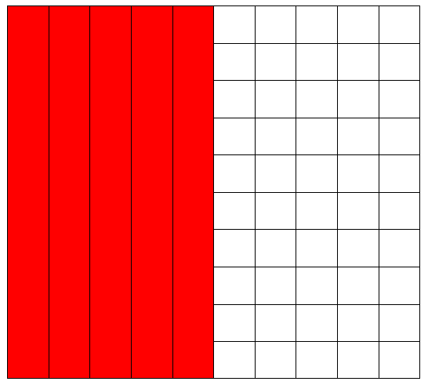
Matching fractions, decimals and percentages
DISCUSS
What fraction does the coloured part represent?
Notes:
Ask learners to suggest what fraction the coloured part of the picture shows. Accept all variations, including $\frac{50}{100}$ and $\frac{5}{10}$ .
Ask learners what percentage of the picture is coloured.
Ask: If 50% is 0.5 then what is 10% as a decimal/fraction? What is 30% etc.

Slide 4
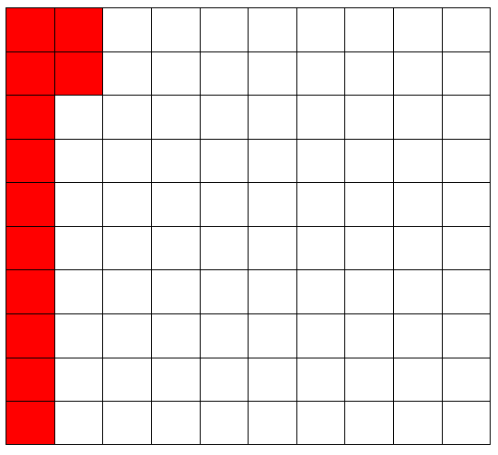
DISCUSS
Matching fractions, decimals and percentages
What fraction does the coloured part represent?
What are some equivalent fractions for your answer?
Notes:
Ask learners what the coloured part of the diagram represents. Encourage all variations ($\frac{12}{100}$ , $\frac{3}{25}$ , $\frac{6}{50},$ etc.)
Ask learners what percentage of the picture is coloured. How do they write this percentage a decimal?

Slide 5
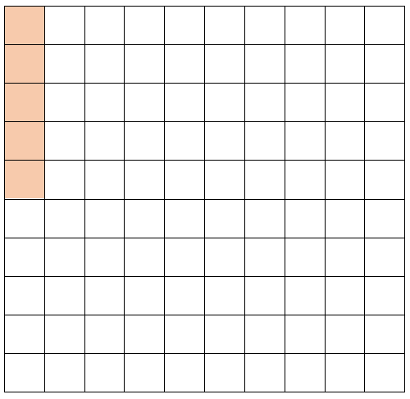
Matching fractions, decimals and percentages
DISCUSS
What fraction is this?
Notes:
Tutor may ask learners what this is as a fraction. 5/100
What is percent out of? 100
So what is this as a percent? 5%
Tutor asks whole class, so if 50% is 0.5 then what is 5% as a decimal?

Slide 6
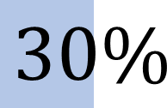





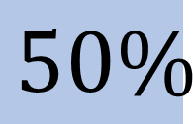

Which of these are true?
DISCUSS
$$\frac{1}{2}$$
$$\frac{1}{3}$$
=
$$50\%$$
=
$$30\%$$
$$\frac{1}{10}$$
$$\frac{2}{5}$$
$$0.01$$
=
$$0.4$$
=
Which of these are true?
Explain why, using diagrams or otherwise.
Notes:
Encourage learners to discuss in pairs. Ask learners to write their explanations on mini whiteboards.

Slide 7
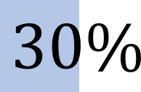





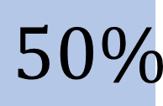

Answers: Which of these are true?
DISCUSS
$$\frac{1}{2}$$
$$\frac{1}{3}$$
=
$$50\%$$
=
$$30\%$$
$$\frac{1}{10}$$
$$\frac{2}{5}$$
$$0.01$$
=
$$0.4$$
=
Notes:
Ask some pairs to share their explanations. Refer back to the 100-grid to help explain, if necessary, especially for the 1/3, as this is a very common misconception.

Slide 8
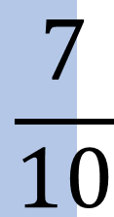

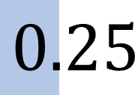

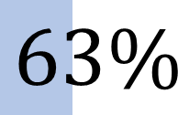
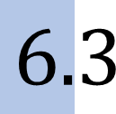
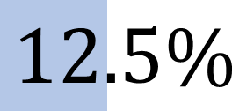
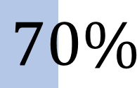
DISCUSS
Which of these are true? (2)
$$\frac{1}{4}$$
=
$$63\%$$
=
$$6.3$$
$$0.25$$
$$\frac{1}{8}$$
$$\frac{7}{10}$$
=
=
$$12.5\%$$
$$70\%$$
Which of these are true?
Explain why, using diagrams or otherwise.
Notes:
Encourage learners to discuss in pairs. Ask learners to write their explanations on mini whiteboards.

Slide 9
DISCUSS
Answers: Which of these are true? (2)
$$\frac{1}{4}$$
=
$$63\%$$
=
$$6.3$$
$$0.25$$
$$\frac{1}{8}$$
$$\frac{7}{10}$$
=
=
$$70\%$$
$$12.5\%$$
Notes:
Ask some pairs to share their explanations. Again, use the 100 grid to help explain that 63% is 63/100, which is 0.63 as a decimal.

Slide 10
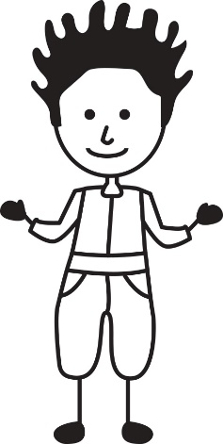
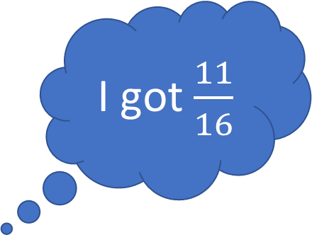
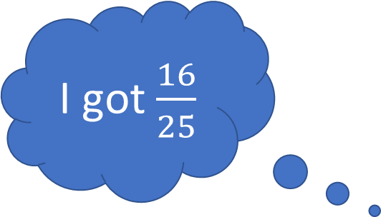
EXPLORE
Using a calculator
Nina and Dev are comparing their test scores.
I got $\frac{16}{25}$
I got $\frac{11}{16}$
Who did better?
Think–pair–share. You may use a calculator.
10
10
Notes:
Allow the learners a minute to work this out. Encourage discussion on how to use a calculator to convert from fraction to decimal.
Think–pair–share.
Some learners may use the division key on the calculator. Some may know about the fraction key and S>D key. Some learners may not know how to use a calculator for this and may be trying to convert the fraction into an equivalent fraction over 100. Good opportunity for discussion.
Ask the learners what Nina and Dev each got as a percentage.
Answer:
Nina: 16/25 = 0.64 = 64%
Dev: 11/16 = 0.6875 = 68.75%
So Dev got better.

Slide 11




EXPLORE
Card sort – matching fractions, decimals
and percentages
Handout
available
Put four triangles together to make a square card.
Each group of four triangles should contain equivalent fractions, decimals and percentages
$$50\%$$
$$\frac{10}{20}$$
$$\frac{50}{100}$$
0.5
11
Notes:
Handout 1 - Tarsia to include FDP equivalents.
If learners are struggling, encourage them to apply to grids or bars to prove they match.
Extension also provided with more challenging FDP amounts, within the set.

Slide 12
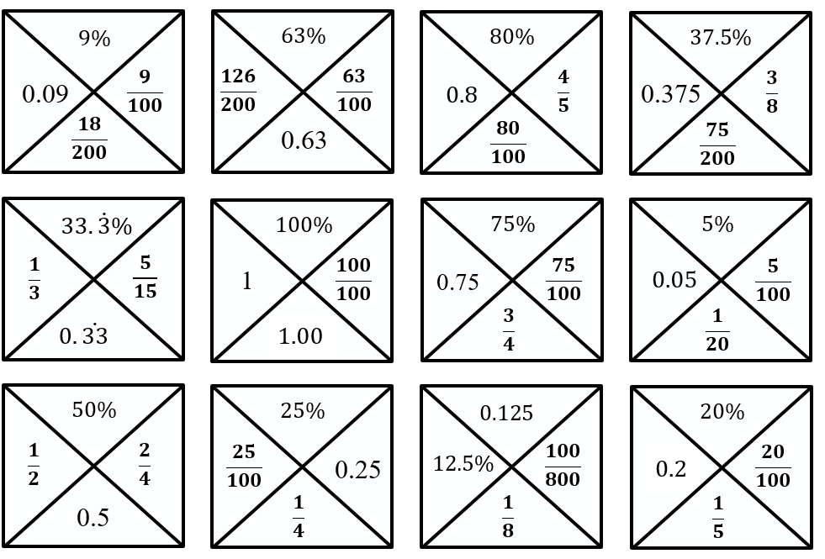
DISCUSS
Card sort – answers
12

Slide 13





EXPLORE
Add to make 1
$$\frac{1}{5}$$
12.5%
$$\frac{3}{4}$$
0.01
20%
$$\frac{1}{2}$$
10%
One quarter
$$\frac{1}{20}$$
0.5
25%
0.15
$$\frac{1}{3}$$
5%
75%
One tenth
You may use each fraction, decimal and percentage more than once, and add in new ones.
Find different combinations of fractions, decimals and percentages that add up to one.
Present the combinations using a bar model.
Notes:
Tutor to ensure that
Learners can use all of the quantities multiple times to make 100% or 1 and add in more to make the bar total.
Learners should be challenged to find as many different solutions as possible using all FDP.
Learners then represent their answers in bar models.
Before learners start the task, show next slide as an example.

Slide 14
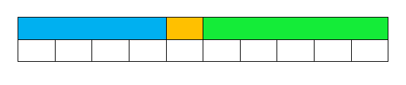
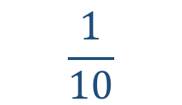
How many ways to make 1?
EXPLORE
40%
0.5
Make 1
$$\frac{1}{10}$$
Notes:
Bars for $\frac{1}{10}$ and tenths are shown to model an answer.
Encourage learners to apply variation when developing their own ideas.
Stretch and challenge
Suggest learners use at least one of each fraction/decimal/percentage and can create their own combinations with new fraction/decimal/percentage amounts.
Misconceptions
Learners do not understand place value and think that 0.9 is $\frac{9}{100}$ or that 0.15 is greater than 0.2.
Learners order fractions using only the numerator and do not grasp equivalence and think $\frac{2}{3}$ , $\frac{3}{5}$ , $\frac{4}{9}$ , $\frac{5}{8}$ are in order of smallest first.
Learners are unable to work out thirds and think one third is equivalent to 0.3.
Learners are only able to use double and double again and do not know that 0.2 is $\frac{1}{5}$.
This activity allows for exploration of different outcomes, while helping to highlight common misconceptions with fractions/decimals/percentages .

Slide 15
REVIEW
How many ways to make 1?
Add to 1
Notes:
Some examples may be provided by each group to the tutor. This slide can be used as a template on which their ideas are noted.
Identify complex combinations or combinations that draw out misconceptions.

Slide 16
DISCUSS
Percentages of an amount (1)
What is 75% of 200?
75%
50
50
50
50
200
Answer = 150
16
Notes:
Animations to bring bar model in gradually.
Tutors could model on the white board.
Before showing animations – ask the learners how they can present the question in a bar model?
Ask learners to help label the bar.
What information does the question tell them? How would they show this on the bar model?
What is it that they are trying to find? How would they show this on the bar model?
How would it be divided up?
What would each section be worth?

Slide 17
DISCUSS
Percentages of an amount (2)
What is 60% of 50?
60%
5
5
5
5
5
5
5
5
5
5
50
Answer = 30
17
Notes:
Animations to bring bar model in gradually.
Tutors could model on the white board.
Before showing animations – ask the learners how they can present the question in a bar model?
Ask learners to help label the bar.
What information does the question tell them? How would they show this on the bar model?
What is it that they are trying to find? How would they show this on the bar model?
How would it be divided up? Could they split the bar into 1/5 or 20%, etc?
What would each section be worth?

Slide 18
DISCUSS
Percentages of an amount (3)
What is 15% of 120?
15%
12
6
6
12
12
12
12
12
12
12
12
120
Answer = 18
18
Notes:
Animations to bring bar model in gradually.
Tutors could model on the white board.
Before showing animations – ask the learners how they can present the question in a bar model?
Ask learners to help label the bar.
What information does the question tell them? How would they show this on the bar model?
What is it that they are trying to find? How would they show this on the bar model?
How would it be divided up?
What would each section be worth?

Slide 19
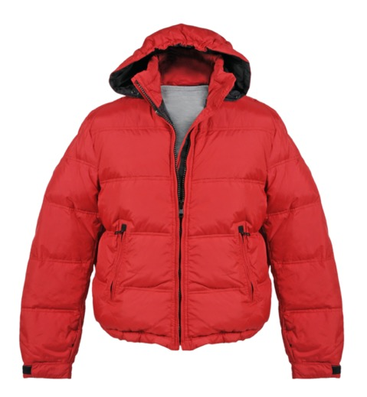
DISCUSS
Percentages without a calculator
A jacket is on sale with 20% off. The original price is £80.
What was the sale price for the jacket?
?
20%
8
8
8
8
8
8
8
8
8
8
£80
Answer = £80 -16= £64
Notes:
Tutors may model the question on the whiteboard.
Before showing the animations, ask learners how they can represent the question in a bar model.
What information does the question tell them? How would they show this on the bar model?
What is it that they are trying to find? How would they show this on the bar model?
How could the bar be divided up? Would they divide the bar into sections 10% or 20%? How many 20%s are there in 100%? How many 10%s?
What would be the money value of each section?
So what would be the discount? … and what would be the sale price of the jacket?

Slide 20
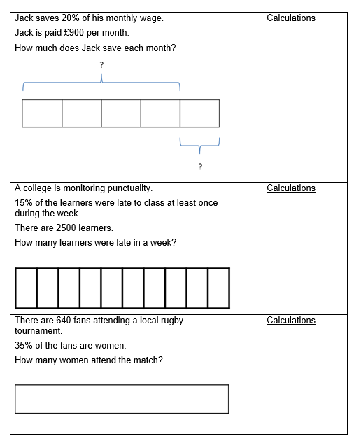
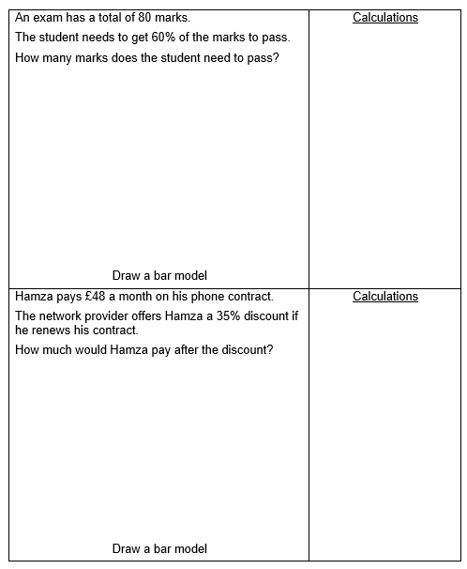
Problem-solving with bar models
YOUR TURN
Handout
available
Notes:
Provide each learner with a copy of Handout 2. Learners can work individually or in pairs for peer support.
Encourage learners to think for themselves. Use probing questions, rather than showing them how to do it.

Slide 21

REVIEW
Problem-solving with bar models (a)
Jack saves 20% of his monthly wage.
Jack is paid £900 per month.
How much does Jack save each month?
80%
20%
£180
£180
£180
£180
£180
£900
Answer: £180
Notes:
Slides 18 to 24 show suggested bar models and solutions for the ‘Problem-solving with bar models’ handout.

Slide 22
REVIEW
Problem-solving with bar models (b)
A college is monitoring punctuality.
15% of the learners were late to class at least once during the week.
There are 2500 learners.
How many learners were late in the week?
85%
15%
£250
250
125
250
250
250
250
250
250
250
125
250
2500
Answer: 375 students
Notes:
Modelled answer for each question from handout 2.

Slide 23
REVIEW
Problem-solving with bar models (c)
There are 640 fans attending a local rugby match.
35% of the fans are women.
How many women attend the match?
65%
35%
32
£250
64
64
64
64
64
64
32
64
64
64
640
Answer: 224 women

Slide 24
REVIEW
Problem-solving with bar models (d)
An exam has a total of 80 marks.
A student needs to get 60% of the marks to pass.
How many marks does the student need to pass?
60%
40%
£250
8
8
8
8
8
8
8
8
8
8
80
Answer: 48 marks

Slide 25
REVIEW
Problem-solving with bar models (e)
Hamza pays £48 a month on his phone contract.
The network provider offers Hamza a 35% discount if he renews his contract.
How much would Hamza pay after the discount?
65%
£250
4.80
4.80
4.80
4.80
4.80
2.40
4.80
4.80
4.80
4.80
2.40
35%
Answer £31.20
£48.00
Notes:
Modelled answer for each question from Handout 2.

Slide 26
PRACTICE QUESTION
REVIEW
Practice question (1)
Worksheet
available
Write 8% as a decimal.
0.08

Slide 27
PRACTICE QUESTION
REVIEW
Practice question (2)
Worksheet
available
Write 21.9% as a decimal.
0.219

Slide 28
PRACTICE QUESTION
REVIEW
Practice question (3)
Worksheet
available
Alex says,
‘The probability that the score is negative is 0.5, which means there is a 5% chance that the score is negative.’
Alex is incorrect.
Explain why.
0.5 = 50% and 5% is 0.05. There is a 50% chance.

Slide 29
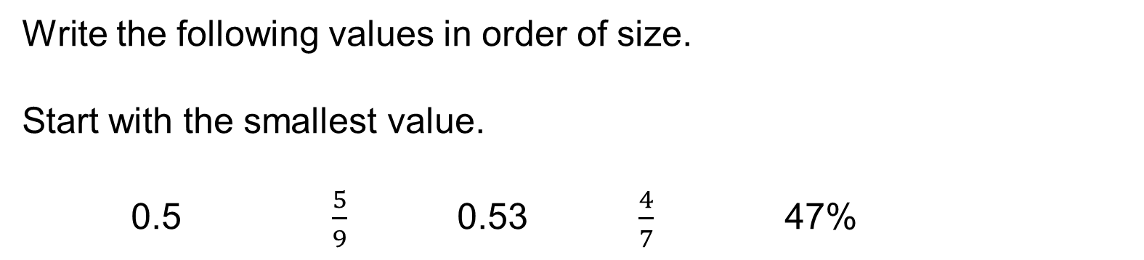
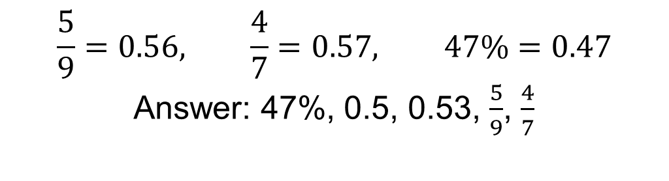
PRACTICE QUESTION
REVIEW
Practice question (4)
Worksheet
available
Write the following values in order of size.
Start with the smallest value.
0.5 $\frac{5}{9}$ 0.53 $\frac{4}{7}$ 47%
$$\frac{5}{9}=0.56, \frac{4}{7}=0.57, 47\%=0.47$$
Answer: 47%, 0.5, 0.53, $\frac{5}{9}$, $\frac{4}{7}$

Slide 30
Lesson review:
Work with equivalent fractions, decimals and percentages and find percentages of an amount Level 2
Objectives
Working with equivalent fractions, decimals and percentages using multiple representations
Calculate benchmark percentages and apply bar models to solve percentage of an amount problems (non-calculator)

Slide 31

Lesson 10:
Credits
Photo acknowledgements
Shutterstock.com: Karkas
Text acknowledgements
Pearson Edexcel Functional Skills, Practice Paper 3 - Mathematics Level 2 (Non-Calculator) PRACL2/N03 Question 3a, Pearson Edexcel Functional Skills, Past Paper 4 - Mathematics Level 2 (Calculator) PMAT2/C04 Question 4, Pearson Edexcel Functional Skills, Past Paper 3 - Mathematics Level 2 (Calculator) PMAT2/C03 Question 7, Pearson Edexcel Functional Skills, Practice Paper 2 - Mathematics Level 2 (Calculator) PRACL2/C03 Question 7

