Slide 1


Lesson 29:
Substitution and Formulae
Objectives
Revise order of operations.
Use formulae in words and numbers.
Substitute positive and negative numbers in the formula.
Use variations of concepts to promote mathematical thinking and discussion, building on existing knowledge relevant for substitution and formulae.
Notes:
You may choose not to share the lesson objectives at the beginning of the lesson so as not to disengage learners who may resist engagement with algebra.

Slide 2
What’s the same? What’s different?
DISCUSS
a + 3
3 + a
a + a + a
Are there any other combinations of 3 and a that you could make?
Notes:
Depending on class size, this can be a grouped, paired or individual activity.
Allow time for discussions to take place between learners before capturing feedback.
Ensure that the captured feedback is recorded or noted to demonstrate existing knowledge.
If necessary, ensure that key language is introduced if learners are not using it.
The purpose of this slide and the following two is for you as a tutor to get to understand the level of prior knowledge that learners are bringing to this topic. Slides 1–3 also support the tutor in addressing misconceptions and key algebra vocabulary if learners are not forthcoming.
The questions can serve as a prompt and help learners to see patterns, make relationships and connections, and build learning. This aids in the formation of a strong conceptual network.

Slide 3
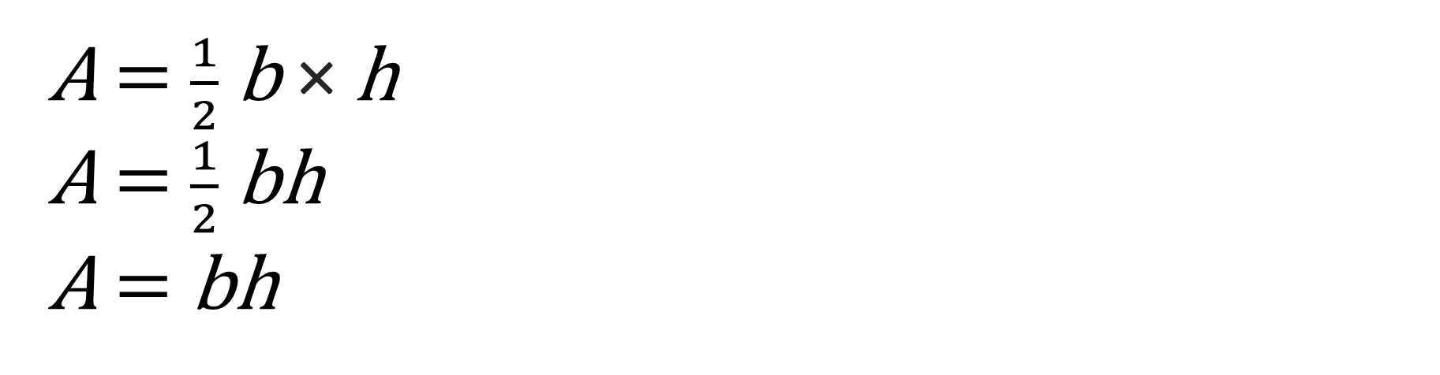
What’s the same? What’s different?
DISCUSS
A = $\frac{1}{2}$b × h
A = $\frac{1}{2}$bh
A = bh
Any letter can be a variable, not just x.
Notes:
This slide builds on the complexity of the previous examples.
Continue to ask learners ‘What’s the same?’ and ‘What’s different?’ and allow time for learners to consider.
Highlight that though x is often used as a variable, other letters can be used. This addresses the misconception that learners can have about x always being the variable.
Remind learners that bh is the same as b × h as part of the order of operations. This is a common misconception where learners add bh together instead of multiplying them.
Highlight that letters being together without a symbol represents multiplication. This also addresses a common misconception that nothing is done with letters with no symbol between them.
Ask learners if they can think of any other examples of formulae as part of their existing knowledge. This information can be recorded on a board or discussed in class. This will also demonstrate prior knowledge and could be referred to later when working through the area-, speed- and temperature-based examples.

Slide 4
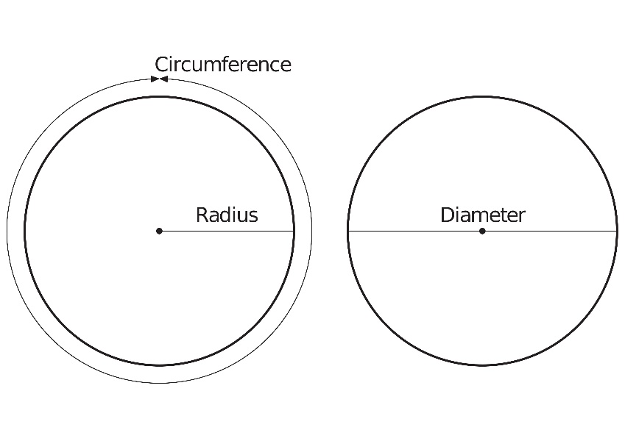
What’s the same? What’s different?
DISCUSS
2x + y
C = 𝜋d
A = 𝜋r ²
What key mathematical words can you extract from the above equations?
Notes:
Support may be required to identify that two of the statements are formulae (possibly mentioned in the discussion from the previous slide).
Make it clear that 2x + y is an expression, whereas the other two are equations.
Learners will have an opportunity to discuss keywords on this slide. What’s different and what’s the same? Confirm understanding of key terms such as expression and equation.
Address the misconception that there is no difference between a formula and an expression.
A formula is a rule written using symbols that describe a relationship between different quantities.
An expression is a group of mathematical symbols that represent a number or a quantity.
Learners can spot the difference as expressions will never have equality or inequality signs =, >, <, ≠ ,≥, ≤

Slide 5

Expressions
DISCUSS
Dev says,
10 + a
10 ÷ a
a – 10
10 – a
a × 10
I had £10
I gave some money away.
✓
a is the amount of money, in pounds, that Dev gave away.
Which expression shows how much money Dev has left?
Notes:
Throughout this scenario, allow time for learners to review the expressions and identify the correct one.
Continue to use the appropriate language. The following slide continues the discussion that is taking place here.
Demonstrate to learners that the expression can be constructed from the words presented in the question. Tutor to demonstrate data extraction if required.
As a reminder from the previous slides, highlight that x is not the variable here – it is a.

Slide 6
Expressions
DISCUSS
Dev says,
10 + a
10 ÷ a
a – 10
10 – a
a × 10
I had £10
I gave some money away.
What do the other options represent?
Notes:
This slide allows further discussion of the other options Dev has.
Encourage learners to investigate the other options and identify what each represents.
Deepen learning by exploring the other expressions not selected.
Why are they not correct? What does each statement mean?
Promote the order of operations if required.
The tutor may need to confirm understanding through questioning. ‘Is a − 10 the same as 10 − a?’ Also, ‘When would it be possible for the answer in "a − 10" or "10 − a" to be a negative number?’
Promote mastery by empowering learners to understand why the correct statement is correct but also what the other statements represent and why they do not represent Dev’s statement.

Slide 7

Dev and Ruby play a game…
YOUR
TURN
Use a letter to represent the number Ruby is thinking of, and write the statement on your whiteboards using letters and numbers:
1. I am thinking of a number, and I add three.
2. I am thinking of a number, and I multiply by two and add three.
3. I am thinking of a number, and I square it.
4. I am thinking of a number, and I square it and multiply it by 6.
Remember your order of operations.
Use your whiteboards.
Notes:
Whiteboards, pens and erasers are required.
Learners should write down expressions for the statements posed by Ruby.
Class size can determine whether this is a group, paired or individual activity.
Prior knowledge of the order of operations is needed; tutor will provide assistance throughout the activity.
Knowledge and skills in solving positive and negative number tasks is required.
Have a discussion about the misconception of squaring numbers if appropriate. Some learners might view a squared number as multiplying by 2, not multiplying by itself, i.e., 8² = 64, not 16.
Questions 2 and 4 can highlight this misconception.
Potential ways to assess the learners include:
Move around the classroom and listen to learners' discussions, offering assistance as needed.
Learners write down answers and present whiteboards to tutor for an overview of their answers.
A key element is for the tutor to gather feedback to understand the level of class and individual confidence and understanding.
(Note that x does not have to be the variable.)
Answers:
1. x + 3
2. x × 2 + 3
3. x²
4. x² × 6

Slide 8


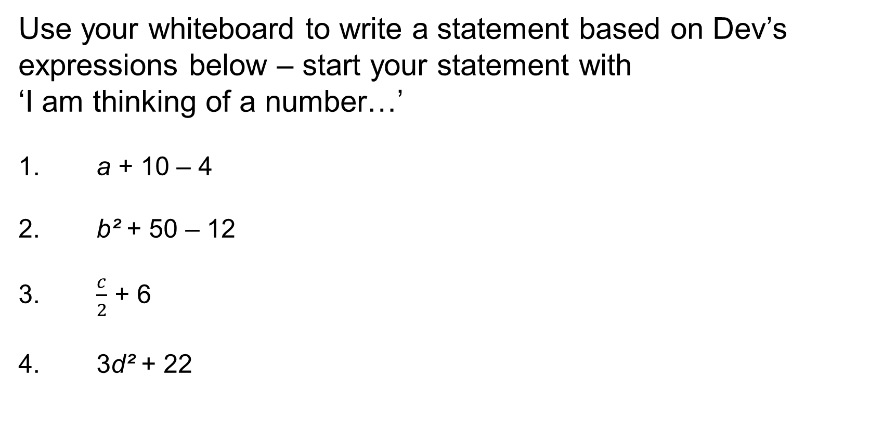
Dev and Ruby play a game…
YOUR
TURN
Use your whiteboard to write a statement based on Dev’s expressions below – start your statement with
‘I am thinking of a number…’
1. a + 10 – 4
2. b² + 50 – 12
3. $\frac{c}{2}$ + 6
4. 3d² + 22
I am thinking of a number…
Notes:
Promote mastery and cognitive thinking by flipping the previous activity.
This allows for deeper learner thinking and understanding through statement construction. It also promotes ownership of learning by having learners create their own scenarios and statements.
Again, the tutor may need to move about the room to listen in on conversations and offer support and guidance.
Feedback can be captured individually or as a group (similar to the previous slide activity).
1. I am thinking of a number, and I add 10 and subtract 4.
2. I am thinking of a number, and I square it, add 50, and subtract 12.
3. I am thinking of a number, and I divide it by 2 and add 6.
4. I am thinking of a number, and I square it, multiply by 3, and add 22.
Potential extension task: if learners are paired or grouped, they could create their own ‘thinking of a number’ scenarios and have their partner write down the expressions.

Slide 9

Expressions and Formulae
KEY IDEA
A variable is an unknown value represented by a letter (e.g. n).
The value of a variable can change.
x is common, but other letters can be used.
The order of operations can define the steps required to work through the formula.
Notes:
This slide can be used to recap knowledge from previous slides.
This is also an opportunity to emphasise the importance of formula structure.
This is an opportunity for the tutor to summarise and review the knowledge and language covered so far.

Slide 10
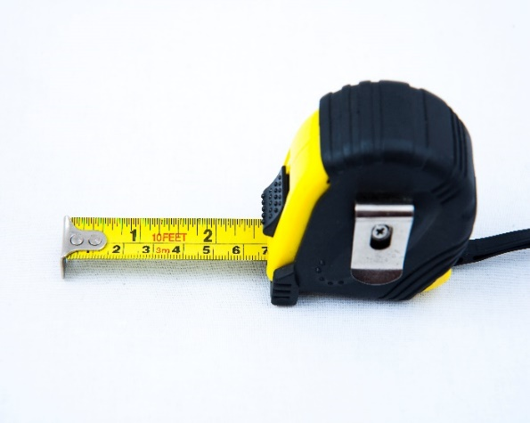
Substitution example: what is the area?
DISCUSS
Dev and Ruby are working out the area of their classroom. Dev knows the area can be calculated by multiplying the length by the width.
Ruby writes the formula
A = L × W
Ruby measures the length to be nine metres.
Dev measures the width to be six metres.
What is the area?
Remember your units metres squared.
A = 9 m × 6 m
Dev calculates the answer to be 54 m².
Notes:
This example of substitution aims to be accessible and recognisable.
Clarify that the letters L and W are substituted by the numbers 9 and 6 as part of building the formula.
Emphasise that substitution is simply changing the letters to numbers in order to answer the question and solve the formula.
Learners should use their whiteboards to go through the questions step by step.
Learners will write down the formula, substitute L × W with numbers, and calculate the answer.
The tutor can ask for feedback from a learner or give an example. The key is to demonstrate straightforward substitution by changing letters to numbers.
The tutor should emphasise the importance of units.

Slide 11

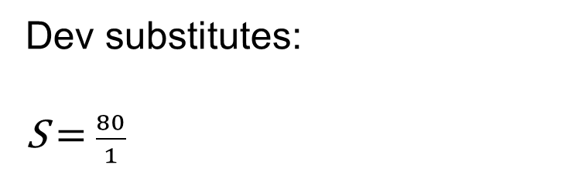
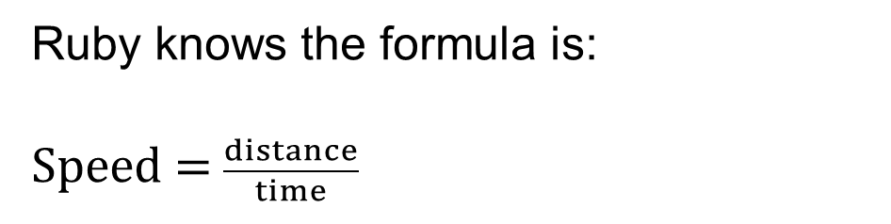
Substitution example 2: calculating speed
DISCUSS
Dev and Ruby take the train to London for a school trip. They travel 80 kilometres from their town to the city. The train journey takes 1 hour. Dev wonders how fast they travelled.
Ruby knows the formula is:
Speed = $\frac{distance}{time}$
Dev substitutes:
S = $\frac{80}{1}$
Ruby explains that they travelled at 80 km/h.
Dev says when he and his dad drove to London from their town, it took 2 hours, so they were travelling at 160 km/h.
Is Dev correct? Why?
Notes:
The questioning of Dev’s accuracy is an opportunity for learners to demonstrate their problem-solving skills.
The tutor should use "why" questions to allow learners to explore Dev’s answer in more detail and offer their suggestions and opinions. This should give the tutor a much clearer insight into the learners’ learning journey.
The tutor can use this as an opportunity to identify who is consolidating their learning, is ready to learn the next concept, and has made links with previous learning.
Have learners write down the formula on whiteboards and substitute, resulting in an answer of 80 km/h.
The tutor will then have the blue box question appear and allow learners to consider whether Dev is correct or incorrect and offer reasons why, via class discussion.
The misconception addressed here is that Dev is misreading the formula and not substituting correctly. Dev has wrongly assumed that if the journey has doubled in time (1 hour to 2 hours), then the speed has doubled too (from 80 km/h to 160 km/h).
By working through the formula and substituting correctly, the tutor can demonstrate that S = $\frac{80}{2}$ = 40 km/h. Learners should be able to recognise that the journey was at a slower speed and therefore took longer.
The scenario can require significant structure from the tutor if learners are finding this question challenging. The concepts of time, distance, and speed may require discussion to unpack and comprehend. Either way, emphasise that substitution is the key and is, in this case, straightforward.

Slide 12

Card match
EXPLORE
Worksheets
available
Step 1: Card match up | Step 2: Number tables
Match up the formula with the expression using the cards provided. | Calculate the missing numbers in the sequence by matching to the paired sentences and expressions. How are you going to work out the missing numbers?
Notes:
The tutor to hand out envelopes of cut up expressions and formulae.
Learners to complete the paired card activity first.
Depending on the dynamics of the class, this would ideally be an activity for 2 or 3 learners and good for collaborative learning.
Once checked by the tutor, the next part of the activity can be distributed to the learners.
If the paired exercise has incorrect answers, encourage learners to review.
If the answers are all correct, distribute the number tables. The tutor will need to explain and can use the prompts on the slide.
Learners can be encouraged to write the correct formula in the same box as the number tables, allowing the tutor to check and mark their work throughout.
Answers will be shown on the next slide, though learners may not match up in the same order. By having learners write the expression, checking will be easier.
This is a significant activity that consolidates the objectives of the lesson. Allow plenty of time for moving around the classroom, engaging all groups, and having guided conversations to ensure learners understand the processes of this activity.

Slide 13

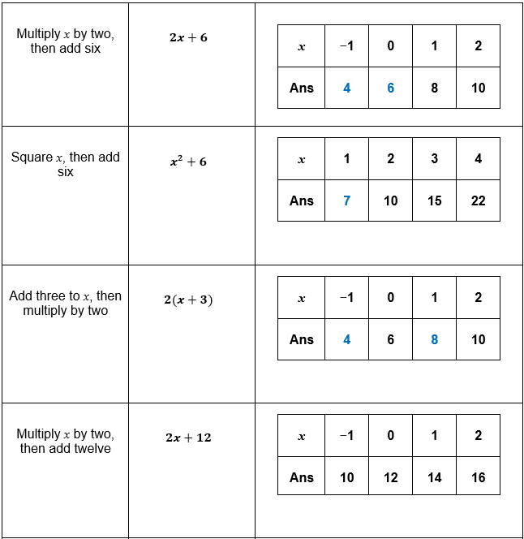
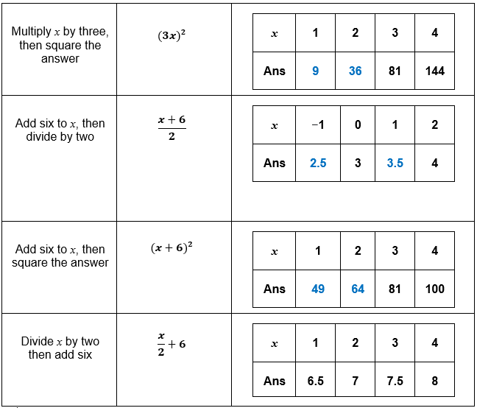
Card match answers
REVIEW
Handout
available
Notes:
The tutor should print out the answers to use as part of the card sort exercise when working with learners.
The answers on this slide can be projected once the activity is completed.

Slide 14
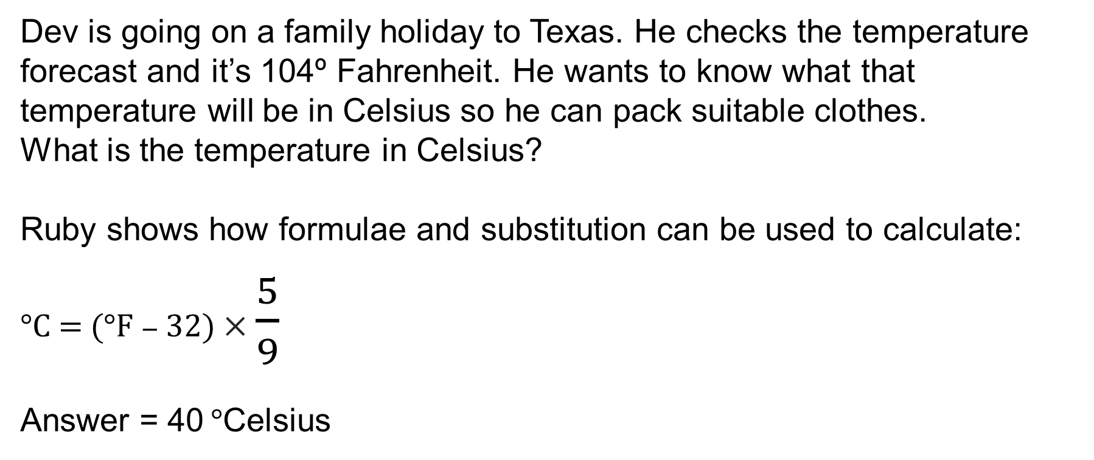
Converting Fahrenheit to Celsius
DISCUSS
Dev is going on a family holiday to Texas. He checks the temperature forecast and it’s 104º Fahrenheit. He wants to know what that temperature will be in Celsius so he can pack suitable clothes.
What is the temperature in Celsius?
Ruby shows how formulae and substitution can be used to calculate:
°C = (°F − 32) × $\frac{5}{9}$
Answer = 40 °Celsius
Substitute 104 for °F and complete the calculation. Remember your order of operations.
Notes:
Ideal opportunity to assess consolidation of knowledge and skills of applying order of operations. Are there still any misconceptions that need addressing?
If so, tutor is to intervene at this point and review.
This is a substitution question that uses a real-life scenario. It also reflects some of the questions found in an exam paper that have a context.
This is an individual activity that learners can complete using their own whiteboards and it provides an opportunity to reflect on their own learning that has taken place during this lesson. Equally, the tutor can gather feedback on class knowledge and understanding.
Tutor to provide feedback with the answer and this will feed into the next slide question.

Slide 15
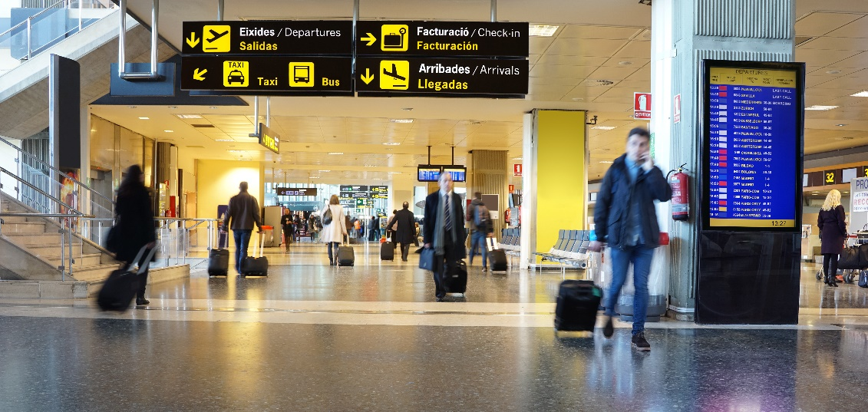
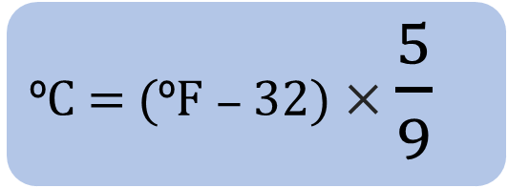
Converting Fahrenheit to Celsius
EXPLORE
Ruby is going on holiday with her family to Mexico in December to celebrate the festive season.
The forecast temperature is 79 ºF.
Dev tells Ruby to take a woolly hat and some gloves because December is always cold.
Is he right? Why?
ºC = (ºF − 32) × $\frac{5}{9}$
Notes:
Less scaffolding is given in this scenario so learners can demonstrate knowledge from the previous example.
Learners are required to extract information from the scenario as before and decide whether or not Dev is correct in saying that December is always cold and to justify their reasoning.
Learners to use their whiteboards to calculate the answer. Tutor to provide structure if required but aim for the blue box providing the relevant information.
79 − 32 = 47
47 × 5 = 235
235 ÷ 9 = 26.1 recurring.
This provides a learning opportunity to review suitable rounding.
This question is consistent with the previous Ruby and Dev scenario from earlier in the lesson (travelling to London and speed) as well as the previous slide.
It encourages learners to engage with the narrative and continuity of the two characters and promotes a sense of familiarity that can enhance learners' confidence in solving tasks.

Slide 16
Review
REVIEW
KEY IDEA
Substitution replaces letters with numbers
A variable is not always the letter x
Variables change in value
Use the order of operations to work through a formula
Add units if appropriate
Notes:
This is an opportunity to review the lesson and progress made so far.
Allow time for questions where required.
Lead into exam questions as the next activity.

Slide 17
Exam question examples
PRACTICE QUESTION
Worksheet
available
Use your skills to complete the exam questions
Remember to use units where possible.
Notes:
Exam handout to be distributed and tutor to support throughout the activity.
Highlight that all examples relate to the skills developed throughout the lesson.
The tutor should use this activity to relate knowledge and skills to exam questions. Tutor to support and check answers as appropriate.
Activity can be concluded by the tutor projecting questions and working through them or asking learners to explain their answers.

Slide 18
Exam questions
PRACTICE QUESTION
Worksheet
available
1. g = 9
h = 4
Work out the value of 2g + 3h
2. w = 4u + 3
Find the value of w when u = 8
3. T = 3x + 4y
Work out the value of T when x = 5 and y = −7
Notes:
Exam handout to be distributed and tutor to support throughout the activity.
Highlight that all examples relate to the skills developed throughout the lesson.
The tutor should use this activity to relate knowledge and skills to exam questions. Tutor to support and check answers as appropriate.
Activity can be concluded by the tutor projecting questions and working through them or asking learners to explain their answers.

Slide 19
Exam questions
PRACTICE QUESTION
Worksheet
available
4. P = 7r + 3q
Work out the value of P when r = 5 and q = –4
5. v² = u² + 2as
u = 12 a = −3 s = 18
Work out a value of v
Notes:
Exam handout to be distributed and tutor to support throughout the activity.
Highlight that all examples relate to the skills developed throughout the lesson.
The tutor should use this activity to relate knowledge and skills to exam questions. Tutor to support and check answers as appropriate.
Activity can be concluded by the tutor projecting questions and working through them or asking learners to explain their answers.

Slide 20
Lesson review:
Substitution and Formulae
Objectives
Revise order of operations.
Use formulae in words and numbers.
Substitute positive and negative numbers in the formula.
Use variations of concepts to promote mathematical thinking and discussion, building on existing knowledge relevant for substitution and formulae.
Suggested further steps/areas to work on
Solving equations
Notes:
See below the objectives facing the tutor, which complement the student-friendly objectives shown on the slide:
Use order of operations to navigate through expressions and formulae.
Use formulae in words and numbers, recognising links between language and numbers.
Substitute positive and negative numbers in algebraic formulae.
Use variations of concepts to promote mathematical thinking and discussion, building on existing knowledge relevant for substitution and formulae.
As part of concluding the lesson, the tutor should run through objectives and draw out key learning points from learners and the activities completed.

Slide 21
Lesson 29:
Credits
Text acknowledgements
Pearson Education Ltd: Edexcel Level 1/Level 2 GCSE (9-1) November 2018 1MA1/1F Mathematics Paper 1 (Non-Calculator) Foundation Tier Question 9 (slide 18), Edexcel Level 1/Level 2 GCSE (9-1) November 2019 1MA1/3F Mathematics Paper 3 (Calculator) Foundation Tier Question 7 (slide 18), Edexcel Level 1/Level 2 GCSE (9-1) November 2020 1MA1/2F Mathematics Paper 2 (Calculator) Foundation Tier Question 15 (slide 18), Edexcel Level 1/Level 2 GCSE (9-1) June 2019 1MA1/2F Mathematics Paper 2 (Calculator) Foundation Tier Question 11 (slide 19), Edexcel Level 1/Level 2 GCSE (9-1) November 2018 1MA1/1F Mathematics Paper 1 (Non-Calculator) Foundation Tier Question 21 (slide 19)
Photo acknowledgements
Pearson Education Ltd: HL Studios, Naki Kouyioumtzis
Shutterstock.com: Vectorfair.com, BOOCYS, Muratart

