Slide 1


Lesson 18:
Circles
Level 2
Objectives
Calculate the area and perimeter of circles, semicircles and quadrants (in terms of π or to an appropriate degree of accuracy)
Explore problems involving the area or perimeter of compound shapes that include circles, semicircles or quadrants
Apply knowledge learned to exam-style questions

Slide 2
Starter activity
Measure the circumference and diameter of the object you have been given using a string and a ruler.
Write the measurements in a table.
For each object, divide the circumference by the diameter.
What do you notice?
Object | Diameter | Circumference | C ÷ D
Can you remember the formula for:
the circumference of a circle?
the area of a circle?
Notes:
Ask learners to work in groups. Provide each group with a different circular or a cylindrical object, a piece of string and a ruler. Each group measures the circumference and diameter of their object. Ask groups to report their measurements and record them in a table on the board. Then ask learners to divide the circumference by the diameter for each object and share their observations.
Elicit the formulae for area and circumference from the learners and link to rearrangement of π=C/d. Tutors can display these formulae on the board.

Slide 3


Circumference and area of a circle
KEY IDEA
Circumference of a circle:
$$C=πd or C=2πr$$
Area of a circle:
$$A=πr^{2}$$

Slide 4
DISCUSS
Is the statement correct?
The diameter of a circle is 10 cm.
Adam says its radius must be 5 cm.
The radius of a circle is 3 cm
Ruby says the diameter must be 6 cm².
The diameter of a circle is 4 cm.
Dev says the radius is 8 cm.
Do you agree with these statements?
Why or why not?
Notes:
Learners might need a reminder of the relationship between the diameter and the radius of a circle. Refer back to the task they carried out in slide 2 if necessary.
Adam’s statement is correct, as the diameter of a circle is twice the length of its radius.
Ruby’s statement is incorrect. The diameter is measured in cm, not cm². The diameter must be 6 cm.
Dev’s statement is incorrect. The radius of a circle is half the length of the circle’s diameter. If the diameter of the circle is 4 cm, the radius must be 2 cm.

Slide 5
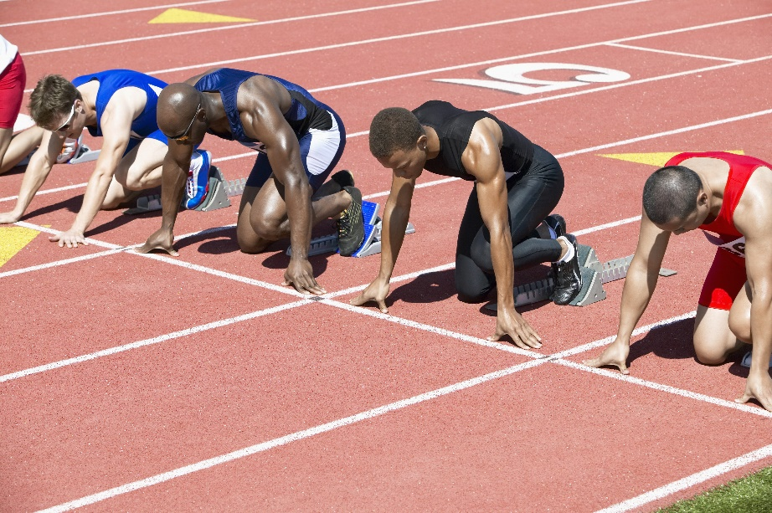
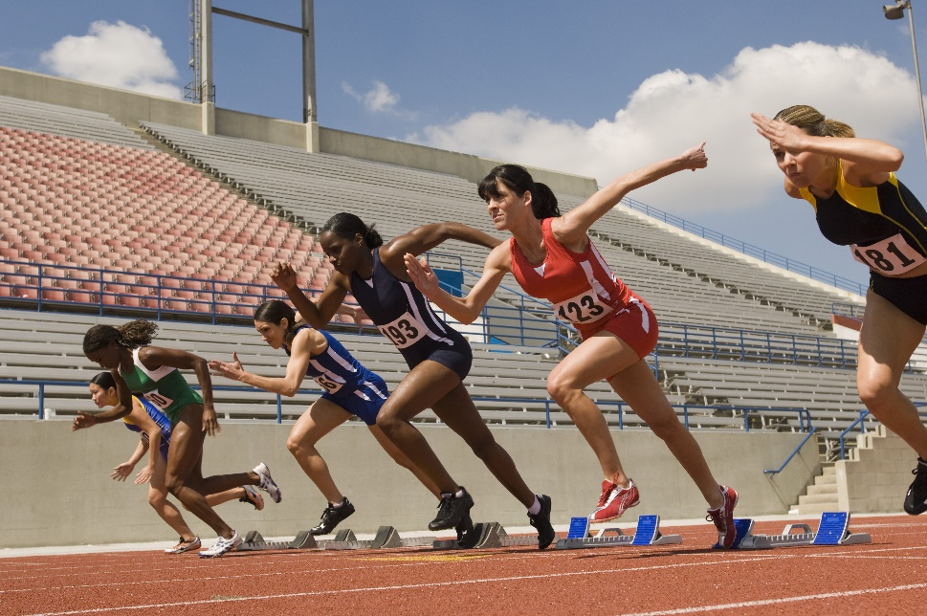
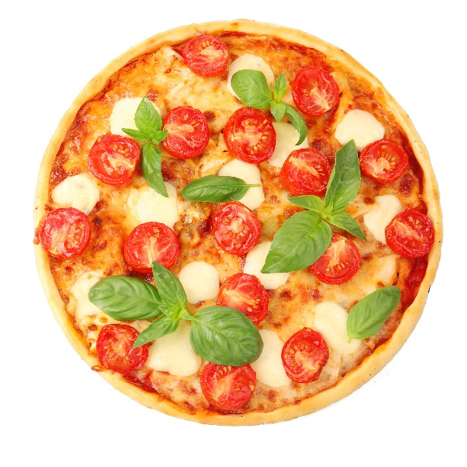
Youth athletics final
DISCUSS
Notes:
Introduce the context for this activity: A group of learners have made it through to the national youth athletics final. They will be staying overnight near the athletics track, and will enjoy a pizza treat on arrival. During their meal, they discuss tactics and preparation for the final.

Slide 6

Pizza treat
DISCUSS
EXPLORE
Ruby and Florence can buy one 12-inch pizza or two 8-inch pizzas.
Ruby thinks that two 8-inch pizzas are better because they get 4 more inches of pizza for the same price.
Florence does not agree.
12-inch pizza
£7.99!!!
Two 8-inch pizzas
£7.99!!!
Notes:
Ask learners to work in pairs to decide which offer they would choose and why. Ask some pairs to share their methods and ask other learners if they believe their method and arguments are valid.
The misconception addressed here is that learners think that if the diameter is doubled, the area is also doubled. Ask: Why did Ruby think they will get 4-inch extra? Will doubling the length (diameter) of a pizza also double the area (size)?

Slide 7

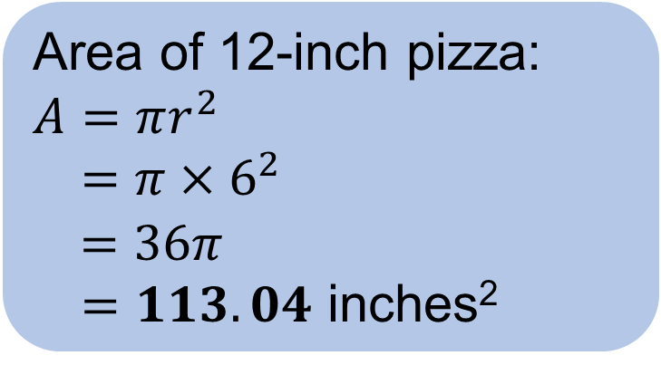
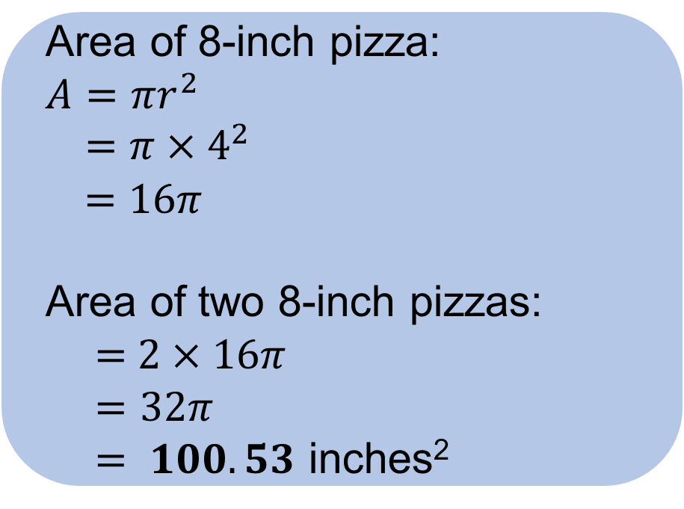
Area of the pizzas
DISCUSS
  Area of 8-inch pizza:
  $$A=πr^{2}$$
  $=π×4^{2}$
  $$=16π$$
  Area of two 8-inch pizzas:
  = $2×16π$
  $=32π$
  $= 100.53$ inches²
  Area of 12-inch pizza:
  $$A=πr^{2}$$
  $=π×6^{2}$
  $$=36π$$
  $=113.04$ inches²
Which offer should they choose?
Why?
Notes:
Ask learners why they should avoid rounding the answers until the end.

Slide 8
Stuffed crust pizza
DISCUSS
EXPLORE
Ruby and Florence want to find out which deal would give them the most stuffed crust.
What do they need to work out?
12-inch pizza
£7.99!!!
On your mini whiteboard, work out:
the circumference of a 12-inch pizza
the total circumference of two 8-inch pizzas
which choice has more stuffed crust
Two 8-inch pizzas
£7.99!!!
Notes:
Guide learners to link the amount of stuffed crust to the circumference – the option that gives the most stuffed crust is the option with the greatest circumference.
Refer to the formula for circumference in the ‘Key idea’ slide.

Slide 9
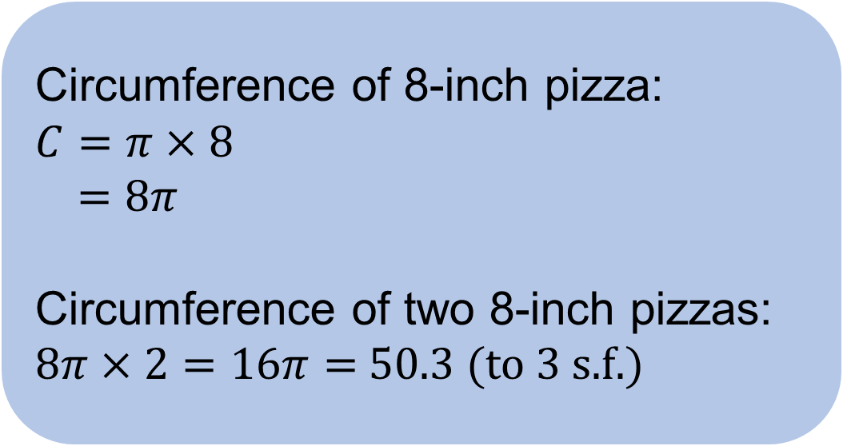
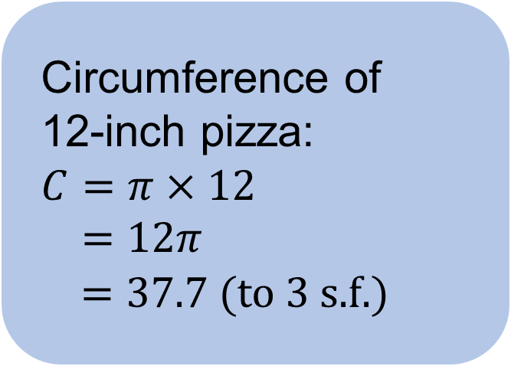
Circumference of the pizzas
DISCUSS
EXPLORE
  Circumference of
  12-inch pizza:
  $$C=π×12$$
  $=12π$
  $=37.7$(to 3 s.f.)
  Circumference of 8-inch pizza:
  $$C=π×8$$
  $=8π$
  Circumference of two 8-inch pizzas:
  $8π×2=16π=$50.3 (to 3 s.f.)
Which deal has more stuffed crust?
Notes:
Ask learners why they should avoid rounding the answers until the end.

Slide 10


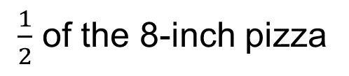
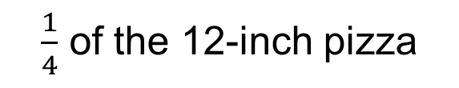
Adam’s choice
DISCUSS
Adam has a choice between:
half of the 8-inch pizza
a quarter of the 12-inch pizza.
or
$\frac{1}{2}$ of the 8-inch pizza
$\frac{1}{4}$ of the 12-inch pizza
Adam wants the most pizza. Which should he choose?
What if Adam wants the most stuffed crust?
Is the length of the stuffed crust the same as the perimeter of each half-slice or quarter-slice? Why or why not?
Notes:
For the first question, learners should calculate the areas and compare.
For the second question, learners should only consider the circumference of the curved edge of the pizza.
Learners should pick the quarter of the 12-inch for the first question, but half the 8-inch for the second question.
Answer for the third question:
No, it is not. The crust is only around curved edge. You will need to add in the diameter for half pizza and twice the radius for quarter pizza to get the perimeter.

Slide 11
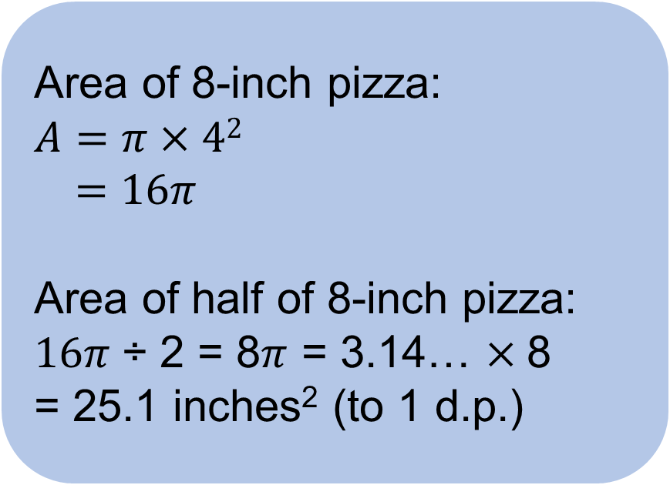
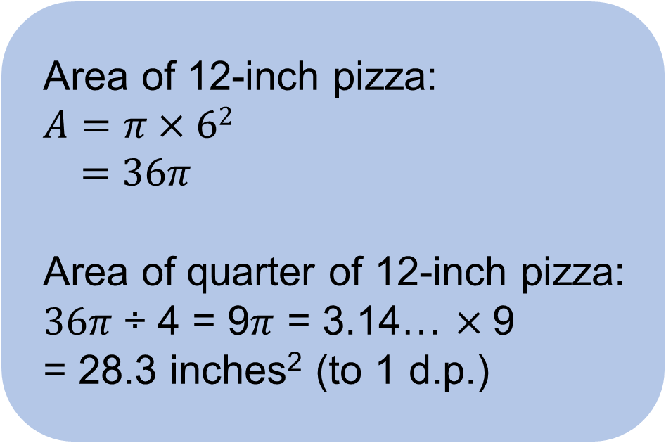
Area of semicircles and quadrants
DISCUSS
EXPLORE
If Adam wants the most pizza, which should he choose?
  Area of 8-inch pizza:
  $$A=π×42$$
  $=16π$
  Area of half of 8-inch pizza:
  $16π$÷ 2 = 8$π$ = 3.14… $×$8
  = 25.1 inches² (to 1 d.p.)
  Area of 12-inch pizza:
  $A=π×6$²
  $=36π$
  Area of quarter of 12-inch pizza:
  $36π$÷ 4 = 9$π$ = 3.14… $×$9
  = 28.3 inches² (to 1 d.p.)
Notes:
This activity assesses learners’ understanding of area of semicircles and quadrants.
The area of quarter of 12-inch pizza is more than that of half 8-inch pizza. Since Adam wants the most pizza, he should choose the quarter of 12-inch pizza.

Slide 12
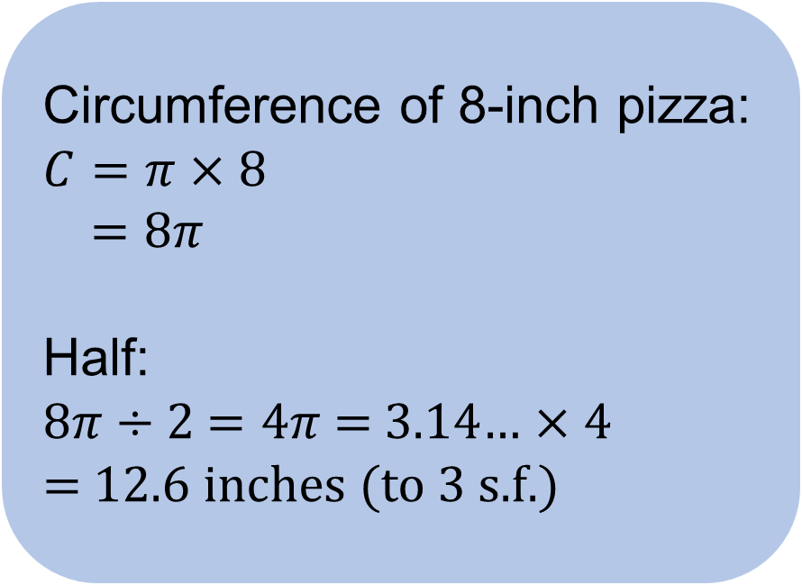
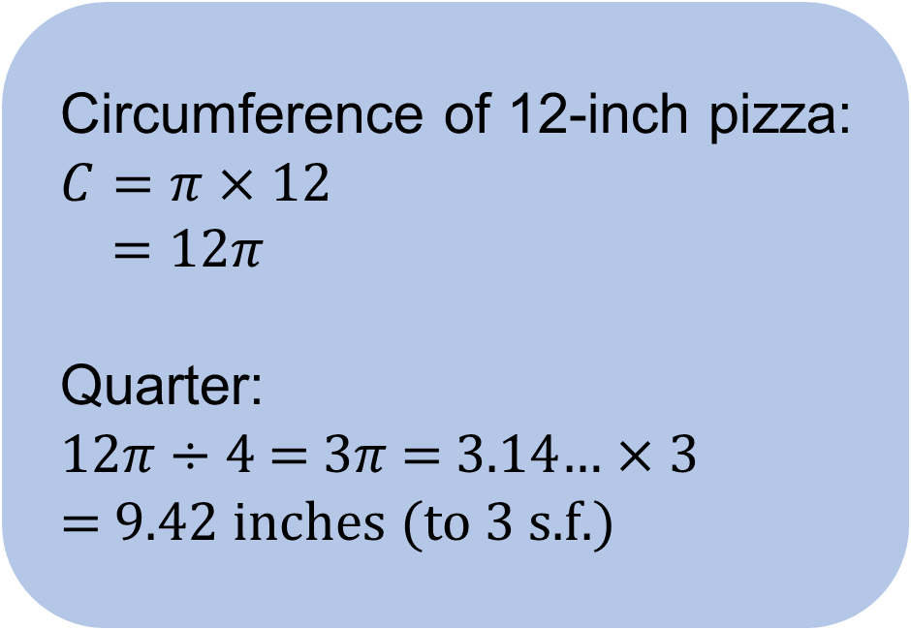
Circumference of semicircles and quadrants
DISCUSS
EXPLORE
What if Adam wants the most stuffed crust?
  Circumference of 8-inch pizza:
  $$C=π×8$$
  $=8π$
  Half:
  8$π$ ÷ 2 $=4π$ = 3.14… $×4$
  = 12.6 inches (to 3 s.f.)
  Circumference of 12-inch pizza:
  $$C=π×12$$
  $=12π$
  Quarter:
  12$π$ ÷ 4 = $3π$ = 3.14… $×3$
  = 9.42 inches (to 3 s.f.)
Notes:
Ask learners why they should avoid rounding the answers until the end.

Slide 13

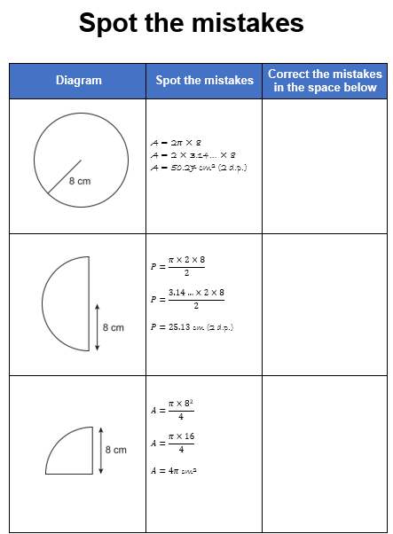
Spot the mistakes
YOUR
TURN
Handout
available
Work in pairs.
Spot the mistakes in each working.
Give the correct working.
Notes:
Give learners the ‘Spot the mistakes’ handouts. Ask them to work in pairs. The next few slides show the misconceptions and correct calculations.

Slide 14
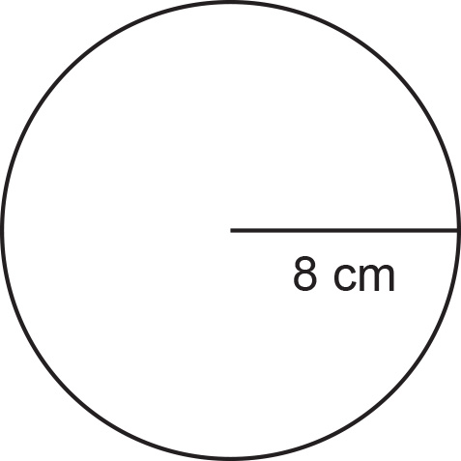
Answers: Spot the mistakes (1)
REVIEW
YOUR
TURN
Handout
available
Diagram | Spot the mistakes | Correct the mistakes in the space below
 | C = 2 × 𝜋 × 8² C = 2 × 3.14… × 64 C = 402.12 cm² (2 d.p.) | C = 2 × 𝜋 × 8 C = 16 × 𝜋 C = 50.27 cm (2 d.p.)
Using the wrong formula for circumference

Slide 15
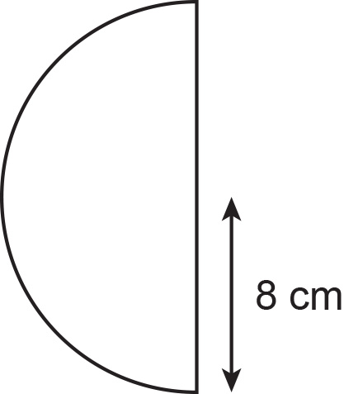
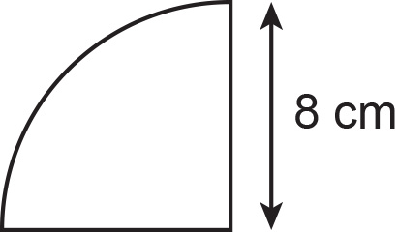
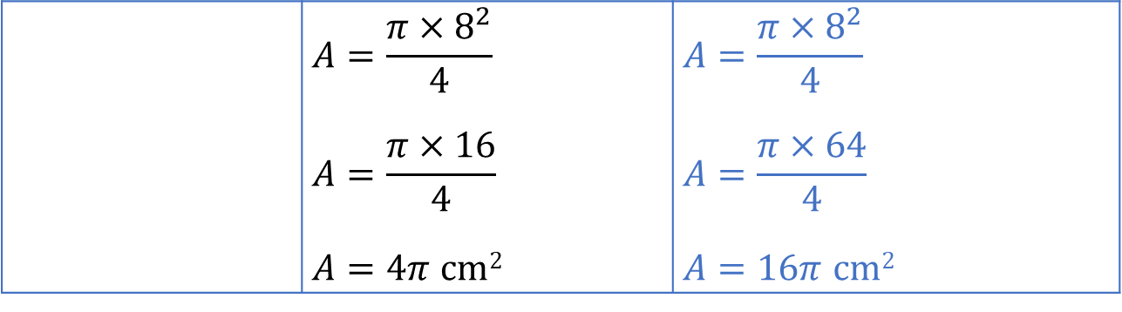
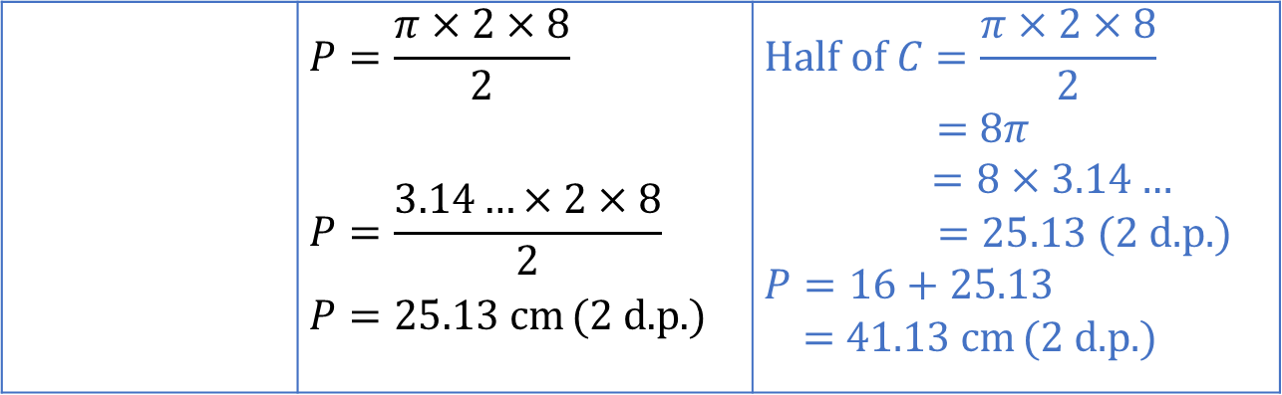
Answers: Spot the mistakes (2–3)
REVIEW
YOUR
TURN
Handout
available
 | $$P=\frac{π×2×8}{2}$$ $$P=\frac{3.14…×2×8}{2}$$ $P=25.13$ cm (2 d.p.) | $$Half of C=\frac{π×2×8}{2}$$ = 8𝜋 $=8×3.14…$ $=25.13$ (2 d.p.) $P=16+25.13$ = 41.13 cm (2 d.p.)
  Did not add the diameter to the circumference to find the perimeter of the semicircle.
 | $$A=\frac{π×8^{2}}{4}$$ $$A=\frac{π×16}{4}$$ $A=4π$ cm² | $$A=\frac{π×8^{2}}{4}$$ $$A=\frac{π×64}{4}$$ $A=16π$ cm²
  Multiplied 8 by 2 instead of finding 8²

Slide 16


Preparing for the athletics final
DISCUSS
EXPLORE
Notes:
This section includes problems involving area/perimeter of compound shapes involving circles.

Slide 17
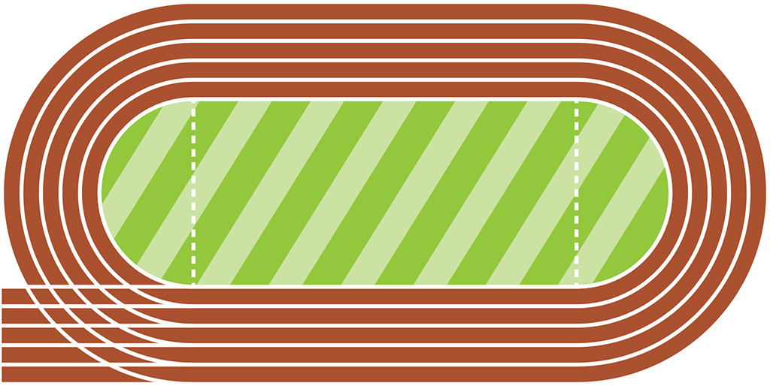
Repainting the inside line
DISCUSS
EXPLORE
Use your mini whiteboard to draw the inside line part of the racetrack or create the running track using a paper plate and a piece of paper.
Adam thinks that the total length of the inside line to be repainted is more than 400 m. Is Adam correct?
2 tins of white paint are enough to repaint 7 m and there are 113 tins. Will this be enough to repaint the whole inside line?
70 m
90.1 m
Use reverse calculation to check your work.
Notes:
Using the context of the athletics track and the need to re-paint the inside perimeter white line and resurface the grass. Learners can use mini whiteboards to draw this, or physical manipulatives.
Perimeter
Tutor to ensure that learners understand that there are two semicircles attached to a rectangle and ‘parts of the circumference of the semicircles are needed’.
Discussion questions after students have calculated or perhaps as scaffolding:
What shape is the curved part of the racetrack?
How did you calculate the distance around the curved parts?
How did you then calculate the total length of the inside line?
In calculating the circumference of the semi-circle, did you add the diameter?
Ask learners why they have not added the diameter and elicit from the learners under what circumstance can they add the diameter in real-life examples.
What’s the mathematical term for the total length of the inside line? (Perimeter)

Slide 18
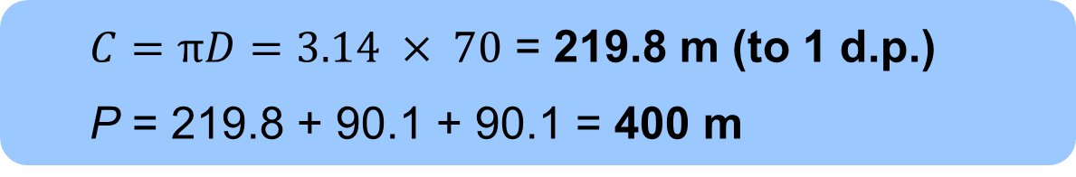
Total length of the inside line
(Perimeter of racetrack)
REVIEW
70 m
90.1 m
  $C=πD=3.14 × 70$ = 219.8 m (to 1 d.p.)
  P = 219.8 + 90.1 + 90.1 = 400 m
No. of Tins
2
113
Length (m)
7
395.5
Adam is not correct, as the total length is 400 m.
  No, its not enough, as 113 tins will repaint 395.5 m.
Using reverse calculation to check your answer:
400 – 90.1 – 90.1 = 219.8 m
Notes:
Tutor to ensure that learners understand that ‘parts of the circumference are needed’. Show the animation of the comprising shapes. Tutor to discuss with learners why they wouldn’t divide by 2 then multiply by 2 to get the curved edges.

Slide 19

Resurfacing the grass
DISCUSS
DISCUSS
Dev thinks that the area needed to resurface the grass is less than 10 000 m². Is Dev correct?
70 m
10 m² of grass cost £150 and the available budget is £150 000. Will this budget be enough to resurface the pitch?
90.1 m
Use reverse calculation to check your work.
Notes:
Again, using the context of the athletics track and the need to resurface the grass every year, learners are asked how they would calculate the area needed. Ratio table is a good tool for proportional/multiplicative reasoning and should be used to encourage learners who find it challenging.

Slide 20
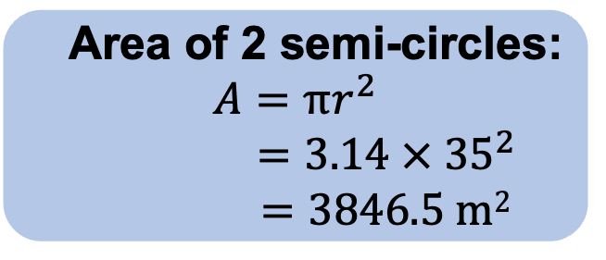
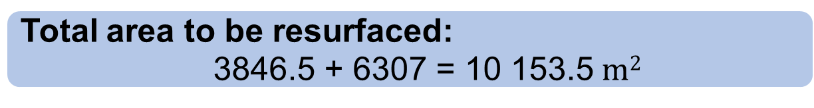
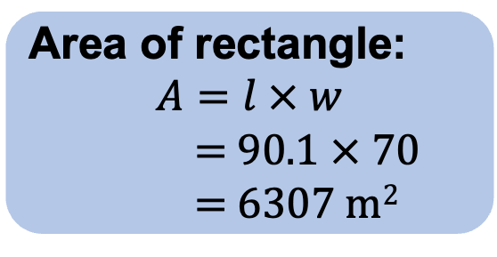
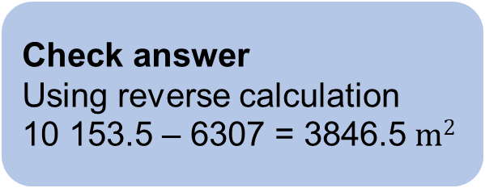
Resurfacing the grass
REVIEW
Area of 2 semi-circles:
$$A=πr^{2}$$
$$=3.14 × {35}^{2}$$
$=3846.5 m2$
Area of rectangle:
$$A=l × w$$
= 90.1 $×$ 70
= 6307 m²
Area m²
10
10 000
Cost £
150
150 000
Total area to be resurfaced:
3846.5 + 6307 = 10 153.5 $m2$
No, this budget will only resurface 10 000 m².
No, Dev is not correct, as it is more than 10 000 m².
Check answer
Using reverse calculation
10 153.5 – 6307 = 3846.5 $m2$
70 m
90.1 m
Notes:
The learners need to find the area of the circle, i.e. the 2 semicircles. Learners may find the area of the semicircle, then multiply by 2, but the tutor can explain why this may be an inefficient method. The tutor to explain the use of ratio table for learners who find proportional/multiplicative reasoning challenging.

Slide 21
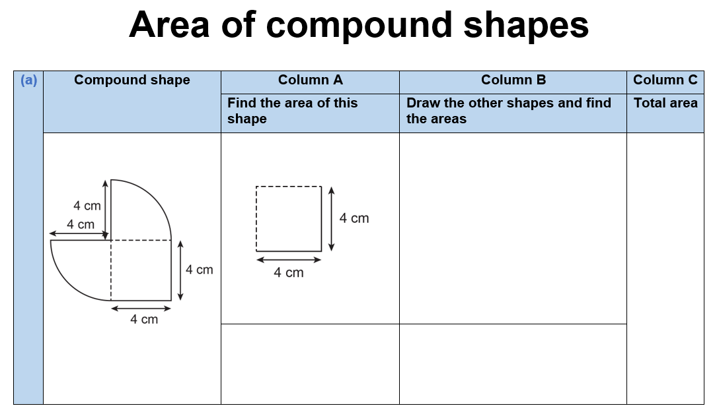
Area of compound shapes
YOUR
TURN
Handout
available
Look at each compound shape.
Column A shows part of the compound shape.
In Column B, draw the other shape(s) that make up the compound shape.
Calculate the area of the shape in each Column A.
Calculate the area of the shape in each Column B.
Work out the area of the compound shape.
Notes:
Provide learners with the ‘Area of compound shapes’ handout. Ask them to work in pairs to draw the missing shape.
Slides 22–25 provide the solutions to these tasks.

Slide 22
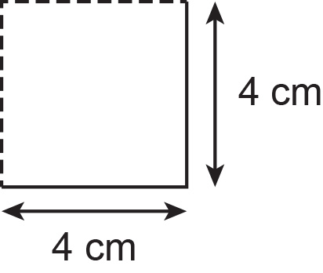
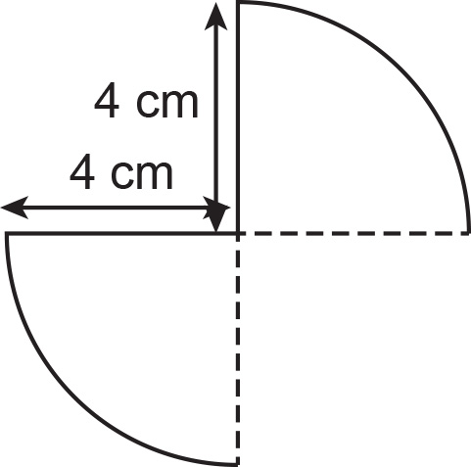
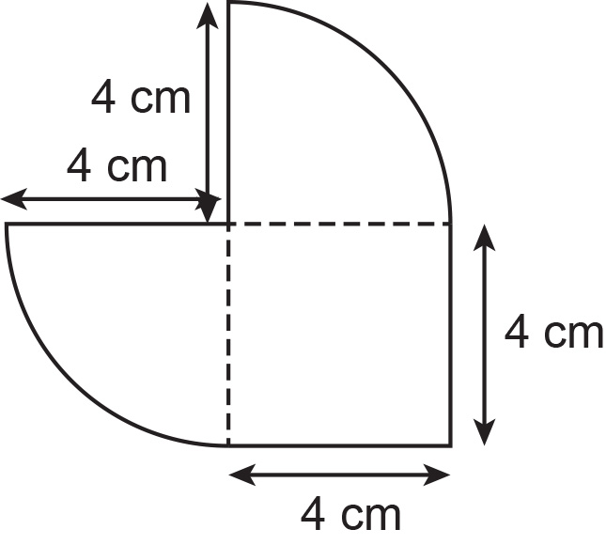
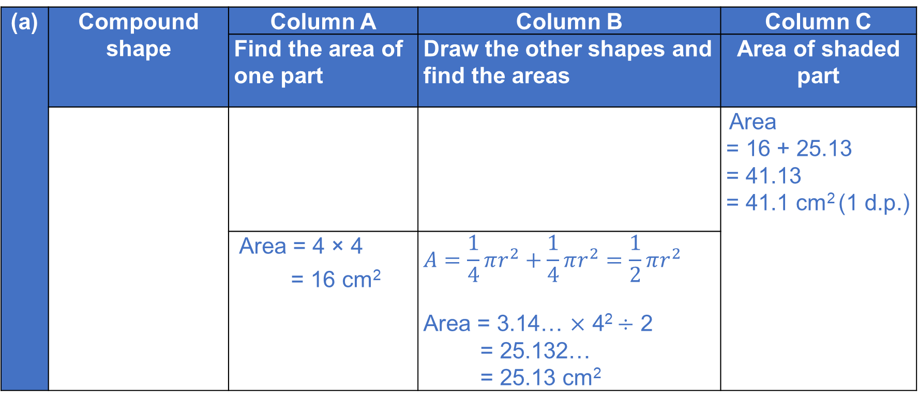
Answers (a)
REVIEW
(a) | Compound shape | Column A | Column B | Column C
 |  | Find the area of one part | Draw the other shapes and find the areas | Area of shaded part
 |  |  |  | Area = 16 + 25.13 = 41.13 = 41.1 cm² (1 d.p.)
 |  | Area = 4 × 4 = 16 cm² | $$A=\frac{1}{4}πr^{2}+\frac{1}{4}πr^{2}=\frac{1}{2}πr^{2}$$ Area = 3.14… × 4² ÷ 2 = 25.132… = 25.13 cm²
Notes:
Draw responses from the learners by asking these questions:
In Column B, what shapes have you drawn? (2 quarter circles)
How do you calculate the area of the two shapes?
How do you figure out the area of the compound shape? Do you add the parts or subtract?

Slide 23
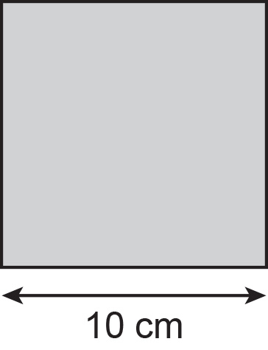
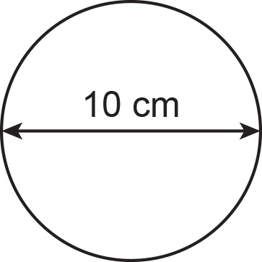
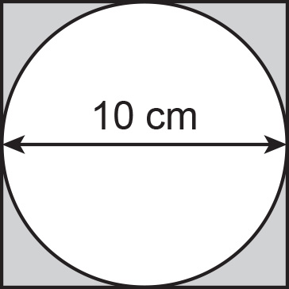
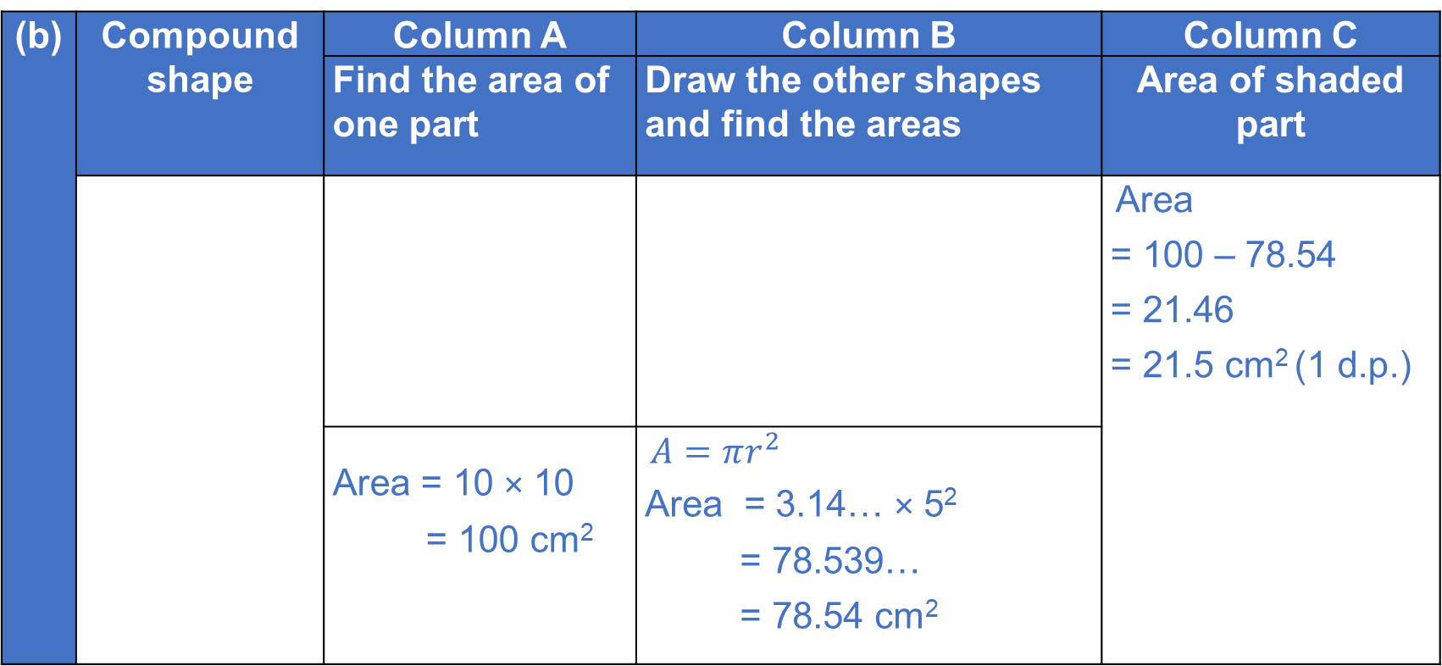
Answers (b)
REVIEW
(b) | Compound shape | Column A | Column B | Column C
 |  | Find the area of one part | Draw the other shapes and find the areas | Area of shaded part
 |  |  |  | Area = 100 – 78.54 = 21.46 = 21.5 cm² (1 d.p.)
 |  | Area = 10 × 10 = 100 cm² | $A=πr^{2}$ Area = 3.14… × 5² = 78.539… = 78.54 cm²
Notes:
Draw responses from the learners by asking these questions:
In Column B, what missing shape have you sketched? (circle)
Can you add up the square and circle to find out the area of the compound shape. Why/why not?
How do you calculate the area of the shaded part?

Slide 24
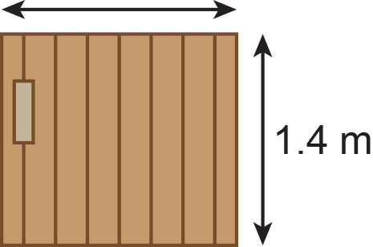
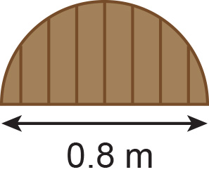
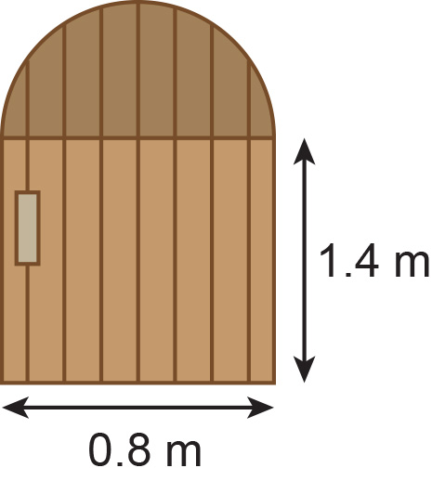
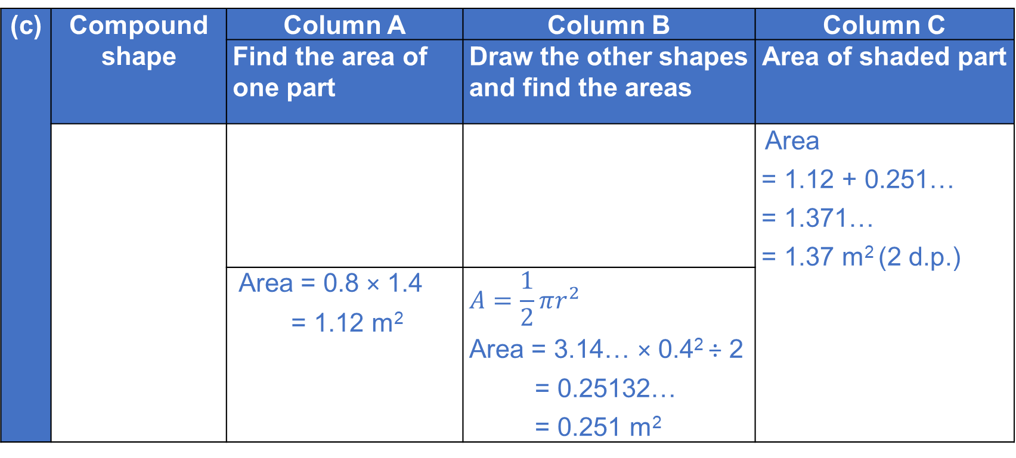
Answers (c)
REVIEW
(c) | Compound shape | Column A | Column B | Column C
 |  | Find the area of one part | Draw the other shapes and find the areas | Area of shaded part
 |  |  |  | Area = 1.12 + 0.251… = 1.371… = 1.37 m² (2 d.p.)
 |  | Area = 0.8 × 1.4 = 1.12 m² | $$A=\frac{1}{2}πr^{2}$$ Area = 3.14… × 0.4² ÷ 2 = 0.25132… = 0.251 m²
Notes:
Draw responses from the learners by asking these questions:
In Column B, what shape did you sketch? (semicircle)
How do you find out the area of the compound shape?

Slide 25
FS exam question tips
KEY IDEA
Underline the key information, e.g. area, perimeter, etc.
Look at the marks awarded, as they could link to the number of steps in the answer.
Could you use a ratio table or bar model?
You may be required to check your work either by reverse check or estimation.

Slide 26
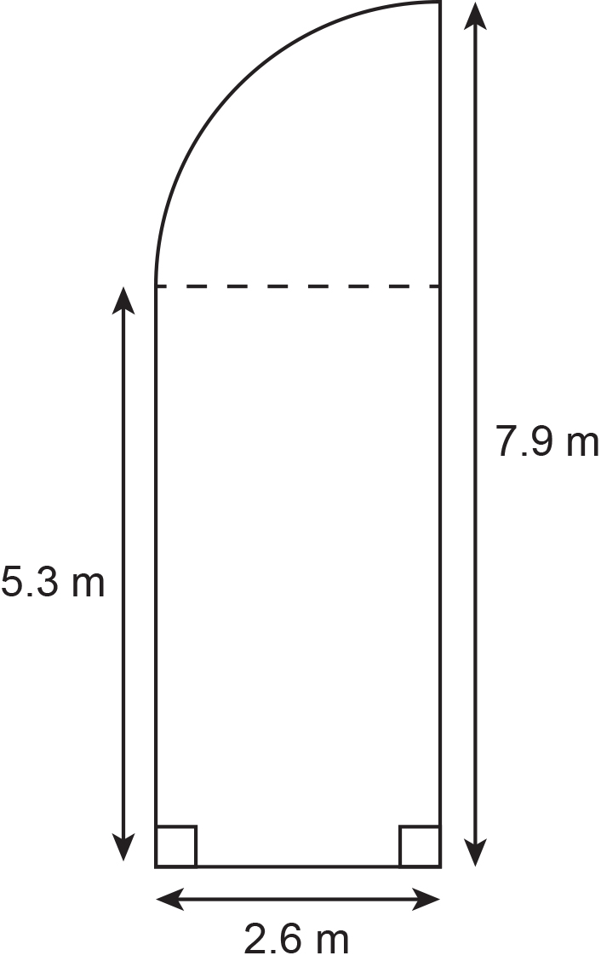
PRACTICE QUESTION
Practice question 1
Worksheet
available
Jessie needs to cover a wooden floor with varnish.
The floor is in the shape of a rectangle and a quarter circle.
A tin of varnish:
  covers 6 m²
  costs £5.41
  Jessie has £25 to buy the tins of varnish she needs to cover this wooden floor.
Exam tip: Look at units in the question. They would usually give clues on whether it is an area, perimeter or volume.
Exam tip: Can you use a ratio table to help with proportional reasoning?
Is £25 enough to buy all the tins of varnish Jessie needs?
Exam tip:
Answer the question (Yes or no), with a sentence. For example, ‘No, Jessie needs…’
Notes:
A shape from exam-style question is shown to learners on the board without the scenario/question. The tutor opens up a discussion to ask what learners can find out from the information shown. The tutor will write these ideas as questions on the board (additional questions to be provided in teacher guidance if learners are unable to create the questions).
Learners are then asked to attempt one of the questions which they feel confident that they can answer.
Information/scenario/question about the shape and exam tips are then shown to learners. Tutor to lead discussion on how to go about answering the question.
Handout available with all questions.

Slide 27
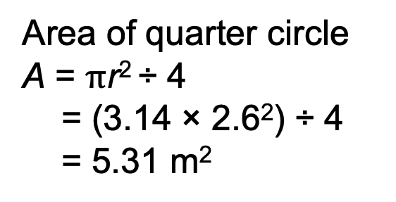
Varnishing wooden floor
REVIEW
Area of rectangle
5.3 × 2.6 = 13.78 m²
6 m² = 1 tin
19.09 m² = 19.09 ÷ 6
= 3.18
= 4 tins
Area of quarter circle
A = $π$r² ÷ 4
= (3.14 × 2.6²) ÷ 4
= 5.31 m²
1 tin costs £5.41
4 tins = 5.41 × 4
= £21.64
Sample solution (answers rounded to 2.d.p)
Total area = 13.78 + 5.31
= 19.09 m²
Yes, £25 is enough
Notes:
Tutor to remind learners that the compound shape includes a rectangle and quarter circle. The area of each needs to be found and added to find the total area. For area of the quarter circle, learners need to divide area of the circle by 4 or multiply by $\frac{1}{4}$.
Tutor may ask whether it is wrong if the area of the circle is multiplied by $\frac{90}{360},$and why?
Tutor to encourage learners to use ratio table for the section that requires multiplicative reasoning to find the cost and number of tins.

Slide 28
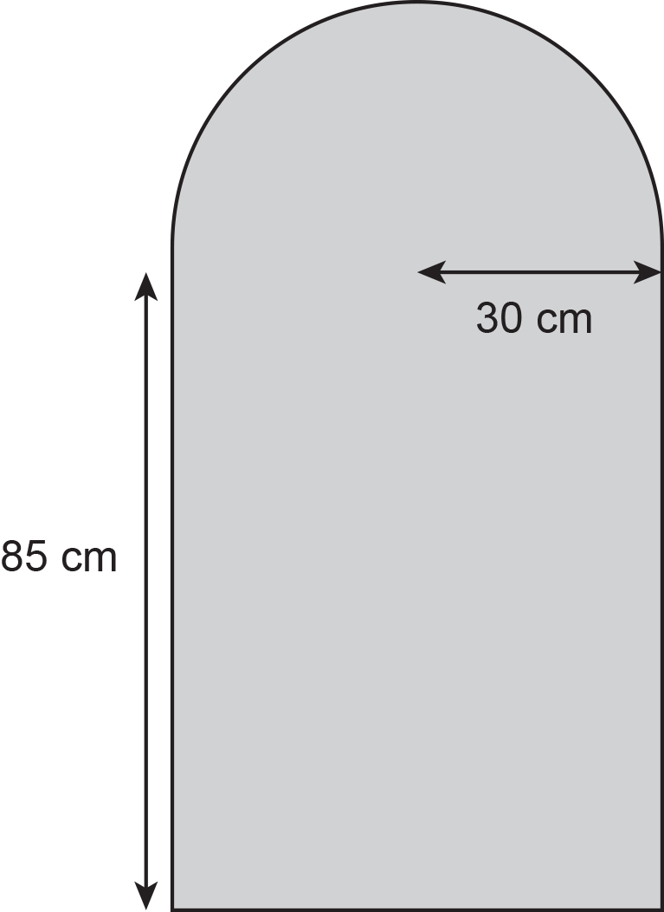
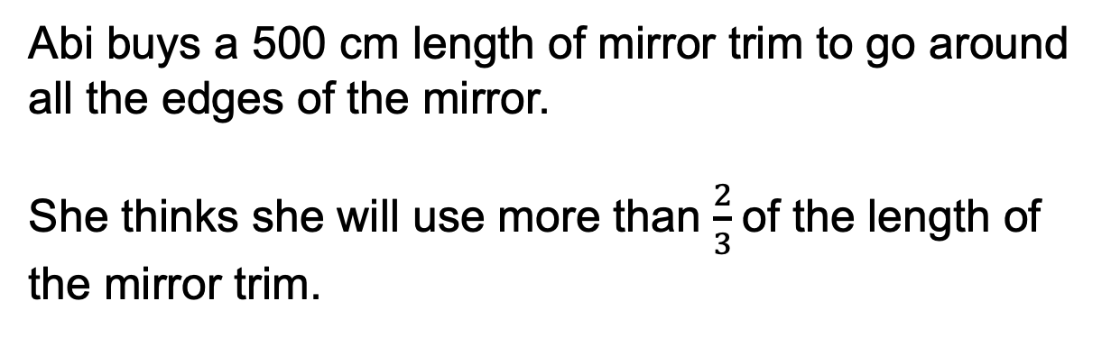
PRACTICE QUESTION
Practice question 2
Worksheet
available
Abi has a mirror in the shape of a rectangle with a semicircle on one of the shorter edges.
The radius of the semicircle is 30 cm.
The longer edge of the rectangle is 85 cm.
Abi buys a 500 cm length of mirror trim to go around all the edges of the mirror.
She thinks she will use more than $\frac{2}{3}$of the length of the mirror trim.
Is Abi correct?
Show why you think this.
Exam tip: Answer the question (Yes or no, with a sentence. No, the length is …)
Notes:
A shape from exam-style question is shown to learners on the board without the scenario/question. The tutor opens up a discussion to ask what learners can find out from the information shown. The tutor will write these ideas as questions on the board (additional questions to be provided in teacher guidance if learners are unable to create the questions).
Learners are then asked to attempt one of the questions which they feel confident that they can answer.
Information/scenario/question about the shape and exam tips are then shown to learners. Tutor to lead discussion on how to go about answering the question.

Slide 29
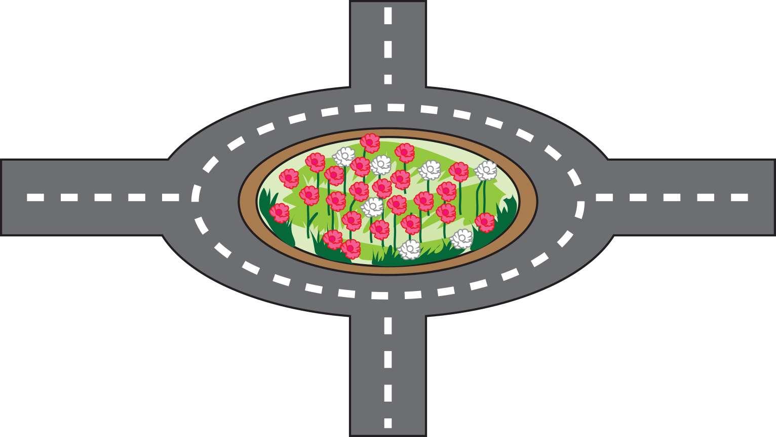
PRACTICE QUESTION
Practice question 3
Worksheet
available
Joanna is a landscape gardener.
She has to fill a circular space with flowers.
Exams tips: Look at units in the question. They would usually give clues on whether it is an area, perimeter or volume.
The radius of the circular space is 4.5 metres.
Joanna will plant 40 flowers per square metre of space.
She will plant 4 times as many red flowers as white flowers.
How many red flowers will she plant?
Exams tips:
Can you use a bar model or ratio table to help in proportional reasoning?
Notes:
A roundabout with a circular garden is shown to learners on the board. The tutor opens up a discussion to ask what learners are likely be asked to find from the picture. The tutor will write these ideas as questions on the board (additional questions to be provided in teacher guidance if learners are unable to create the questions).
Information about the picture is shown and learners are asked to calculate what they feel confident to do.
The final question and exam tips are shown and the tutor to lead discussion on how to go about answering the question.

Slide 30
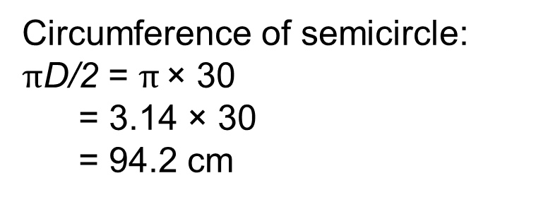
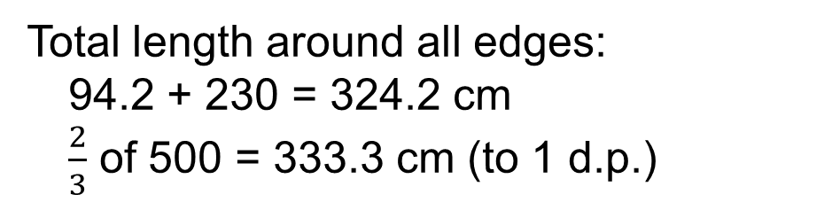
Practice question 1 – answers
REVIEW
Q1: Length of mirror trim
Circumference of semicircle:
$π$D/2 = $π$ × 30
= 3.14 × 30
= 94.2 cm
Total length around all edges:
94.2 + 230 = 324.2 cm
$\frac{2}{3}$ of 500 = 333.3 cm (to 1 d.p.)
Perimeter of 3 sides of rectangle:
85 + 85 + 60 = 230 cm
Abi is wrong, 324.2 cm is less than 333.3 cm.
Notes:
Length of mirror trim
Tutor to remind learners that the compound shape includes a rectangle and a circle. Circumference of the semicircle is calculated and ask learners why the diameter was not added. For the perimeter of the rectangle, ask the learners why we only added three sides.
Decision needs to be made by comparing the total length of the trim with two thirds of what Abi has (500 cm) and see if it is more.
Number of red flowers
Learners need to find the area of the circular space. Tutor to encourage learners to use a ratio table if necessary to calculate the total number of flowers (red and white). Tutor to ask learners on how to deal with the number of flowers if the answer is in decimals (to round up or down?).
Tutor may ask learners to use a bar model when confused with ratios.

Slide 31
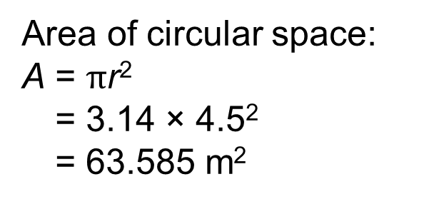
Practice question 2 – answers
REVIEW
Q2: Number of red flowers
Area of circular space:
A = $π$r²
= 3.14 × 4.5²
= 63.585 m²
1m² = 40 flowers
63.585m² = 40 × 63.585
= 2543.4
= 2543 flowers
Red
White
}
2543
4 + 1 = 5
2543 ÷ 5 = 508.6
508.6 × 4 = 2034 Flower (RED)
Notes:
Length of mirror trim
Tutor to remind learners that the compound shape includes a rectangle and a circle. Circumference of the semicircle is calculated and ask learners why the diameter was not added. For the perimeter of the rectangle, ask the learners why we only added three sides.
Decision needs to be made by comparing the total length of the trim with two thirds of what Abi has (500 cm) and see if it is more.
Number of red flowers
Learners need to find the area of the circular space. Tutor to encourage learners to use a ratio table if necessary to calculate the total number of flowers (red and white). Tutor to ask learners on how to deal with the number of flowers if the answer is in decimals (to round up or down?).
Tutor may ask learners to use a bar model when confused with ratios.

Slide 32
Lesson review:
Circles
Objectives
Calculate the area and perimeter of circles, semicircles and quadrants (in terms of π or to an appropriate degree of accuracy)
Explore problems involving the area or perimeter of compound shapes that include circles, semicircles or quadrants
Apply knowledge learned to exam-style questions
Suggested further steps/areas to work on
Volume of a cylinder: V = 𝜋𝑟²h

Slide 33
Lesson 18:
Credits
Photo acknowledgements:
Shutterstock.com: Africa Studio, Brent Hofacker, sirtravealot
Text acknowledgements:
Pearson Edexcel Functional Skills, Practice Set 2, Mathematics Level 2 (Calculator) PracL2/C02 Question 8, Pearson Edexcel Functional Skills, Past Paper 2, Mathematics Level 2 (Calculator) PMAT2/c03 Question 8, Pearson Edexcel Functional Skills, Practice Set 2, Mathematics Level 1 (Calculator) PracL2/01 Question 11

