Slide 1


Lesson 4:
Averages Level 2
Objectives
To understand the difference between mean, mode and median
To be able to use the appropriate average for different purposes
To understand that range is the data spread and not an average
Use appropriate checking procedures and evaluate their effectiveness at each stage

Slide 2

What is average?
DISCUSS
Hi! How are you?
Oh, you know – pretty average today.
What do you think Parvis means when he says ‘average’?
Notes:
Whole group discussion about the nature of averages. This lesson is designed to explore the different averages and their possible uses.
The discussion should start to draw out learners’ previous knowledge about averages. Learners often know how to calculate averages, even if they get the names mixed up. Do they know what an average is and when to use each average?
The first two slides are to explore the nature of average. In the first slide, Parvis feels average. This cannot be quantified with numbers, but it does allow for discussion of what the nature of ‘average’ is.
You might prompt the discussion by asking: Does Parvis feels fabulous? Does Parvis feel terrible? This could start the idea of the middle ground – somewhere between terrible and amazing.
Could we calculate how Parvis feels? Not easily, but we could give his feelings a rating on a scale (1 being terrible and 10 being wonderful) – where would Parvis be on this scale?

Slide 3
What is average?
DISCUSS
How did you do in your maths test?
Average!
What do you think Parvis means by average in this case? Has anything changed?
3
Notes:
Asking how Parvis did in his maths test allows the class to start exploring different averages. The score can be quantified, as can the grade. It is unlikely that learners will know if their maths test results are actually average or not, but it does allow them to think about how the scores might be ordered to see if they are average.
Does Parvis’ response of ‘Average!’ refer to how he feels he did, or does he know his grade and score? (Learners should move on from the abstract middle ground introduced in the previous slide to thinking about a quantified average).
Grades and scores can be used to find averages. How? This gives the class the opportunity to explore exactly how averages are calculated and to think about scores and grades.
Is there a way to see if Parvis has done averagely well on his math test? Can learners think how this might be done? Explore this with the class.
Would it be possible to find out the average for the class? The college? The country? How?
There is a lot of scope here for discussion and the tutor should take this opportunity to explore the class’s previous knowledge.

Slide 4
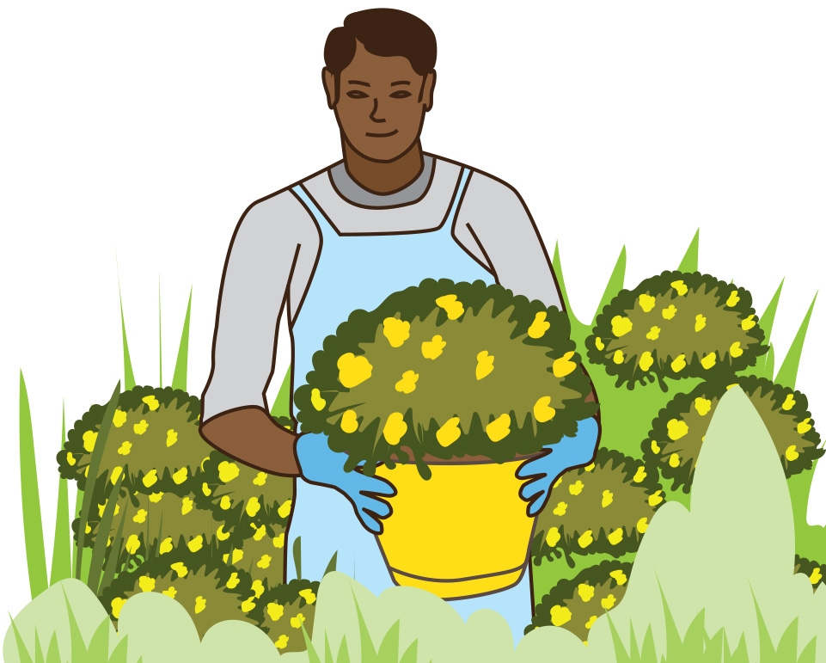
Garden centre
DISCUSS
James is starting work at a
garden centre.
A customer wants a flower that
is not too tall or too short.
How could James approach this?
Notes:
This slide introduces the context of the lesson, which revolves around a garden centre. In doing so, learners are introduced to averages within a real-life work context.
The scenario is that James has started to work here, and there are various activities and discussions around James’ tasks, which can be solved using averages and range.
Discuss with the class how James could do this.
One possible solution is to attempt to find the average height of a number of flowers and then choose one that is about that size. The class could come to this conclusion during the discussion.
The next slide explicitly tells the class that they should use an average or averages. You may want to skip this slide and rely on the group to come to this conclusion.
If the class decides that an average would be a good way to find a flower that is not too tall or too short, then you may wish to display the next slide to confirm their decision.

Slide 5
James’ friends offer to help.
You could find the average height.
Good idea!
Notes:
This slide is optional and can be skipped if the class has already come to this conclusion, and you do not feel that there is a need to confirm their decision.
It could be used to explicitly tell the class that finding the average height of a number of flowers is the best way to select one that is not too short or too tall, if the class were unable to find a solution to the task.

Slide 6
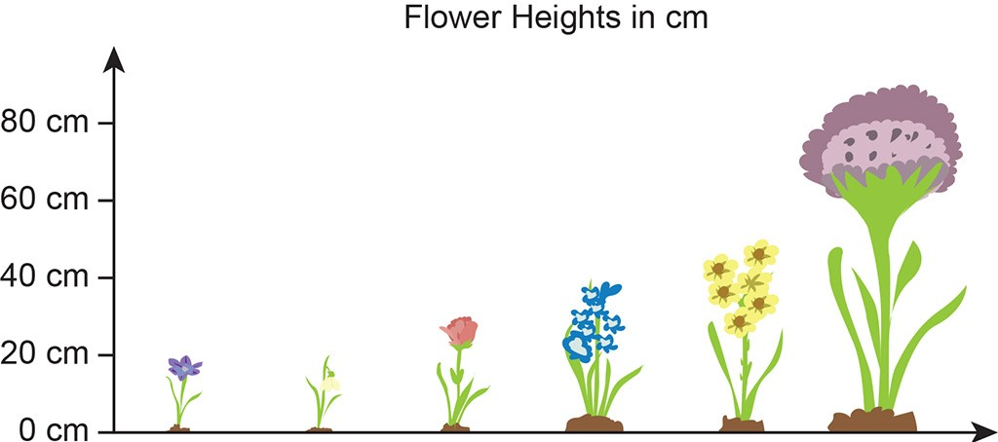
Heights of flowers
DISCUSS
90 cm
50 cm
40 cm
30 cm
20 cm
20 cm
Crocus Snowdrop Tulip Hyacinth Daffodil Allium
Notes:
A range of flowers of different heights has been selected. The class may be able to determine the modal value (20 cm) and the median value (35 cm). The median is not written here, but learners may deduce that the 30 cm and 40 cm flowers are the middle heights, and so the median is in the middle of these two values.
If learners cannot find these values on their own, they will have the opportunity to explore this and develop these skills in the next slide.

Slide 7
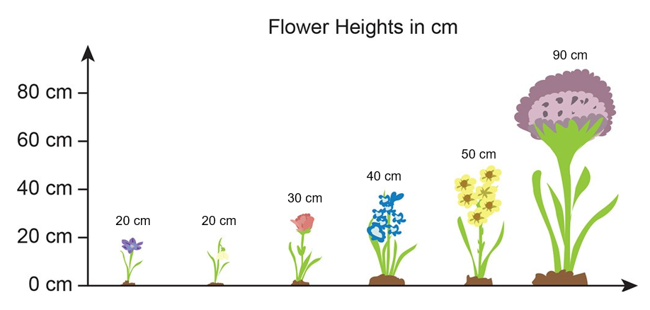
Heights of flowers
YOUR
TURN
Parvis says:
The average is 42 cm.
Jane says:
The average is 20 cm.
Maya says:
The average is 35 cm.
Kenji says:
The average is 70 cm.
Crocus Snowdrop Tulip Hyacinth Daffodil Allium
Working in pairs: What have James’ friends calculated?
How can the results help James?
Notes:
This slide shows all three averages calculated as well as the range.
Parvis has calculated the mean, Jane the mode, Maya the median, and Kenji has calculated the range.
Learners are to work in pairs to identify what has been calculated.
This will expose their prior knowledge level. During the learners’ discussions, the tutor should listen and take notes of any ideas or calculations that are being made for the class discussion afterwards.
The slide is also designed to expose the misconception that range is an average. The range is visually apparent in the slide, and time should be dedicated to thinking about why the range is not an average, and possible uses for the range.
A use for range will be addressed later in the lesson, and so the depth to which it is discussed at this point is up to the tutor’s discretion. For example, if learners have a strong opinion or in-depth knowledge of range and its function within statistical analysis, explore this further. However, it is sufficient at this stage simply to explore the fact that range is not an average.
Once time is up, a discussion should take place about what learners have found and how useful each of the averages might be.
The modal value of 20 cm is of little value to James, as these are the shortest flowers.
The mean is 42 cm (rounded from 41.6), and the median is 35 cm. Discuss which is better to use in this case. There is no one true answer here, but exploration through discussion is essential as learners begin to think about how different averages can supply different information.

Slide 8
Heights of flowers
YOUR
TURN
One of the flowers has been removed.
What are the mean and range figures for this data set now?
Can you show checks for your calculations?
Crocus Snowdrop Tulip Hyacinth Daffodil
Notes:
Why has removing one flower affected the data? Encourage and provoke responses and discussion about outliers and data being skewed – the data now has a lower range and so the values are all closer to each other without an ‘outlier’. Discuss what an outlier is.
How can you check – discuss reverse calculations, estimations and sense checking (Is it a reasonable answer? Does your answer make sense?).

Slide 9

Types of average
YOUR
TURN
KEY IDEA
Mean:
The most commonly used average, but less useful when there are a few extremes (or outliers) in the data that skew the mean
Calculate by adding up the values of each piece of data and dividing by how many pieces of data there are
Median:
Tells you the middle value in a set of data, so it is not susceptible to outliers
If there are two values in the middle, take the mid-point between them
Mode:
Tells you the most common value in a set of data, though there may be several modes (or none at all)
Notes:
Summarise the three types of average – what they are (and aren’t) useful for, and how to calculate them. Provide examples to illustrate, if necessary.
Emphasise that the range is not an average, but a measure of spread – how variable (or consistent) the values are in the set of data.

Slide 10
Time of customers’ stay
EXPLORE
James has been given a table of information about the average length of stay of customers.
Survey | Time (in minutes) |  |  |  |  |  | Mean
A | 26 | - | 32 | 24 | 20 | 30 | 26
B | 26 | 32 | - | 26 |  |  | -
Survey A consisted of six customers and survey B consisted of four customers.
Unfortunately, three entries are missing from the table.
In survey A, 6 customers were timed and their mean visit time was 26 minutes.
In survey B, 4 customers were timed.
The overall mean of the combined data was 26.8 minutes.
Can you work out what the three missing values are?
Notes:
This exercise is designed to test learners' understanding of the mathematical structure of mean.
Ask the learners to work alone for a few minutes before discussing what they have done or what they think with their partner.
This may lead to a productive struggle, as this is a little tricky. Allow time for the learners to solve the problem, but scaffold by asking questions should the task become too much.

Slide 11

Time of customers’ stay
YOUR
TURN
Handout
available
Survey | Time (in minutes) |  |  |  |  |  | Mean
A | 26 | - | 32 | 24 | 20 | 30 | 26
B | 26 | 32 | - | 26 |  |  | -
The overall mean of the combined data was 26.8 minutes.
Work by yourself at first and see if you can complete the table.
Talk to your partner about what you have done and why.
If your answers are the same, talk to each other and explain how you got your answers.
Notes:
Give the learners some time to work alone.
Once they have worked on the problem alone, learners will then explain their answer to their partner.
If the pair agrees, then each learner must explain in their own words what they did. If they disagree, then they must work out why they disagree and see if they can come to an agreement.
The tutor will observe and listen to what the learners are saying, taking note of common errors or correct calculations, which will help with the review.

Slide 12
Time of customers’ stay
REVIEW
Survey | Time (in minutes) |  |  |  |  |  | Mean
A | 26 |  | 32 | 24 | 20 | 30 | 26
B | 26 | 32 |  | 26
24
28
28
The overall mean of the combined data was 26.8 minutes.
Notes:
Here, the tutor should bring the class's ideas together, before confirming the correct answers.
It could be useful to question the whole group to bring ideas together, or the tutor could ask a successful pair to demonstrate what they did.
Focus of discussions is methods used & reasoning behind them. If learners struggle, use probing questions and scaffolding as appropriate
When discussions have run their course, use the animations to confirm the correct answers.
Answer for row A is 24
Calculation is:
26 x 6 = 156
All current numbers add up to 132
156 − 132 = 24
Answer for row B (missing time) is 28
Find the mean for all 10 combined
10 × 26.8 = 268
All 9 add up to 240
268 − 240 = 28
Answer for row B (missing average) is 28

Slide 13

Which delivery service?
DISCUSS
The garden centre wants to choose the most consistent delivery service to use.
They have used two local ones and recorded their delivery times.
Moving Target Delivery |  |  | Glossop Delivery
Delivery Day | Hours Taken |  | Delivery Day | Hours Taken
Monday | 2 |  | Monday | 4
Tuesday | 2 |  | Tuesday | 4
Wednesday | 5 |  | Wednesday | 5
Thursday | 4 |  | Thursday | 3
Friday | 7 |  | Friday | 4
Working with a partner, think about which service you would choose.
You must be able to justify your answer.
Notes:
The more consistent delivery service will be the better service to use. Glossop Delivery has the smaller range (2 hours, compared to 5 hours for Moving Target) and is therefore the more consistent.
The mean and median delivery time for both of these firms is 4 hours, so there is no difference in terms of the average times.
The role of the tutor is to listen to the learners' reasoning while they have their thinking and discussion time, and then to use this to facilitate the discussion of which service they would choose.

Slide 14
Grouped data
Handout
available
Below is some data from the garden centre about the customers who visited on a Saturday in April.
Is there anything wrong with the way in which they have been grouped? Why have they been grouped this way?
How can we use this information to calculate the mean?
Can we calculate the median, mode or range from this data?
Age of customer | Frequency | Midpoint | Total
10 – 14 | 4
15 – 25 | 17
25 – 35 | 59
35 – 45 | 170
45 – 55 | 86
55 – 65 | 14
TOTAL
14
Notes:
Introduce concept of grouped data – draw reference to the fact that this is NOT raw data, but data that have been grouped into a series of bands.
Click to reveal the 1st bullet and ask: is there anything wrong with this table? Draw out issues of overlapping groups, no group for under 10 or over 65 – why not?
Discuss what the groups should be.
Click to reveal 2nd bullet and discuss how the mean can be calculated. You may probe questions to draw out the method:
Can we tell the specific ages of any of these customers? So what values do we use in calculating the mean? Highlight the use of mid-points, asking what if all the 55–65s were aged 55 (or 65) – what difference would this make? Emphasise that mid-points are just estimates, so final mean will also be an estimate.
Next step is to multiply the frequencies by the midpoints – why? Relate this to what they already know about calculating the mean and what an expanded view of the frequency table might look like.
What do we do next? What do we divide the total by? (Carry on making links to the basic method of calculating the mean.)
Finish by asking – does the estimate of the mean look reasonable? Within which group would you expect it to lie?
Click to reveal 3rd bullet.
Finish by asking whether it would be possible to identify the median (no), mode (can identify the modal group – in this case 35–45) & range (no) from grouped data.

Slide 15
Practice question (1)
PRACTICE QUESTION
Handout
available
Gavin is a car salesman.
The table shows the number of cars he sold in one week.
For every car Gavin sells, he earns
commission = 1.25% × £20 950 = £261.88
bonus = £50
total earning per car = 261.88 + 50 = £311.88
We order the number of cars he sold in one week:
0, 1, 1, 2, 2, 4
The median number of cars he sold per day is:
(1 + 2) ÷ 2 = 1.5 cars
The median amount he earned per day is therefore £311.88 × 1.5 = £467.82
Mon | Tue | Wed | Thu | Fri | Sat
2 | 0 | 1 | 4 | 1 | 2
The cost of each car is £20 950
For every car Gavin sells he earns
1.25% of the cost of the car in commission
a bonus of £50.
Work out the median amount Gavin earned per day for this week.
Notes:
This is a Level 2 question and we would recommend you print out this question.

Slide 16
Practice question (2)
PRACTICE QUESTION
Handout
available
Nikos owns a restaurant.
The table shows information about the number of customers that visited the restaurant on each of the 31 nights in August.
Number of customers | Frequency
1 – 15 | 2
16 – 30 | 7
31 – 45 | 12
46 – 60 | 10
The mean number of customers per night in July was 32.
Nikos thinks the mean number of customers per night in August was more than the mean number of customers per night in July.
Is Nikos correct?
Show why you think this.
Notes:
This is a Level 2 question and we would recommend you print out this question.

Slide 17
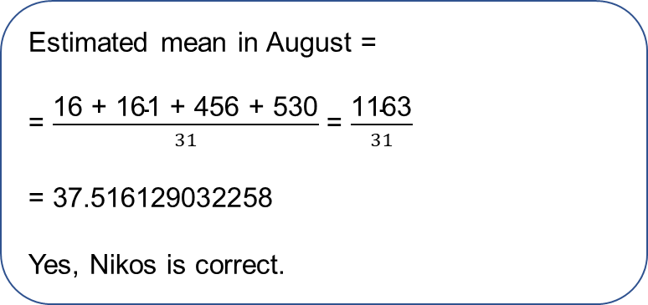
Practice question (2) – Answers
PRACTICE QUESTION
Nikos owns a restaurant.
The table shows information about the number of customers that visited the restaurant on each of the 31 nights in August.
Number of customers | Frequency | Midpoint | Midpoint × Frequency
1 – 15 | 2 | 8 | 16
16 – 30 | 7 | 23 | 161
31 – 45 | 12 | 38 | 456
46 – 60 | 10 | 53 | 530
The mean number of customers per night in July was 32.
Nikos thinks the mean number of customers per night in August was more than the mean number of customers per night in July.
Is Nikos correct?
Show why you think this.
Estimated mean in August =
= $\frac{\text{16} \text{+} \text{161 + 456 +} \text{530}}{31}$ = $\frac{\text{1163}}{31}$
= 37.516129032258
Yes, Nikos is correct.

Slide 18
Practice question (3)
PRACTICE QUESTION
Handout
available
In October Mr Barker gave a group of 250 students a history test.
These are the results.
In the October test the lowest mark was 2 and the highest mark was 17.
In November the same students took a similar test.
The lowest mark was 5 and the highest mark was 18.
Mr Barker wants to write a statement comparing the spread of marks in the two tests.
Write a statement to compare the spread of marks in the two tests.
You must show calculations to support your statement.
Number of marks | Frequency
1 to 5 | 20
6 to 10 | 50
11 to 15 | 120
16 to 20 | 60
Mr Barker estimates the mean mark to be 12.
Is Mr Barker correct?
Show why you think this.
Notes:
This is a Level 2 question and we would recommend you print out this question.

Slide 19
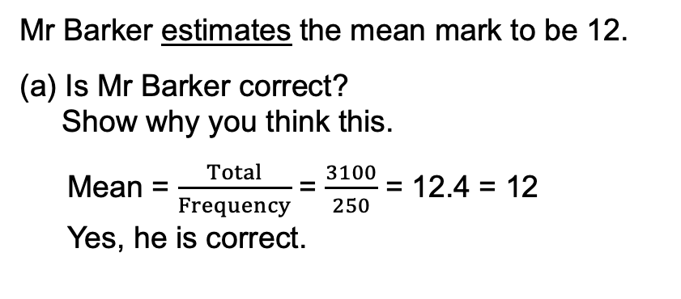
Practice question (3) – Answers
PRACTICE QUESTION
(a)
Write a statement to compare the spread of marks in the two tests.
  You must show calculations to support your statement.
Number of marks | Frequency | Midpoint | Midpoint × Frequency
1 to 5 | 20 | 3 | 60
6 to 10 | 50 | 8 | 400
11 to 15 | 120 | 13 | 1560
16 to 20 | 60 | 18 | 1080
Total | 250 |  | 3100
 | Lowest | Highest | Range
Oct | 2 | 17 | 15
Nov | 5 | 18 | 13
The range of marks in November was lower than in October.
Mr Barker estimates the mean mark to be 12.
Is Mr Barker correct?
Show why you think this.
Mean = $\frac{Total}{Frequency}$ = $\frac{3100}{250}$ = 12.4 = 12
Yes, he is correct.

Slide 20
Lesson review:
Averages Level 2
Objectives
To understand the difference between mean, mode and median
To be able to use the appropriate average for different purposes
To understand that range is the data spread and not an average
Use appropriate checking procedures and evaluate their effectiveness at each stage
Suggested further steps/areas to work on
Frequency tables

Slide 21
Lesson 4:
Credits
Text acknowledgements
Pearson Edexcel Functional Skills, Past Paper 3- Mathematics Level 2 (Calculator) PMAT2/C03 Question 11, Pearson Edexcel Functional Skills, Practice Paper 3 - Mathematics Level 2 (Calculator) PRACL2/C03 Question 7, Pearson Edexcel Functional Skills, Past Paper 3 – Mathematics Level 2 (Calculator) PMAT2/C03 Question 5
Photo acknowledgements
Shutterstock.com: SimpleEPS

