Slide 1

Motivation and Engagement
Using the Growth Zone Model

Slide 2
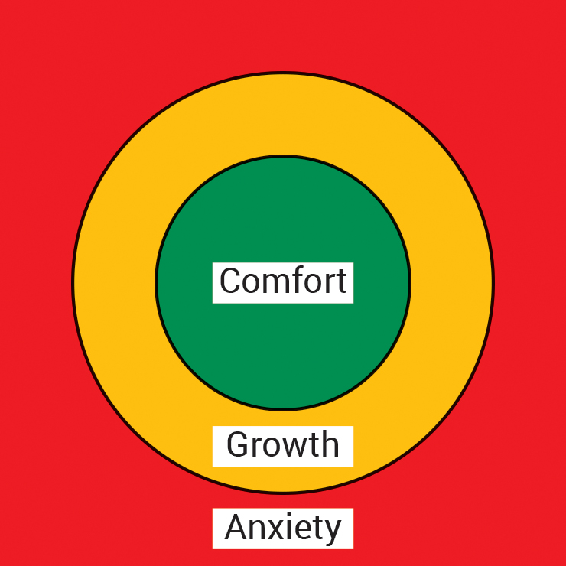
Learning maths needs a struggle – and support
Comfort zone
Growth zone
The green zone is a good place to be. Here you are comfortable and safe. You are working on stuff you know and can do and making sure you remember. BUT you are not moving your learning forward.
In the amber zone, you are learning. But learning feels risky and slightly uncomfortable because at first you have to struggle. You don’t understand everything and there are barriers to overcome. You need the right support to stay here as long as you can, but only you can say what the right support is.
Anxiety zone
If you go into the red zone you are finding the risks too great – you feel unsafe and anxious. You feel the barriers are too much and you just cannot do this. If you are in the red zone you need help and support – ask for it. It is not stupid to ask for help – it is more stupid not to. ​
You may need to go back over some stuff, or you may need to discuss the ideas with someone – your peers or the teacher or someone else. Don’t go red – get help.​

Slide 3
Timeline
Stage of the lesson
Start of lesson
Activity 1
Activity 2
Activity 3
Activity 4
End of lesson
Am I feeling green, amber or red?
Why?

