Slide 1
APPRENTICESHIP WORKFORCE DEVELOPMENT
SESSION 2: Line Manager Coaching Support and Tools to Support Apprentice Development and Progression
By University of Portsmouth

Slide 2
Session 2 : Coaching Support and Tools to support Apprentice Development and Progression 19th Oct 2023
Becky Quew-Jones
Faculty Learning and Teaching Lead
Principal lecturer

Slide 3

The session today…
Key aim: Equip ourselves with coaching strategies and tools to support our apprentices development
Share coaching strategies and tools
Practice the coaching skills skills using knowledge gained
Notes:
( 5 mins)
Key objective : Equip line managers with coaching strategies and tools to support employee development within degree apprenticeships.
Review the learning outcomes for this session.
Emphasise the skills and knowledge participants will gain.

Slide 4

Recap of Previous Session
What key concepts and skills covered in the previous session did you have chance to practice?
Notes:
Recap
(10 mins)
Review key concepts and skills covered in the previous session.
Ensure participants are up to date and ready to build upon their knowledge.

Slide 5
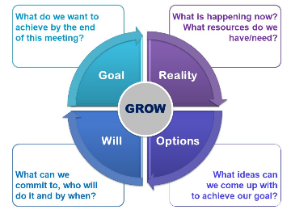
Coaching Models and frameworks
Coaching models like the GROW model and the OSKAR model - advantages and disadvantages.
Discuss how these frameworks guide coaching conversations and goal attainment.
Notes:
Coaching Models and Frameworks (10 minutes)
Introduce coaching models like GROW model and the OSKAR model.
Explain how these frameworks guide coaching conversations and goal attainment.

Slide 6
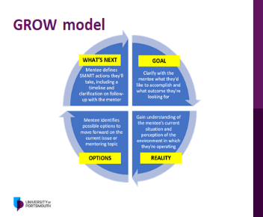
Grow Model
The GROW Model: Goal, Reality, Options, Will
Exploring the components of GROW
Links to effective coaching
Notes:
10 mins
The GROW Model: Goal, Reality, Options, Will
GROW model, explaining its components: Goal, Reality, Options, and Will.
Show how each element contributes to effective coaching.

Slide 7

Fostering Self Awareness
Fostering Self-awareness and Self-reflection as a coach
Importance of self-awareness and self-reflection in apprentices.
Techniques for encouraging self-awareness in coaching.
Notes:
15 mins
Fostering Self-awareness and Self-reflection
Discuss the importance of self-awareness and self-reflection in apprentices.
Share techniques for encouraging self-awareness in coaching.

Slide 8

Questioning Skills
Advanced questioning skills to promote critical thinking and problem solving
Powerful questions can drive meaningful critical conversations
Notes:
15 mins
Questioning Techniques for Critical Thinking
Explore advanced questioning techniques to promote critical thinking and problem-solving.
Explain how powerful questions can drive meaningful conversations.

Slide 9
Active Coaching skills
Active coaching skills - exploring paraphrasing, summarising, and clarifying.
Coaching skills that have Impact on communication communication and understanding in coaching.
Notes:
Active Coaching Skills (10 minutes)
Highlight active coaching skills like paraphrasing, summarising, and clarifying.
Show how these skills enhance communication and understanding in coaching.

Slide 10

Providing Support and Encouragement
Strategies for supporting skill development in apprentices
Role of encouragement in fostering growth.
Notes:
(10 mins)
Providing Support and Encouragement
Share strategies for supporting skill development in apprentices.
Emphasise the role of encouragement in fostering growth.

Slide 11


Identifying Barriers and dealing with challenges
Identifying and Overcoming Barriers
Barriers to progress in coaching relationships
Strategies to identify and overcome these obstacles
Dealing with Challenges
Challenges and difficult situations that may arise in coaching
Guidance to handle these situations effectively
Notes:
25 mins
Identifying and Overcoming Barriers
Discuss common barriers to progress in coaching relationships.
Offer strategies to identify and overcome these obstacles.
Dealing with Challenges in Coaching
Address challenges and difficult situations that may arise in coaching.
Provide guidance on handling these situations effectively.

Slide 12

Providing Feedback and Managing Performance
Examining the role of constructive feedback in driving performance improvement
Our best practices for delivering feedback effectively and managing performance issues
Notes:
10 mins
Providing Feedback and Managing Performance
Examine the role of constructive feedback in driving performance improvement.
Share best practices for delivering feedback effectively and managing performance issues.

Slide 13

Conclusion and next steps
Key takeaways from the session
Resources available
For next session
Notes:
Summarise key takeaways from the session.
Resources available
Discuss commitments for next time,....

Slide 14
Claire Middleton
Degree Apprenticeship Manager – University of Portsmouth

