Slide 1
Sustainability Starts
A series of suggested activities to raise awareness of the United Nations’ Sustainable Development Goals.

Slide 2
About this resource
The United Nations’ Sustainable Development Goals are a universal call to action to end poverty, protect the planet and improve the lives and prospects of everyone, everywhere by 2030. They address the current global challenges we face, including poverty, inequality and climate change.
These Sustainability Starts have been developed by ESOL practitioners to raise awareness of and start conversations with ESOL learners about the sustainable development agenda and everyone’s role in it.
The activities can be used in a variety of ways, for example as warmer or filler activities or as introductions to topics that can be developed further into a whole class discussion or a guided debate. All activities can be adapted or changed to suit the needs of your learners.
For each goal, there are three ideas for activities you can use to raise awareness of sustainable development issues and actions with adult ESOL learners.
The activities are intended as a starting point for learning and discussion about a complex and sensitive range of issues, that will enable learners to share and extend their language and knowledge around these issues, as well as promote and develop critical thinking skills and identify things everyone can do to support the goals.
This resource has been developed by Manchester Adult Education Service as part of a project commissioned by the Education and Training Foundation and delivered by HOLEX to identify effective practice and develop resources around Education for Sustainable Development in ESOL.

Slide 3

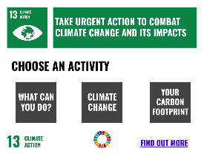
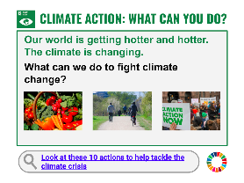
Using this resource
This resource has been designed to be used as a Powerpoint or Slides presentation in Present mode.
In Present mode,
select the goal you want to use from the Sustainable Development Goals overview.
For each goal, there is a description, three activities and a link to find out more about the goal. Select the activity you want to use.
To return to the goal, select the icon in the top left corner.
To return to the Sustainable Development Goals overview select the SDG icon in the bottom right hand corner.

Slide 4


















Select a goal to choose a related activity

Slide 5


NO
POVERTY
END POVERTY IN ALL ITS FORMS EVERYWHERE
CHOOSE AN ACTIVITY
FOOD BANKS
UNWANTED ITEMS
LIVING WAGE
1
FIND OUT MORE

Slide 6


FOOD BANKS
What is a
Food Bank?
How do food banks help
people?
Where is the nearest food bank?
Find out more about food banks

Slide 7
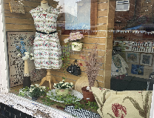
UNWANTED ITEMS
What do you do with clothes, toys and furniture that you don’t need anymore?
a. throw them away
b. donate them to charity
c. give them to friends or neighbours
Find out where you can donate things in your area.
Find out what to do with items

Slide 8
LIVING WAGE
National Living Wage and
Real Living Wage
The National Living Wage is the minimum wage rate for over 23s. It is set from a percentage of medium earnings
The Real Living Wage is a higher wage rate that employers can choose to pay their staff. It is based on the actual cost of living. There is a higher rate for people working in London.
What are the current living wage rates?
What do you think about the Real Living Wage?
Find out about the Real Living Wage

Slide 9

ZERO
HUNGER
END HUNGER, ACHIEVE FOOD SECURITY AND IMPROVED NUTRITION AND PROMOTE SUSTAINABLE AGRICULTURE
CHOOSE AN ACTIVITY
FAIR
TRADE
FOOD WASTE
HUNGER &
NUTRITION
2
FIND OUT MORE

Slide 10


FAIRTRADE
What does this
sign mean?
Where do you see it?
Do you buy things with
this sign?
Find out more about Fairtrade

Slide 11
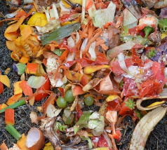

FOOD WASTE
What do you do when you
have leftover food?
a. throw it away
b. freeze it
c. give it to friends or neighbours
Share a tip for reducing food waste
Visit Love Food Hate Waste for more ideas

Slide 12
HUNGER AND NUTRITION
“
An estimated 2 billion people in the world did not have regular access to safe, nutritious and sufficient food in 2019.
What do the words ‘nutritious’ and ‘sufficient’ mean?
What are the long term consequences of hunger and malnutrition?
What can we do to help?
Read why Zero Hunger matters

Slide 13

GOOD HEALTH
AND WELL-BEING
ENSURE HEALTHY LIVES AND PROMOTE WELL-BEING FOR ALL AT ALL AGES
CHOOSE AN ACTIVITY
EXERCISE
5 STEPS TO WELLBEING
ACCESS TO HEALTHCARE
3
FIND OUT MORE

Slide 14

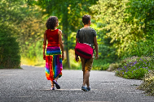
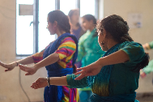
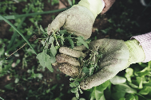

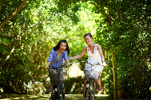
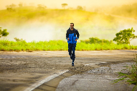
EXERCISE
What type of exercise do you enjoy?
Find out how to get fit for free

Slide 15
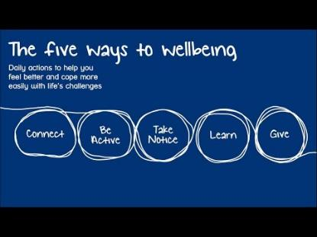
FIVE STEPS TO WELLBEING
Five steps to mental wellbeing
These 5 steps can improve your mental health and wellbeing. They can help you feel more positive.
Do you like these steps?
What makes you feel good?
Find out more on the NHS website or try this mindful breathing exercise
Notes:
Alternative, longer video - https://youtu.be/_gJ5V525SCk

Slide 16
ACCESS TO HEALTHCARE
“
In 2017, only around one third to half of the global population was covered by essential health services.
1. What do you think about the National Health Service (NHS) in the UK?
2. How does the NHS compare with health services in other countries?
Read why Zero Hunger matters

Slide 17

QUALITY
EDUCATION
ENSURE INCLUSIVE AND EQUITABLE QUALITY EDUCATION AND PROMOTE LIFELONG LEARNING OPPORTUNITIES FOR ALL
CHOOSE AN ACTIVITY
SCHOOL IN THE UK
LEARNING FOR LIFE
FACT CHECKING
4
FIND OUT MORE

Slide 18


SCHOOL IN THE UK
School starting and leaving ages
When do children have to start school in the UK?
When can they leave school in the UK?
Is this the same in other countries?
Find out about schools in the UK

Slide 19

LEARNING FOR LIFE
Many museums and galleries in the UK are free.
Talk about a museum or gallery you
have visited.
What can you see and learn there?
Find museums and galleries near you

Slide 20

FACT CHECKING
“
We’re not just fighting an epidemic; we’re fighting an infodemic
Tedros Adhanom Ghebreyesus
Director-General of the World Health Organization (WHO)
What is an infodemic and why is it a problem?
How do you know if things you read on the internet and social media are reliable?
Use the W W W . method to check information

Slide 21

GENDER
EQUALITY
ENSURE INCLUSIVE AND EQUITABLE QUALITY EDUCATION AND PROMOTE LIFELONG LEARNING OPPORTUNITIES FOR ALL
CHOOSE AN ACTIVITY
GENDER PAY GAP
INSPIRING WOMEN
SAFE SPACES NOW
5
FIND OUT MORE

Slide 22

GENDER PAY GAP
Around the world, women earn 20% less than men.
How does this make you feel?
£
£
Watch this video about the gender pay gap

Slide 23


INSPIRING WOMEN
Talk about a woman who inspires you.
Who are they?
Why do you they inspire you?
Malala
Yousafzai
is an
education activist from Pakistan. She inspires me because...
Michelle Obama is a lawyer and writer. She inspires me because...
The BBC's 100 women of 2020

Slide 24
SAFE SPACES NOW
“
Over 70% of women in the UK say they have experienced sexual harassment in public.
What is sexual harassment?
What could help women, girls and marginalised genders feel safer on public transport and in public spaces?
Visit #SafeSpacesNow to find out more.

Slide 25

CLEAN WATER
AND SANITATION
ENSURE AVAILABILITY AND SUSTAINABLE MANAGEMENT OF WATER AND SANITATION FOR ALL
CHOOSE AN ACTIVITY
USING WATER
HAND HYGIENE
VALUING WATER
6
FIND OUT MORE

Slide 26


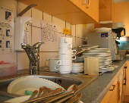
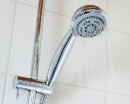
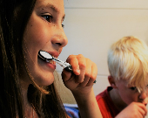

USING WATER
What do you use water for in your daily life?
What can you do to use less water?
Visit Friends of the Earth for more water saving tips

Slide 27
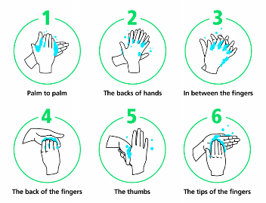
HAND HYGIENE
Finish the sentences
_____________ is one of the easiest ways to protect yourself and others from illnesses such coronavirus, flu and food poisoning.
You should ___________ for 20 seconds with _________ and _________ regularly.
Find out more on the NHS website

Slide 28
VALUING WATER
How is water important to your
… home and family life?
… livelihood?
… cultural practices?
… wellbeing?
… local environment?
Find out what water means to others

Slide 29

AFFORDABLE AND
CLEAN ENERGY
ENSURE ACCESS TO AFFORDABLE, RELIABLE, SUSTAINABLE AND MODERN ENERGY FOR ALL
CHOOSE AN ACTIVITY
SAVING ENERGY
ENERGY SOURCES
ALTERNATIVES TO
FOSSIL FUELS
7
FIND OUT MORE

Slide 30



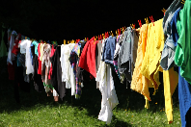



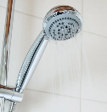

SAVING ENERGY
Share a tip for saving energy in your home
I keep the lid on the pan when
I boil water.
Visit the Energy Saving Trust for more tips

Slide 31




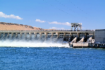



ENERGY SOURCES
Name the energy source
Does it harm the
environment?
Is it renewable?
Look at your bill to find out where your energy comes from.
Find out about switching your energy supplier

Slide 32
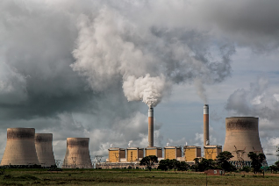
ALTERNATIVES TO FOSSIL FUELS
“
Burning fossil fuels like coal, oil and gas produces large amounts of greenhouse gases which cause climate change and have harmful impacts on people’s well-being and the environment.
What are the alternatives to coal, oil and gas?
How can we use less coal, oil and gas?
Find out about different energy resources

Slide 33

DECENT WORK AND
ECONOMIC GROWTH
PROMOTE SUSTAINED, INCLUSIVE AND SUSTAINABLE ECONOMIC GROWTH, FULL AND PRODUCTIVE EMPLOYMENT AND DECENT WORK FOR ALL
CHOOSE AN ACTIVITY
NATIONAL LIVING WAGE
WORKERS’
RIGHTS
SOFT SKILLS
8
FIND OUT MORE

Slide 34


NATIONAL LIVING WAGE
How much is the National Living Wage in the UK?
£7.50
£8.91
£9.50 or £10.85 in London
Do you think that this is enough to live on?
Find out more about soft skills on the National Careers Service website

Slide 35
WORKERS’ RIGHTS
Finish the sentences about your rights at work
5.6 48 6
If you work more than hours a day, you are entitled to a rest break.
The maximum you should work in a week is hours.
You get weeks paid leave a year if you are full time.
Find out more on the Citizens Advice website

Slide 36
SOFT SKILLS
“
Soft skills are general skills that employers look for and are needed for most jobs. They include communication, leadership, positivity, flexibility and problem solving skills.
Why are soft skills so important?
What can you do to develop your soft skills?
Share your ideas with the group.
Find out more about soft skills on the National Careers Service website

Slide 37

INDUSTRY, INNOVATION AND INFRASTRUCTURE
BUILD RESILIENT INFRASTRUCTURE, PROMOTE SUSTAINABLE INDUSTRIALIZATION AND FOSTER INNOVATION
CHOOSE AN ACTIVITY
TRAVEL & TRANSPORT
DIGITAL DEVICES & THE INTERNET
IMPROVING YOUR LOCAL AREA
9
FIND OUT MORE

Slide 38






TRAVEL AND TRANSPORT
How do you usually travel?
Are roads and transport good in your area?
What is the cleanest form of transport?
Get support to improve your digital skills with Learn My Way

Slide 39

DIGITAL DEVICES AND THE INTERNET
How do you use computers, phones and the internet in your everyday life?
What help and support is available to people who don’t have access to the internet or need to improve their skills?
Get support to improve your digital skills with Learn My Way

Slide 40



IMPROVING YOUR LOCAL AREA
What would you change to make your area a better place to live and work?
How would this improve opportunities for local people?
Look at these ideas for improving your street on the Sustrans website

Slide 41

REDUCED
INEQUALITIES
REDUCE INEQUALITY WITHIN AND AMONG COUNTRIES
CHOOSE AN ACTIVITY
EQUALITY ACT
INEQUALITY
EXTREME WEALTH
EXTREME
POVERTY
10
FIND OUT MORE

Slide 42


EQUALITY ACT
The Equality Act protects the rights of individuals and advances equality of opportunity for all.
What is discrimination?
What are the protected characteristics?
Find out about your rights under the Equality Act

Slide 43
INEQUALITY
What is inequality?
Inequality is the unfair situation in society when some people have more opportunities and money than other people.
Do you think inequality is increasing or decreasing in the world?
“
Find out more on OXFAM International

Slide 44
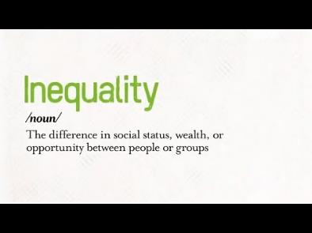
EXTREME WEALTH, EXTREME POVERTY
“
The world’s richest 1% have more than twice as much wealth as 6.9 billion people (60% of the population).
How does this make you feel?
What can Governments do to reduce the gap between rich and poor?
Find out more on OXFAM International

Slide 45

SUSTAINABLE CITIES
AND COMMUNITIES
MAKE CITIES INCLUSIVE, SAFE, RESILIENT AND SUSTAINABLE
CHOOSE AN ACTIVITY
PARKS AND GREEN SPACES
CHOOSING WHERE TO LIVE
AIR POLLUTION
11
FIND OUT MORE

Slide 46

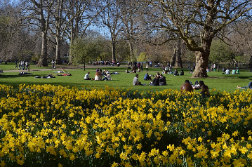
PARKS AND GREEN SPACES
Talk about your local park or green space
Where is it?
What can you do there?
How could it be better?
Find your local park

Slide 47
CHOOSING WHERE TO LIVE
What is most important about the area you live in?
clean
friendly
safe
good transport
good schools
shops and services

Slide 48

AIR POLLUTION
Air pollution causes 36,000 deaths in the UK a year.
What causes air pollution?
What can we all do to reduce air pollution?
What other types of pollution are there?
Find out more on the Clean Air Hub website

Slide 49

RESPONSIBLE CONSUMPTION AND PRODUCTION
ENSURE SUSTAINABLE CONSUMPTION AND PRODUCTION PATTERNS
CHOOSE AN ACTIVITY
REDUCE
REUSE
RECYCLE
FAST FASHION
REDUCE WASTE
12
FIND OUT MORE

Slide 50


REDUCE, REUSE, RECYCLE
Match the words to the meanings
reduce |  | use again
reuse |  | use in a different way
recycle |  | use less
Do you reduce, reuse and recycle?
Find out what you can recycle at home and locally

Slide 51
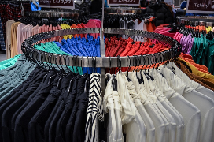
FAST FASHION
What is fast fashion?
Clothes that are made and sold cheaply, so that people can buy new clothes more often.
How often do you buy new clothes?
What do you do with clothes you don’t wear anymore?
What can you do instead of buying new clothes?
Watch this BBC video about fast fashion

Slide 52
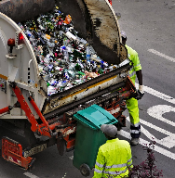
REDUCE WASTE
“
UK households produced just under 27 million tonnes of waste in 2017 which is equivalent to 409 kg per person. It's mostly made up of food scraps, newspapers, cardboard, glass bottles and plastics.
How can we reduce the waste we produce?
Share your ideas.
Read this BBC article about where our rubbish and recycling from the UK goes

Slide 53

CLIMATE
ACTION
TAKE URGENT ACTION TO COMBAT CLIMATE CHANGE AND ITS IMPACTS
CHOOSE AN ACTIVITY
WHAT CAN YOU DO?
CLIMATE CHANGE
YOUR
CARBON FOOTPRINT
13
FIND OUT MORE

Slide 54


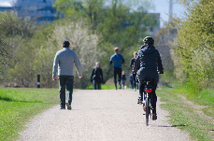

CLIMATE ACTION: WHAT CAN YOU DO?
Our world is getting hotter and hotter. The climate is changing.
What can we do to fight climate change?
Look at these 10 actions to help tackle the climate crisis

Slide 55
CLIMATE CHANGE
How is the climate changing?
How does climate change affect our lives?
hotter
colder
It is getting hotter - there are more heatwaves now.
heatwave
fire
wetter
drier
floods
drought
Find out more about climate change

Slide 56
REDUCE YOUR CARBON FOOTPRINT
“
Your carbon footprint is a measure of the amount of carbon dioxide released into the atmosphere by your activities.
Calculate your carbon footprint using one of these websites:
Go Climate: https://www.goclimate.com/gb
WWF: https://footprint.wwf.org.uk/#/questionnaire
What can you do to reduce your carbon footprint?
Try the WWF Footprint Calculator

Slide 57

LIFE
BELOW WATER
CONSERVE AND SUSTAINABLY USE THE OCEANS, SEAS AND MARINE RESOURCES
CHOOSE AN ACTIVITY
USE LESS PLASTIC
OVER
FISHING
PLASTICS IN YOUR BATHROOM
13
FIND OUT MORE

Slide 58




USE LESS PLASTIC
Every year, 11 million tonnes of plastic enter our seas.
How long do these items take to break down?
What tips do you have for using less plastic?
20 years
450 years
500 years
Visit the Cleans Seas website for more ways to turn the tide on plastic

Slide 59
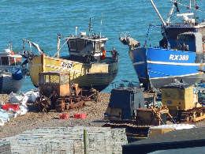
OVERFISHING
Overfishing means catching too many fish in an area of the sea, so that there are not many fish left there.
What problems do you think this causes?
How can you make sure the fish and seafood you eat is sustainable?
Have a look at the Good Fish Guide to see if the seafood you eat is sustainable.
Good Fish Guide

Slide 60
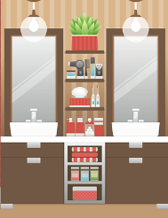
PLASTICS IN THE BATHROOM
What’s in your bathroom?
Personal care products are a major source of plastic pollution in our seas.
For example, plastic toothbrushes and disposable nappies takes 500 years to break down.
How could you use less plastic in your bathroom?
Find out about the plastic in your bathroom and ideas to reduce it on the Clean Seas website.

Slide 61

LIFE
ON LAND
SUSTAINABLY MANAGE FORESTS, COMBAT DESERTIFICATION, HALT AND REVERSE LAND DEGRADATION, HALT BIODIVERSITY LOSS
CHOOSE AN ACTIVITY
GROW YOUR OWN
TALKING ABOUT THE
ENVIRONMENT
GO WILD
15
FIND OUT MORE

Slide 62

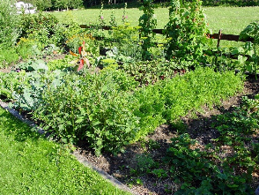
GROW YOUR OWN
Do you grow any fruit or vegetables?
What would you like to grow?
Find out about local allotments and community gardening projects
Tips and advice on growing your own

Slide 63
TALKING ABOUT THE ENVIRONMENT
Talking about the environment
Choose a word below, write a definition and use it in a sentence
biodiversity
conservation
rewilding
deforestation
endangered
extinction
Find out more about climate change

Slide 64
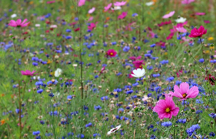
GO WILD
“
We have lost 97% of our wild flower meadows since the 1930s. They are very important for bees and other pollinators and many of our favourite fruits, vegetables and nuts rely on bees.
Why do you think we have lost so many wild flower meadows?
What can we do to restore wild flowers in the UK?
Find out more on the Grow Wild website

Slide 65

PEACE, JUSTICE AND STRONG INSTITUTIONS
PROMOTE JUST, PEACEFUL AND INCLUSIVE SOCIETIES
CHOOSE AN ACTIVITY
PEACE
VOTING
HUMAN RIGHTS
16
FIND OUT MORE

Slide 66


PEACE
When there is peace, there is no war, violence or arguing.
Peace also means quiet and calm.
What does peace mean to you?
Definition of peace

Slide 67

VOTING
Why is voting important?
Share your ideas with the group.
Check if you can vote on the Electoral Commission website.
“Voting gives you a say in how the country is run.”
Register to vote on the GOV.UK website.

Slide 68
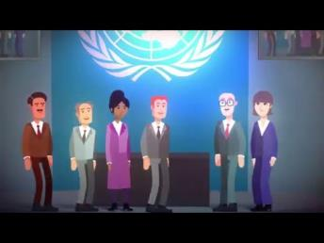
HUMAN RIGHTS
Human rights
Human rights are the basic rights and freedoms that belong to every person in the world, from birth until death.
What are these rights and why are they important?
Find out more on the Equality and Human Rights Commission website

Slide 69

PARTNERSHIPS
FOR THE GOALS
STRENGTHEN THE MEANS OF IMPLEMENTATION AND REVITALIZE THE GLOBAL PARTNERSHIP FOR SUSTAINABLE DEVELOPMENT
CHOOSE AN ACTIVITY
HELPING EACH OTHER
WORKING TOGETHER
ABOUT THE UN
17
FIND OUT MORE

Slide 70



HELPING EACH OTHER
Working together to achieve the goals.
How can we help each other to achieve the goals?
£
Find out more about Goal 17

Slide 71


WORKING TOGETHER
“
Many hands make light work.
What does this phrase mean?
Do you know any similar sayings?
Find out more about Goal 17

Slide 72
ABOUT THE UNITED NATIONS
“
One place where the world's nations can gather together, discuss common problems and find shared solutions.
About Us, United Nations
Find out about the work of the United Nations (UN)
Why and when was it formed?
How many countries are part of it?
What does the UN do?
Essential UN website

Slide 73
Teacher notes and sources
Here are some notes and links to source material and wider information for each suggested activity
Activity | Notes and sources
1 No Poverty Ensure everyone has access to food, shelter clothing, healthcare and education so they can fully participate in society.
Food banks | Before the session, find out about food banks, where they are in your area and the referral process The Trussell Trust is a nationwide network of food banks providing emergency food and support. Related goals: 2
Donating unwanted items | Before the session, find out about local charity shops and other places people can take unwanted items for reuse or recycling. Recycle Now website has a search tool that gives information about what you can do with different items and where you can take them. Related goals: 12, 13, 15
Living wage | Before the session, find out about the real living wage on the Living Wage Foundation website. There are lots of resources, including videos, that you could use to introduce the Real Living Wage and how it differs from the National Living Wage. Related goals: 1, 8, 10 and 11.
2 Zero Hunger Address poor agricultural practices, food waste and environment degradation to ensure no one goes hungry.
Fairtrade | Before the session, visit the Fairtrade website to find out more about Fairtrade.This activity has been included for Zero Hunger as Fairtrade promotes sustainable agricultural practices, This video explains more about Fairtrade and sustainability in general. Related goals: 1, 5, 8, 12, 15.
Reducing food waste | Before the session, find out about the Love Food Hate Waste campaign Related goals: 12, 13, 14, 15
Hunger and malnutrition | Before the session, look at the SDG page for Zero Hunger - the quote is one of the facts and figures. Zero Hunger: Why It Matters provides lots of information about the causes and impact of hunger and malnutrition. Related goals: 1

Slide 74
Teacher notes and sources
Activity | Notes and sources
3 Good Health and Well-Being Ensure healthy lives and promote well-being for all at all ages.
Exercise | Before the session, find out about local facilities and exercise groups. Related goals:11
Five Ways to Wellbeing | Before the session, find out about the fives steps to mental wellbeing on the NHS website. Related goals:
Access to healthcare | Before the session, look at the Good Health and Well-Being: Why It Matters- the quote is one of the facts and figures. For an overview of the NHS, look at this article on Full Fact Related goals: 10, 16
4 Quality Education Ensure inclusive and quality education for all and promote lifelong learning for everyone, no matter who they are or where they are.
School in the UK | Before the session, remind yourself of when children must start school (5) and when they can choose to leave school (16). Related goals: 10
Learning for life | Before the session, find out about the museums and galleries in your area and an idea of what you can see or do there. Related goals: 9, 11
Fact checking | Before the session, find out what an infodemic is on the World Health Organisation’s website. Watch the video on how to check information with the www. method on the Buzz Manchester website to familiarise yourself with www. Related goals: 3, 16
5 Gender Equality Ensure equal access to education, health care and decent work for women and girls. End discrimination and violence against women and girls everywhere.
Gender Pay Gap | Before the session, visit the UN Women website to find out more about women and employment. These infographics clearly present a range of facts on where women stand today in the changing world of work. Related goals: 1, 8, 10
Inspiring Women | Before the session, think about a woman who inspires you so you are ready to share an example with your learners. Related goals: 10
Safe Spaces for Women and Girls | Before the session, visit the UN Women website to find out about the Safe Spaces Now campaign. Related goals: 3, 10, 11, 16

Slide 75
Teacher notes and sources
Activity | Notes and sources
6 Clean Water and Sanitation Ensure access to clean water and toilets for everyone. Value, protect and restore sources of water.
Saving Water | Before the session, read the UN’s leaflet on Clean Water and Sanitation - Why It Matters. Look at the Friends of the Earth website for tips on saving water. Related goals: 12
Hand Hygiene | Before the session, look at the NHS advice on hand hygiene. Related goals: 3
Valuing Water | Before the session, look at the World Water Day resources on Valuing Water campaign. To view previous campaigns, go to the archive page. Related goals: 10, 16
7 Affordable and Clean Energy Enable everyone to access affordable, reliable, sustainable and modern energy that is clean and renewable.
Saving Energy | Before the session, find out about ways you can save energy in the home There are some good tips on the Energy Saving Trust website and this BBC quiz on saving energy at home is a useful resource. Related goals: 12, 13
Energy Sources | Before the session, familiarise yourself with different energy sources and if they are clean/renewable. The images show coal, wind (R), tidal (R), hydroelectric (R), solar (R), petrol/diesel, wood and gas. The Energy Saving Trust has some useful information about switching to a Green tariff Related goals: 9, 11, 12, 13, 15
Alternatives to Fossil Fuels | Before the session, read Affordable and Clean Energy: Why It Matters and familiarise yourself with different energy sources. Related goals: 3, 9, 11, 12, 13, 15

Slide 76
Teacher notes and sources
Activity | Notes and sources
8 Decent Work and Economic Growth Promote inclusive and sustainable economic growth and create employment opportunities and decent work for all.
National Living Wage | Before the session, check the National Living Wage. In 2021 it was £8.91 for people aged 23 and over. You will need to check and update any reference to the National Living Wage as this changes regularly. Related goals: 1
Workers’ Rights | Before the session, have a look at the information on Rights at Work on the Citizen’s Advice Bureau website. If you work more than 6 hours a day, you are entitled to a rest break. The maximum you should work in a week is 48 hours. You get 5.6 weeks paid leave a year if you are full time. Related goals: 1, 16
Soft Skills | Before the session, find out about soft skills on the Careers Service website. Collate information about opportunities to develop soft skills that you can signpost learners to. Related goals: 4
9 Industry, Innovation and Infrastructure Encourage industries that bring opportunities to everyone while protecting the environment, supported by resilient infrastructure such as reliable transport and technological innovation
Travel and Transport | Before the session, gather information about local transport, including any new initiatives, such as the introduction of cycle lanes and pedestrianising areas. To prepare for discussing cleaner forms of travel and transport, Energy Saving Trust has some information and advice around low carbon travel, including active travel which has a useful sustainable travel hierarchy infographic, as well as information on shared travel. Related goals: 11, 13
Using Digital Devices and the Internet | Before the session, find out about the Essential Digital Skills Framework. Collate information about opportunities to develop digital skills that you can signpost learners to, including online opportunities like Learn My Way and Make it Click. Related goals: 4, 8
Improving your Area | This activity lends itself to participatory approaches. You can find out more about participatory approaches in this activity pack produced by the Learning and Work Institute. Related goals: 11

Slide 77
Teacher notes and sources
Activity | Notes and sources
10 Reduced Inequalities Reduce inequalities between rich and poor people and countries and make sure that everyone everywhere has a chance to live a healthy and happy life.
Equality Act | Before the session, refresh your understanding on the Equality Act by visiting the Equality and Human Rights Commission website. This video provides a clear overview of the protected characteristics. This glossary includes some useful definitions of terms related to the Equality Act. Related goals: 5, 8, 16
Inequality | Before the session, find out about Oxfam’s Fight inequality, Beat Poverty campaign. Related goals: 1, 2, 3, 4, 5, 6, 8, 16
Extreme Wealth, Extreme Poverty | Before the session, find out about Oxfam’s Fight inequality, Beat Poverty campaign and this video, What is inequality?. Related goals: 10, 16
11 Sustainable Cities and Communities Ensure cities and communities are clean, safe and sustainable, with good housing and services, as well as clean transport systems and green spaces for everyone.
Local Parks and Green Spaces | Before the session, identify local parks and green spaces and the available facilities. You may want to find some photographs to use in class. Related goals: 3, 9, 15
Choosing Where to Live | This activity lends itself to participatory approaches. You can find out more about participatory approaches in this activity pack produced by the Learning and Work Institute. Related goals: 3, 4, 8, 9
Air Pollution | Before the session, visit the Clean Air Hub to find out more about the causes and impact of air pollution, what we can do to reduce air pollution and the effect on our lives. This video is a useful introduction to air pollution. Related goals: 3, 9, 15

Slide 78
Teacher notes and sources
Activity | Notes and sources
12 Responsible Consumption and Production Encourage individuals, companies and governments to think about the things we produce and use and the waste we create in order to take more sustainable actions and reduce the impact on the planet.
Reduce, Reuse, Recycle | Before the session, find out about local donation. recycling and waste disposal services and collate relevant information for learners, such as what can and can’t be recycled, use of bins, location of facilities and collection points. The Recycle Now website is a useful source of information. Reduce - use less; reuse - use again; recycle - use in a different way Related goals: 2, 13, 14, 15
Fast Fashion | Before the session, find out about fast fashion and its impact on the environment. This BBC report How do we slow down fast fashion? introduces fast fashion and its impact on the environment. Related goals: 13, 14, 15
Reduce Waste | Before the session, find out about recycling and rubbish by reading this BBC article Where does our recycling and rubbish go? Related goals: 2, 13, 14, 15
13 Climate Action Take urgent action to combat climate change and change its impact.
Climate Action: what can you do? | Before the session, find out more about climate change. There is lots of information on the Greenpeace website and this BBC page on climate change has some useful clearly presented information and videos. The images for the activity relate to eating a more plant based diet, active travel and giving your support to climate action. The UN have identified 10 actions we can all take to combat climate change in the Act Now campaign. Related goals: 2, 11, 12, 14, 15
How is the Climate Changing? | Before the session, find out more about climate change. There is lots of information on the Greenpeace website, including the difference between weather and climate: Weather - what you experience day to day: sun, rain, wind or snow. Climate - the long term average of the weather for a specific region over a long period of time – typically 30 years or more. Related goals: 2, 7, 9, 11, 12, 14, 15
Reducing your Carbon Footprint | Before the session, try out the suggested Carbon Footprint calculators to decide if you want to use one or both: Go Climate or WWF. The UN have identified 10 actions we can all take to combat climate change in the Act Now campaign. Related goals: 2, 6, 7, 9, 11, 12, 14, 15

Slide 79
Teacher notes and sources
Activity | Notes and sources
14 Life Below Water Conserve and sustainably use the oceans, seas and marine resources.
Use less plastic | Before the session, visit the Clean Seas website to find out about the impact of plastic in our seas, as well as ways to take action for clean seas. Related goals: 12, 13, 15
Overfishing | Before the session, find out about sustainable seafood on the Marine Conservation Society website and the Good Fish Guide which provides information about sustainable seafood. Related goals: 2, 12, 13, 15
Plastics in your bathroom | Before the session, use the Clean Seas interactive tool, What’s in your bathroom? to explore the hidden plastics in cosmetics and personal care products. Related goals: 12, 13, 15
15 Life on Land Stop activities that threaten our global home, including deforestation, land degradation and loss of animal and plant species.
Grow your own | Before the session, collate information about allotments and other community gardening projects in the local area - you can usually find out information on the local council website. You can also find information on the RHS website and the National Allotment Society website. Related goals: 13, 14
Talking about the environment | Before the session, collate meanings for the suggested words. Related goals: 13, 14
Go wild | Before the session, read this BBC article on why wildflowers meadows are so special and find out why wildflowers matter on the Grow Wild website. You could get some photos of wildflowers in the local area. Related goals: 13, 14

Slide 80
Teacher notes and sources
Activity | Notes and sources
16 Peace, Justice and Strong Institutions Ensure that everyone can live in a peaceful society, where they can have access to justice and don’t have to live in fear. Encourage everyone to participate in the public life of their countries.
Peace | Before the session, reflect on the meaning of peace.
Voting | Before the session, consider the reasons to vote, visit the Electoral Commission website to find out who can vote, elections and how to register.
Human Rights | Before the session, refresh your knowledge about Human Rights. There is lots of information on the Equality and Human Rights Commission website.
17 Partnerships for the Goals Encourage governments, the private sector, civil society and individuals to work together to reach the goals.
Helping each other | Before the sessions, think about the value of working together. The images for the activity represent sharing ideas, communication, support and encouragement and financial support.
Working together | Before the session, think about phrases that promote the importance of working together.
About the United Nations | Before the session, visit the Essential UN website to find out more about the how and when the UN was formed, who is part of the UN and the work it does.

Slide 81




DELIVERED BY | DEVELOPED BY |  | FUNDED BY

