Slide 1


Lesson 45:
Averages and Range
Objectives
To understand the difference between mean, mode, and median
To be able to use the appropriate average for different purposes
To understand that range refers to the spread of data rather than an average

Slide 2
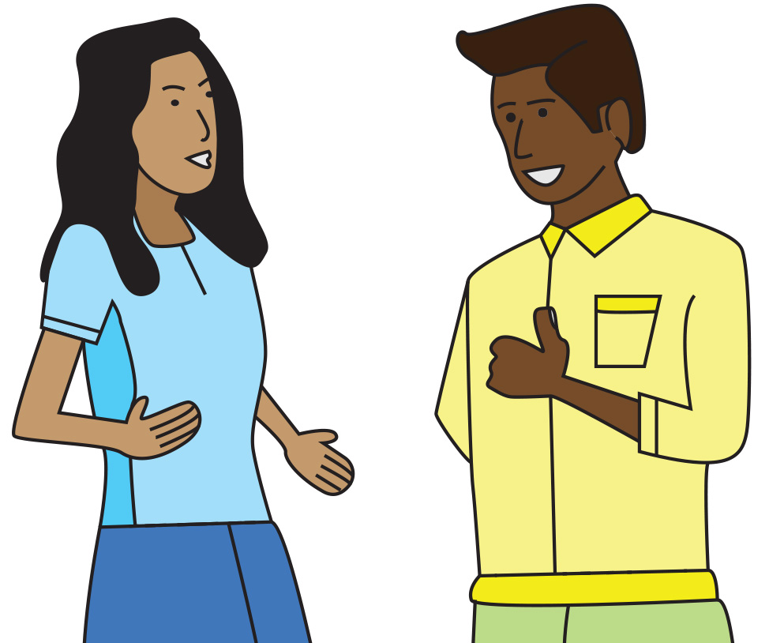
What is average?
DISCUSS
Hi! How are you?
Oh, you know – pretty average today.
What do you think Parvis means when he says "average"?
Notes:
Whole group discussion about the nature of averages. This lesson is designed to explore the different averages and their possible uses.
The discussion should start to draw out learners’ previous knowledge about averages. Learners often know how to calculate averages, even if they get the names mixed up. Do they know what an average is and when to use each average?
The first two slides are to explore the nature of average. In the first slide, Parvis feels average. This cannot be quantified with numbers, but it does allow for discussion of what the nature of “average” is.
You might prompt the discussion by asking: Does Parvis feels fabulous? Does Parvis feel terrible? This could start the idea of the middle ground – somewhere between terrible and amazing.
Could we calculate how Parvis feels? Not easily, but we could give his feelings a rating on a scale (1 being terrible and 10 being wonderful) – where would Parvis be on this scale?

Slide 3
What is average?
DISCUSS
How did you do in your maths test?
Average!
What do you think Parvis means by average in this case? Has anything changed?
3
Notes:
Asking how Parvis did in his maths test allows the class to start exploring different averages. The score can be quantified, as can the grade. It is unlikely that learners will know if their maths test results are actually average or not, but it does allow them to think about how the scores might be ordered to see if they are average.
Does Parvis’ response of “Average!” refer to how he feels he did, or does he know his grade and score? (Learners should move on from the abstract middle ground introduced in the previous slide to thinking about a quantified average).
Grades and scores can be used to find averages. How? This gives the class the opportunity to explore exactly how averages are calculated and to think about scores and grades.
Is there a way to see if Parvis has done averagely well on his math test? Can learners think how this might be done? Explore this with the class.
Would it be possible to find out the average for the class? The college? The country? How?
There is a lot of scope here for discussion and the tutor should take this opportunity to explore the class’s previous knowledge.

Slide 4
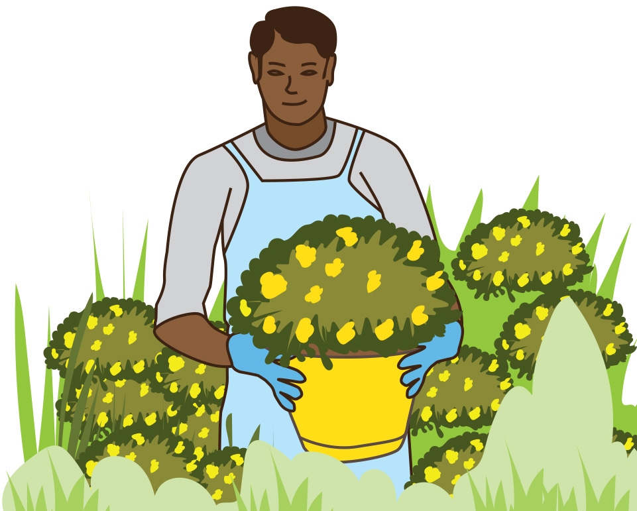
Garden centre
DISCUSS
James is starting work at a
garden centre.
A customer wants a flower that
is not too tall or too short.
How could James approach this?
Notes:
This slide introduces the context of the lesson, which revolves around a garden centre. In doing so, learners are introduced to averages within a real-life work context.
The scenario is that James has started to work here, and there are various activities and discussions around James’ tasks, which can be solved using averages and range.
Discuss with the class how James could do this.
One possible solution is to attempt to find the average height of a number of flowers and then choose one that is about that size. The class could come to this conclusion during the discussion.
The next slide explicitly tells the class that they should use an average or averages. You may want to skip this slide and rely on the group to come to this conclusion.
If the class decides that an average would be a good way to find a flower that is not too tall or too short, then you may wish to display the next slide to confirm their decision.

Slide 5
James’ friends offer to help.
You could find the average height.
Good idea!
Notes:
This slide is optional and can be skipped if the class has already come to this conclusion, and you do not feel that there is a need to confirm their decision.
It could be used to explicitly tell the class that finding the average height of a number of flowers is the best way to select one that is not too short or too tall, if the class were unable to find a solution to the task.

Slide 6
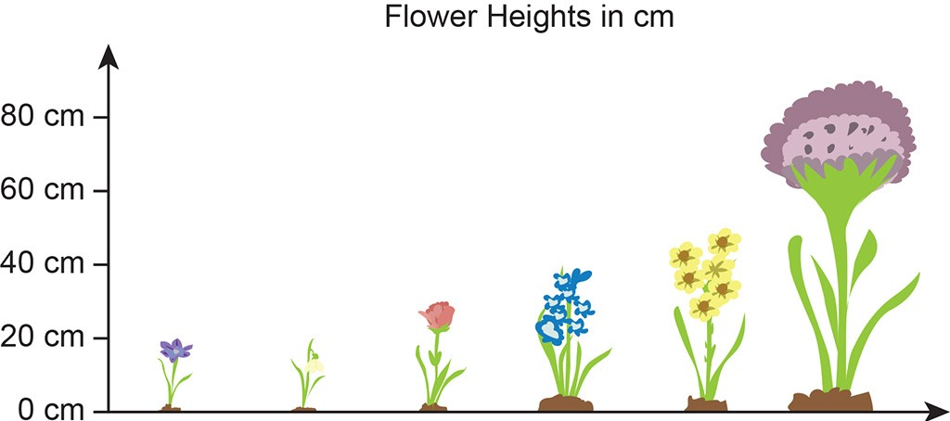
Heights of flowers
DISCUSS
90 cm
50 cm
40 cm
30 cm
20 cm
20 cm
Notes:
‘Say what you see.’ A range of flowers of different heights has been selected. The class may be able to determine the modal value (20 cm) and the median value (35 cm). The median is not written here, but learners may deduce that the 30 cm and 40 cm flowers are the middle heights, and so the median is in the middle of these two values.
If learners cannot find these values on their own, they will have the opportunity to explore this and develop these skills in the next slide.

Slide 7
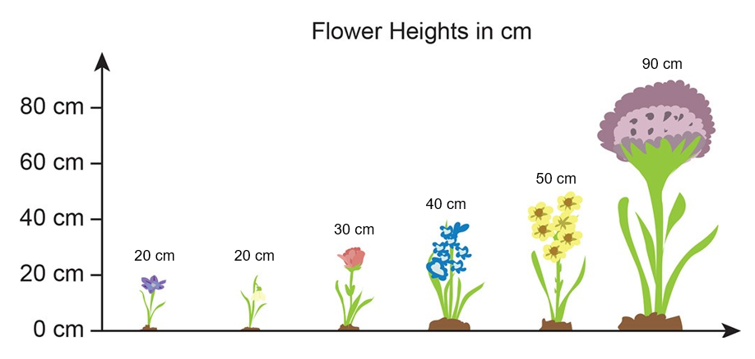
Heights of flowers
YOUR
TURN
Parvis says:
The average is 42 cm.
Jane says:
The average is 20 cm.
Maya says:
The average is 35 cm.
Kenji says:
The average is 70 cm.
Working in pairs: What have James’ friends calculated?
How can the results help James?
Notes:
This slide shows all three averages calculated as well as the range.
Parvis has calculated the mean, Jane the mode, Maya the median, and Kenji has calculated the range.
Learners are to work in pairs to identify what has been calculated.
This will expose their prior knowledge level. During the learners’ discussions, the tutor should listen and take notes of any ideas or calculations that are being made for the class discussion afterwards.
The slide is also designed to expose the misconception that range is an average. The range is visually apparent in the slide, and time should be dedicated to thinking about why the range is not an average, and possible uses for the range.
A use for range will be addressed later in the lesson, and so the depth to which it is discussed at this point is up to the tutor’s discretion. For example, if learners have a strong opinion or in-depth knowledge of range and its function within statistical analysis, explore this further. However, it is sufficient at this stage simply to explore the fact that range is not an average.
Once time is up, a discussion should take place about what learners have found and how useful each of the averages might be.
The modal value of 20 cm is of little value to James, as these are the shortest flowers.
The mean is 42 cm (rounded from 41.6), and the median is 35 cm. Discuss which is better to use in this case. There is no one true answer here, but exploration through discussion is essential as learners begin to think about how different averages can supply different information.

Slide 8

Customer expenditure
For market research purposes, the garden centre wants to estimate how much each customer spends per visit.
Notes:
This slide indicates that we have moved on from flower heights and are now examining the context of customer expenditure.
Learners will consider individual customer expenditures. The following slides show that we can only estimate this through the use of averages. You may find it valuable to briefly discuss this.

Slide 9
Customer spending
DISCUSS
 | No. of Customers | Daily takings
Monday | 100 | £1200
Tuesday | 90 | £1500
Wednesday | 3 | £15 000
Thursday | 120 | £2400
Friday | 200 | £3000
Saturday | 500 | £7000
Sunday | 420 | £6500
 | Total Customers | Total Expenditure
 | 1433 | £36 600
For market research purposes, the garden centre wants to estimate how much each customer spends per visit.
Notes:
This slide indicates that we have moved on from flower heights and are now examining the context of customer expenditure.
The title shows that we want to look at individual customer expenditures. The following slides show that we can only estimate this through the use of averages. You may find it valuable to briefly discuss this.
This exercise has been designed to show that outliers have an effect on averages.
On Wednesday, there were only three visitors to the garden centre, and they spent more money than on any other day. This is an unlikely scenario; learners should recognise this, and it can be dismissed as unlikely but possible. If learners do make this observation, they should be praised, and this can be followed by a discussion on how an outlier may affect the outcome of the exercise, which is to find a customer’s average spend.

Slide 10

Customer spending
YOUR
TURN
Handout
available
Estimate how much each customer spends on each visit to the garden centre.
Discuss with your partner how you will estimate how much money is spent by each customer.
Show your working out on your whiteboard.
 | No. of Customers | Daily takings
Monday | 100 | £1200
Tuesday | 90 | £1500
Wednesday | 3 | £15 000
Thursday | 120 | £2400
Friday | 200 | £3000
Saturday | 500 | £7000
Sunday | 420 | £6500
 | Total Customers | Total Expenditure
 | 1433 | £36 600
Notes:
Learners are to discuss with their partner how to complete the task and find out what the average customer spends.
The exercise has been designed to show that range is an important aspect of statistical analysis (there is no mode in this data set).
You should set this task (note the accompanying handout), observe what learners are saying, and take notes for the discussion after the exercise.
It is likely that the learners will divide the total expenditure of all the customers for the whole week by the number of customers for that week. This would give the mean average score, which is about £25.50. This is fine, but does not provide the full picture, as the Wednesday sales skew the figures.
A daily mean average would be a useful figure to work out. The anomaly of the Wednesday sales could provide a way into this discussion, as there are only three customers. You could ask how much each of these customers spent. The answer to this is unknown (Did one customer spend £1000, and the others £7000 each?)
A daily analysis shows the mean averages to be:
Monday: £12.00, Tuesday: £16.67, Wednesday: £5000(!), Thursday: £20.00, Friday: £15.00, Saturday: £14.00 and Sunday: £15.48.
Once this daily average is found, then a median of the mean daily averages could be useful.
So, taken daily, the range without Wednesday, is only £8.00, but if you include Wednesday's anomaly, it is £4988.
The median of the data set, when a daily average is taken, is £15.48.
This can be discussed in depth if the learners have worked on the figures. If they have not worked this out, then careful questioning could be used to scaffold.
There is huge scope for discussion with this task.

Slide 11
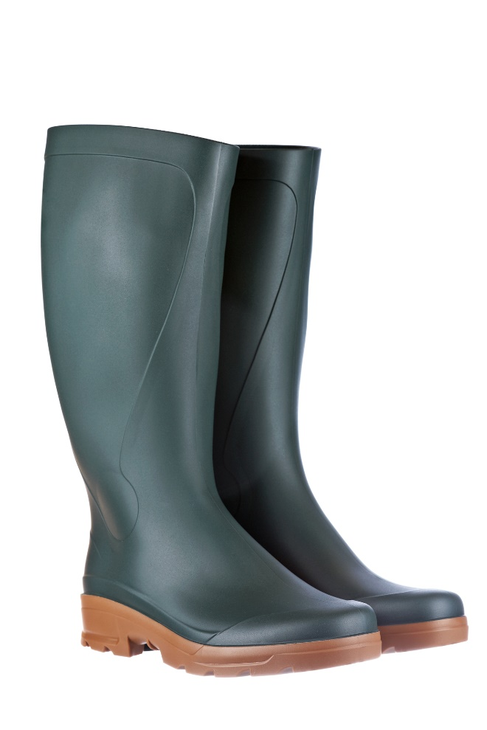
Buying wellies
The garden centre is running low on their stock of wellingtons.
James must buy new stock from the warehouse.
James only has information about welly sales from the previous week.
James says, “I need to know the average size of welly that has sold so that I can order lots of that size, so I’ll work out the mean.” Is he correct?
Notes:
This slide introduces the next task that James has: to buy wellies.

Slide 12
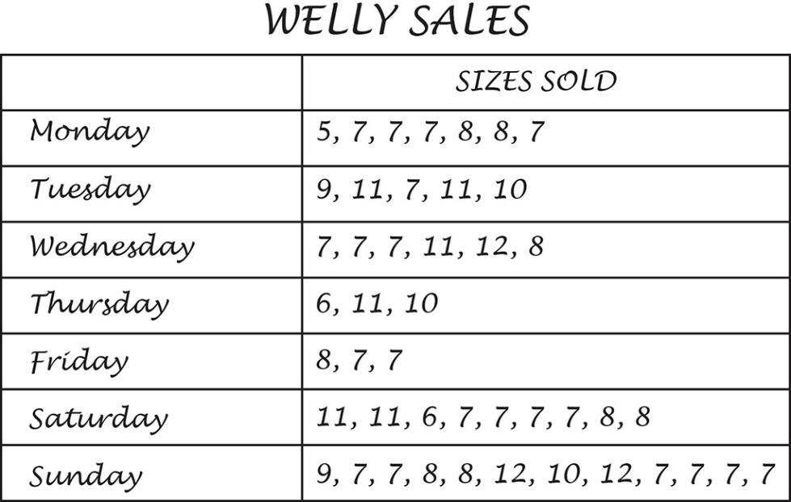
Buying wellies
DISCUSS
Handout
available
Ashton Wholesale Shoes
Order Form
Item | Size | Quantity | Price | Subtotal
 |  |  | Total
He only has a budget of £300, and wellies cost him £10 at the warehouse.
Working with your partner, figure out how many pairs of each size of wellies James can buy.
Decide how you will do this and work together to fill in the order form.
Notes:
The only information that James has about what has been bought recently is a handwritten note by his predecessor, which gives information about one week’s welly sales.
It’s not a lot of information, but it is all that he has. It might be useful to ask how this might change throughout the year. Are more wellies bought in the winter? Are there more wellies purchased in the summer (for festivals)?
This should not be a long discussion, but the fact that more information would be useful should be highlighted.
The most useful average here is the modal average. 7 is the modal size, and so more of this size should be purchased. It should be highlighted that James will not be able to buy as many wellies as the week for which he has the information due to his small budget. He must, therefore, prioritise which sizes to buy.
During the exercise, learners will work in pairs to discuss how the information should be used. For example, tally charts would be a useful way to organise the information.
Some learners might try to calculate the mean average size by dividing the total of the sizes by the total of the wellies. This is a common mistake. Why is this not useful?
While the learners are working on this task, take note of the discussions and calculations taking place.
Once the time has elapsed, or the learners seem to be finished, a discussion should take place about the learners’ findings.

Slide 13

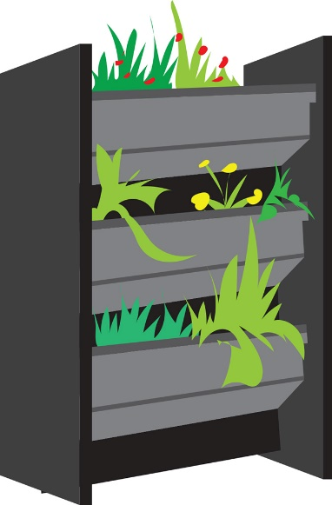
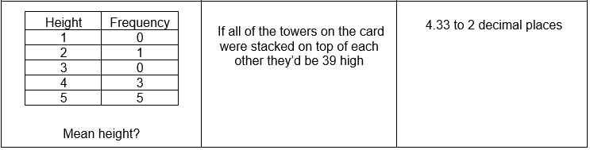
Stackable plant boxes
Handout
available
Stackable plant boxes can be built into a tower of any size.
They are one of the garden centre’s best sellers.
James is working out the average height of towers sold, using the mean average.
Take turns with your partner to match the cards.
Notes:
In this exercise, learners are to work in pairs to match the cards. The exercise is designed around the calculation of the mean average and helps learners understand the mathematical structure using visual representations, tables and numbers.
The garden centre sells stackable plant boxes. This gives an opportunity to use connecting blocks as manipulatives.
Learners, working in pairs, should discuss the task and take it in turns to place a card. Each time they place a card, they should explain to their partner why they are placing that particular card.
The tutor should monitor the activity by taking note of discussions and reasoning to help with the post-activity discussion.
Once the exercise is completed, the tutor should facilitate a discussion as to what the learners did and why.
It will be useful to think about whether a mean average is a suitable way to find out the average height of the stackable boxes. For example, why is there a decimal? Could there be a better average to use?
It must be noted that this exercise can be adapted to use the other averages and even the range depending upon the ability of the groups that are being taught.
Matching cards answers:
b, d, k, f, h
a, c, e, g, i
l, o, n, r
m, p, q, s

Slide 14
Time of customers’ stay
James has been given a table of information about the average length of stay of customers.
Survey | Time (in minutes) |  |  |  |  |  | Mean
A | 26 | - | 32 | 24 | 20 | 30 | 26
B | 26 | 32 | - | 26
Survey A consisted of six customers and survey B consisted of four customers.
Unfortunately, three entries are missing from the table.
In survey A, 6 customers were timed and their mean visit time was 26 minutes.
In survey B, 4 customers were timed.
The overall mean of the combined data was 26.8 minutes.
Can you work out what the three missing values are?
Notes:
This exercise is designed to test learners' understanding of the mathematical structure of mean.
Ask the learners to work alone for a few minutes before discussing what they have done or what they think with their partner.
This may lead to a productive struggle, as this is a little tricky. Allow time for the learners to solve the problem, but scaffold by asking questions should the task become too much.

Slide 15
Time of customers’ stay
YOUR
TURN
Handout
available
Survey | Time (in minutes) |  |  |  |  |  | Mean
A | 26 | - | 32 | 24 | 20 | 30 | 26
B | 26 | 32 | - | 26 |  |  | -
The overall mean of the combined data was 26.8 minutes.
Work by yourself at first and see if you can complete the table.
Talk to your partner about what you have done and why.
If your answers are the same, talk to each other and explain how you got your answers.
Notes:
Give the learners some time to work alone.
Once they have worked on the problem alone, learners will then explain their answer to their partner.
If the pair agrees, then each learner must explain in their own words what they did. If they disagree, then they must work out why they disagree and see if they can come to an agreement.
The tutor will observe and listen to what the learners are saying, taking note of common errors or correct calculations, which will help with the review.

Slide 16
Time of customers’ stay
REVIEW
Survey | Time (in minutes) |  |  |  |  |  | Mean
A | 26 | 24 | 32 | 24 | 20 | 30 | 26
B | 26 | 32 | 28 | 26 |  |  | 28
The overall mean of the combined data was 26.8 minutes.
Notes:
Here, the tutor should bring the class's ideas together.
It could be useful to question the whole group to bring ideas together, or the tutor could ask a successful pair to demonstrate what they did.
Answer for row A is 24
Calculation is:
26 x 6 = 156
All current numbers add up to 132
156 − 132 = 24
Answer for row B (missing time) is 28
Find the mean for all 10 combined
10 × 26.8 = 268
All 9 add up to 240
268 − 240 = 28
Answer for row B (missing average) is 28

Slide 17

Which delivery service?
DISCUSS
The garden centre wants to choose the most consistent delivery service to use.
They have used two local ones and recorded their delivery times.
Moving Target Delivery |  |  | Glossop Delivery
Delivery Day | Hours Taken |  | Delivery Day | Hours Taken
Monday | 2 |  | Monday | 4
Tuesday | 2 |  | Tuesday | 4
Wednesday | 5 |  | Wednesday | 5
Thursday | 5 |  | Thursday | 3
Friday | 6 |  | Friday | 4
Working with a partner, think about which service you would choose.
You must be able to justify your answer.
Notes:
The more consistent delivery service will be the better service to use. Glossop Delivery has the smaller range (2 hours) and is therefore the more consistent.
The mean delivery time for both of these firms is 4 hours, so a mean average is not very useful to determine the most consistent.
The median time for Moving Target is 5 hours and the median for Glossop Delivery is 4 hours.
This information combined with the range gives the impression that Glossop Delivery is more consistent (and can be better relied upon), and that the median average is shorter.
The role of the tutor is to listen to the learners' reasoning while they have their thinking and discussion time, and then to use this to facilitate the discussion of which service they would choose.

Slide 18
Practice question
PRACTICE QUESTION
Here are some numbers.
3 6 2 2 5 3
(a) Find the median.
(b) Work out the range.
(c) Work out the mean.
Notes:
This question is designed for those learners who are confused between their averages and the range. It is a simple question for learners who need to practise these calculations.
Answers: a) 3, b) 4, c) 3.5

Slide 19
Practice question
PRACTICE QUESTION
There are 15 children at a birthday party.
The mean age of the 15 children is 7 years.
9 of the 15 children are boys.
The mean age of the boys is 5 years.
Work out the mean age of the girls.
Notes:
Answer: 10
From mark scheme: 3 marks are available
M1 for 15 × 7 (= 105) or 9 × 5 (= 45)
M1 for (15 × 7 − 9 × 5) ÷ (15 − 9)
A1 cao

Slide 20
Lesson review:
Averages and Range
Objectives
To understand the difference between mean, mode, and median
To be able to use the appropriate average for different purposes
To understand that range refers to the spread of data rather than an average
Suggested further steps/areas to work on
Frequency tables

Slide 21
Lesson 45:
Credits
Text acknowledgements
Pearson Education Ltd: Pearson Edexcel GCSE Mathematics B Foundation Tier 5MB1F/01 May 2015 Question 8 (Slide 18), Pearson Edexcel ​GCSE Mathematics A Paper 1 (Non-Calculator) Higher Tier 1MA0/1H November 2016 Question 16 (Slide 19)
Photo acknowledgements
Shutterstock.com: jan kranendonk, Nong4, stockbroker

