Slide 1


Lesson 12:
Probability
Level 1
Objectives
Understand the likelihood of events using a probability scale
Calculate simple probability as a fraction, decimal or percentage, including from a table
Identify and correct common misconceptions

Slide 2

The line up
INTRODUCTION
Worksheet
available
What is the probability of…
you sleeping tonight?
it snowing today?
Choose a scenario.
Line up against the wall in order from certain to impossible according to where your scenario would be on a probability scale.
Notes:
This is a whole class activity and involves ordering events according to their probability of occurring. It can be done in several ways, according to the space available, including:
A ‘washing line’ hung across the classroom, or along one wall.
Asking learners to stand in a line across the classroom, or along one wall.
Mark one end of the line ‘impossible’ and the other end ‘certain’.
Ask learners to blind pick event cards (also have blank cards for them to write their own events). Then ask them to place themselves (or hang their card) in a line and justify their position.
Ask probing questions to keep the conversation going, e.g.:
Why did you place yourself there?
Look to your left and to your right – is your event less likely than one and more likely than the other? If not both of those – should you move or should they move?
What if I made a minor change to your scenario – e.g. you bought twice as many lottery tickets, or instead of rain in summer, it is rain in winter?

Slide 3
Probability scale
DISCUSS
0 | 0.1 | 0.2 | 0.3 | 0.4 | 0.5 | 0.6 | 0.7 | 0.8 | 0.9 1
Impossible
100% Chance
75% Chance
Likely
50% Chance
No Chance
Certain
Even chance
Unlikely
25% Chance
Notes:
Introduce the number line from 0 to 1 and check understanding through questioning:
Which number represents ‘impossible’ & which represents ‘certain’?
What number would ‘unlikely’ be? What about ‘likely’? What label would you use for 0.5?
As learners respond, move the blue labels to the appropriate point on the scale.
Discuss some of the events from the previous activity, and what numbers would they apply to these.
Ask learners to come up with other examples – ask ‘Is that a reasonable chance?’. Identify where each would be positioned on the probability line.
Finally, highlight the percentage cards, and ask the class where these would sit on the number line. Move these to the appropriate place.

Slide 4

Probability
DISCUSS
KEY IDEA
A probability is a number showing the likelihood that an event will occur.
Probabilities can be expressed as decimals or fractions between 0 and 1, or as percentages between 0% and 100%.
A probability of 0 indicates that an event is impossible, while a probability of 1 means an event is certain to happen.
Notes:
Use this slide to summarise the basic ideas of probability.
Check that everyone understands the meaning of an ‘event’ and provide examples to illustrate.

Slide 5
Say what you see
DISCUSS
Worksheet
available
List as many things you notice about this grid.
You have two minutes!
Notes:
Ask the class what they can see on the slide. Answers could include: 'different coloured rectangles’, ‘squares’, ‘squares within squares’, ‘bit like Tetris’, and so on.
Probe further for more mathematical responses, such as ‘100 squares’, ‘10 × 10’, ‘blue is 5 × 5’, ‘blue is a ¼’, ‘yellow is 1 out of a 100’, ‘There are 4 times as many green as brown squares.’
Provide learners with a handout of the grid, and ask them to work individually to label the grid with fraction, decimal & percentage of each coloured area. Ask them to check their answers with their neighbour and discuss any differences in their labelling.

Slide 6
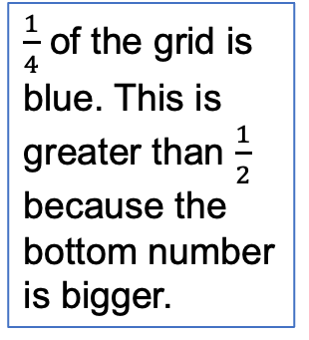

Spot the mistakes
EXPLORE
4 orange squares is the equivalent of $\frac{1}{4}$
$\frac{1}{4}$ of the grid is blue. This is greater than $\frac{1}{2}$ because the bottom number is bigger.
Which of the statements are incorrect?
Can you explain how to correct them?
There are twice as many black squares than pink, this is an increase of 50%
1 shaded square is yellow, this is the equivalent of 0.1 which is 1%
Notes:
Click to reveal each statement, one at a time. For each one, ask whether it is correct, then nominate a learner to correct it if not.

Slide 7
Probability game
EXPLORE
The grid has been developed into a game.
Imagine that a light flashes under each square in turn, then stops at random on a square.
What is the probability of the light stopping on a blue square?
Notes:
Explain that the grid is part of a game. Each square lights up in turn, then stops at random on one of the squares.
Provide each learner with a mini whiteboard and marker, and ask a series of questions about the probability of the light stopping on different coloured squares.
Start with easier questions, but work up to more challenging ones, depending on the group.
For each question, ask learners to write their answers on their mini whiteboards and hold them up.
Write down some of the responses on the board and discuss how they were arrived at. Ask for equivalent fractions, decimals and percentages, if not included.
Example questions might be:
What is the probability of the light stopping on a blue square?
What are the chances of the light stopping on a pink square?
What is the probability of a blue or pink square? (highlight that these are additive)
If the chances of a blue one is 1 out of 4, what is the chance of not stopping on a blue?
What are the chances of not stopping on a blue or a pink?
What is the probability of stopping on a white square?
What is the probability of a purple square? (zero, it’s impossible!)
Highlight that the sum of all possible outcomes must add up to 1.

Slide 8
Writing questions
YOUR
TURN
Worksheet
available
Working in pairs, write down 3 probability questions under the grid you’ve been given.
One should be easy and the other two more difficult.
Make sure you can work out the answers from the grid.
Pass your questions on to another pair (who have been working on a different grid) and ask them to answer the questions.
Afterwards, pass your answers back to the pair who set the questions to be marked.
Notes:
Ask learners to work in pairs and give each pair blank grids and coloured markers and ask learners to complete their own grids.
Ask each pair to write three probability questions that can be answered from the grid. These should be written on the handout, underneath the grid. Suggest that the first questions be easy, but the other two can be more challenging (e.g. involving ‘or’ or ‘not’ in the question).
When pairs have written their questions, click to reveal the next instruction – and ask learners to pass their questions to a different pair to answer.
Finally, click to reveal the final step – pairs return the answered questions to the writer to be marked. Learners should then give feedback to the pair who answered their questions.
Finish by asking what sorts of questions were difficult – and what made them difficult.

Slide 9
Probability of events
EXPLORE
KEY IDEA
the number of ways the event can happen
the total number of equally likely outcomes
The total probability of all possible events = 1
The probability of an event =
Notes:
Use this slide to summarise the key idea of calculating probabilities of equally likely events.
Provide examples to illustrate the formula – including examples from the grid, but also introduce other contexts – e.g. coins, dice, cards, balls in a bag.

Slide 10

Football match
REVIEW
Emma supports her local football team, Blackburn Rovers.
On Saturday, they are playing against Manchester United.
Emma says they can either win, lose or draw. Therefore they have a 1 in 3 chance of winning.
Is she correct?
Notes:
Discuss what Emma has said and draw out the misconception – it would only be 1 in 3 if each result was equally likely. Is this the case in this scenario? Are Blackburn Rovers as equally likely to win as Manchester United?
How is this different from other probability scenarios – such as the grid or throwing a dice?
What do they think the actual probability would be?
How would this change if it was a different team they were playing?

Slide 11
Probability of events given
YOUR
TURN
Worksheet
available
No Chance
25% Chance
50% Chance
75% Chance
100% Chance
0 | 0.1 | 0.2 | 0.3 | 0.4 | 0.5 | 0.6 | 0.7 | 0.8 | 0.9 1
Impossible
Unlikely
Even chance
Likely
Certain
In pairs, discuss the probability questions you have been given.
Decide the probability of each event happening, and place it on the probability scale you have been given.
Notes:
Ask learners to work in pairs or small groups and remind them of the probability scale from earlier.
Provide an A3 size probability scale and card set A. Ask each group to agree on the probability of each event happening and write this on the card, then stick the card (using a glue stick) at the appropriate place on the grid. There are 2 blanks provided for learners to make up their own probability statements.
When learners have completed card set A, give them card set B to work with – these are more challenging. Again, there are two blank cards for learners to write in their own statements.
When all statements have been placed, tell learners to stick their posters on the wall. Learners should then compare their posters with those of other learners, and note any differences.
Finally, discuss any differences between posters or anything else learners found difficult, making sure any errors are addressed.
Card set A
Rolling a 1 on a dice: 1/6
Flipping a coin and it landing heads: 1/2
Not rolling a 6 on a dice: 5/6
Rolling a 7 on a dice: 0
An odd number being picked at random from numbers 1 to 20: 10/20 = 1/2
Spinning a 5 on spinner labelled 1 to 8: 1/8
Rolling a number less than 7 on a dice: 6/6 = 1
Drawing a green ball from a bag containing 3 red, 6 green and 1 blue balls: 6/10 = 3/5
Rolling an even number on a dice: 3/6 = 1/2
Rolling a number greater than 4 on a dice: 2/6 = 1/3
Card set B
Flipping 2 coins and both landing on tails: ½ × ½ = ¼
Spinning a number greater than 2 on a spinner labelled 1 to 8: 6/8 = 3/4
Rolling an odd number less than 5 on a dice: 2/6 = 1/3
Drawing a green or red ball from a bag containing 3 red, 5 green or 2 blue balls: 8/10 = 4/5
Throwing 2 dice and getting a total of 12: 1/6 × 1/6 = 1/36
An odd number greater than 6 being picked at random from the numbers 1 to 20: 7/20

Slide 12
Dice game
REVIEW
In a game, there are three events for an ordinary fair dice.
If the number is an odd number, Aisha wins a prize.
If the number is greater than 6, Sam wins a prize.
If the number is an even number less than 3, Sunil wins a prize.
Who is most likely to win?
Sam says,
  ‘The probabilities should add up to 1, so one of us is certain to win.’
Is Sam right?
Notes:
Ask learners to answer the first part of this question working individually at first, but then conferring with their neighbour.
Take feedback and ensure that everyone is clear about how each person’s probability was calculated.
Next, reveal the second part of the question. Ask learners to reflect on what Sam says and decide if he is right. Ask volunteers to explain why they think he is or isn’t right.
Probe to bring out the point that the three events only include odd numbers and those even numbers less than 3 (i.e. 2) – so if the dice lands on 4 or 6, no-one wins.
Finish by asking what is the probability of no-one winning?
Answers:
Q1:
The probability that Aisha wins is 3/6 = 1/2
The probability that Sam wins is 0/6 = 0
The probability that Sunil wins is 1/6
So Aisha is most likely to win.
Q2: Sam is not right, as the three events are not ALL possible events. For example, throwing the number 4 or 6 is not included in any of the three events. As a result, the total probability of the three events is not 1 and there is a chance that no one wins the game, e.g., when a 4 or 6 is thrown.

Slide 13
Sum of all possible events
KEY IDEA
The total probability of all possible events = 1
Notes:
Highlight that the sum of the probabilities equals 1 only if all possible probabilities are included.
Refer back to the previous example and give further examples.

Slide 14
Calculate probabilities from a table
EXPLORE
Below is a table that shows the daily number of text messages sent on a single day by members of a class of 30 people.
Number of text messages sent | Number of people
0 | 3
1–5 | 3
6–10 | 7
11–15 | 10
16–20 | 5
21+ | 2
Total | 30
One of the people is selected at random.
What is the probability that this person sent fewer than 11 text messages that day? How do you know?
What is the probability that this person sent more than 15 messages that day?
14
Notes:
Introduce the data in a tabular format. Discuss the similarities of this to the 100 square grid and recap what is known of the probability values. Remind the learners that the key idea is to work out the number of ways an event can happen divided by the total number of possible outcomes.
Ask learners how to calculate probability from data in a table.
Adapt slides to be at the right level for learners where possible.
Answers:
(a) 13/30. According to the table, there are 13 people who sent fewer than 11 messages that day. The total number is 30. So the probability is 13/30.
(b) 7/30

Slide 15
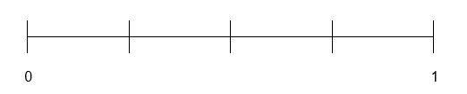
Practice question 1
REVIEW
Worksheet
available
Pierre is a teacher.
There are 13 boys and 17 girls in his class.
Pierre chooses one of these students at random for a presentation.
(a) Work out the probability this student is a boy.
Pierre travels to work on the train.
He records whether the train is on time or late.
These are his results after 20 train journeys
on time 15 days
late 5 days.
Mark with a cross (X) on the scale the probability the train is on time.
Notes:
Provide learners with a handout of these questions from past papers and ask to work through them independently.

Slide 16
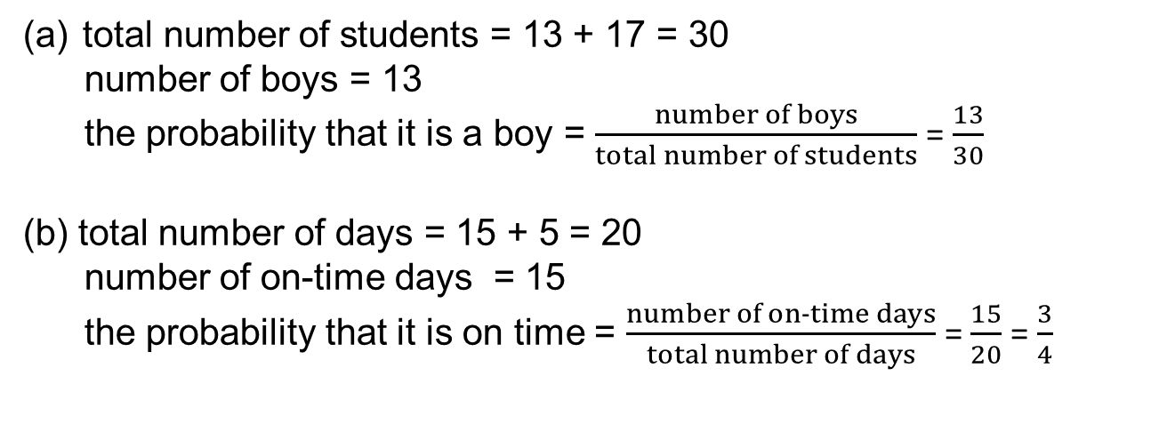
Practice question 1 (answers)
REVIEW
total number of students = 13 + 17 = 30
number of boys = 13
the probability that it is a boy = $\frac{number of boys}{total number of students}$ = $\frac{13}{30}$
(b) total number of days = 15 + 5 = 20
number of on-time days = 15
the probability that it is on time = $\frac{number of on‑time days}{total number of days}$ = $\frac{15}{20}$ = $\frac{3}{4}$
X
Notes:
Discuss answers with the class, highlighting any misconceptions.

Slide 17
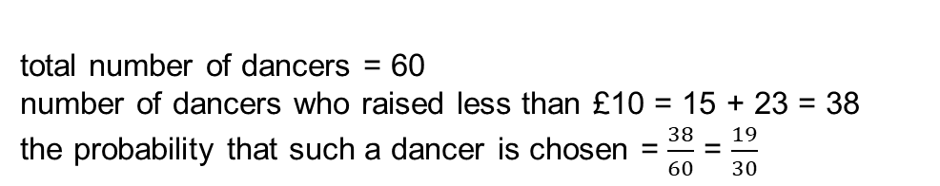
Practice question 2
REVIEW
Worksheet
available
A group of dancers raised some money for a charity.
Here is some information about the money raised.
money raised (£) | number of dancers
4.99 or less | 15
5 to 9.99 | 23
10 to 14.99 | 12
15 to 19.99 | 7
20 to 24.99 | 3
total | 60
total number of dancers = 60
number of dancers who raised less than £10 = 15 + 23 = 38
the probability that such a dancer is chosen = $\frac{38}{60}$ = $\frac{19}{30}$
One of the dancers is chosen at random to give the money raised to the charity.
What is the probability that this dancer raised less than £10?

Slide 18
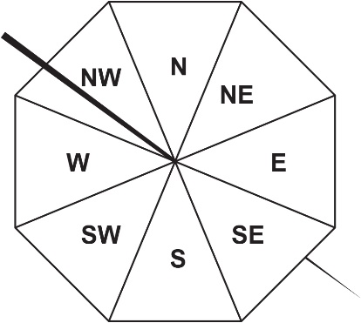

Practice question 3
REVIEW
Worksheet
available
Here is a fair 8-sided spinner.
Laura spins the spinner once.
Write down the probability that the spinner will land on a section that includes the letter E.
$\frac{3}{8}$

Slide 19
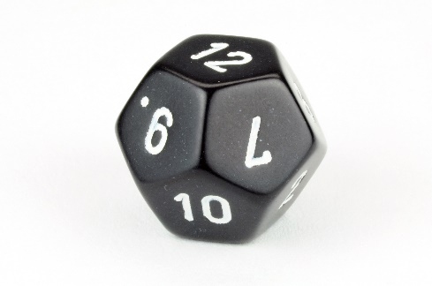
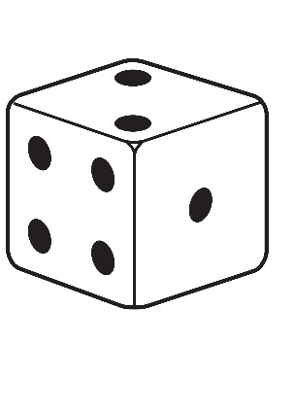
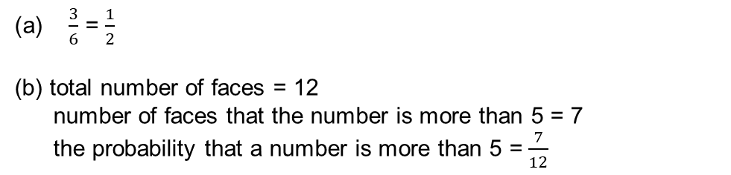
Practice question 4
REVIEW
Worksheet
available
Tom rolls an ordinary fair dice.
Mark with a cross (X) on the scale the probability that Tom rolls an
even number.
Tom has a fair dice with 12 faces of equal size.
There is one number on each face.
The numbers are 1 to 12.
Tom rolls the dice and looks at the number on the top face.
What is the probability that this number is more than 5?
$\frac{3}{6}$ = $\frac{1}{2}$
(b) total number of faces = 12
number of faces that the number is more than 5 = 7
the probability that a number is more than 5 = $\frac{7}{12}$
X
0
1
Notes:
Ask learners to work through these questions from past papers. Print out where possible.

Slide 20
Lesson review:
Probability Level 1
Objectives
Understand the likelihood of events using a probability scale
Calculate simple probability as a fraction, decimal or percentage, including from a table
Identify and correct common misconceptions

Slide 21
Lesson 12:
Credits
Photo acknowledgements
Shutterstock.com: Vectorfair.com
Text acknowledgements
Pearson Edexcel Functional Skills, Past Paper 3 Mathematics Level 1 (Calculator) PMAT1/C03 Question 8, Pearson Edexcel Functional Skills, Practice Paper 1 Mathematics Set 1 (Calculator) PRACL1 /01 Question 8, Pearson Edexcel Functional Skills, Past Paper 4 Mathematics Level 1 (Calculator) PMAT1/C04 Question 10

