Slide 1


Lesson 35:
Properties of 2D Shapes
Objectives
Name and identify the properties of a range of 2D shapes.
Sort and classify different types of triangles and quadrilaterals according to their properties.
Identify the sum of the interior angles of triangles and quadrilaterals.

Slide 2
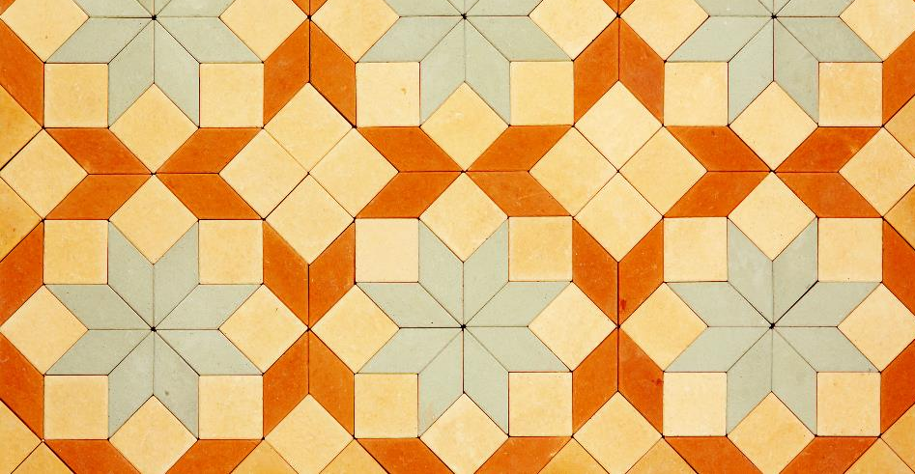


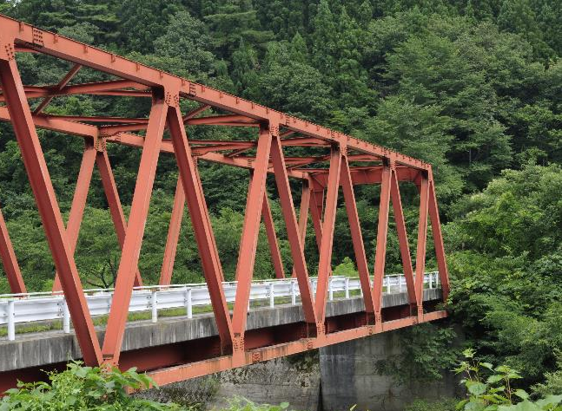

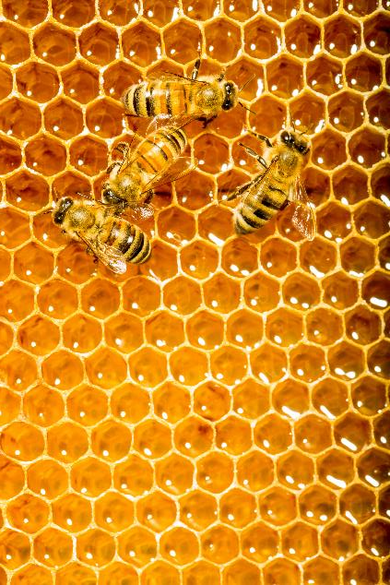

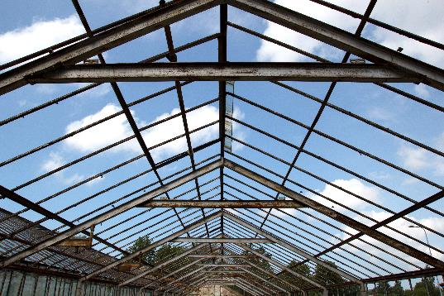
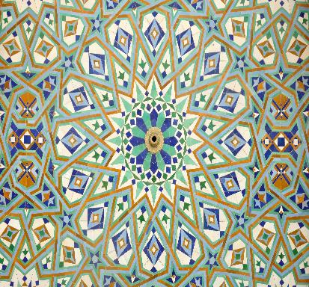
Shapes are all around us
Notes:
Shapes are all around us.
Ask the learners to write down three shapes they can find:
in a classroom
in nature
on their vocational course.
This may lead to a discussion on tessellation. Any key words/shape names that are mentioned to be addressed and recorded on the board so that learners get more familiar with the spelling of these words.

Slide 3


Shapes Poster Activity
Handout
available
Your group have 5 minutes to write down everything you know about the shapes on your card.
Use diagrams to help.
Swap your poster with a different group.
Can you add anything about their shapes?
Notes:
Learners have been learning about shapes since primary school, so this group poster sharing activity is an opportunity for them to recall and demonstrate their prior knowledge and for the tutor to assess their starting points.
1. Split the class into groups (suggested group size: 3–4).
2. Give each group a poster topic (Handout 1) to begin a "poster”. You can subdivide or duplicate the topics if you need more groups. Make sure learners focus on content rather than artwork.
3. After 5 minutes, ask groups to swap posters (or groups could move to a different poster) and ask learners to add to posters started by other groups. Continue swapping the posters/groups every few minutes until each group has had the chance to add additional information to each poster.
If groups are running out of ideas, select a prompt card (Resource 1) to guide them or extend their thinking.
Encourage learners to use the correct notation on the diagrams (e.g., if they know sides are equal, how will they represent equal sides on the diagram?)
Prompt cards to include: Are any of the sides equal? Are any of the angles equal? Does the shape have any lines of symmetry? How many? Does the shape have any parallel sides? Does the shape have rotational symmetry? What order? Do you know anything else about the shape? Do you know any other types of triangles, quadrilaterals or polygons?

Slide 4
Poster Feedback
REVIEW
Triangles
Quadrilaterals
Circles
Other polygons
Notes:
Groups get their original posters back and display the poster so the rest of the class can see the information. They should then present a brief summary of the main facts about their group of shapes. This should be brief, and groups should aim to keep their presentations to a couple of minutes.
Tutor should prompt if needed. For example, how many sides does that shape have? What are the names of the different types of triangles? What can you say about the angles in that shape? What are the different parts of a circle called?
The tutor should draw attention to incorrect or missing information and try to elicit the correct information from the group or the rest of the class.
Posters can be displayed on the wall so learners can see them in their entirety and refer to them in the lesson as a source of support.

Slide 5

Isosceles Triangle
REVIEW
Joe says
C
Angle CAB = Angle ABC
because base angles in an isosceles triangle are always equal.
A
B
Is Joe correct?
Explain why / why not
Notes:
From learner feedback, draw out the misconception here:
The base angles are not always at the bottom of the triangle. They are the angles opposite the equal sides.

Slide 6

Mathematical Language
KEY IDEA
Parallel lines are always the same distance apart for their entire length.
Perpendicular lines cross each other at right angles.
A line of symmetry is a line that divides a shape into two equal and symmetrical halves.
Rotational symmetry is when a shape still looks the same after a rotation about its centre.
Notes:
Previous discussion may have included these key words. The tutor should highlight this key vocabulary and ask learners to give a definition or an example to show their understanding.

Slide 7
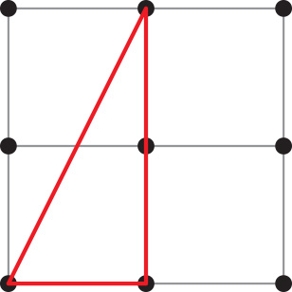
Explore Triangles and Quadrilaterals
Worksheet
available
Geoboards or dotty paper can be used to construct shapes.
How many different triangles can you make?
How many different quadrilaterals can you make?
Notes:
Note: Physical geoboards are useful as they allow learners to progress from concrete to pictorial representations.
Your construction department might be able to make some geoboards for you using approximately 80-100 mm square offcuts and nine nails, but if geoboards are not available, learners can go straight to dotty paper (Handout 2).
Alternatively, they could use Geoboard (mathsbot.com) on their phones or other devices. This is also useful for tutors to use for review purposes.
1. Give learners a 9-pin geoboard and/or 9-dot dotty paper (Resource 2) and ask them to make as many triangles and quadrilaterals as they can. If using geoboards, ask learners to record the different shapes they make by sketching on the dotty paper.
You might like to separate the tasks (triangles and quadrilaterals) to focus on one at a time.
2. The tutor circulates and provides prompts to develop thinking. For example: What do you notice? Are any of your shapes the same? Does it matter where they are on the grid? Do you know the specific name of this shape?
Note: There are eight distinct triangles and sixteen quadrilaterals in total, but learners will probably not find them all in the time available.

Slide 8
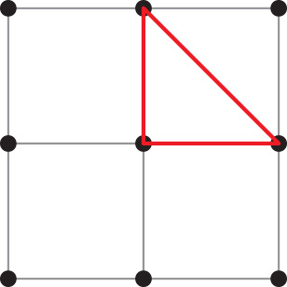
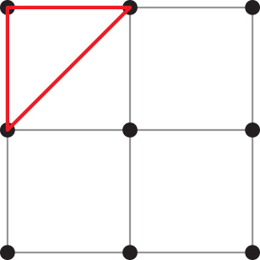
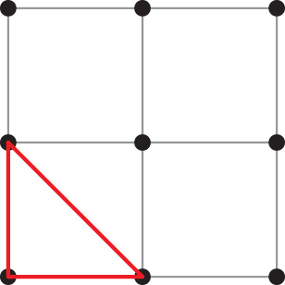


Congruence and similarity
I think that all your triangles are the same.
Dev says
Ruby replies
I drew three different triangles.
Who is correct? Discuss their reasoning.
Notes:
Tutor to ask for learners’ opinions on who is correct and why.
Elicit from learner responses (or highlight to them) that all have a right angle and the 3 sides of one triangle equal the 3 sides of each of the other triangles (they can measure 2 sides of 1 unit in length).
Review the idea of congruence, highlighting that the triangles fit exactly on top of another and that different orientations do not make them different shapes. Tip: Tracing paper could be used to test if the shapes are congruent.
Some learners may be familiar with congruence rules for triangles (SAS, SSS, etc.), but in general, do not worry about covering this here.
Highlight that if the side lengths were different, then the triangles would be different.

Slide 9
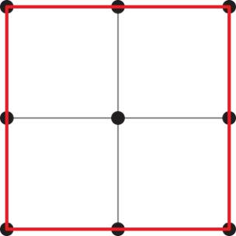
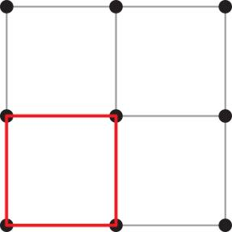

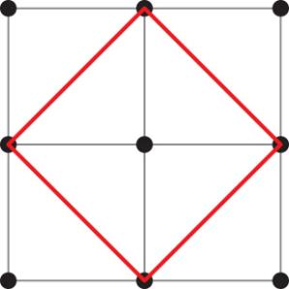
Congruence and similarity
Joe found these quadrilaterals.
Are they all different?
Notes:
The tutor should ask the class if these shapes are congruent. Why? Why not? This reinforces the previous slide.
The tutor should introduce the term and concept of similarity.

Slide 10
Mathematical Language
KEY IDEA
Congruent shapes are exactly the same.
  If two shapes are congruent they will fit exactly on top of one another.
Similar shapes are enlargements of each other using a scale factor. Similar shapes can be bigger or smaller than the original shape but all sides and angles will be increased or decreased proportionally.
Notes:
The tutor should highlight this key vocabulary and check for learners’ understanding of the concepts of congruency and similarity.

Slide 11
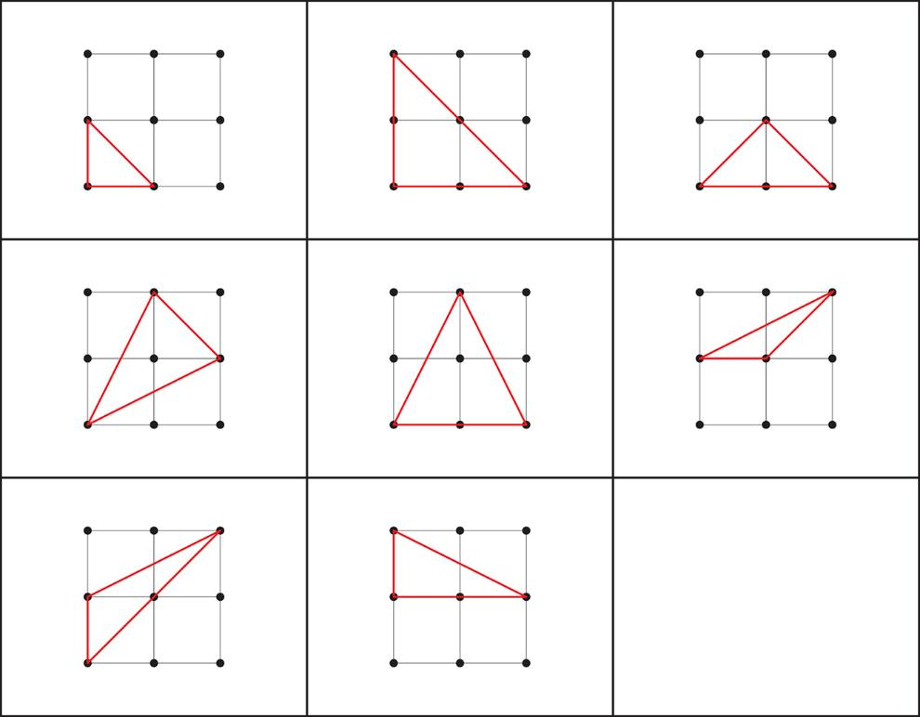
Triangles – how many did you find?
REVIEW
Notes:
The tutor should ask learners to check how many of the 8 possible different triangles they found.
Reinforce the concept of congruence (different orientations count as one shape).

Slide 12
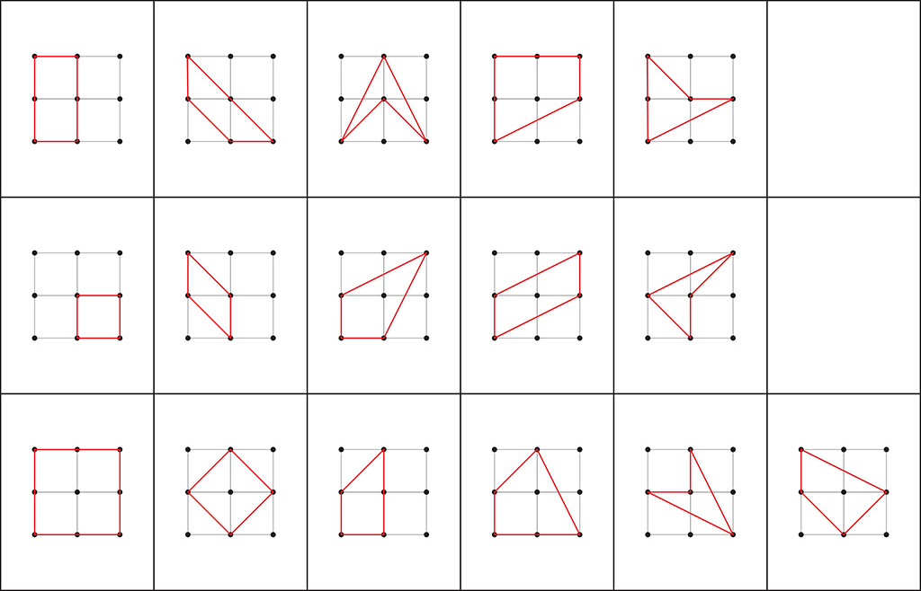
Quadrilaterals – how many did you find?
REVIEW
Notes:
The tutor should ask learners to check how many of the 16 possible different quadrilaterals they found.
Reinforce the concept of congruence (different orientations count as one shape).

Slide 13
Common Shapes
KEY IDEA
A polygon is a closed figure made up of line segments in a two-dimensional plane
A triangle is a polygon with 3 sides and 3 angles
A quadrilateral is a polygon with 4 sides and 4 angles
Other common polygons include:
pentagons (5 sides)
hexagons (6 sides)
heptagons (7 sides)
octagons (8 sides)
nonagons (9 sides)
decagons (10 sides)
Notes:
The tutor should reinforce the shapes learners are most likely to encounter.

Slide 14
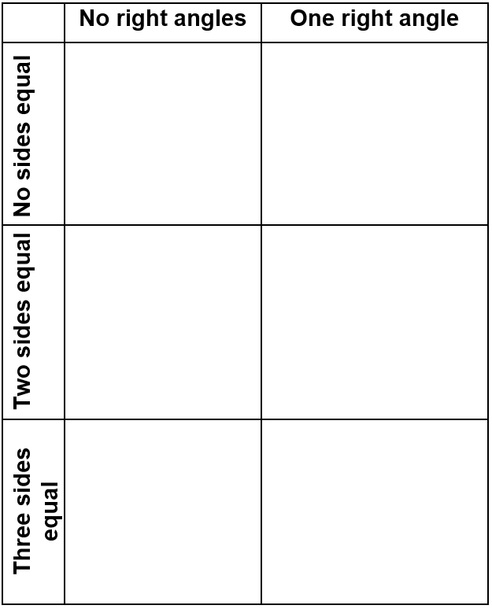
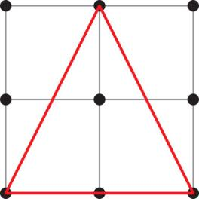
Sorting Triangles and Quadrilaterals
Handout
available
Place each shape in a cell on the table.
Cells may have one card, more than one card, or no cards.
Notes:
You will need:
A set of 8 triangle cards (Handout 3a) and a table to sort the triangles (Handout 3b).
A set of 16 quadrilateral cards (Handout 3a) and a table to sort the quadrilaterals (Handout 3b).
Learners to work in pairs to place the shape cards in the cells that match the characteristics of the shape.
Tutor to circulate and check learners’ work, asking them to explain their sorting decisions.
Differentiation:
You could give some working pairs triangles and other pairs quadrilaterals. Note that the quadrilaterals may be slightly more demanding.
Some learners may need more support so consider sorting on just one criterion, e.g. no right angles/right angles.

Slide 15

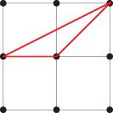
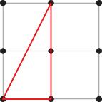
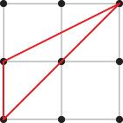
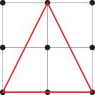
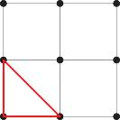
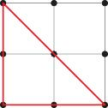
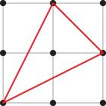
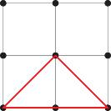
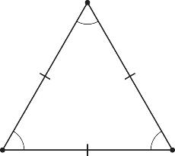
Sorting triangles
REVIEW
Can you draw a triangle that would fit in the empty cells?
Are any cells impossible to fill?
Can you explain why?
Notes:
The tutor should show learners the correct sorting and ask them to check their work.
Reinforce names of particular triangles: isosceles, scalene, right-angled, right-angled isosceles. This will reinforce the discussions from the poster activity.
Bottom left: an equilateral triangle (but it cannot be drawn on 9-dot dotty paper).
Bottom right: impossible (Pythagoras’ theorem states that there is a set relationship between the lengths of the sides in a right-angled triangle). Discuss the equation and show the equation and triangle if appropriate for your groups.

Slide 16
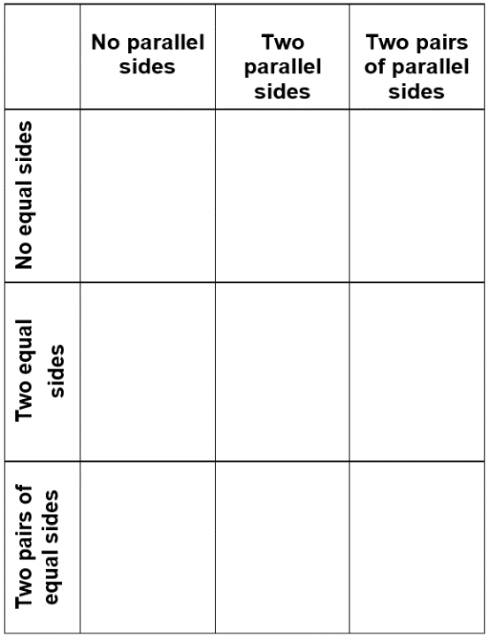
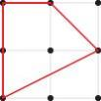
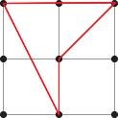
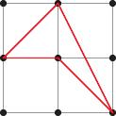
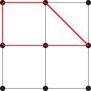
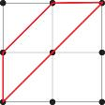
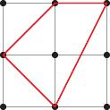
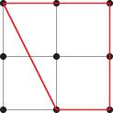
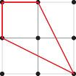
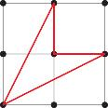


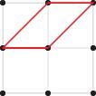

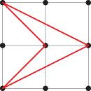


Sorting quadrilaterals
REVIEW
Is it possible to fill any of the empty cells?
Can you explain why?
Notes:
The tutor should show learners the correct sorting and ask them to check their work.
Reinforce the names of quadrilaterals.
Highlight that shapes with two parallel sides are all trapezia.
Extension:
Discuss similarities and differences between shapes in the bottom right cell.
Do squares and rhombuses have four equal sides rather than two pairs of equal sides?
Which has right angles, and which does not?
What is a rhombus, and where would it be placed?
What shapes (if any) could be placed in the blank cells?

Slide 17
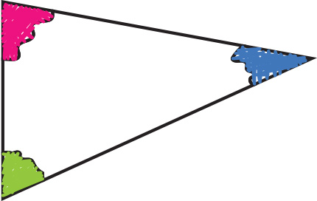

Sum of the interior angles of triangles and quadrilaterals
Handout
available
1. Carefully cut out your shape.
2. Shade or colour each angle.
3. Tear each angle off your shape.
4. Carefully put the straight edges of the angles
together.
What do you notice?
Notes:
Note: The sum of the angle facts may have come up in the lesson already, most likely in the poster activity. The aim of this task is to show why the angles add up to 180˚ and 360˚ degrees, respectively, helping learners understand the fact and remember it for future problems.
Learners will be given a shape (Handout 4). Make it clear that learners are not all getting the same shapes.
Learners should cut out their shapes and then shade or colour each of the angles.
It is important that learners tear their angles and do not cut them with scissors.
Learners should then put the straight edges of the angles (of the original shape) together, lining them up as best they can.
Ask learners to write down what they notice.
Feedback: Ask a learner who had a triangle what they noticed. Ask other learners who had triangles if they noticed the same thing. Repeat for quadrilaterals. Encourage learners to deduce that it will be the same for all triangles and all quadrilaterals. It is possible that some learners will have made errors and will not have come to the same conclusion as others.

Slide 18
Sum of interior angles
KEY IDEA
If you add up the three angles in any triangle, the answer is always 180°.
If you add up the four angles in a quadrilateral, the answer is always 360°.
Notes:
The tutor should reinforce key ideas and explain that this will always be the case.
Highlight that these angle facts are going to be important when solving questions to find angles, and that learners will need to remember these two theorems.

Slide 19
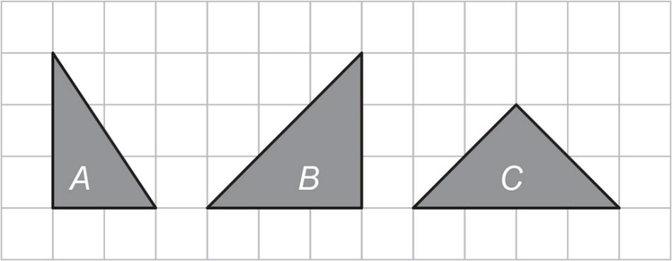
Practice question
REVIEW
Worksheet
available
Three triangles are shown on the centimeter grid.
Which triangle is not isosceles?
Answer
A
Notes:
Encourage learners to use the squares to check which triangles have two equal-length sides.
The correct answer is A.

Slide 20

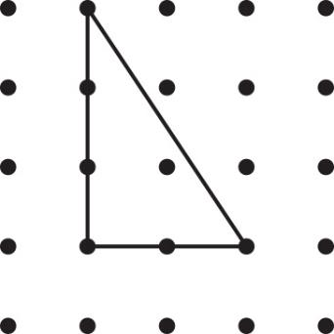
Practice question
REVIEW
Worksheet
available
Here is a triangle on a square dotty grid.
On the grid below, show how you can make a parallelogram with two of these triangles.

Slide 21
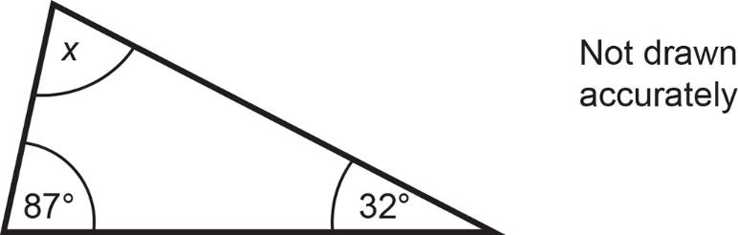
Practice question
REVIEW
Worksheet
available
Work out the value of x.
87 + 32 + x = 180°
x = 180 – 87 – 32
x = 61
Answer degrees
Notes:
Reinforce that if all angles in a triangle add up to 180˚, then the two given angles plus the angle marked x will add up to 180˚.
Some learners will start by taking away the known angles from 180˚. Emphasise that any correct method is fine, but they may make a calculation error and therefore should show their working and not just put down the answer.

Slide 22
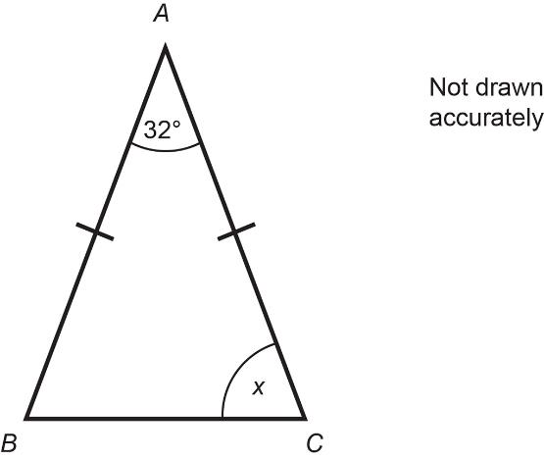
Practice question
REVIEW
Worksheet
available
In the diagram, AB = AC
x + x + 32 = 180°
x
2x + 32 = 180°
Work out the size of angle x.
2x = 148°
x = 74
Answer degrees
Notes:
Learners working at grade 3 should attempt this question.
Encourage learners to fill in what they know on the diagram.
Bring in the language used earlier in the lesson − what type of triangle is this? What do we know about these triangles?
Prompt learners to use the posters made in Activity 1 if they are unsure of the angle facts.

Slide 23
Lesson review:
Properties of 2D Shapes
Objectives
Name and identify the properties of a range of 2D shapes.
Sort and classify different types of triangles and quadrilaterals according to their properties.
Identify the sum of the interior angles of triangles and quadrilaterals.
Suggested further steps/areas to work on
Sum of the interior angles of other polygons.
Notes:
Recap the lesson objectives and highlight key learning points from the lesson.

Slide 24
Lesson 35:
Credits
Text acknowledgements
AQA: GCSE Maths 4360/3F November 2012 Question 14 (Slide 19), GCSE Maths 4360/3F November 2013 Question 13 (Slide 20), GCSE Maths 4360/3F November 2012 Question 14 (Slide 21), GCSE Maths 4365/2F June 2014 Question 13 (Slide 22)
Photo acknowledgements
Shutterstock.com: StudioSmart, Aigars Reinholds, Marco Tomasini, MeeRok, buket bariskan, Rachelle Burnside, Philip Lange, Roman Sigaev, javarman, Vectorfair.com; 123RF.com: stockbroker, subarashii21

