Slide 1


Lesson 37:
Circles
Objectives
Calculate the area and perimeter of circles, semicircles and quadrants (in terms of π or to an appropriate degree of accuracy)
Explore problems involving the area or perimeter of compound shapes that include circles, semicircles or quadrants
Apply knowledge learned to exam-style questions

Slide 2
Starter activity
Measure the circumference and diameter of the object you have been given using a string and a ruler.
Write the measurements in a table.
For each object, divide the circumference by the diameter.
What do you notice?
Object | Diameter | Circumference | C ÷ D
Can you remember the formula for:
the circumference of a circle?
the area of a circle?
Notes:
Ask learners to work in groups. Provide each group with a different circular or a cylindrical object, a piece of string and a ruler. Each group measures the circumference and diameter of their object. Ask groups to report their measurements and record them in a table on the board. Then ask learners to divide the circumference by the diameter for each object and share their observations.
Elicit the formulae for area and circumference from the learners and link to rearrangement of π=C/d. Tutors can display these formulae on the board.

Slide 3


Circumference and area of a circle
KEY IDEA
Circumference of a circle:
$$C=πd or C=2πr$$
Area of a circle:
$$A=πr^{2}$$

Slide 4
DISCUSS
Is the statement correct?
The diameter of a circle is 10 cm.
Adam says its radius must be 5 cm.
The radius of a circle is 3 cm
Ruby says the diameter must be 6 cm².
The diameter of a circle is 4 cm.
Dev says the radius is 8 cm.
Do you agree with these statements?
Why or why not?
Notes:
Learners might need a reminder of the relationship between the diameter and the radius of a circle. Refer back to the task they carried out in slide 2 if necessary.
Adam’s statement is correct, as the diameter of a circle is twice the length of its radius.
Ruby’s statement is incorrect. The diameter is measured in cm, not cm². The diameter must be 6 cm.
Dev’s statement is incorrect. The radius of a circle is half the length of the circle’s diameter. If the diameter of the circle is 4 cm, the radius must be 2 cm.

Slide 5
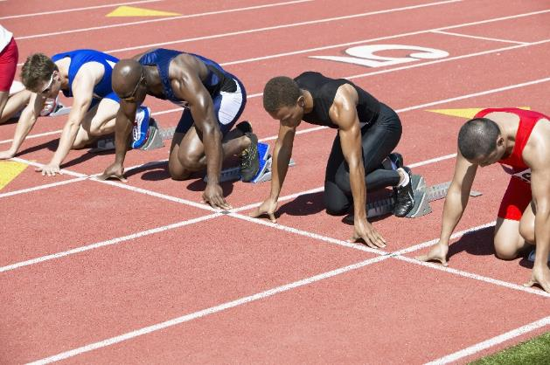
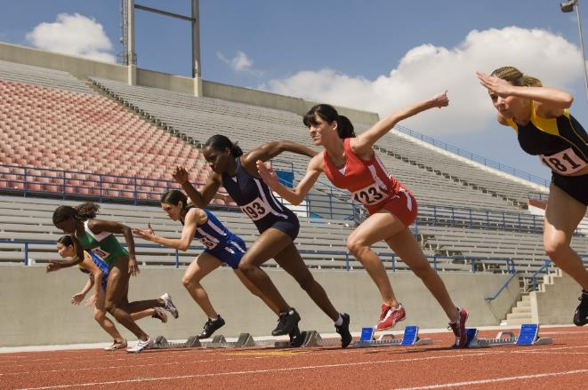
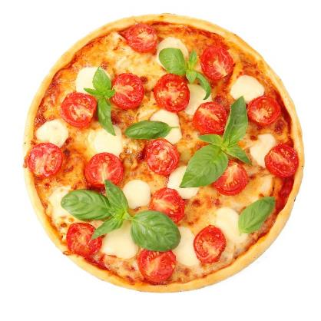
Youth athletics final
DISCUSS
Notes:
Introduce the context for this activity: A group of learners have made it through to the national youth athletics final. They will be staying overnight near the athletics track, and will enjoy a pizza treat on arrival. During their meal, they discuss tactics and preparation for the final.

Slide 6
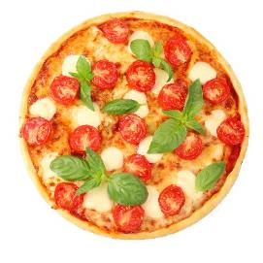
Pizza treat
DISCUSS
EXPLORE
Ruby and Florence can buy one 12-inch pizza or two 8-inch pizzas.
Ruby thinks that two 8-inch pizzas are better because they get 4 more inches of pizza for the same price.
Florence does not agree.
12-inch pizza
£7.99!!!
Two 8-inch pizzas
£7.99!!!
Notes:
Ask learners to work in pairs to decide which offer they would choose and why. Ask some pairs to share their methods and ask other learners if they believe their method and arguments are valid.
The misconception addressed here is that learners think that if the diameter is doubled, the area is also doubled. Ask: Why did Ruby think they will get 4-inch extra? Will doubling the length (diameter) of a pizza also double the area (size)?

Slide 7

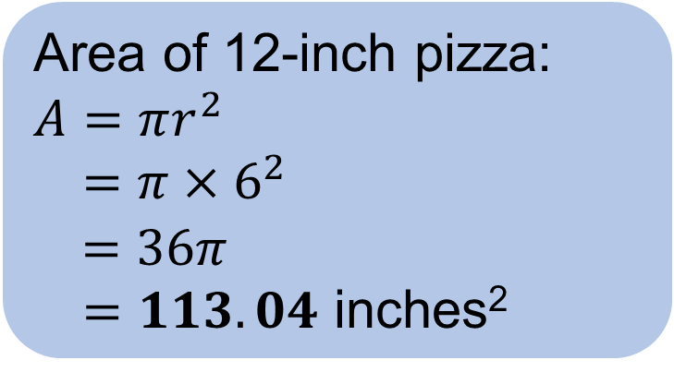
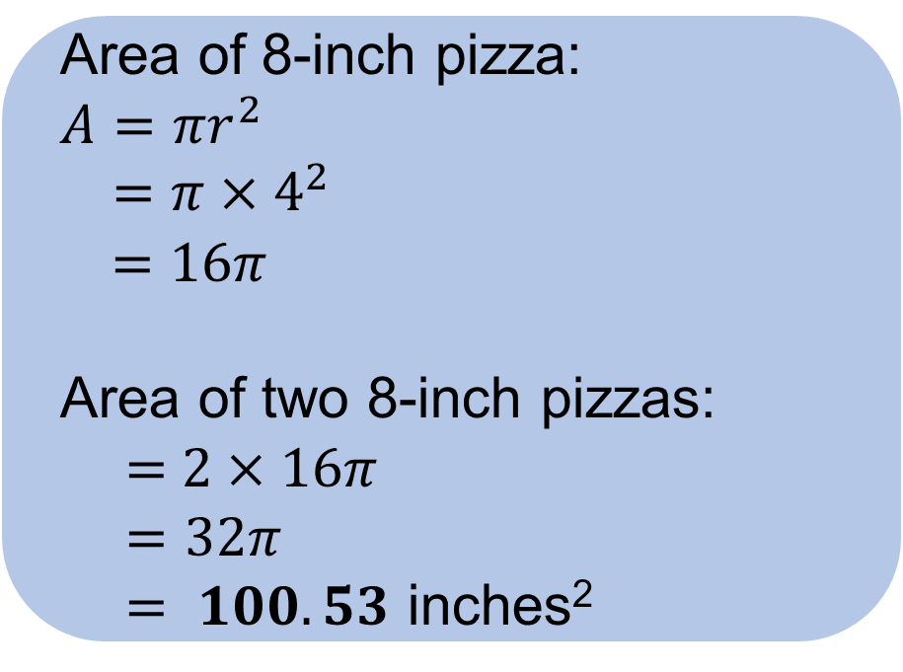
Area of the pizzas
DISCUSS
  Area of 8-inch pizza:
  $$A=πr^{2}$$
  $=π×4^{2}$
  $$=16π$$
  Area of two 8-inch pizzas:
  = $2×16π$
  $=32π$
  $= 100.53$ inches²
  Area of 12-inch pizza:
  $$A=πr^{2}$$
  $=π×6^{2}$
  $$=36π$$
  $=113.04$ inches²
Which offer should they choose?
Why?
Notes:
Ask learners why they should avoid rounding the answers until the end.

Slide 8
Stuffed crust pizza
DISCUSS
EXPLORE
Ruby and Florence want to find out which deal would give them the most stuffed crust.
What do they need to work out?
12-inch pizza
£7.99!!!
On your mini whiteboard, work out:
the circumference of a 12-inch pizza
the total circumference of two 8-inch pizzas
which choice has more stuffed crust
Two 8-inch pizzas
£7.99!!!
Notes:
Guide learners to link the amount of stuffed crust to the circumference – the option that gives the most stuffed crust is the option with the greatest circumference.
Refer to the formula for circumference in the ‘Key idea’ slide.

Slide 9
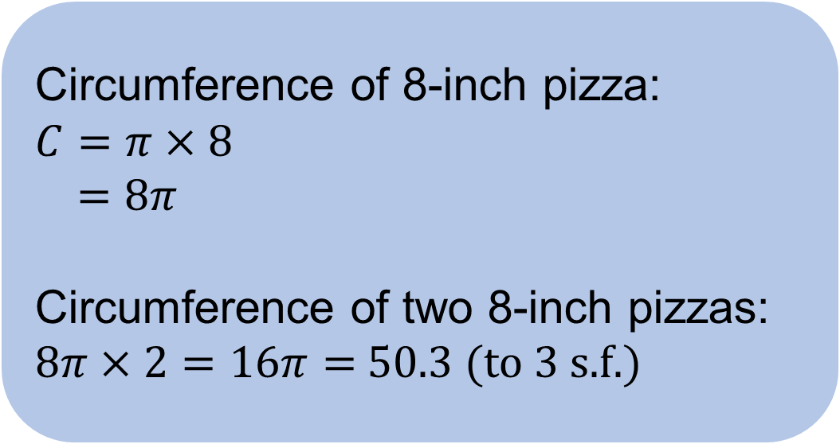
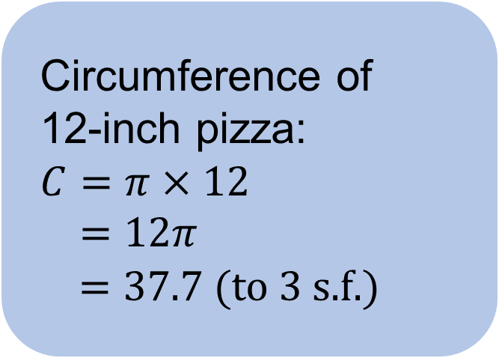
Circumference of the pizzas
DISCUSS
EXPLORE
  Circumference of
  12-inch pizza:
  $$C=π×12$$
  $=12π$
  $=37.7$(to 3 s.f.)
  Circumference of 8-inch pizza:
  $$C=π×8$$
  $=8π$
  Circumference of two 8-inch pizzas:
  $8π×2=16π=$50.3 (to 3 s.f.)
Which deal has more stuffed crust?
Notes:
Ask learners why they should avoid rounding the answers until the end.

Slide 10


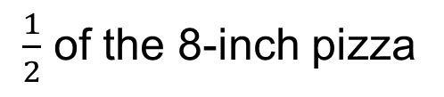
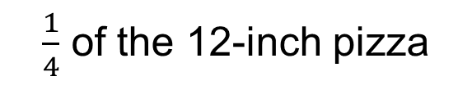
Adam’s choice
DISCUSS
Adam has a choice between:
half of the 8-inch pizza
a quarter of the 12-inch pizza.
or
$\frac{1}{2}$ of the 8-inch pizza
$\frac{1}{4}$ of the 12-inch pizza
Adam wants the most pizza. Which should he choose?
What if Adam wants the most stuffed crust?
Is the length of the stuffed crust the same as the perimeter of each half-slice or quarter-slice? Why or why not?
Notes:
For the first question, learners should calculate the areas and compare.
For the second question, learners should only consider the circumference of the curved edge of the pizza.
Learners should pick the quarter of the 12-inch for the first question, but half the 8-inch for the second question.
Answer for the third question:
No, it is not. The crust is only around curved edge. You will need to add in the diameter for half pizza and twice the radius for quarter pizza to get the perimeter.

Slide 11
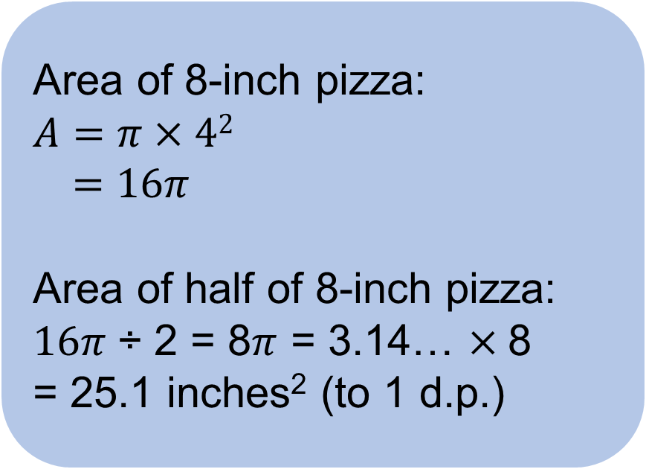
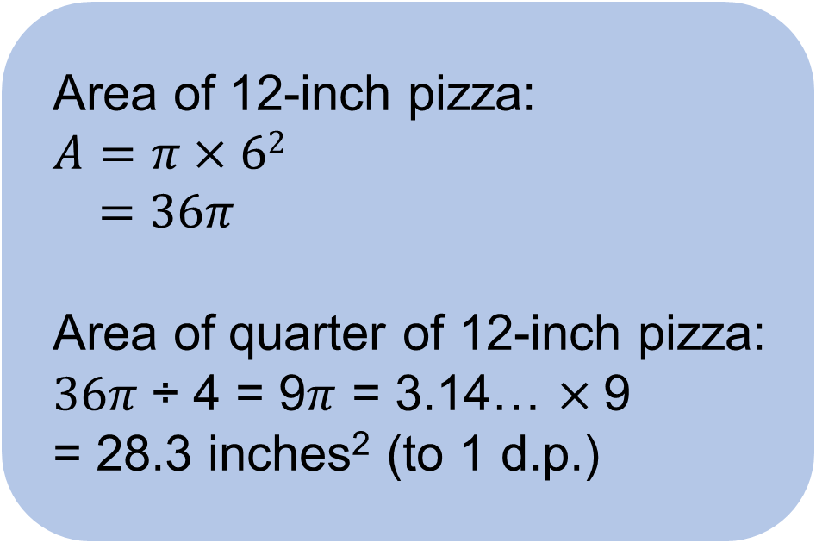
Area of semicircles and quadrants
DISCUSS
EXPLORE
If Adam wants the most pizza, which should he choose?
  Area of 8-inch pizza:
  $$A=π×42$$
  $=16π$
  Area of half of 8-inch pizza:
  $16π$÷ 2 = 8$π$ = 3.14… $×$8
  = 25.1 inches² (to 1 d.p.)
  Area of 12-inch pizza:
  $A=π×6$²
  $=36π$
  Area of quarter of 12-inch pizza:
  $36π$÷ 4 = 9$π$ = 3.14… $×$9
  = 28.3 inches² (to 1 d.p.)
Notes:
This activity assesses learners’ understanding of area of semicircles and quadrants.
The area of quarter of 12-inch pizza is more than that of half 8-inch pizza. Since Adam wants the most pizza, he should choose the quarter of 12-inch pizza.

Slide 12
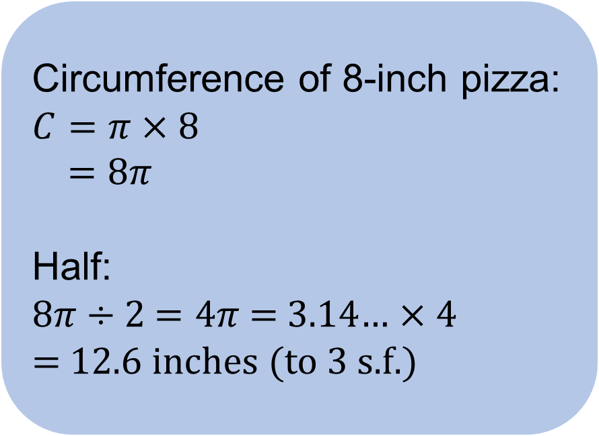
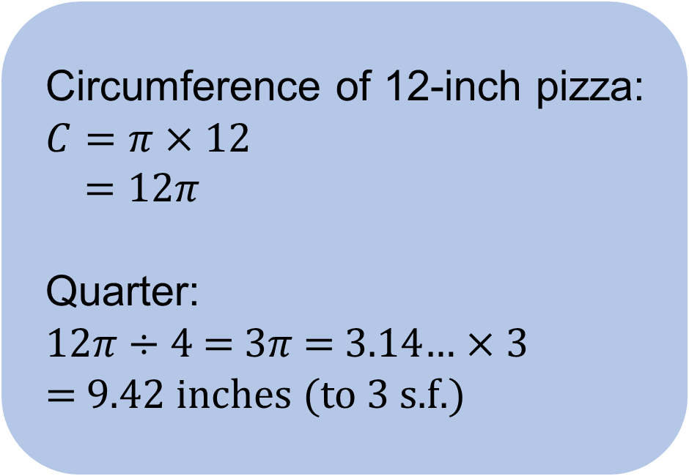
Circumference of semicircles and quadrants
DISCUSS
EXPLORE
What if Adam wants the most stuffed crust?
  Circumference of 8-inch pizza:
  $$C=π×8$$
  $=8π$
  Half:
  8$π$ ÷ 2 $=4π$ = 3.14… $×4$
  = 12.6 inches (to 3 s.f.)
  Circumference of 12-inch pizza:
  $$C=π×12$$
  $=12π$
  Quarter:
  12$π$ ÷ 4 = $3π$ = 3.14… $×3$
  = 9.42 inches (to 3 s.f.)
Notes:
Ask learners why they should avoid rounding the answers until the end.

Slide 13

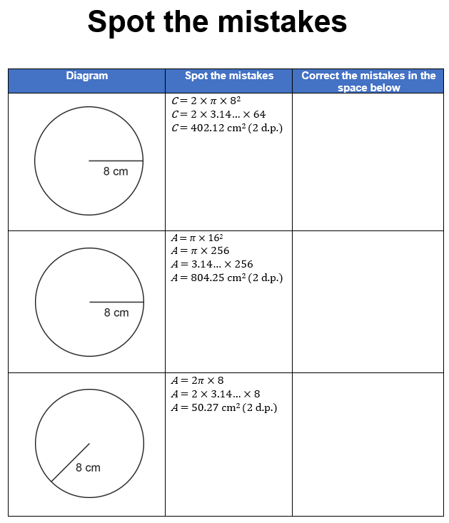
Spot the mistakes
YOUR
TURN
Handout
available
Work in pairs.
Spot the mistakes in each working.
Give the correct working.
Notes:
Give learners the ‘Spot the mistakes’ handouts. Ask them to work in pairs. The next few slides show the misconceptions and correct calculations.

Slide 14
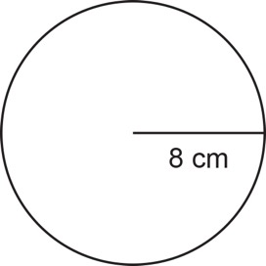
Answers: Spot the mistakes (1)
REVIEW
YOUR
TURN
Handout
available
Diagram | Spot the mistakes | Correct the mistakes in the space below
 | C = 2 × 𝜋 × 8² C = 2 × 3.14… × 64 C = 402.12 cm² (2 d.p.) | C = 2 × 𝜋 × 8 C = 16 × 𝜋 C = 50.27 cm (2 d.p.)
Using the wrong formula for circumference

Slide 15

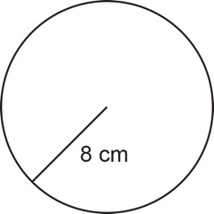
Answers: Spot the mistakes (2–3)
REVIEW
YOUR
TURN
Handout
available
 | A = 𝜋 × 16² A = 𝜋 × 256 A = 3.14… × 256 A = 804.25 cm² (2 d.p.) | A = 𝜋 × 8² A = 𝜋 × 64 A = 3.14… × 64 A = 201.06 cm² (2 d.p.)
  Using diameter instead of the radius for the area formula
 | A = 2𝜋 × 8 A = 2 × 3.14… × 8 A = 50.27 cm² (2 d.p.) | A = 𝜋 × 8² A = 3.14… × 64 A = 201.06 cm² (2 d.p.)
  Using the formula for perimeter when calculating area

Slide 16
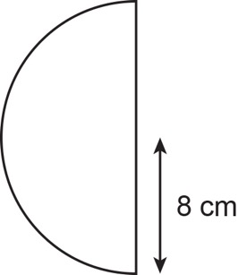
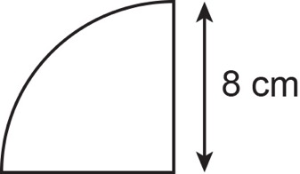
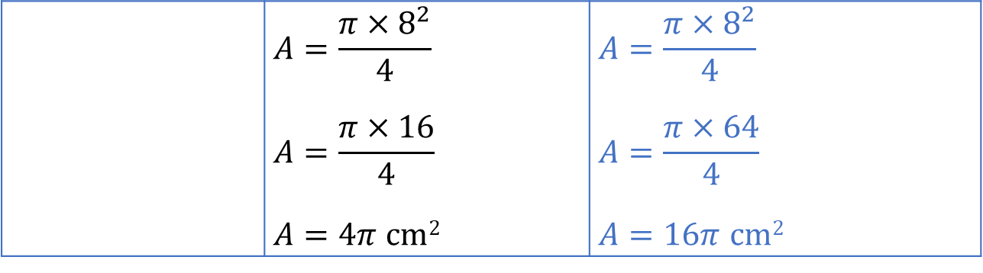
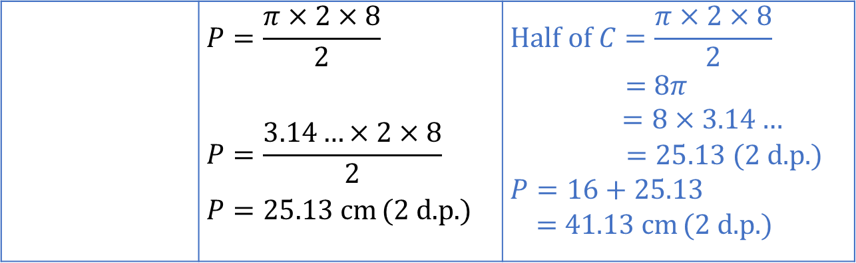
Answers: Spot the mistakes (4–5)
REVIEW
YOUR
TURN
Handout
available
 | $$P=\frac{π×2×8}{2}$$ $$P=\frac{3.14…×2×8}{2}$$ $P=25.13$ cm (2 d.p.) | $$Half of C=\frac{π×2×8}{2}$$ = 8𝜋 $=8×3.14…$ $=25.13$ (2 d.p.) $P=16+25.13$ = 41.13 cm (2 d.p.)
  Did not add the diameter to the circumference to find the perimeter of the semicircle.
 | $$A=\frac{π×8^{2}}{4}$$ $$A=\frac{π×16}{4}$$ $A=4π$ cm² | $$A=\frac{π×8^{2}}{4}$$ $$A=\frac{π×64}{4}$$ $A=16π$ cm²
  Multiplied 8 by 2 instead of finding 8²

Slide 17


Preparing for the athletics final
DISCUSS
EXPLORE
Notes:
This section includes problems involving area/perimeter of compound shapes involving circles.

Slide 18
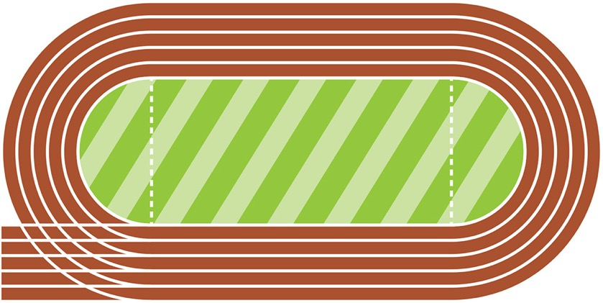
Re-painting the thick white line and Resurfacing the grass
DISCUSS
EXPLORE
Use your mini whiteboard to draw the thick white line part of the racetrack or create the running track using a paper plate and a piece of paper
70m
90.1m
Using the dimensions on the board, find the total length of the thick white line to be repainted
How would you calculate the space needed to resurface the grass?
Notes:
Using the context of the athletics track and the need to repaint the innermost perimeter with white line and resurface the grass. Learners can use mini whiteboards to draw this shape, or recreate it using paper plates and paper.
Ensure that learners can see that the shape of the field is two semicircles joined to a rectangle. To find the distance around the field, they need to calculate the circumference of the curved edge of each semicircle.
Use these questions for discussion:
What shape is the curved part of the racetrack?
How did you calculate the distance around the curved parts?
How did you then calculate the total distance around the field?
Guide learners to see that they should not add the diameter of the semicircles to the total perimeter, unlike when calculating the perimeter of a semicircle.
What’s the term for the distance around the field? (Perimeter)

Slide 19

Restoring the grass
DISCUSS
EXPLORE
70m
90.1m
The officials also want to restore the grass on the field.
How do they work out how much grass they will need?
Notes:
Again, using the context of the athletics track and the need to resurface the grass every year, ask learners how they would calculate the area needed.

Slide 20
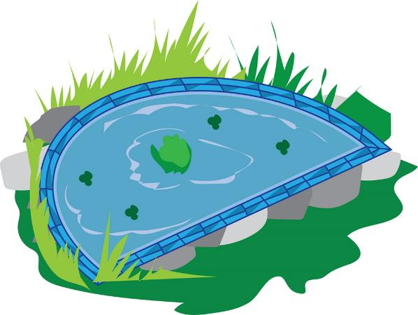
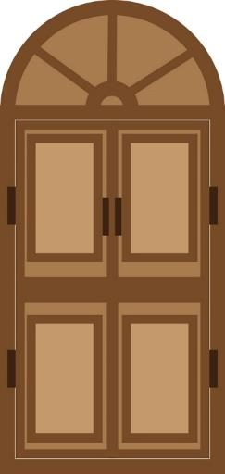
Other real-life examples
DISCUSS
EXPLORE
These are examples where you should add the diameter to the circumference to find perimeter.
Paving round a semicircle pond
Frame of a semicircle door arch
Notes:
Before the pictures appear. Ask the class to think of examples in real life when you may need to measure the perimeter of something.

Slide 21

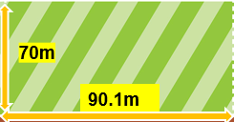

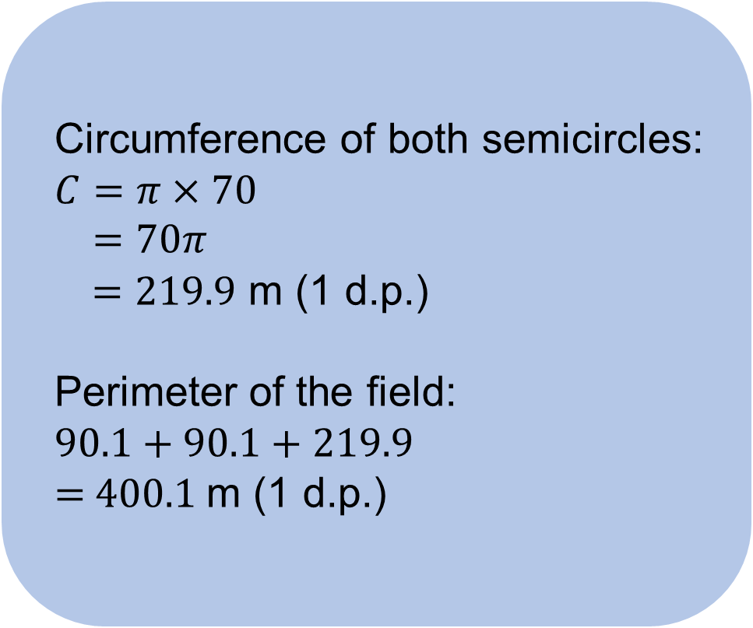
Perimeter of the field
DISCUSS
EXPLORE
  Circumference of both semicircles:
  $$C=π×70$$
  $=70π$
  $=219.9$ m (1 d.p.)
  Perimeter of the field:
  90.1 + 90.1 + 219.9
  = 400.1 m (1 d.p.)
Notes:
Discuss with learners why they wouldn’t divide by 2, then multiply by 2 to get the circumference of the semicircles.
In this example, the diameter was not added to find the perimeter. Compare with the shapes in slide 19, where the diameter must be added to the circumference to find the perimeter of the semicircle.

Slide 22
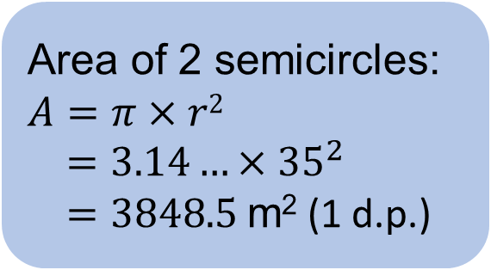
Area of the field
DISCUSS
EXPLORE
  Area of rectangle
  = 90.1 × 70
  = 6307 m²
  Total area
  = 3848.5 + 6307
  = 10 155.5 m² (1 d.p.)
  Area of 2 semicircles:
  $$A=π×r2$$
  $=3.14…×35^{2}$
  $=3848.5$ m² (1 d.p.)
Notes:
Learners may work out the area of the semicircle, then multiply by 2. Explain that this is not wrong but less efficient than the method in the slide.

Slide 23
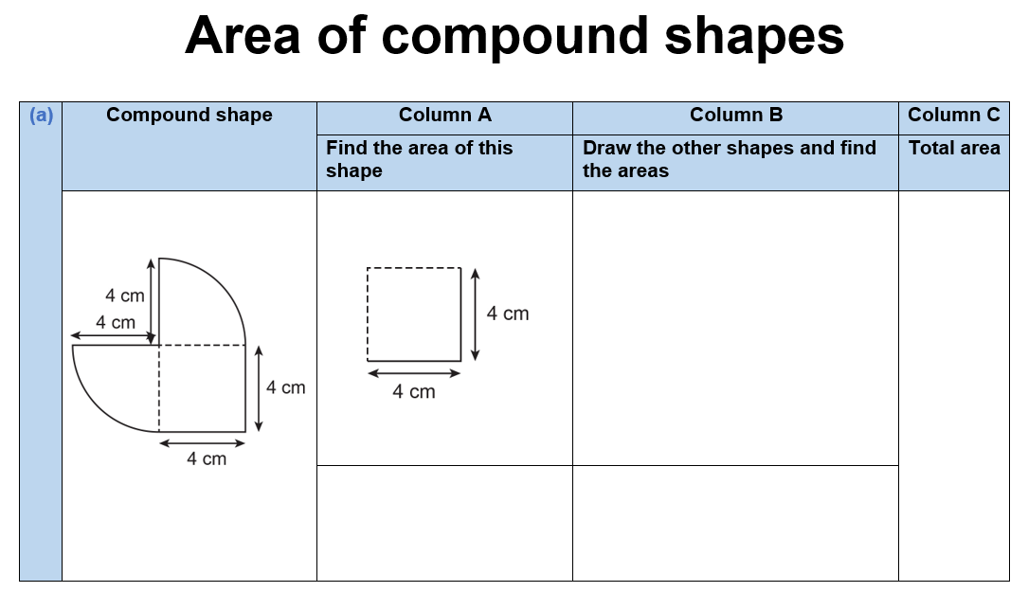
Area of compound shapes
YOUR
TURN
Handout
available
Look at each compound shape.
Column A shows part of the compound shape.
In Column B, draw the other shape(s) that make up the compound shape.
Calculate the area of the shape in each Column A.
Calculate the area of the shape in each Column B.
Work out the area of the compound shape.
Notes:
Provide learners with the ‘Area of compound shapes’ handout. Ask them to work in pairs to draw the missing shape.
Slides 24–26 provide the solutions to these tasks.

Slide 24
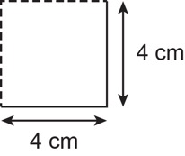
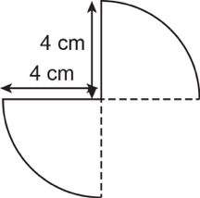
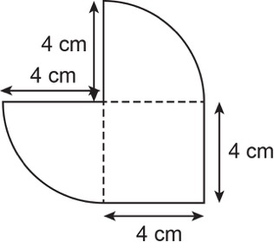
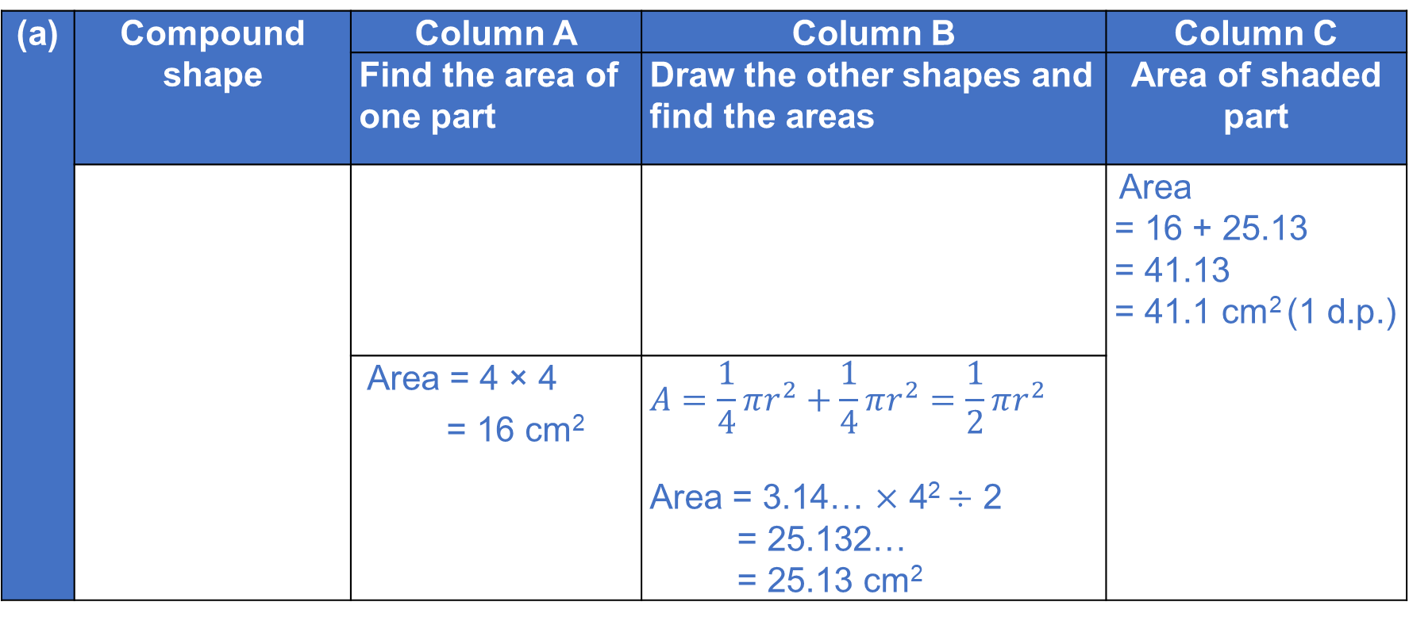
Answers (a)
REVIEW
(a) | Compound shape | Column A | Column B | Column C
 |  | Find the area of one part | Draw the other shapes and find the areas | Area of shaded part
 |  |  |  | Area = 16 + 25.13 = 41.13 = 41.1 cm² (1 d.p.)
 |  | Area = 4 × 4 = 16 cm² | $$A=\frac{1}{4}πr^{2}+\frac{1}{4}πr^{2}=\frac{1}{2}πr^{2}$$ Area = 3.14… × 4² ÷ 2 = 25.132… = 25.13 cm²
Notes:
Draw responses from the learners by asking these questions:
In Column B, what shapes have you drawn? (2 quarter circles)
How do you calculate the area of the two shapes?
How do you figure out the area of the compound shape? Do you add the parts or subtract?

Slide 25
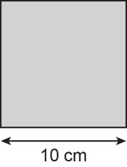
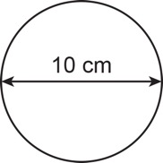
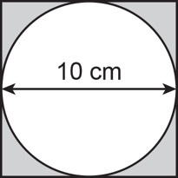
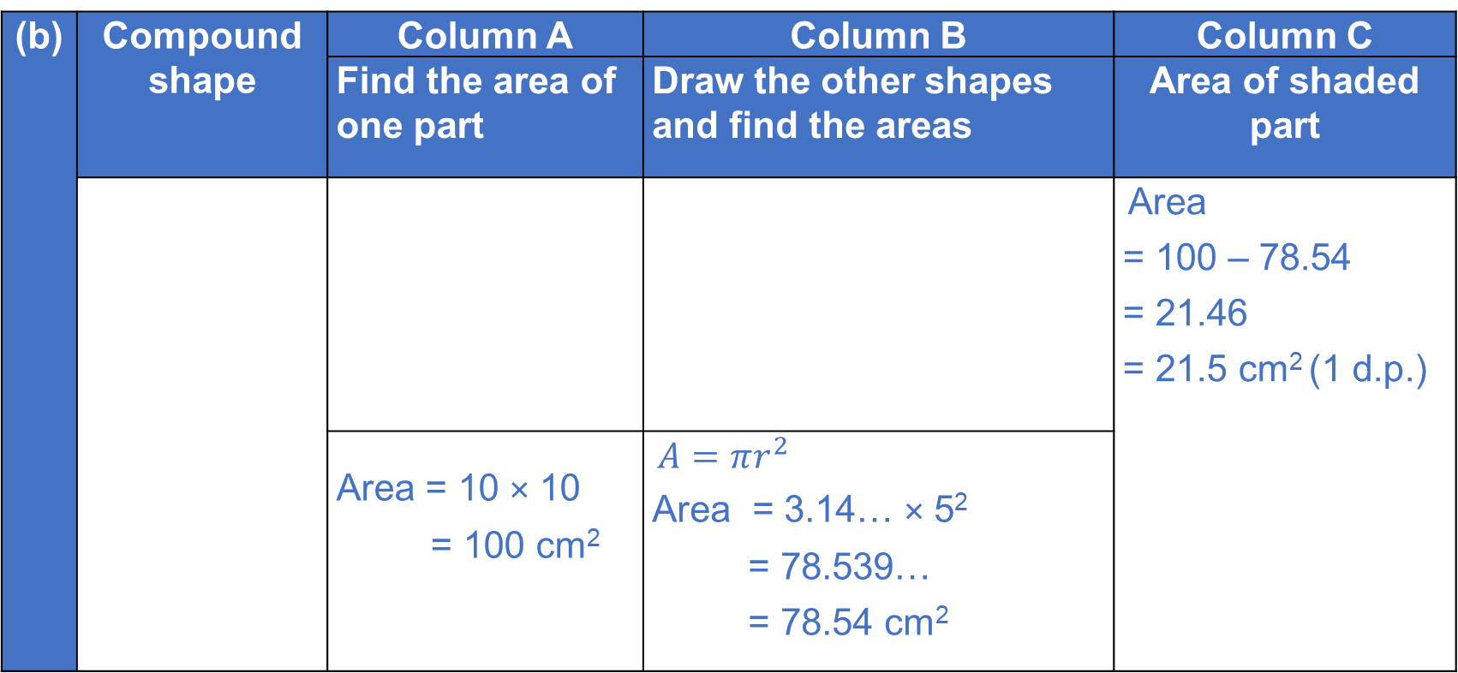
Answers (b)
REVIEW
(b) | Compound shape | Column A | Column B | Column C
 |  | Find the area of one part | Draw the other shapes and find the areas | Area of shaded part
 |  |  |  | Area = 100 – 78.54 = 21.46 = 21.5 cm² (1 d.p.)
 |  | Area = 10 × 10 = 100 cm² | $A=πr^{2}$ Area = 3.14… × 5² = 78.539… = 78.54 cm²
Notes:
Draw responses from the learners by asking these questions:
In Column B, what missing shape have you sketched? (circle)
Can you add up the square and circle to find out the area of the compound shape. Why/why not?
How do you calculate the area of the shaded part?

Slide 26
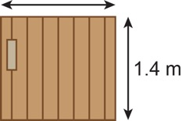
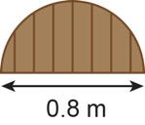
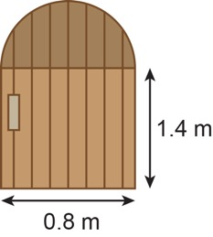
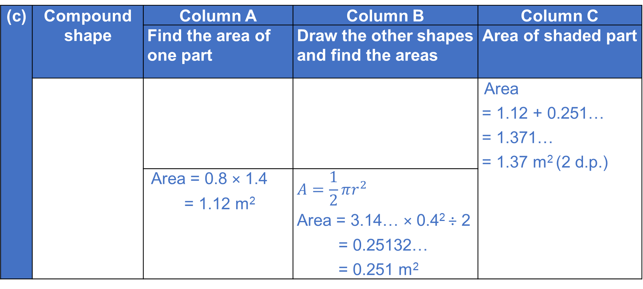
Answers (c)
REVIEW
(c) | Compound shape | Column A | Column B | Column C
 |  | Find the area of one part | Draw the other shapes and find the areas | Area of shaded part
 |  |  |  | Area = 1.12 + 0.251… = 1.371… = 1.37 m² (2 d.p.)
 |  | Area = 0.8 × 1.4 = 1.12 m² | $$A=\frac{1}{2}πr^{2}$$ Area = 3.14… × 0.4² ÷ 2 = 0.25132… = 0.251 m²
Notes:
Draw responses from the learners by asking these questions:
In Column B, what shape did you sketch? (semicircle)
How do you find out the area of the compound shape?

Slide 27
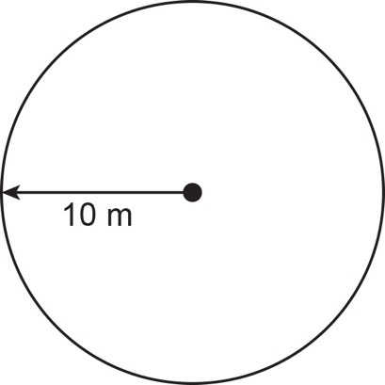
PRACTICE QUESTION
Practice question (1)
Worksheet
available
Balena has a garden in the shape of a circle of radius 10 m.
He is going to cover the garden with grass seed to make a lawn.
Grass seed is sold in boxes.
Each box of grass seed will cover 46 m² of garden.
Work out an estimate for the number of boxes of grass seed Balena needs.
You must show your working.
…………………………….
Notes:
Ask learners to focus on the diagrams first. Begin a discussion on what can be found or worked out from the information in the diagram. Write these ideas as questions on the board.
Ask learners to then attempt the exam question. Emphasise to learners that working out part of the question will still gain them marks.

Slide 28
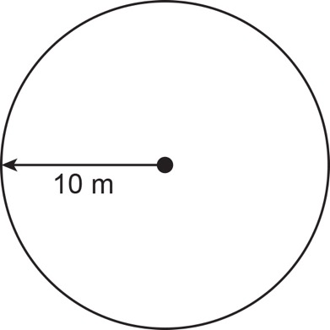

DISCUSS
Practice question (1) answer
Worksheet
available
…………………………….
  $$A=π×{10}^{2}$$
  $=3.14…×{10}^{2}$
  $$=314.2 m2$$
  314.2 ÷ 46 = 6.8
7
Notes:
This working is a sample. Ask learners to share if they have used a different method. The acceptable answer range is 6 to 8.

Slide 29
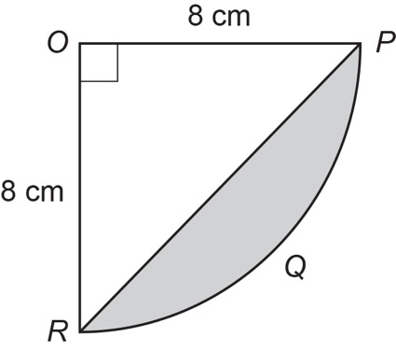
PRACTICE QUESTION
Practice question (2)
Worksheet
available
The diagram shows a sector OPQR of a circle, centre O and radius 8 cm.
OPR is a triangle.
Work out the area of shaded segment PQR.
Give your answer correct to 3 significant figures.
…………………………….
Notes:
Ask learners to focus on the diagrams first. Begin a discussion on what can be found or worked out from the information in the diagram. Write these ideas as questions on the board.
Ask learners to then attempt the exam question. Emphasise to learners that working out part of the question will still gain them marks.

Slide 30


DISCUSS
Practice question (2) answer
Worksheet
available
$$≈$$
…………………………….
  Area of triangle
  = 0.5 × 8 × 8
  = 32 $cm2$
  $$Area of sector OPQR=\frac{1}{4}×π×8^{2}$$
  $$=50.27 cm2$$
  50.27 – 32 = 18.27
  $$≈18.3 cm2$$
18.3 cm²

Slide 31
Lesson review:
Circles
Objectives
Calculate the area and perimeter of circles, semicircles and quadrants (in terms of π or to an appropriate degree of accuracy)
Explore problems involving the area or perimeter of compound shapes that include circles, semicircles or quadrants
Apply knowledge learned to exam-style questions
Suggested further steps/areas to work on
Volume of a cylinder: V = 𝜋𝑟²h

Slide 32
Lesson 37:
Credits
Photo acknowledgements
Shutterstock.com: sirtravelalot, Africa Studio
Text acknowledgements
Pearson Education Ltd: Pearson Edexcel GCSE (9-1) In Mathematics (1MA1) Foundation (Non-Calculator) Paper 1F, Q18, May 2017
Pearson Education Ltd: Pearson Edexcel GCSE (9-1) In Mathematics (1MA1) Foundation (Calculator) Paper 3F, Q27, November 2021

