Slide 1


Lesson 21:
Percentages with a calculator
Objectives
Work out how to increase and decrease a quantity with a calculator, using a multiplier
Solve a range of percentage questions using a multiplier (percentage of an amount, percentage increase/decrease, an amount as a percentage, reverse percentages)
Use a double number line to see the common mathematical structure across a range of percentage questions

Slide 2

Khadeja says…
DISCUSS
Thinking about percentages
‘To find 10% of a number you divide by 10 and to find 20% of a number you divide by 20.’
Is she correct?
Notes:
This starter activity is designed to address some of the misconceptions that learners have about percentages.
Are they clear that percentages relate to the original amount, which is 100%?
So, because finding 10% is 100% ÷ 10, we need to divide the amount by 10.
20% is 100% ÷ 5, so we need to divide the amount by 5.

Slide 3
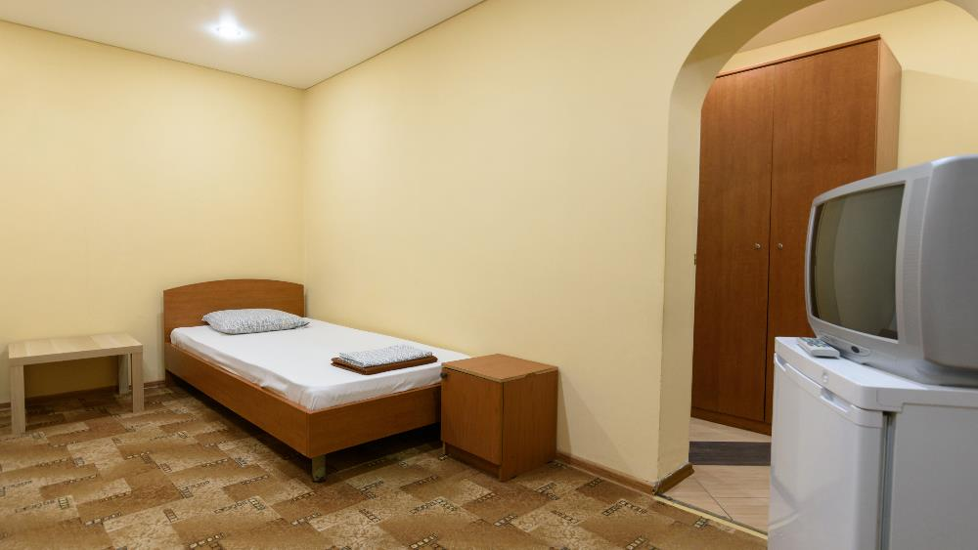
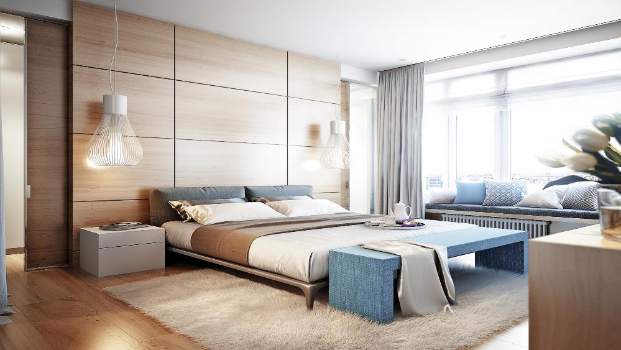
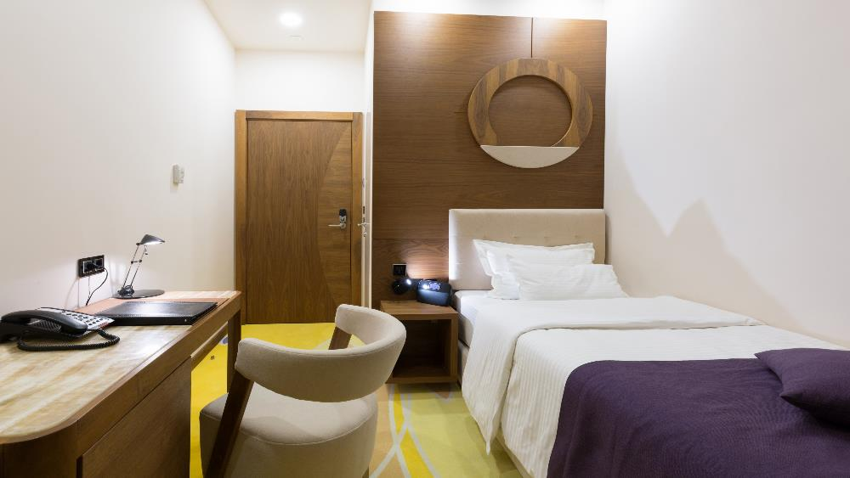
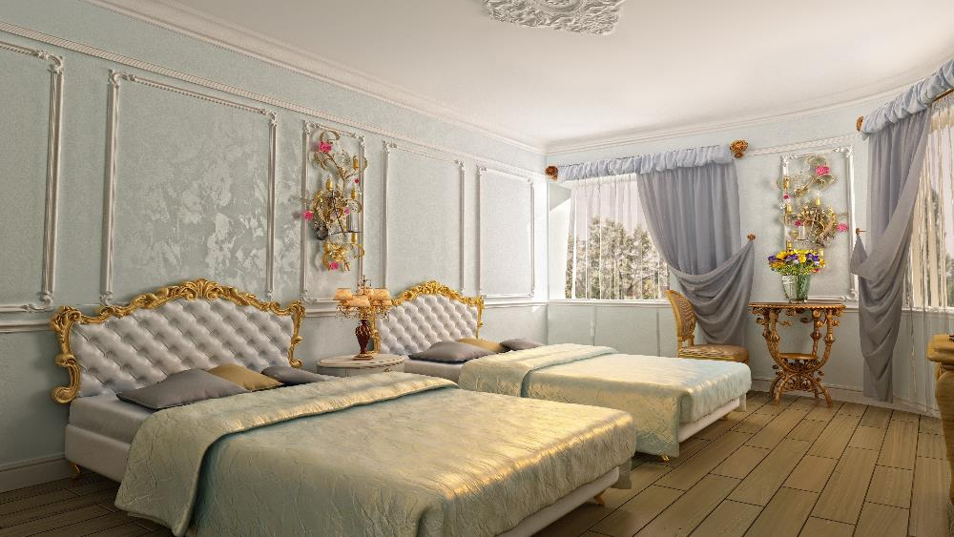
EXPLORE
In pairs, calculate the cost of the types of rooms per week.
Jamie has a lot of financial decisions to make for his holiday in Spain.
He is researching accommodation and has found a hotel with different rooms available.
Super deluxe
Additional 34% on the standard price
Economy
20% off the standard price
Standard
£422 per week
Deluxe
Additional 15% on the standard price
Notes:
This activity allows you to see how confident learners are at calculating percentages using a calculator and what methods they use.
Many learners will try to use non-calculator methods for more complicated calculations such as 34%.
Do they, between them, know more than one method? Which are they confident with? Which methods are more efficient, using a calculator?

Slide 4

Jamie’s hotel rooms
EXPLORE
Standard
£422 per week
Economy
20% off the standard price
Deluxe
Additional 15% on the standard price
Super deluxe
Additional 34% on the standard price
Complete the following table.
Room type | Economy | Standard | Deluxe | Super deluxe
Percentage |  | 100%
Cost per week (£) |  | 422
Which method are you using?
Which method is most efficient?
Notes:
This is the worksheet for the activity.
Learners should work in pairs.

Slide 5
Calculating percentages with a calculator
REVIEW
100% - 20% = 80%
Standard
£422 per week
Economy
20% off the standard price
0
× 0.80
80%
100%
%
Cost (£)
× 0.80
0
337.60
422
Notes:
This slide shows how to solve the problem using a multiplier.
How did learners solve it?
Show learners other methods as well as this multiplier method.
What do learners need to do to find the multiplier?
Ensure that learners check that the multiplier works on the top line before using it on the bottom.

Slide 6
Calculating percentages with a calculator 1
REVIEW
Standard
£422 per week
Deluxe
Additional 15% on the standard price
100% + 15% = 115%
× 1.15
0
100%
115%
%
Cost (£)
× 1.15
0
422
485.30
Notes:
This slide shows how to solve the problem using a multiplier.
How did learners solve it?
Show learners other methods as well as this multiplier method.
What do learners need to do to find the multiplier?
Ensure that learners check that the multiplier works on the top line before using it on the bottom.

Slide 7
Calculating percentages with a calculator 2
REVIEW
Standard
£422 per week
Super deluxe
Additional 34% on the standard price
100% + 34% = 134%
0
100%
× 1.34
134%
%
Cost (£)
× 1.34
0
422
565.48
Notes:
This slide shows how to solve the problem using a multiplier.
How did learners solve it?
Show learners other methods as well as this multiplier method.
What do learners need to do to find the multiplier?
Ensure that learners check that the multiplier works on the top line before using it on the bottom.

Slide 8

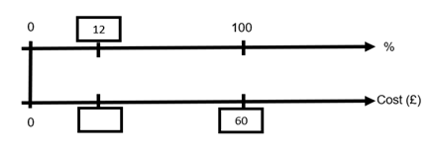
Matching activity
EXPLORE
Worksheet
available
1
The cost for large luggage is £60. Small luggage is 12% less.
What is the cost for small luggage?
A
Notes:
Learners work in pairs to match the percentage questions with the double number lines.
There is one blank question and one blank double number line that learners need to fill in to complete the pairing.
Learners can then use the double number lines to help them solve the questions.

Slide 9
Matching activity answers 1
EXPLORE
1 The cost for large luggage is £60. Small luggage is 12% less. What is the cost for small luggage? the cost for small luggage?
C
c
0
88
100
%
Cost (£)
0
52.80
60
2 Online luggage check-in cost is £60, airport check-in is 12% more. How much extra is the airport check-in cost?
A
c
0
12
100
%
Cost (£)
0
7.20
60
3 The July flight cost is £360. If you book 4 months early you get a 30% discount. What is the cost if you book early?
E
0
30
70
100
%
Cost (£)
0
108
252
360
Notes:
Ensure that learners check their matchings and answers against the correct answers.

Slide 10
Matching activity answers 2
EXPLORE
4 Your question the cost for small luggage?
F
0
88
100
%
Cost (£)
0
316.80
360
5 The cost for large luggage is £60 including £12 tax. What is £12 as a percentage of £60?or small luggage?
B
0
20
100
%
Cost (£)
0
12
60
6 The November flight cost increased by 30% in December, which is now advertised at £360. What was the cost in November?
D
0
100
130
%
Cost (£)
0
276.92
360
Notes:
Ensure that learners check their matchings and answers against the correct answers.

Slide 11
Holiday shopping
PRACTICE QUESTION
Worksheet
available
A pair of sunglasses costs £32. Jamie has a 14% discount voucher off the cost price. How much does he pay? | Jamie bought some shorts in a 14% off sale. He paid £32 for them. What was their original price?
Jamie wants to take his laptop on holiday. It weighs 3.2 kg. His baggage allowance is 14 kg. What percentage of his baggage allowance does the laptop take up? | Factor 40 suntan cream normally weighs 320 g but a special offer bottle has 14% extra. How much suntan cream does it now contain?
Notes:
Learners work in pairs on this unscaffolded activity.
They will need to identify which value is 100% and what value they want to work out.
Encourage learners to draw double number lines to support their thinking.
Learners should round to two decimal places for currency questions, and round to one decimal place for the remaining.

Slide 12
Holiday shopping answers
PRACTICE QUESTION
Worksheet
available
A pair of sunglasses costs £32. Jamie has a 14% discount voucher off the cost price. How much does he pay? £27.52 | Jamie bought some shorts in a 14% off sale. He paid £32 for them. What was their original price? £37.21
Jamie wants to take his laptop on holiday. It weighs 3.2 kg. His baggage allowance is 14 kg. What percentage of his allowance does the laptop take? 22.9% | Factor 40 suntan cream normally weighs 320 g but a special offer bottle has 14% extra. How much suntan cream does it now contain? 364.8 g

Slide 13
Exam question
REVIEW
Worksheet
available
The value of Michelle’s car has decreased by 15%.
The car now has a value of £13 600.
Work out the value of Michelle’s car before the decrease.
£………….
Which value is the original 100%?
-15%
0
× 1.176…
What is the multiplier?
85%
100%
%
Cost (£)
16000
0
× 1.176…
13600
16000
Notes:
Learners work on the exam question on their own.
There are two hints that can be shown to learners.
The slide then shows how to solve the question using multipliers.

Slide 14
Lesson review:
Percentages with a calculator
Objectives
Work out how to increase and decrease a quantity with a calculator, using a multiplier
Solve a range of percentage questions using a multiplier (percentage of an amount, percentage increase/decrease, an amount as a percentage, reverse percentages)
Use a double number line to see the common mathematical structure across a range of percentage questions
Suggested further steps/areas to work on
Simple and compound interest

Slide 15
Lesson 21:
Credits
Text acknowledgements
Slide 13: Pearson Edexcel GCSE (9-1) June 2022 1MA1/3F Mathematics Paper 3 (Calculator) Foundation Tier, Question 30
Photo acknowledgements
123RF.com: madhourse / Alekesi Ivanov; Victor Zastolskiy; Shutterstock.com: Svet_Feo, Edward Nalbantjan

