Slide 1


Lesson 19:
Surface area and volume
Level 2
Objectives
Identify properties of common 3D shapes
Through exploration, calculate volume and surface area of common 3D shapes
Use knowledge of volume and surface area for problem solving questions

Slide 2
Starter activity: What do you know?
YOUR
TURN
In your group, create a poster with everything you know about your 3D shape.
Notes:
Tutor to allocate 3D shapes to each group. These could be cereal boxes, a cube, Pringles tube, Toblerone, ball, etc.
In small groups, learners prepare a poster showing everything they know about their shape.
After a few minutes move to the next slide which has some prompts.

Slide 3
Starter activity: What do you know?
YOUR
TURN
How many faces, edges and vertices does your shape have?
What possible exam questions could be asked about your shape?
What else can you say about your shape?
Notes:
This slide gives the learners some prompts to help them develop their poster.

Slide 4

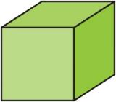

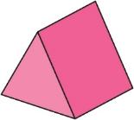
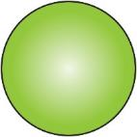
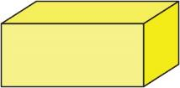
Starter activity: Feedback
YOUR
TURN
Worksheet
available
Starter Task – side 1
Name of 3D shape
Number of faces
Number of vertices
Number of edges
Notes
Notes:
Before the learners feed back details about their shapes, the tutor hands out the starter worksheet and the learners fill in sides 1 and 2 for each shape while their peers feed back.
Class discussion about any misconceptions/errors (learners may struggle to understand about the properties of sphere (edges/faces etc) and will not know the mathematical name of a triangular prism.
Discussion about what possible exam questions could be asked (these could be noted down in the ‘notes’ box on the worksheet. Surface area and volume will probably be mentioned. There may be opportunity to discuss units of measure for volume and SA and possible methods of calculating volume and SA.
If cross-section is not mentioned, then lead a discussion about the cross-section of the shape and to elicit the formula for working out the area of the cross-section.

Slide 5

Review
YOUR
TURN
Worksheet
available
Starter Task – Answer side 1
Name of 3D shape | Cube | Cuboid | Cylinder | Triangular prism | Sphere
Number of faces | 6 | 6 | 3 | 5 | 1
Number of vertices | 8 | 8 | 0 | 6 | 0
Number of edges | 12 | 12 | 2 | 9 | 0
Notes |  |  | NOT A PRISM BUT HAS THE SAME CROSS-SECTION |  | NOT A PRISM
Notes:
Before the learners feed back details about their shapes, the tutor hands out the starter worksheet and the learners fill in sides 1 and 2 for each shape while their peers feed back.
Class discussion about any misconceptions/errors (learners may struggle to understand about the properties of sphere (edges/faces etc) and will not know the mathematical name of a triangular prism.
Discussion about what possible exam questions could be asked (these could be noted down in the ‘notes’ box on the worksheet. Surface area and volume will probably be mentioned. There may be opportunity to discuss units of measure for volume and SA and possible methods of calculating volume and SA.
If cross-section is not mentioned then lead a discussion about the cross-section of the shape and to elicit the formula for working out the area of the cross-section.

Slide 6
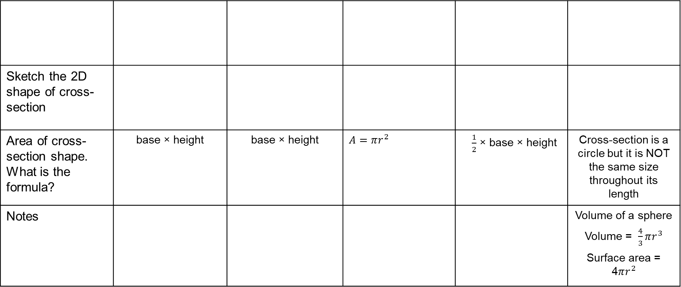
YOUR
TURN
Review
Worksheet
available
Starter Task – Answer side 2
Sketch the 2D shape of cross- section
Area of cross-section shape. What is the formula? | base × height | base × height | $$A=πr^{2}$$ | $\frac{1}{2}$ × base × height | Cross-section is a circle but it is NOT the same size throughout its length
Notes |  |  |  |  | Volume of a sphere Volume = $\frac{4}{3}πr^{3}$ Surface area = 4$πr^{2}$
Notes:
Before the learners feed back details about their shapes, the tutor hands out the starter worksheet and the learners fill in sides 1 and 2 for each shape while their peers feed back.
Class discussion about any misconceptions/errors (learners may struggle to understand about the properties of sphere (edges/faces etc) and will not know the mathematical name of a triangular prism.
Discussion about what possible exam questions could be asked (these could be noted down in the ‘notes’ box on the worksheet. Surface area and volume will probably be mentioned. There may be opportunity to discuss units of measure for volume and SA and possible methods of calculating volume and SA.
If cross-section is not mentioned then lead a discussion about the cross-section of the shape and to elicit the formula for working out the area of the cross-section.

Slide 7
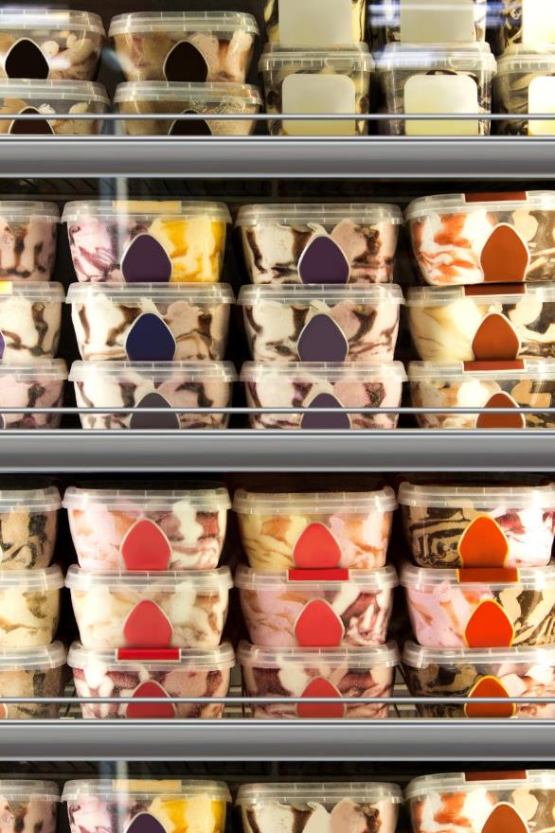
The ice-cream factory
Richard and Shobhna have started working at their local ice-cream factory and have been told that they need to keep costs down so that the profit is maximised.
They are looking at the costs of different containers of ice-cream.
Notes:
The slide introduces the context. Start a discussion about what costs are and what profit is. To reduce costs will help to increase profit.
Do learners understand the word maximised? Discuss this.

Slide 8

ACTIVITY
At the factory
The company are changing the packaging for their 900 ml tubs.
Richard has been asked to come up with some designs for the tubs.
Sketch 3 different designs that would hold 900 cm³ and mark the dimensions on them.
They must be cuboid in shape.
Discuss in pairs.
Think about the factors of 900 to help you with the dimensions.
ice-cream
Notes:
This slide should be used to get the learners thinking about having a constant volume but different dimensions of a cuboid. Pose the problem to the class and allow them to discuss in pairs.
Scaffold animation: ask learners to think about the factors of the number.
Start a discussion about different ways of coming up with cuboids with the same volume looking at factors. This is important for their main task as they will be exploring cuboids and other prisms with a set volume.
Are some of the cuboid shapes an unrealistic shape?
Some possible dimensions: 3 × 3 × 100, 15 × 6 × 10, 3 × 30 × 10, 9 × 5 × 20…

Slide 9
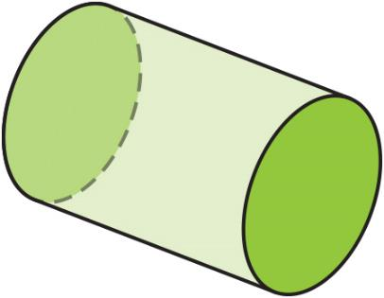
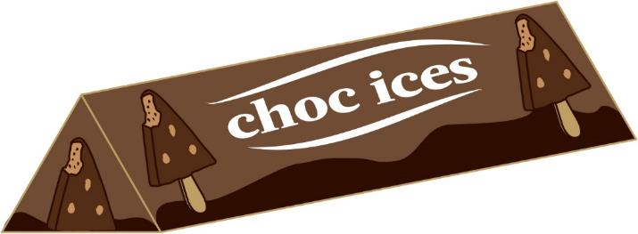
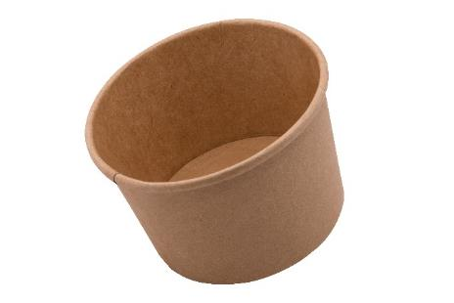
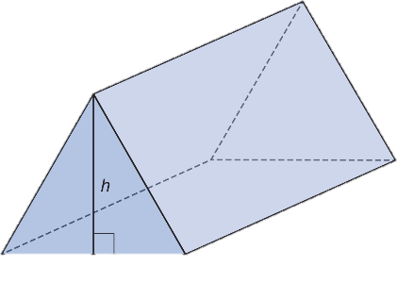
DISCUSS
DISCUSS
At the factory
Richard and Shobhna were also asked to look at other containers and change the size of them. They looked into the cylinder tubs and also triangular prisms.
Think, pair, share:
How would they calculate the volume of a cylinder and triangular prism?
Notes:
Gather feedback from the learners about volume of 3D shapes/prisms.
Ensure the key words are addressed: CROSS-SECTION. Ensure learners understand that the shape must be a prism or uniform throughout its length.

Slide 10

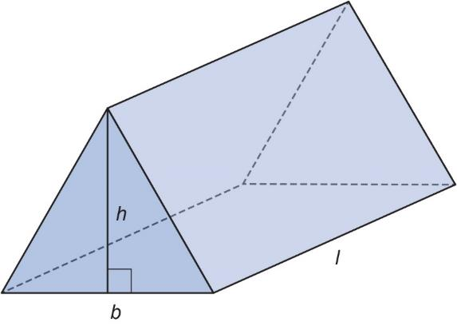

Volume of a prism and cylinder
KEY IDEA
Volume of a prism or cylinder = cross-section × length or height
Volume is measured in cubic units (cm³ / m³ / mm³…)
Notes:
Tutor reinforces the area of a cross-section of a 3D prism × depth/length.

Slide 11
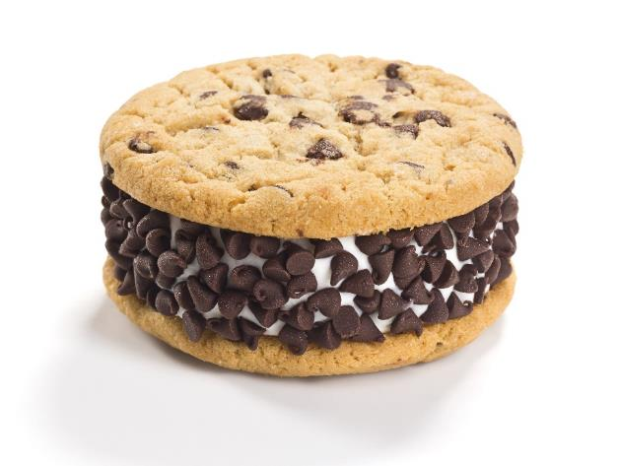
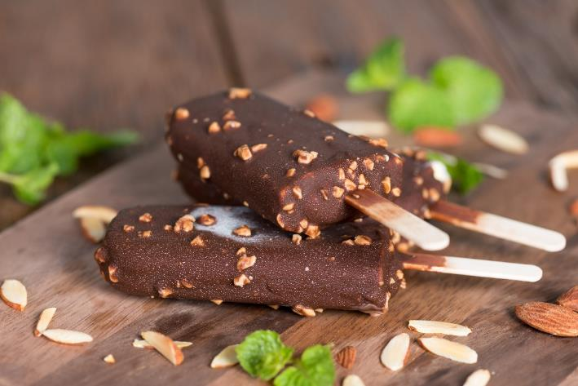
EXPLORE
The ice-cream task
Develop the best ice-cream to increase profits.
Notes:
Tutor to introduce the ice-cream task. An ice-cream needs to be created – it is made up of ice-cream and chocolate coating. Re-iterate the difference between surface area and volume. If the surface area has not been mentioned much previously, ensure that the learners understand the concept. It is the covering, the chocolate coating; the amount of wrapping on a present; the amount of icing on a cake and so on.
In the choc-ice, the chocolate is coating the surface and therefore this represents the surface area.
The ice-cream is inside, therefore this is the volume. To increase profits we need the LEAST amount of chocolate covering on the choc-ice.
How would we calculate surface area? Learner to feed back how they do this (thinking of nets/of sketching the sides and doubling etc.)

Slide 12
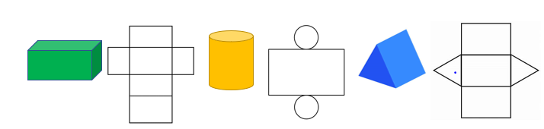
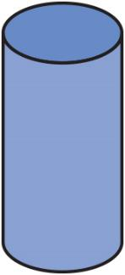

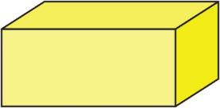
Surface area
KEY IDEA
Surface area is the sum of the area of all the faces of a shape (the sum of the area of its net).
It is measured in units squared (cm² / m² / mm² …)
Notes:
Tutor reinforces the key idea about surface area.

Slide 13

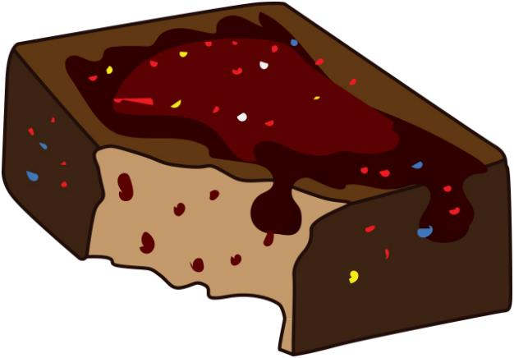

EXPLORE
Which shape is best for minimal chocolate?

Slide 14
Ice-cream 3D shapes
EXPLORE
Worksheet
available
Typically, ice-creams and choc ices are about 64 ml, which is the same as 64 cm³.
Each ice-cream must have volume of 64 cm³.
For maximum profit, you need to use as little chocolate for the coating as possible but the whole ice-cream needs to be coated in chocolate.
Explore what shape ice-cream you will use and what the dimensions will be to make it the cheapest.
Has your best ice-cream got a name?
Notes:
The aim of the task is for learners to explore ice-creams with a volume of 64 cm³ with the minimum amount of chocolate covering (although this must cover the whole ice-cream).
The worksheet provides a starting point for each different type of shape for the learners to explore.
They must work out the volume of ice-cream and the surface area – looking for the shape with the LEAST surface area to keep chocolate coating costs DOWN.
Mention that the learners can look at cuboids/cubes/Extension: triangular prisms and cylinders. Can the learners come to any conclusions about the effect of dimensions on the surface area?
Have a discussion about profit. What is profit? What are costs? How do you maximise profit?

Slide 15
Which shape of ice-cream is better?
REVIEW
    Feed back to the class which shape is your best shape.
    Why is this?
Notes:
Tutor sketches on the board the best shape from each group and the amount of ice-cream and chocolate used (volume and SA).
Can the learners come to any conclusions about the effect of dimensions on the surface area?
For cuboids, the shape with the LEAST surface area is a cube with dimensions 4 × 4 × 4. Volume 64 cm³ and SA is 96 cm². The more you move away from the cube shape, the longer and thinner the cuboid becomes and therefore the bigger the surface area.
Triangular prisms are not cheap for chocolate. They have the largest surface area so are not a good design.
A cylinder, however, when similar in diameter to depth, has the LEAST surface area so is the CHEAPEST ice-cream.
Possible business discussion: if there are several shapes with similar amounts, what would make one better than another? Which would be easier to sell? Will some melt quicker or be more difficult to eat? Will they drip more?
Tutor re-caps the key learning points and then explains that the following exam questions are based on the key learning points.

Slide 16
FS exam question tips
KEY IDEA
Underline the key information (e.g. area, volume, perimeter, etc)
Can you sketch it or draw a picture to help?
Look at the marks awarded – could link to number of steps in the answer
Look at the units in the question and the detail
Notes:
FS exam question tips. Explain to the learners that the work they have been doing should enable them to answer the following exam questions but for them to make sure that they read the questions carefully, remember units etc.
Talk through the tips.

Slide 17
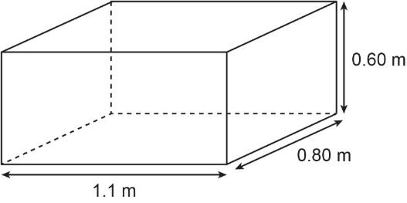
PRACTICE QUESTION
Exam question (1)
Exams tip:
Look at the DETAIL. 30 tanks. Outside surfaces but NOT the top.
James has a contract to paint 30 identical water tanks.
He has to paint the outside surfaces of each tank, but not the top.
Each surface is rectangular.
Exams tip:
Look at units in the question. Gives clues (area, perimeter or volume).
James knows that 1 tin of paint
is enough to cover 12 m² of surface
costs £26.99
Work out the total cost of the tins of paint he will need for all 30 water tanks.
Exams tip:
Answer the question: COST of the tins.

Slide 18
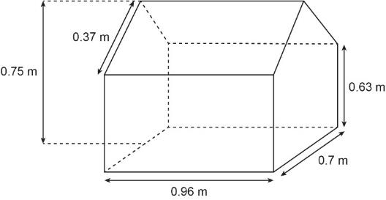
PRACTICE QUESTION
Exam question (2)
Here is a diagram of a doll’s house Jayden has made.
Exams tip:
Look at the DETAIL. Needs to cover ALL surfaces but given the area of the base and roof.
Two faces are each in the shape of a pentagon with a vertical line of symmetry.
All other faces are rectangular.
The base angles of each pentagon are right angles.
Jayden wants to cover all the surfaces of the doll’s house with paint.
He knows the total area of the base and the roof is 1.3824 m².
Jayden has enough paint to cover 3.5 m².
Has Jayden got enough paint to cover all the surfaces of the doll’s house?
Show why you think this.
Exams tip:
Answer the question: Has he got enough paint? Yes or No and WHY.
18

Slide 19
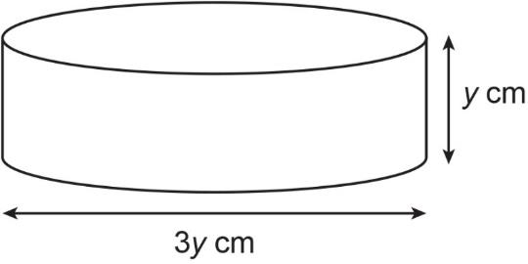
PRACTICE QUESTION
Exam question (3)
Here is a cylinder.
Using y = 11, calculate the area of the curved surface of the cylinder.

Slide 20

PRACTICE QUESTION
Exam question (1) – answers
James has a contract to paint 30 identical water tanks.
He has to paint the outside surfaces of each tank, but not the top.
Each surface is rectangular.
1.1 m × 0.6 m × 2 = 1.32 m²
0.8 m × 0.6 m × 2 = 0.96 m²
1.1 m × 0.8 m × 1 = 0.88 m²
Total surface area = 3.16 m²
3.16 m² × 30 = 94.8 m²
94.8 m² ÷ 12 = 7.9 tins
He needs 8 tins.
8 × £26.99 = £215.92
James knows that 1 tin of paint
is enough to cover 12 m² of surface
costs £26.99
Work out the total cost of the tins of paint he will need for all 30 water tanks.
No. of tins | 1 | 8
Cost | £26.99 | £215.92
20

Slide 21
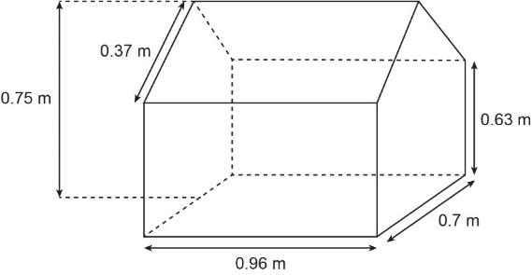
PRACTICE QUESTION
Exam question (2) – answers
Here is a diagram of a doll’s house Jayden has made.
Base and roof = 1.3824 m²
Rectangular sides:
0.96 × 0.63 × 2 = 1.2096 m²
End-side rectangles:
0.7 × 0.63 × 2 = 0.882 m²
Height of triangle:
0.75 – 0.63 = 0.12 m
End-side triangles:
(0.7 × 0.12 ÷ 2) × 2 = 0.084 m²
Total SA = 3.558 m²
He doesn’t have enough paint.
Two faces are each in the shape of a pentagon with a vertical line of symmetry.
All other faces are rectangular.
The base angles of each pentagon are right angles.
Jayden wants to cover all the surfaces of the doll’s house with paint.
He knows the total area of the base and the roof is 1.3824 m².
Jayden has enough paint to cover 3.5 m².
Has Jayden got enough paint to cover all the surfaces of the doll’s house?
Show why you think this.

Slide 22
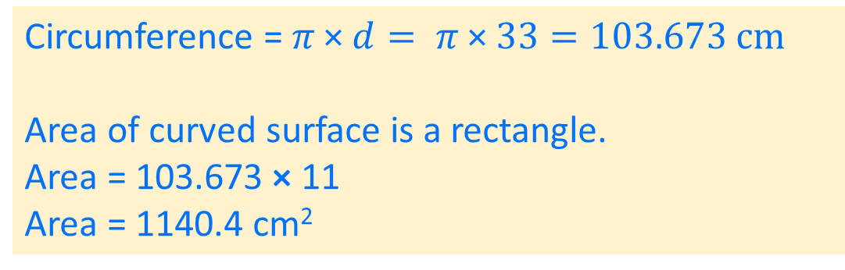
PRACTICE QUESTION
Exam question (3) – answers
Here is a cylinder.
Using y = 11, calculate the area of the curved surface of the cylinder.
Circumference = $π \text{×} d= π \text{×} 33=103.673 cm$
Area of curved surface is a rectangle.
Area = 103.673 × 11
Area = 1140.4 cm²

Slide 23
Lesson review:
Surface area and volume
Level 2
Review Objectives
Identify properties of common 3D shapes
Through exploration, calculate volume and surface area of common 3D shapes
Use knowledge of volume and surface area for problem solving questions
Notes:
Tutor to draw out key learning points from the lesson.
Next steps would be finding the surface area and volume of compound shapes.

Slide 24

Lesson 19:
Credits
Photo acknowledgements
Shutterstock.com: Hitra, Inewsfoto, Viennetta, Waeel Quttene
Text acknowledgements
Pearson Edexcel Functional Skills, Practice Paper 1 - Mathematics Level 2 (Calculator) PRACL2/01 Question 8, Pearson Edexcel Functional Skills, Practice Paper 3 – Mathematics Level 2 (Calculator) PRACL2/C03 Question 5, Pearson Edexcel Functional Skills, Past Paper 5 - Mathematics Level 2 (Calculator) PMAT2/C05 Question 5

