Slide 1


Lesson 9:
Sharing in a ratio
Objectives
Understand how ratios correspond with real-world situations
Use ratio reasoning to solve whole-to-part and part-to-part simple problems
Simply ratios
Use bar model representations to provide insights into solving problems and simplify ratios

Slide 2

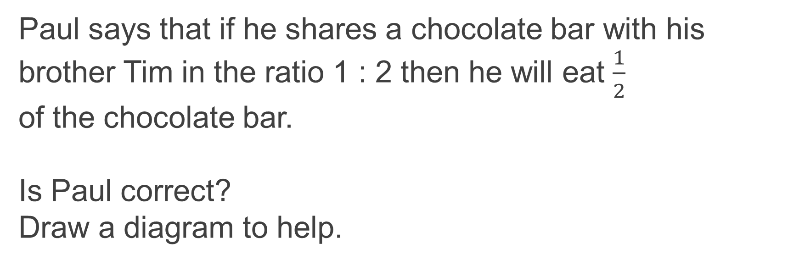
Thinking about Sharing in a Ratio
DISCUSSION
Paul says that if he shares a chocolate bar with his brother Tim in the ratio 1 : 2 then he will eat $\frac{1}{2}$
of the chocolate bar.
Is Paul correct?
Draw a diagram to help.
Notes:
This starter activity is designed to address some of the misconceptions that learners have about ratios.
Are they clear about the difference between 1 : 2 and $\frac{1}{2}$?
Elicit into how many parts a bar has been split in the first case (1 : 2, 1 + 2 = 3) and in the second case ($\frac{1}{2}$- denominator shows the number of parts the bar has been split into) .
Encourage the use of diagrams to represent a ratio and a fraction.

Slide 3


Sharing in a Ratio
Handout
available
One chocolate chunk
Two groups of friends share chocolate bars with 6 chunks each.
How much does each friend receive in each group?
Write a ratio for each group and construct a diagram to show how much they receive.
Group 1
5 bars of chocolate
are shared equally
between two friends
Group 2
7 bars of chocolate
are shared equally
between three friends
Notes:
Learners work in pairs. In this activity, we extend the exploration the learners engaged in using Slide 2, where learners figured out that a ratio refers to the part-to-part relationship. Here we develop problem-solving skills. The thrust in this activity is to model ratios and use those models to write a ratio in its simplest form. Learners might make organised lists or diagrams. Take advantage of the diversity of representations even if they are initial attempts. Discuss how these models help learners to write the ratio. Learners will likely find it disconcerting that both questions result in the same answer, a ratio of 1 : 1.

Slide 4

Sharing in a Ratio
REVIEW
One chocolate chunk
Group 1
5 bars of chocolate are shared equally between two friends
Friend 1 : Friend 2
15 : 15
1 : 1
Notes:
Learners work in pairs. For each group, discuss different visual proofs learners have developed, and the ways they approached writing the ratio. If learners have not simplified their ratio, ask another learner to convince them, using the models they have created, that 15 : 15 is the same as 1 : 1 .
Discuss these questions:
How did you find the ratio?
What visual proofs or models are useful for seeing how to share the chocolate bars?
Why is 15 : 15 the same as 1 : 1?

Slide 5

Sharing in a Ratio
REVIEW
One chocolate chunk
Group 2
7 bars of chocolate are shared equally between three friends
Friend 1 : Friend 2 : Friend 3
14 : 14 : 14
1 : 1 : 1
Notes:
Learners work in pairs. For each group, discuss different visual proofs learners have developed, and ways they approached writing the ratio. If learners have not simplified their ratio, ask another learner to convince them, using the models they have created, that 14 : 14 : 14 is the same as
1 : 1 : 1.
Discuss these questions:
How did you find the ratio?
What visual proofs or models are useful for seeing how to share the chocolate bars?
Why is 14 : 14 : 14 the same as 1 : 1 : 1?

Slide 6
Ivan lives with his friends and pays a third of the monthly food outgoings and utility bills. This month the total bill is £1095.
DISCUSSION
Handout
available
How much will Ivan pay?
How much will his friends pay?
Ivan
Friends
?
?
Notes:
Invite learners to extend their exploration of chocolate bars to a non-physical context. Here they explore how to model a utility bill being split between Ivan and his two friends. Encourage discussion of this context. Do they pay bills? With the learners, develop a method of splitting a whole bar into three equal parts and labelling what they already know and what they have been asked to find. Encourage learners to draw and doodle before moving on to the abstract calculations. Here we are developing pictorial skills, which can later be applied to harder questions in the GCSE exam, to help them.

Slide 7

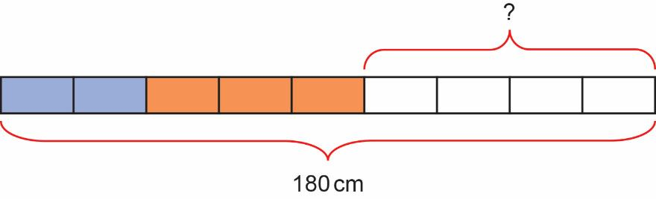
A piece of wood is 180 cm long.
Tom cuts it into three pieces in the ratio 2 : 3 : 4
EXPLORE
Handout
available
Work out the length of the longest piece.
Notes:
The questions in Slides 6–9 are on Handout 2. While the PowerPoint slides can be used to model the answer, it is better for the tutor to work on their whiteboard and draw these bars with the assistance of the learners, telling them what they are doing. How many parts do I need to split the bar into? What do I already know? What do I need to find out?

Slide 8
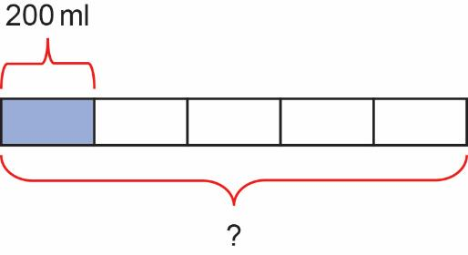
Squash is prepared by combining one part concentrate with four parts of water.
EXPLORE
How much squash drink will you make if 200 ml of squash concentrate is used?
Notes:
Tutor models the use of bars in a relatable context of preparing a squash drink.

Slide 9
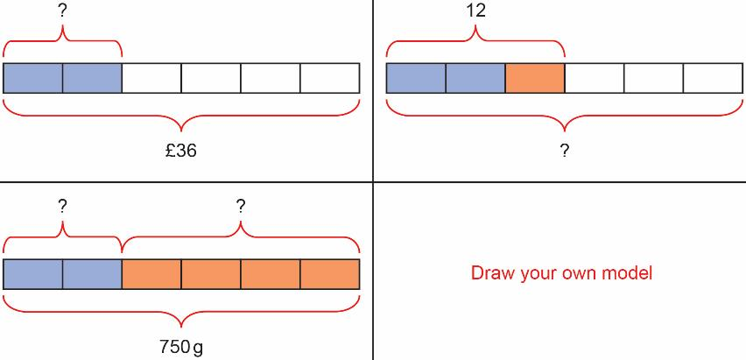
EXPLORE
Worksheet
available
Choose a bar model and write your own question for it. ​
Swap the question with your partner.
(You may opt to draw your own model instead.)
Notes:
Tutor invites learners to share some of the stories that were made into questions.
What did they notice? How did the question vary with each scenario?

Slide 10
Practice question
REVIEW
Handout
available
Alex buys vegetarian and chicken pies for a party in the ratio 3 : 1.
He buys 164 pies in total.
Work out the number of vegetarian pies Alex buys.
Notes:
Learners work independently. Depending on time and the ability of learners in the group, you may choose to do only one of the two questions for the class.

Slide 11
Practice question - calculator
REVIEW
Handout
available
Natalie makes potato cakes in a restaurant.
She mixes potato, cheese and onion so that
weight of potato : weight of cheese : weight of onions = 9 : 2 : 1
Natalie needs to make 6000 g of potato cakes.
Cheese costs £2.25 for 175 g.
Work out the cost of cheese needed to make 6000 g of potato cakes.
Notes:
This question is Number 22 on a GCSE paper and is challenging. Look out for learners who need support to answer this question. Ask learners what they already know and encourage them to draw a picture. The second part of the question has been answered using ratio tables.

Slide 12
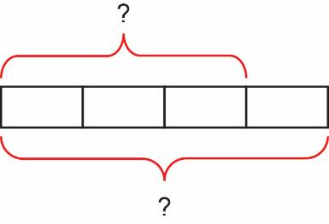
Practice question
REVIEW
How could you complete a bar model to find the number of vegetarian pies?
Answer: 3 × 41 = 123
‘The whole is made up of 4 equal parts’
‘To find the value of each part I must divide the whole by 4’

Slide 13
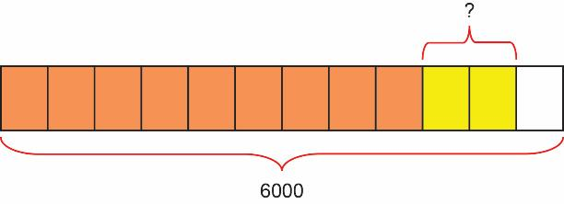
Practice question - calculator
REVIEW
How could you complete a bar model to
find the amount of cheese required?
Answer: 2 × 500 g= 1000 g
‘The whole is made up of 12 equal parts’
‘To find the value of each part
I must divide the whole by 12’

Slide 14
Practice question - calculator
REVIEW
How could you complete a ratio table to
find the cost of the cheese required?
Cost Cheese £ | 2.25 | 0.012 857 | 12.86
Grams | 175 | 1 | 1000
Answer: £12.86

Slide 15
Lesson review:
Sharing in a ratio
Objectives
Understand how ratios correspond with real-world situations
Use ratio reasoning to solve whole-to-part and part-to-part simple problems
Simply ratios
Use bar model representations to provide insights into solving problems
Suggested further steps/areas to work on
Ratio questions where the ratio is given and asked to find parts or the whole using differences. Equivalent ratios

Slide 16


Lesson 9:
Credits
Text acknowledgements
Pearson Edexcel Level 1/Level 2 GCSE (9-1) in Mathematics Paper 3F Foundation Paper November 2021 1MA1

