Slide 1


Lesson 19:
3D shapes and volume
Level 1
Objectives
To identify properties of common 3D shapes
Through exploration, calculate volume and surface area of common 3D shapes
Use knowledge of volume and surface area for problem solving questions

Slide 2
Starter activity: What do you know?
YOUR
TURN
In your group, create a poster with everything you know about your 3D shape.
Notes:
Tutor to allocate 3D shapes to each group. These could be cereal boxes, a cube, Pringles tube, Toblerone, etc.
In small groups, learners prepare a poster showing everything they know about their shape.
After a few minutes move to the next slide which has some prompts.

Slide 3
Starter activity: What do you know?
YOUR
TURN
How many faces, edges and vertices does your shape have?
What possible exam questions could be asked about your shape?
What else can you say about your shape?
Notes:
This slide give the learners some prompts to help them develop their poster.

Slide 4

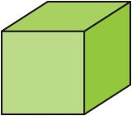

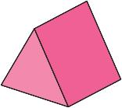
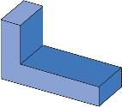
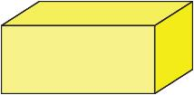
Starter activity
YOUR
TURN
Worksheet
available
Name of 3D shape
Number of faces
Number of vertices
Number of edges
Sketch the cross-section of a shape
Notes:
Before the learners feedback details about their shapes, tutor is to hand out the starter worksheet. Learners will fill in the table for each shape while their peers feedback.
Class discussion about any misconceptions/errors (learners may struggle to understand about the properties of a cylinder (edges/faces etc) and will not know the mathematical name of a triangular prism. Discussion about what a compound/composite shape is and that these are common shapes used in FS exams for perimeter/area/properties, etc.
Discussion about what possible exam questions could be asked. Area, possibly perimeter, surface area and volume will probably be mentioned. There may be opportunity to discuss units of measure for volume and SA and possible methods of calculating volume and SA. For FS Level 1, learners do not need to work out the surface area of 3D shapes. However, they will need to work out volume of cubes/cuboids and the area of rectilinear 2D shapes.
If cross-section is not mentioned then tutor to lead a discussion about the cross-section of the shape and ensure the learners understand what this is. Emphasise that the cross-section is the same all the way through a 3D prism – like cutting a loaf of bread/rectangular cake. This would be a good stage to make sure that learners know how to work out the area of a square/rectangle.

Slide 5

YOUR
TURN
Starter activity – answer
Worksheet
available
Name of 3D shape | Cube | Cuboid | Cylinder | Triangular prism | Compound or composite 3D shape (made up of 2+ 3D shapes
Number of faces | 6 | 6 | 3 | 5 | 8
Number of vertices | 8 | 8 | 0 | 6 | 12
Number of edges | 12 | 12 | 2 | 9 | 18
Sketch the cross-section of a shape
Notes:
Tutor to allow learners to fill in their sheets. Key points can be noted down when their peers feedback.
If cross-section is not mentioned, then tutor to lead a discussion about the cross-section of the shape and to elicit the formulas for working out the area of the cross-section. FSL1 learners will need to be able to work out the volume of a cube and cuboid so they need to recall this.
This should all be recorded on the sheet.

Slide 6
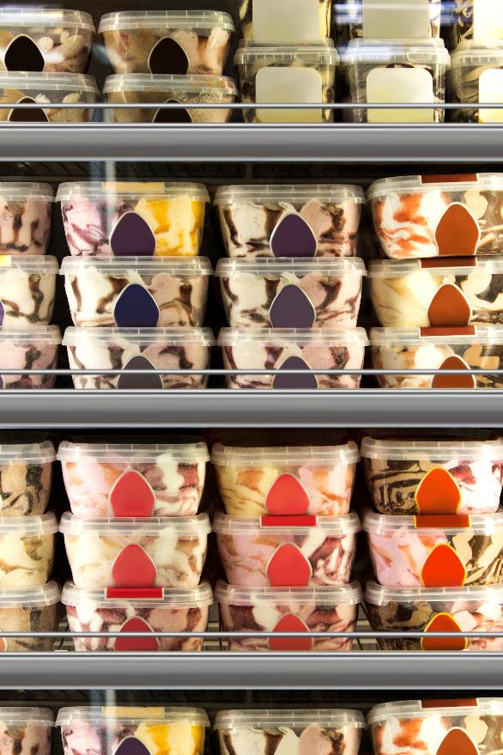
The ice-cream factory
Richard and Shobhna have started working at their local ice-cream factory and have been told that they need to keep costs down so that the profit is maximised.
They are looking at the costs of different containers of ice-cream.
Notes:
The slide introduces the context. Start a discussion about what costs are and what profit is. To reduce costs will help to increase profit.
Do learners understand the word maximised? Discuss this.

Slide 7
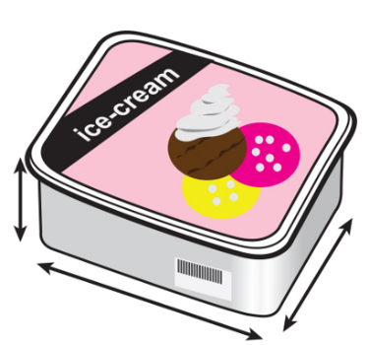
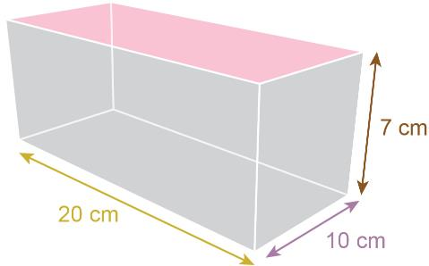
Volume or capacity
Richard thinks the capacity of this ice-cream tub is 1400 cm³.
Shobhna thinks the volume is 1400 cm³.
Are either of them correct? Discuss.
7 cm
10 cm
20 cm
Notes:
Tutor to allow learners to work out the volume/capacity of the ice-cream tub. Tutor to then lead a discussion about how we work out the volume/capacity and the difference between them.

Slide 8
Volume or capacity
Volume is the amount of 3D space taken up by an object.
Measured in cubic units: cm³, m³, etc.
Capacity is the volume of liquid or substance that a container can hold. Only containers have capacity.
Measured in litres, millilitres, etc.
The ice-cream container holds 1400 ml of ice-cream.
The box below it has a volume of 1400 cm³.
7 cm
10 cm
20 cm
Notes:
This slide shows the difference between volume and capacity and the normal units of each.

Slide 9

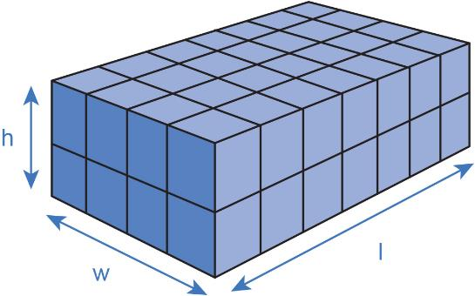
Volume and Capacity
KEY IDEA
Volume of a cuboid = cross-section area × length
= height × width × length
Volume is measured in cubic units (cm³/m³/mm³…)
Capacity is how much substance a container holds.
Capacity is measured in litres/millilitres/gallons…
Example
area of cross-section = 8 units²
length = 7 units
volume = 8 × 7 = 56 units³
cross-section
Notes:
Tutor to re-cap key ideas.

Slide 10

EXPLORE
At the factory
Worksheet
available
The company is changing their ice-cream packaging to 1 litre/1000 ml tubs.
Richard has been asked to come up with some designs for the new tub.
Sketch as many different designs that would hold 1000 ml and mark on the dimensions.
All tub designs must be cuboid in shape.
1000 ml capacity is the same as 1000 cm³ volume.
Discuss in pairs.
Think about the factors of 1000 to help you with the dimensions.
Notes:
10 × 10 × 10 (cube), 10 × 5 × 20, 5 × 5 × 40, 25 × 8 × 5, 2 × 4 × 125…
Handout is available which gives the learners a starting cuboid from which they can calculate the volume and capacity. They then need to come up with cuboids that result in the same volume/capacity.
Discussion about the factors of 1000 will help and re-iterate the fact that they will be multiplying the 3 dimensions together.

Slide 11
REVIEW
What dimensions of ice-cream tub have
you found?
    Feed back on the different shapes and dimensions you have found.
Notes:
Learners to feedback the different dimensions that they explored that resulted in volume/capacity of 1000 cm³/1000 ml.
Did anyone find the cube? Tutor or learners to sketch the cuboids on the board with dimensions.
Discussion about how they found the dimensions.
Possible business discussion: there are several sized cuboids that would hold 1000 ml of ice-cream. Would one be better than others? What would make one better than another? Which would be easier to sell thinking about the ease of storage in freezer, etc.

Slide 12
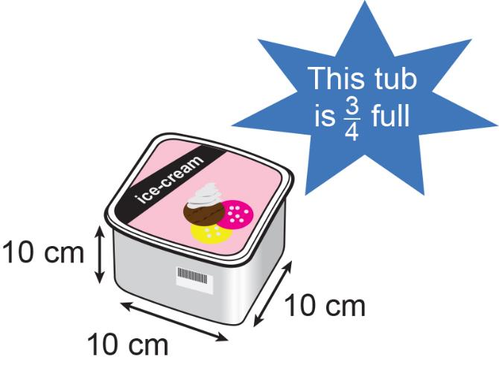
DISCUSS
At the factory
There have been complaints from shops that the ice-cream tubs (various sizes) supplied by the factory are not being filled to the top.
The cube ice-cream container is just ¾ full.
How much ice-cream is in it?
Discuss with your pair.
Notes:
Tutor to allow learners a few minutes to think about these ‘not’ full containers and try to workout how much ice-cream is in the container that is just ¾ full.
Take feedback on answers and different methods used.

Slide 13
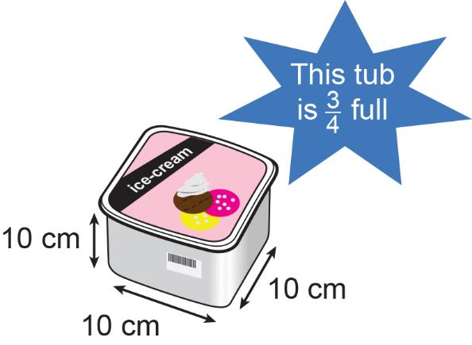

DISCUSS
At the factory
How much ice-cream is in the container?
10 x 10 x 10 = 1000ml
250 | 250 | 250 | 250
$\frac{3}{4}$ of 1000 ml = 750 ml
Notes:
Demonstrate use of a bar model to solve the problem.

Slide 14
DISCUSS
At the factory
Worksheet
available
Due to the complaints, Richard and Shobhna have been asked to look into which tub is being filled with the most ice-cream.
Can you help them find which tub is being filled with the most ice-cream and which with the least?
Notes:
Tutor to hand out the Explore 2 worksheet for the learners to work through.
Encourage learners to use bar models if this helps them.
Review: ask learners to feedback how much each tub had and which tub had the most ice-cream and which had the least.
Discussion about tub 6. How did learners do this?

Slide 15
FS exam question tips
KEY IDEA
Underline the key information (e.g. area, volume, perimeter, etc)
Can you sketch it or draw a picture to help?
Look at the marks awarded – could link to number of steps in the answer
Look at the units in the question and the detail
Notes:
FS exam question tips. Explain to the learners that the work they have been doing should enable them to answer the following exam questions but for them to make sure that they read the questions carefully, remember units etc.
Talk through the tips.

Slide 16
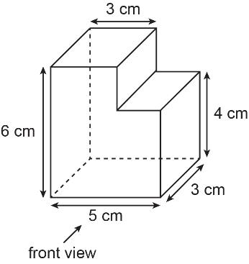
PRACTICE QUESTION
Exam question (1) – answers
Worksheet
available
Here is a prism.
All corners on the prism are right angles.
How many faces are there on the prism?
8 faces
Notes:
There are 3 exam questions for the learners to work through. Answers are provided.

Slide 17
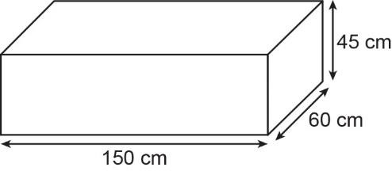
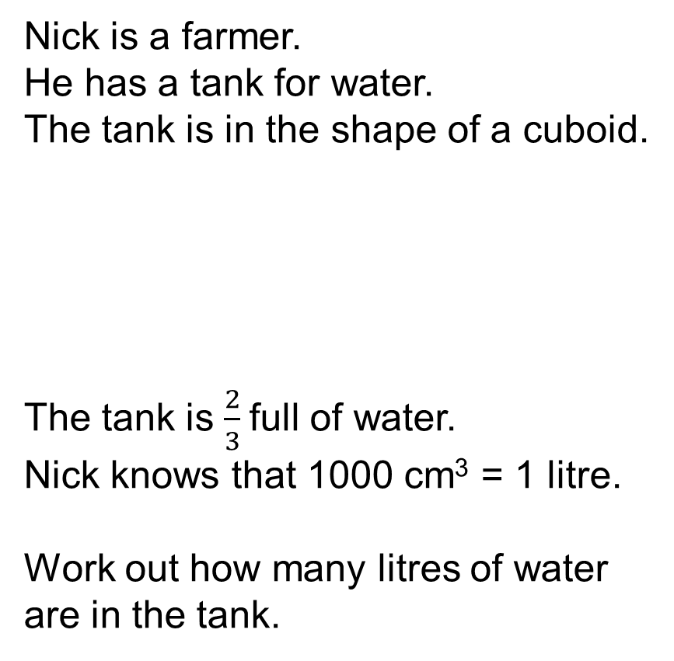
PRACTICE QUESTION
Exam question (2) – answers
Worksheet
available
Nick is a farmer.
He has a tank for water.
The tank is in the shape of a cuboid.
The tank is $\frac{2}{3}$full of water.
Nick knows that 1000 cm³ = 1 litre.
Work out how many litres of water are in the tank.
150 × 45 × 60 = 405 000 cm³
The tank has 270 litres of water.
cm³ | 1000 | 405 000
litre | 1 | 405
135 | 135 | 135

Slide 18
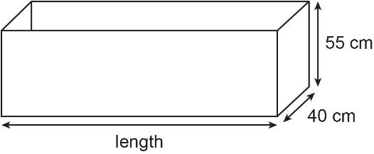
PRACTICE QUESTION
Exam question (3) – answers
Worksheet
available
Dennis is making a container for tomato plants.
The container will be in the shape of a cuboid.
litre | 1 | 180
cm³ | 1000 | 180 000
The capacity of the container will be 180 litres.
1 litre = 1000 cm³
Work out the length of the container.
Give your answer to the nearest whole centimetre.
40 × 55 = 2200
180 000 ÷ 2200 = 81.8 cm
Length ≈ 82 cm

Slide 19
Lesson review:
3D shapes and volume
Level 1
Review Objectives
To identify properties of common 3D shapes
Through exploration, calculate volume and surface area of common 3D shapes
Use knowledge of volume and surface area for problem solving questions
Notes:
Tutor to draw out key learning points from the lesson.
Next steps would be finding the surface area and volume of compound shapes.

Slide 20

Lesson 19:
Credits
Photo acknowledgements
Shutterstock.com: Hitra
Text acknowledgements
Pearson Edexcel Functional Skills, Practice Paper 2 - Mathematics Level 1 (Calculator) PRACL1/CO2 Question7, Pearson Edexcel Functional Skills, Past Paper 3 - Mathematics Level 1 (Calculator) PMAT1/C03 Question 11, Pearson Edexcel Functional Skills, Past Paper 1 - Mathematics Level 1 (Calculator) PMAT1/C03 Question 9

