Slide 1


Lesson 16:
Properties of 2D shapes Level 1
Objectives
Name and draw a range of 2D shapes
Identify lines of symmetry
Measure and categorise angles

Slide 2
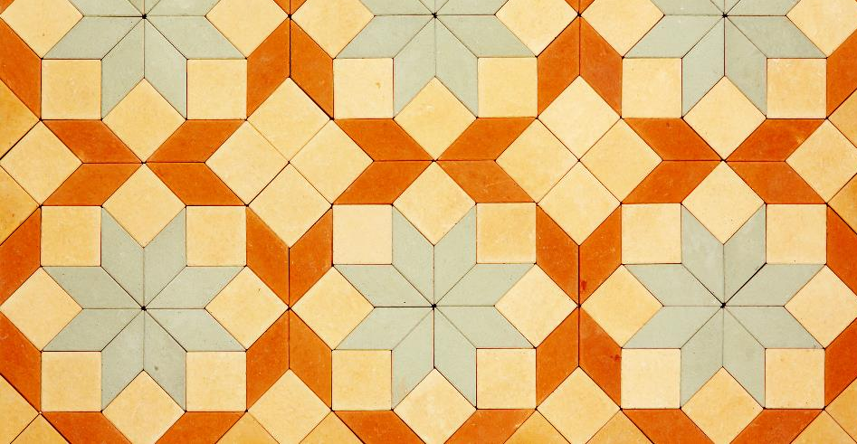
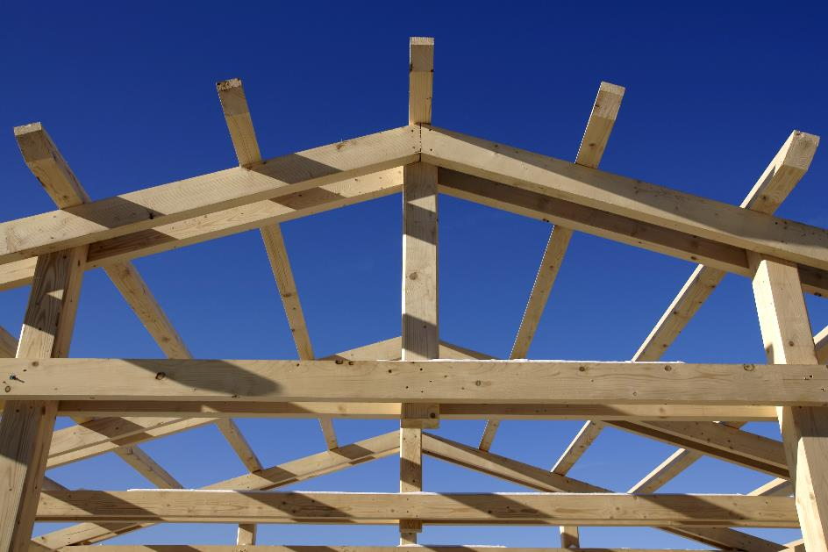



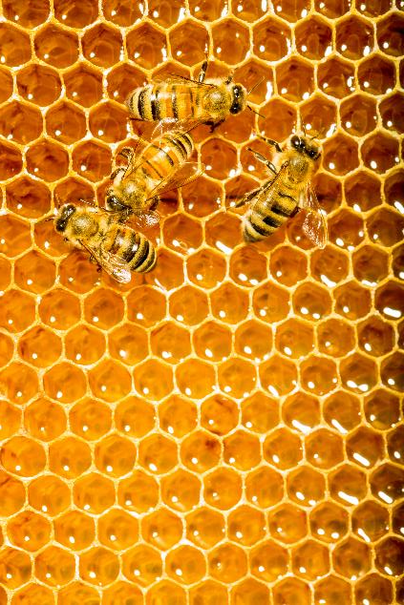

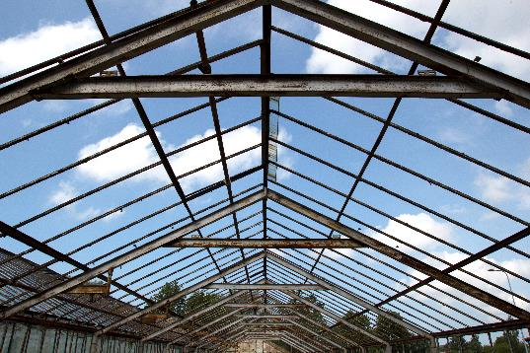

Shapes are all around us
Notes:
Shapes are all around us.
Ask the learners to write down three shapes they can find:
in a classroom
in nature
on their vocational course.
This may lead to a discussion on tessellation. Any key words/shape names that are mentioned to be addressed and recorded on the board so that learners get more familiar with the spelling of these words.

Slide 3


Shapes Matching Activity
Handout
available
In groups of 2 or 3, match the shape diagrams with their names and their properties.
When you’re finished, swap tables with another pair/group and use the answer sheet to check their work.
Notes:
This group card sort activity is an opportunity for learners to recall and demonstrate their prior knowledge and for the tutor to assess learners’ starting points.
Split the class into groups (suggested group size 2–3).
Give each group a set of cards.
After 5 minutes, ask groups to swap places with another group and ask learners to use the answer sheet to check the other group’s work. They should tick for every correct card and put a cross for incorrect cards.
Learners then return to their own cards and correct any mistakes made.
Learners who don’t need to make any corrections could complete the extension task.
Tutor check learners’ work and common misconceptions/difficulties and highlight these in the review of the activity.

Slide 4
Shapes Matching Activity – Extension
REVIEW
Sketch a pentagon and write down the characteristics of this shape.
Sketch a rhombus and write down the characteristics of this shape.
Notes:
Optional extension task for learners to complete if they do not have to make any corrections.

Slide 5

Common shapes
KEY IDEA
A polygon is any 2D shape bounded by straight lines. It does not have curved sides
A triangle is a polygon with 3 sides and 3 angles
A quadrilateral is a polygon with 4 sides and 4 angles
Other common polygons include:
  pentagons (5 sides)
  hexagons (6 sides)
  octagons (8 sides)
Notes:
Reinforce the shapes learners are most likely to encounter.
Reinforce that learners will need to be able to recall the names of these key shapes.

Slide 6
Line of symmetry
KEY IDEA
Line of symmetry
A line that divides a shape into two equal and symmetrical halves.
A rectangle has 2 lines of symmetry.
Notes:
Introduce the terms symmetry, symmetrical and line of symmetry
Use the diagram to demonstrate the drawing of lines of symmetry and emphasise that a shape can have more than one line of symmetry.

Slide 7
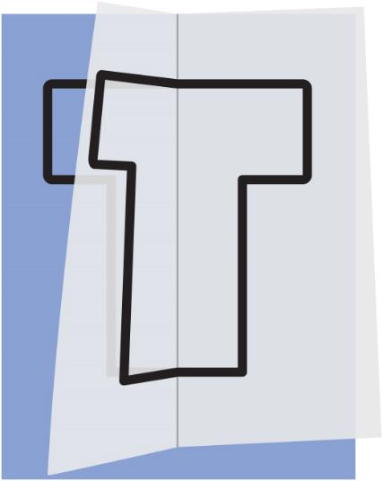
Symmetry explore (1)
EXPLORE
Sometimes we can visualise where the
lines of symmetry are in shapes.
Sometimes it can be harder to visualise.
Using tracing paper can help! Here’s how:
Trace a shape onto the tracing paper.
2) Now fold the tracing paper where you think there is a line of symmetry.
3) If the line is correct, all the corners and sides of the shape should be matched up.
Notes:
The aim of this investigation is for learners to become familiar with finding lines of symmetry.
Some learners will be able to visualise the lines without any support but others may not be able to do so.
Introduce tracing paper as a tool which can be used to help learners to find lines of symmetry.

Slide 8
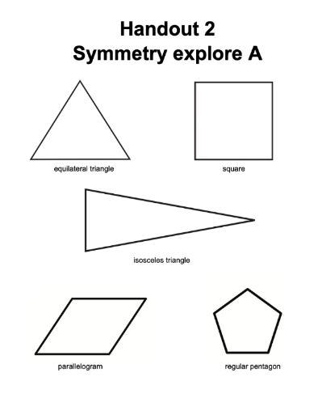
Symmetry explore (2)
EXPLORE
Handout
available
Use the tracing paper trick (or your own visualisation skills) to find all the lines of symmetry for each of the shapes on the worksheet.
When you are done, swap with someone who had a different worksheet and check their work.
Notes:
Give half the class Explore A and the other half Explore B.
Learners should use tracing paper or any preferred method to draw the lines of symmetry on the shapes on their sheet.
When complete, they should swap with someone who had a different worksheet and check their lines of symmetry.
ANSWERS:
A: equilateral triangle: 3, square: 4, isosceles triangle: 1, parallelogram: 0, regular pentagon: 5
B: equilateral triangle: 3, square: 4, scalene triangle: 0, isosceles trapezium: 1, rectangle: 2

Slide 9



Lines of symmetry in regular shapes
REVIEW
Dev says
This triangle has 3 sides and 3 lines of symmetry.
This square has 4 sides and 4 lines of symmetry.
Ruby replies
Zac states
This triangle has 3 sides so it must have 3 lines of symmetry.
Is Zac correct?
Explain why/why not.
Notes:
Ask learners to consider Zac’s deduction based on the two correct statements by Dev and Ruby.
From learners’ feedback, elicit the misconception here – Zac’s statement is only true for regular shapes – a 2D shape where all (interior) angles are equal and all side lengths are equal.

Slide 10
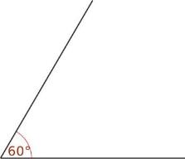
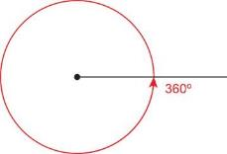

Angles
Angles are measures of degrees of turn from one position to another.
We can think of angles occurring
between two lines.
There are 60 degrees of turn
between these two lines.
Or we can think of an angle being a part of a whole rotation:
- There are 360 degrees in a whole turn.
- There are 180 degrees in a half turn.
Notes:
Introduce the concept and term ‘angles’.
Use the diagrams to highlight important angle facts and the two ways to describe angles.
Emphasise that a full rotation is 360 degrees and a half is 180 degrees.

Slide 11
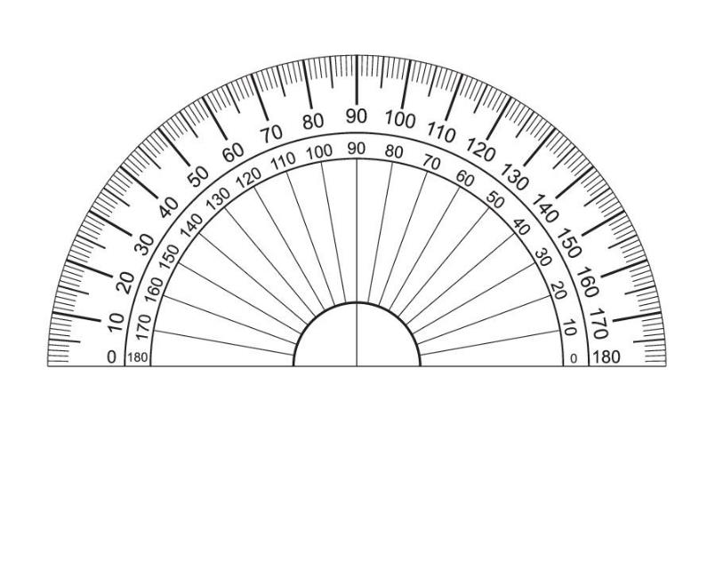
Measuring angles (1)
Angles are measured with a protractor.
Angles are measured in degrees.
The symbol for degree is º
(e.g. 43º)
Notes:
Introduce protractors as the tool used to measure angles, degrees as the unit of measure, and the symbol for degrees.
Reinforce that it is necessary to read measurements carefully and accurately.

Slide 12
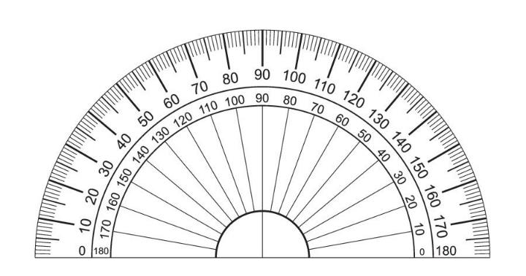
Measuring angles (2)
EXPLORE
The size of this angle is 145 degrees.
Is Ruby correct?
Explain why or why not.
Notes:
Ask learners whether they think Ruby is correct.
Explain that although the line does ‘go through’ 145 degrees this is not correct as angles need to be measured from the scale which starts at zero.
Reinforce that one of the angles’ arms needs to be lined up exactly with zero to ensure an accurate reading.

Slide 13
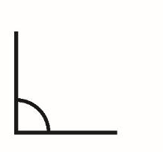


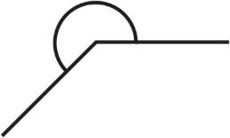
Angles – Types of angles
KEY IDEA
A right-angle measures 90º
An acute angle measures less than 90º
An obtuse angle measures between 90º and 180º
A reflex angle measures between 180º and 360º
Notes:
Introduce the names and descriptions of the 4 types of angles.
Reinforce that the groups are based on the size of the angles.
Emphasise that learners will need to know and remember the correct terminology for the types of angles as well as recognise and draw angles of each type.

Slide 14
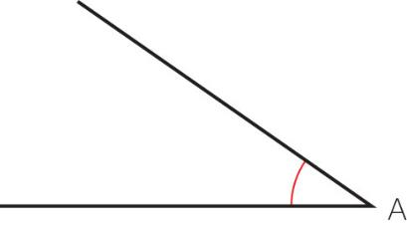
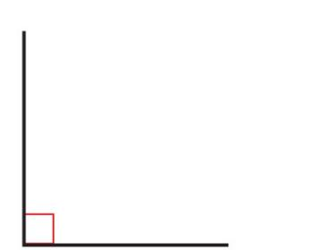
Types of angles – Quiz (1)
Name this type of angle
Sketch an acute angle
Right angle
Name this type of angle
Obtuse angle
An obtuse angle is larger
than _____ degrees
but smaller than ______ degrees.
90
180
Notes:
Learners to use mini whiteboards or their books to answer these quiz style questions.
If using mini whiteboards, learners should keep a score of the number of questions they got correct.

Slide 15
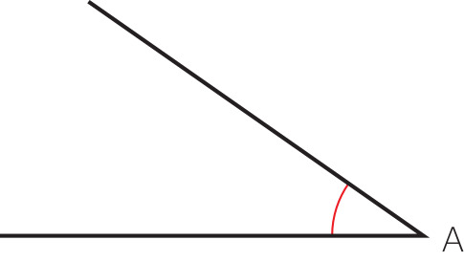
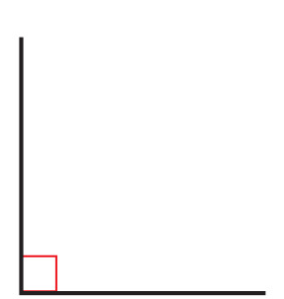
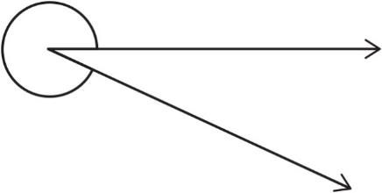
Types of angles – Quiz (2)
False
Name this type of angle
True or false?
An obtuse angle is smaller than 90 degrees.
Acute angle
Sketch a right angle
Name this type of angle
Reflex angle
15
Notes:
Learners to use mini whiteboards or their books to answer these quiz style questions.
If using mini whiteboards learners should keep a score of the number of questions they got correct.

Slide 16
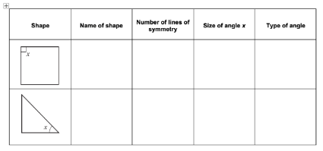

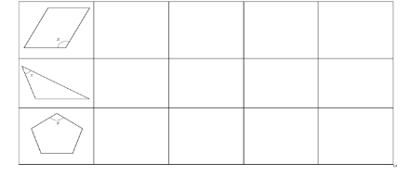
Angles and symmetry
Handout
available
Name the shape.
Find and count all the lines of symmetry.
Measure the angle marked x.
Name the angle you have measured.
Notes:
Learners work individually.
Learners will need activity sheet and a protractor each.
Learners to identify lines of symmetry and measure angles.
Tutor to circulate and check learners’ work, asking them to explain their sorting decisions.
Differentiation:
Some learners may benefit from using tracing paper to find the lines of symmetry.
Answers:
1) square, 4 lines of symmetry, 90°, right angle
2) isosceles (right-angled) triangle, 1 line of symmetry, 45°, acute angle
3) parallelogram, no line of symmetry, ~116°, obtuse angle
4) scalene triangle, no line of symmetry, 40°, acute angle
5) regular pentagon, 5 lines of symmetry, 108°, obtuse angle

Slide 17
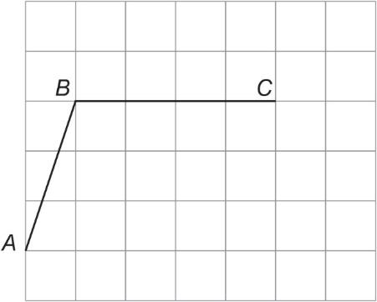
Practice question (1)
REVIEW
Worksheet
available
Karen is a cake designer.
She is designing different shaped cakes.
AB and BC are two sides of a parallelogram.
On the grid, complete the parallelogram.
Notes:
Learners should work through the exam questions individually.
There is a handout for the questions, answers are on the PowerPoint.

Slide 18
Practice question (2)
REVIEW
Worksheet
available
Here is a regular pentagon.
Draw all the lines of symmetry on this pentagon.

Slide 19
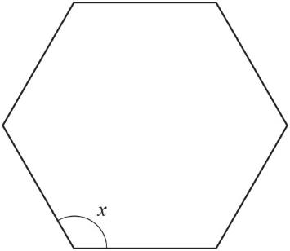
Practice question (3)
REVIEW
Worksheet
available
Here is a regular hexagon.
What type of angle is angle x?
Tick the correct answer.
right angle
acute angle
reflex angle
obtuse angle

Slide 20
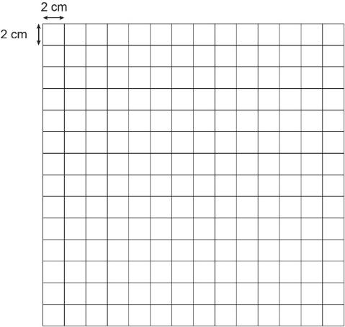
Practice question (4)
REVIEW
Worksheet
available
Karen is making a birthday cake.
The top of the cake needs to be triangular with one side length 10 cm, one side length 12 cm and a 90° angle between these sides.
Draw the top of the cake for Karen.
Use the grid below to draw the top of the cake.

Slide 21
Practice question (5)
REVIEW
Worksheet
available
Draw a hexagon.

Slide 22
Practice question (6)
REVIEW
Worksheet
available
Here is a shape.
How many lines of symmetry does this shape have?

Slide 23
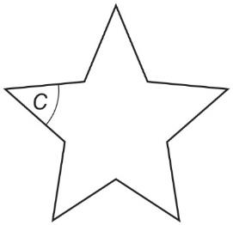
Practice question (7)
REVIEW
Worksheet
available
Which of these words describes angle c in the shape above?
Tick [✓] the correct box below.
obtuse
acute
right
reflex
straight

Slide 24

Practice question – answers (1)
REVIEW
Worksheet
available
Karen is a cake designer.
She is designing different shaped cakes.
AB and BC are two sides of a parallelogram.
On the grid, complete the parallelogram.
Notes:
Highlight to learners that the horizontal distance from B to A is one block so from C to the fourth corner should also be one block.

Slide 25
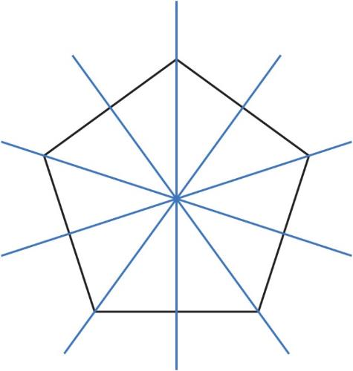
Practice question – answers (2)
REVIEW
Worksheet
available
Here is a regular pentagon.
Draw all the lines of symmetry on this pentagon.
Notes:
Remind learners that they will have access to tracing paper in their exam.
Highlight that this question states the shape is a REGULAR pentagon which implies that the number lines of symmetry is equal to the number of sides.

Slide 26

Practice question – answers (3)
REVIEW
Worksheet
available
Here is a regular hexagon.
What type of angle is angle x?
Tick the correct answer.
right angle
acute angle
reflex angle
obtuse angle

Slide 27
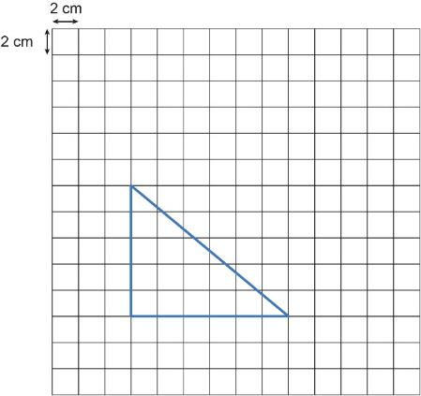
Practice question – answers (4)
REVIEW
Worksheet
available
Karen is making a birthday cake.
The top of the cake needs to be triangular with one side length 10 cm, one side length 12 cm and a 90° angle between these sides.
Draw the top of the cake for Karen.
Use the grid below to draw the top of the cake.
27
Notes:
Draw learners’ attention to the scale: 1 block length is 2 cm so 10 cm is 5 blocks.
Highlight that it doesn’t matter which side (vertical or horizontal) is 10 cm or 12 cm.
Highlight that learners don’t need to know the length of the hypotenuse, as they can just join the two lines to complete the triangle.

Slide 28
Practice question – answers (5)
REVIEW
Worksheet
available
Draw a hexagon.
28
Notes:
Highlight that a hexagon is any 6-sided 2D shape – it doesn’t have to be regular!

Slide 29
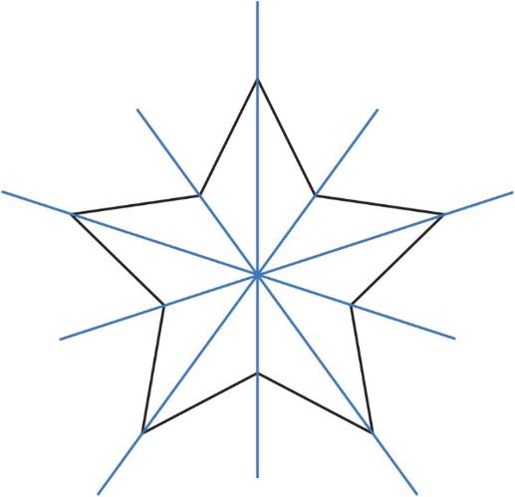
Practice question – answers (6)
REVIEW
Worksheet
available
Here is a shape.
How many lines of symmetry does this shape have?
Answer: 5
29

Slide 30
Practice question – answers (7)
REVIEW
Worksheet
available
Which of these words describes angle c in the shape above?
Tick [✓] the correct box below.
obtuse
acute
right
reflex
straight
30

Slide 31
Lesson review:
Properties of 2D shapes Level 1
Objectives
Name and draw a range of 2D shapes
Identify lines of symmetry
Measure and categorise angles
Suggested further steps/areas to work on
Area and perimeter of simple shapes
Notes:
Recap the lesson objectives and highlight key learning points from the lesson.

Slide 32
Lesson 16:
Credits
Photo acknowledgements
123RF.com: attaphong; Shutterstock.com: StudioSmart, Aigars Reinholds, Marco Tomasini, MeeRok, buket bariskan, Rachelle Burnside, Philip Lange, Roman Sigaev, javarman, DiA99; Pearson Education Ltd: PDQ Digital Media Solutions Ltd
Text acknowledgements
Pearson Edexcel Functional Skills, Practice Paper 1 - Mathematics Level 1 (Calculator) PRACL1/C01 Question 6a, Pearson Edexcel Functional Skills, Practice Paper 1 - Mathematics Level 1 (Calculator) PRACL1/C01 Question 6b, Pearson Edexcel Functional Skills, Practice Paper 1 - Mathematics Level 1 (Calculator) PRACL1/C01 Question 6c, Pearson Edexcel Functional Skills, Practice Paper 1 - Mathematics Level 1 (Calculator) PRACL1/C01 Question 6d, Pearson Edexcel Functional Skills, Practice Paper 2 - Mathematics Level 1 (Calculator) PRACL1/C01 Question 5a, Pearson Edexcel Functional Skills, Practice Paper 2 - Mathematics Level 1 (Calculator) PRACL1/C02 Question 5b, Pearson Edexcel Functional Skills, Practice Paper 2 - Mathematics Level 1 (Calculator) PRACL1/C02 Question 5c

