Slide 1


Lesson 10:
Using ratios
Objectives
Use the difference between ratio parts to solve problems using bar models
Write equivalent ratios including in the form 1 : n or n : 1
This is a non-calculator lesson
Notes:
Tutor guidance for lesson introduction:
Request a confident or fluent learner read lesson objectives to the group
Reiterate and clarify learning objectives

Slide 2

Total amount of money
Marius, Jack and Ann have some money in the ratio 3 : 2 : 7
Ann has £165 more than Jack.
What is the total amount of money they have?
Tim says, first you find the total number of parts. Then you divide the quantity by the total number of parts to work out the final answer
Tim
Why is Tim is not correct?
Explain.
You may use bar models to help you.
Notes:
Introduce learners to Tim’s thinking and ask them to describe to a partner why they think Tim is not correct.
This is a classic misconception question where learners use the one algorithm they remember for all ratio questions.
If learners struggle with this question, encourage them to re-read the question carefully. What is the question asking? Can they draw a picture or bar model to show this?

Slide 3
DISCUSS
Using bar models
Marius
Jack
?
Ann
£165
£165 ÷ 5 = £33
Total amount of money:
£33 × 12 = £33(10 + 2)
= £330 + £66
= £396
Notes:
This slide shows a way to represent the question using bar models, which learners are encouraged to use in this lesson.
If they have answered the first question without bar models, use this slide to help explain their thinking. It is important to describe the braces – one states what they already know, and the other states, with a question mark, what they are trying to find out.
Explain the difference between Ann’s and Jack’s bar models and discuss how drawing bar model can be used to complete a ratio questions.

Slide 4

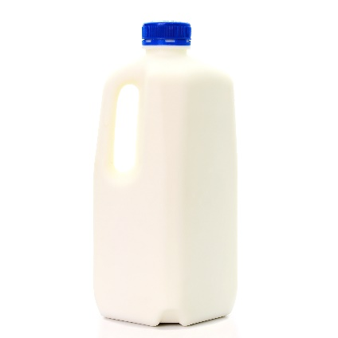

EXPLORE
Handout
available
Ajay, Charles and Rosie
Ajay, Charles and Rosie collect plastic milk bottle tops for recycling.
The number of milk bottle tops Ajay has | : | The number of milk bottle tops Charles has | : | The number of milk bottle tops Rosie has | = | 2 : 3 : 7
Notes:
Provide students with the ‘Bar models’ handout. Ask learners to work in pairs to explore each question. Ask them to find ways of drawing bar models and braces and labelling the braces to help them answer the questions.
Then ask learners use their drawings to explain their thinking about the actual calculations.
Encourage learners to draw first and not to jump to the calculations immediately. Provide positive feedback on their drawings.

Slide 5
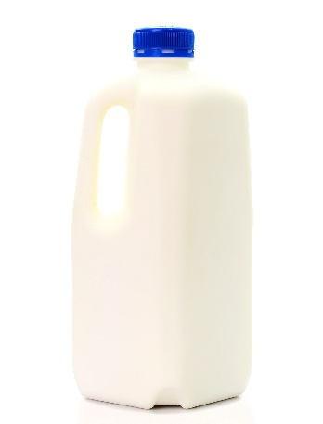

DISCUSS
Milk bottle top recycling (1)
Question
Ajay, Charles and Rosie collect 72 plastic milk bottle tops for recycling. How many more bottle tops than Charles does Rosie have?
The number of milk bottle tops Ajay has | : | The number of milk bottle tops Charles has | : | The number of milk bottle tops Rosie has | = | 2 : 3 : 7
Bar model | Calculation
Ajay
Charles
Rosie
72 ÷12 = 6
6 × 4 = 24
Rosie has 24 more bottle tops than Charles.
72
?
Notes:
Provide students with the ‘Bar models’ handout. Ask learners to work in pairs to explore each question. Ask them to find ways of drawing bar models and braces and labelling the braces to help them answer the questions.
Then ask learners use their drawings to explain their thinking about the actual calculations.
Encourage learners to draw first and not to jump to the calculations immediately. Provide positive feedback on their drawings.

Slide 6
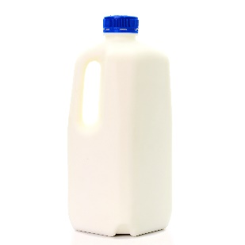

DISCUSS
Milk bottle top recycling (2)
Question
Ajay, Charles and Rosie collected plastic milk bottle tops for recycling. Charles has 6 more bottle tops than Ajay. How many bottle tops do they have in total?
The number of milk bottle tops Ajay has | : | The number of milk bottle tops Charles has | : | The number of milk bottle tops Rosie has | = | 2 : 3 : 7
Bar model | Calculation
6
6 × 12 = 72
They have 72 bottle tops in total.
Ajay
Charles
Rosie
?

Slide 7
DISCUSS
Milk bottle top recycling (3)
Question
Ajay, Charles and Rosie collected 72 plastic milk bottle tops for recycling. Rosie has 24 more bottle tops than Charles. Rosie has more bottle tops than Ajay. How many more bottle tops than Ajay does Rosie have?
The number of milk bottle tops Ajay has | : | The number of milk bottle tops Charles has | : | The number of milk bottle tops Rosie has | = | 2 : 3 : 7
Bar model | Calculation
?
24 ÷ 4 = 6
6 × 5 = 30
Rosie has 30 more bottle tops than Ajay.
Ajay
Charles
Rosie
24

Slide 8
DISCUSS
Milk bottle top recycling (4)
Question
Ajay, Charles and Rosie collected plastic milk bottle tops for recycling. Rosie has 24 more bottle tops than Charles. How many bottle tops do they have in total?
The number of milk bottle tops Ajay has | : | The number of milk bottle tops Charles has | : | The number of milk bottle tops Rosie has | = | 2 : 3 : 7
Bar model | Calculation
Ajay
Charles
Rosie
24 ÷ 4 = 6
6 × 12 = 72
They have 72 bottle tops in total.
?
24

Slide 9
EXPLORE
Handout
available
How many equivalent ratios?
3 : 24
Can you write a ratio in the form 1 : n or n : 1?
Notes:
Introduce the activity by showing learners this spider diagram slide. Ask learners to create equivalent ratios and look at the patterns between each set they find. Give learners a few minutes to work on the activity individually, then ask them discuss with a partner about how they see the ratios and the patterns they find.
Ask learners to give an answer in the form 1 : n and n : 1 on top of any others they give, providing explanation with a different ratio on the whiteboard if necessary.

Slide 10
DISCUSS
How many equivalent ratios?
3 : 24
Can you write a ratio in the form 1 : n or n : 1?
Notes:
Fill in the suggestions from learners on the spider diagram and draw out the multiplicative relationships between sets of equivalent ratios.

Slide 11
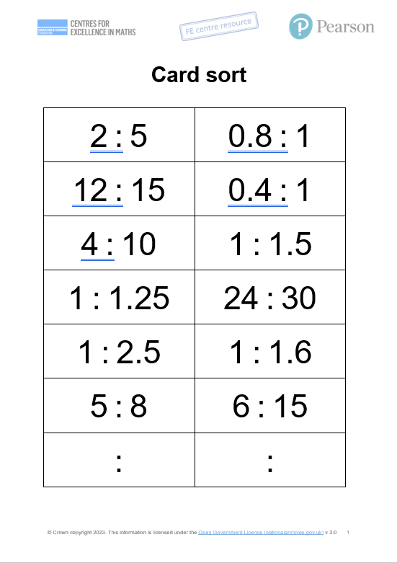
YOUR TURN
Ratio match
Worksheet
available
Make four groups of equivalent ratios. You will have one card left over.
Create a fifth group using this card and use the blank cards to write some equivalent ratios.
Notes:
Provide each pair with a copy of the ‘Card sort’ handout. Tell learners that the goal is to find four equivalent ratios from the 14 cards. They will build on the task before to do this.
Blank cards are provided for 1 : 1.5, which has no equivalent ratios.
As a challenge, learners can try to find other ways of grouping the equivalent ratios.

Slide 12



YOUR TURN
Extension
Handout
available
The ratio of red buses to green buses is 2 : 3
The ratio of green buses to blue buses is 6 : 5
What is the ratio of red buses to green buses to blue buses?
:
:
Notes:
This extension is designed to stretch and challenge higher achieving learners.
Learners should see that if they scale 2 : 3 and multiply by 2 to get the equivalent ratio 4 : 6, they can write the ratio 4 : 6 : 5 for the three types of buses.

Slide 13
DISCUSS
Ratio match answers
2 : 5
12 : 15
5 : 8
1 : 1.5
4 : 10
1 : 1.25
1 : 1.6
:
1 : 2.5
0.8 : 1
:
0.4 : 1
24 : 30
6 : 15
Notes:
If pairs are stuck, you may want to ask them to examine the question differently by drawing discrete bar models.
You might ask them:
“What is happening to each set of ratio?”
“How can you tell if they are equivalent?”
Look for matching of 2 : 5 and 5 : 8 and the additive relationship instead of the multiplicative one.

Slide 14
DISCUSS
Combining ratios
Ratio of red buses to green buses
× 2 for equivalence
Ratio of green buses to blue buses
No change
:
:
:
4
:
6
:
5
Notes:
Discuss and explain combining ratios and the link between equivalent ratios.

Slide 15

Practice question (1)
PRACTICE QUESTION
REVIEW
Worksheet
available
Rosie, Matilda and Ibrahim collect stickers.
number of stickers Rosie has | : | number of stickers Matilda has | : | number of stickers Ibrahim has | = | 4 : 7 : 15
Ibrahim has 24 more stickers than Matilda.
Ibrahim has more stickers than Rosie. How many more?
33
Notes:
tutor to discuss question and encourage learners to use the bar model to complete answer

Slide 16
PRACTICE QUESTION
REVIEW
Practice question (2)
Worksheet
available
Write the ratio 12 : 30 in the form 1 : n
1 : 2.5

Slide 17
Lesson review:
Using ratios
Objectives
Use the difference between ratio parts to solve problems using bar models
Write equivalent ratios including in the form 1 : n or n : 1
Suggested further steps/areas to work on
Using ratio with algebra

Slide 18


Lesson 10:
Credits
Text acknowledgements
Pearson Education Ltd: Pearson Edexcel
GCSE (9-1) In Mathematics (1MA1) Foundation (Non-Calculator) November 2020 Paper 1F, Q9b, November 2021, Q24.

