Slide 1


Lesson 14:
Sharing in a ratio
Level 1
Objectives
Understand how ratios correspond with real-world situations
Simplify ratios
Use ratio reasoning to solve whole-to-part and part-to-part simple problems
Use bar model representations to provide insights into solving problems
Understand the importance of using reverse calculations to check answers

Slide 2
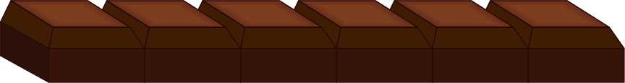
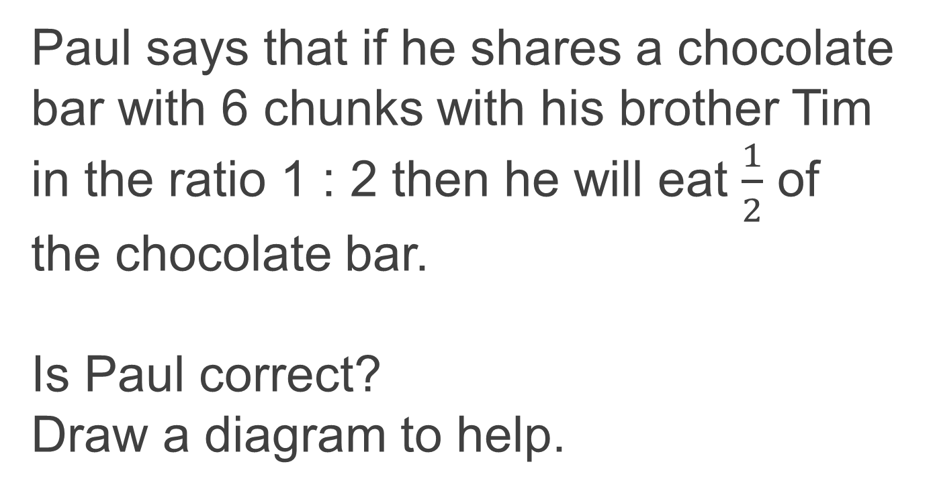
Thinking about Sharing in a Ratio
DISCUSSION
Paul says that if he shares a chocolate bar with 6 chunks with his brother Tim in the ratio 1 : 2 then he will eat $\frac{1}{2}$ of the chocolate bar.
Is Paul correct?
Draw a diagram to help.
Notes:
This starter activity is designed to address some of the misconceptions that learners have about ratios.
Are they clear about the difference between 1 : 2 and $\frac{1}{2}$?
Elicit into how many parts a bar has been split in the first case (1 : 2, 1 + 2 = 3) and in the second case ($\frac{1}{2}$- denominator shows the number of parts the bar has been split into) .
Encourage the use of diagrams to represent a ratio and a fraction.

Slide 3

Sharing in a Ratio
EXPLORE
One chocolate chunk
Handout
available
Two groups of friends share chocolate bars with 6 chunks each.
How much does each friend receive in each group?
Write a ratio for each group and construct a diagram to show how much they receive.
Group 1
5 bars of chocolate
are shared equally
between two friends
Group 2
7 bars of chocolate
are shared equally
between three friends
Notes:
Learners work in pairs. In this activity, we extend the exploration the learners engaged in using Slide 2, where learners figured out that a ratio refers to the part-to-part relationship. Here we develop problem-solving skills. The thrust in this activity is to model ratios and use those models to write a ratio in its simplest form. Learners might make organised lists or diagrams. Take advantage of the diversity of representations even if they are initial attempts. Discuss how these models help learners to write the ratio. Learners will likely find it disconcerting that both questions result in the same answer, a ratio of 1 : 1.

Slide 4
Sharing in a Ratio
DISCUSSION
One chocolate chunk
REVIEW
Group 1
5 bars of chocolate each with 6 chunks are shared equally between two friends
Friend 1 : Friend 2
15 : 15
1 : 1
Notes:
Learners work in pairs. For each group, discuss different visual proofs learners have developed, and the ways they approached writing the ratio. If learners have not simplified their ratio, ask another learner to convince them, using the models they have created, that 15 : 15 is the same as 1 : 1 .
Discuss these questions:
How did you find the ratio?
What visual proofs or models are useful for seeing how to share the chocolate bars?
Why is 15 : 15 the same as 1 : 1?

Slide 5
Sharing in a Ratio
DISCUSSION
One chocolate chunk
REVIEW
Group 2
7 bars of chocolate each with 6 chunks are shared equally between three friends
Friend 1 : Friend 2 : Friend 3
14 : 14 : 14
1 : 1 : 1
Notes:
Learners work in pairs. For each group, discuss different visual proofs learners have developed, and ways they approached writing the ratio. If learners have not simplified their ratio, ask another learner to convince them, using the models they have created, that 14 : 14 : 14 is the same as
1 : 1 : 1.
Discuss these questions:
How did you find the ratio?
What visual proofs or models are useful for seeing how to share the chocolate bars?
Why is 14 : 14 : 14 the same as 1 : 1 : 1?

Slide 6
Ivan lives with his friends and pays a third of the monthly food outgoings and utility bills. This month the total bill is £1095.
MODEL
Using bar models
Handout
available
How much will Ivan pay?
Show a check of your working.
Ivan ?
Friends
?
£1095
Notes:
Invite learners to extend their exploration of chocolate bars to a non physical context. Here they explore how to model a bill being split between Ivan and his two friends. Encourage discussion of this context. Do they pay bills? Develop with them a method of splitting a whole bar into three equal parts and labelling what they already know and what they have been asked to find out. Encourage to draw and doodle before moving into the abstract calculations. Here we are developing pictorial skills to help them that can be later applied to harder questions in the FS exam.
Elicit possible ways of checking answers (checking by estimation or a reverse calculation).

Slide 7
Ivan lives with his friends and pays a third of the monthly food outgoings and utility bills. This month the total bill is £1095.
MODEL
Using bar models
Handout
available
How much will Ivan pay?
Show a check of your working.
Ivan
Friends
Answer:
£1095 ÷ 3 = £365
Valid check:
£365 × 3 = £1095
?
£1095
Notes:
Invite learners to extend their exploration of chocolate bars to a non physical context. Here they explore how to model a bill being split between Ivan and his two friends. Encourage discussion of this context. Do they pay bills? Develop with them a method of splitting a whole bar into three equal parts and labelling what they already know and what they have been asked to find out. Encourage to draw and doodle before moving into the abstract calculations. Here we are developing pictorial skills to help them that can be later applied to harder questions.

Slide 8

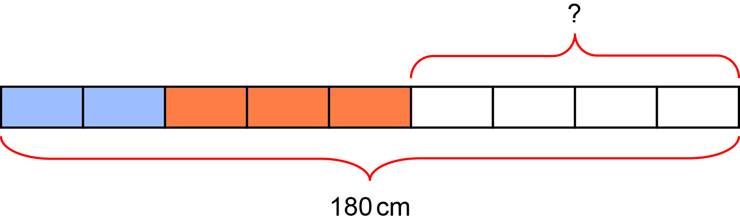
A piece of wood is 180 cm long.
Tom cuts it into three pieces in the ratio 2 : 3 : 4.
EXPLORE
Using bar models
Handout
available
Work out the length of the longest piece.
Show a check of your working.
Answer:
Valid check:
180 ÷ 9 = 20 cm
20 × 4 = 80 cm
80 ÷ 4 = 20 cm
20 × 9 = 180 cm
Notes:
The questions in Slides 6–9 are on Handout 2. While the PowerPoint slides can be used to model the answer, it is better for the tutor to work on their whiteboard and draw these bars with the assistance of the learners, telling them what they are doing. How many parts do I need to split the bar into? What do I already know? What do I need to find out?

Slide 9
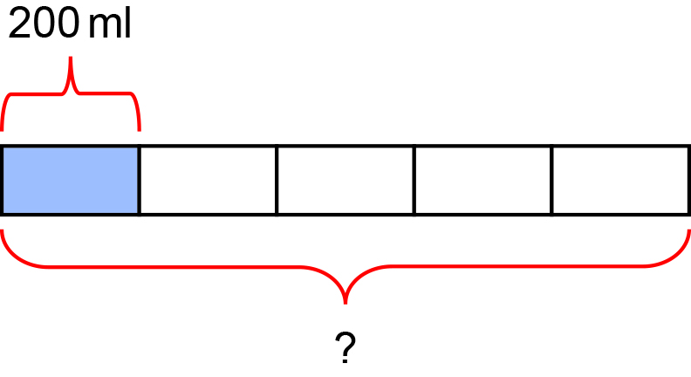
Squash is prepared by combining one part concentrate with four parts of water.
EXPLORE
Using bar models
How much squash drink will you make if 200 ml of squash concentrate is used?
Show a check of your working.
Answer:
200 × 5 = 1000 ml
Valid check:
1000 ÷ 5 = 200 ml
Notes:
Tutor models the use of bars in a relatable context of preparing a squash drink.

Slide 10
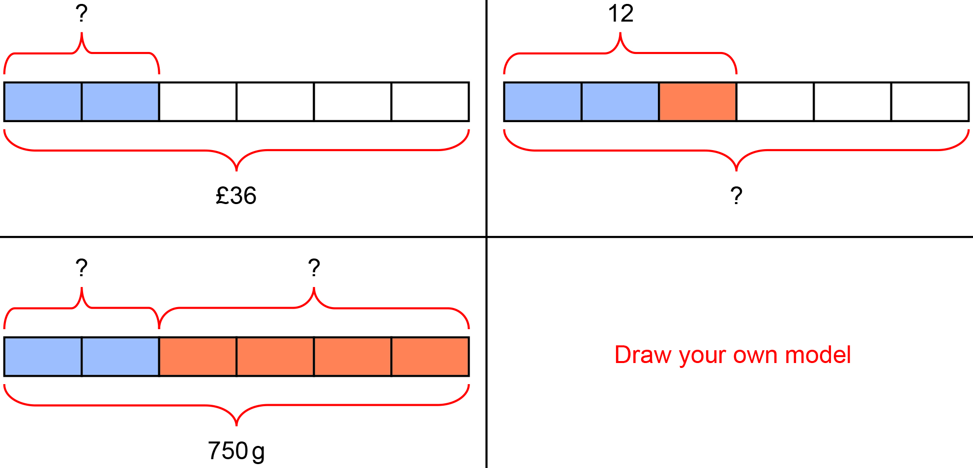
EXPLORE
Using bar models
Worksheet
available
Choose a bar model and write your own question for it. ​
Swap the question with your partner.
(You may opt to draw your own model instead.)
Notes:
Tutor invites learners to share some of the stories that were made into questions.
What did they notice? How did the question vary with each scenario?

Slide 11
Practice question 1
PRACTICE QUESTION
Handout
available
Alex buys vegetarian pies and chicken pies for a party.
He buys 164 pies in total.
Alex buys vegetarian pies and chicken pies in the ratio 3 : 1.
Work out the number of vegetarian pies Alex buys.

Slide 12
Practice question 2 – calculator
PRACTICE QUESTION
Handout
available
Penny is the manager of a nursery for pre-school children.
She knows that the ratio of the number of adults to the number of children must be 1 : 8.
Penny has 56 children at the nursery.
(a) Work out the number of adults Penny needs for 56 children.
(b) Use a reverse calculation to show a check of your answer.
Notes:
Learners work independently. Depending on time and the ability of learners in the group, you may choose to do only one of the two questions for the class.

Slide 13
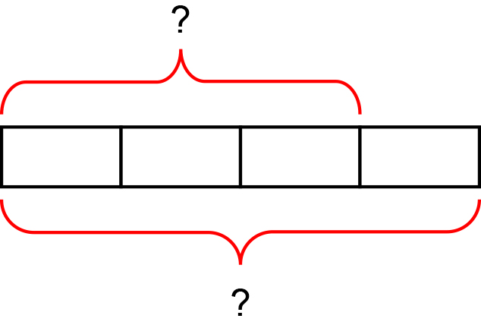
Practice question 1
REVIEW
How could you complete a bar model to find the number of vegetarian pies?
Answer: 3 × 41 = 123
‘The whole is made up of 4 equal parts’
‘To find the value of each part I must divide the whole by 4’

Slide 14
Practice question 2 – answer
REVIEW
How could you complete a bar model to find the number of adults required? Did you complete the check for the extra mark?
Answer:
56 ÷ 8 = 7
Valid check:
7 × 8 = 56

Slide 15
Lesson review:
Sharing in a ratio
Level 1
Objectives
Understand how ratios correspond with real-world situations
Simplify ratios
Use ratio reasoning to solve whole-to-part and part-to-part simple problems
Use bar model representations to provide insights into solving problems
Understand the importance of using reverse calculations to check answers
Suggested further steps/areas to work on
Deficiency problems involving ratio

Slide 16
Lesson 14:
Credits
Text acknowledgements
Pearson Edexcel Functional Skills, Past Paper 3 – Mathematics Level 1 (Calculator) PMAT1/C03 Question 2, Pearson Edexcel Functional Skills, Practice Set 2 – Mathematics Level 1 (Calculator) PRACL2/C02 Question 8

